Slide 1
Teachers’ Guide:
Spotting evidence of the Second World War on 1940s aerial photographs
This guide gives a brief description and examples of the different types of Second World War features that can be identified on 1940s aerial photographs.
It is designed to be used alongside our Aerial Photo Explorer or Local History Packs as part of a KS2 or KS3 Local History Study

Slide 2
Key Stage 2 & 3: Local History Study
Learning Aims and Outcomes
To develop historical enquiry skills by using aerial photographs as primary sources
To gain an overview of how the Second World War impacted life in Britain/on the Home Front
To understand how the Second World War affected pupils’ local area
To compare local evidence with the national picture
This PowerPoint relates to the following Teaching Activity: https://historicengland.org.uk/services-skills/education/teaching-activities/ww2-impact-on-1940s-aerial-photos

Slide 3
Key Stage 2 & 3: Local History Study
The following slides are designed to help you identify any Second World War features on the 1940s aerial photographs shown on our Aerial Photo Explorer or in a Local History Pack.
You can then use the examples of different types of feature on these slides to compare those found in your locality with those found across the whole country.
You can also use the examples shown with pupils to help them understand how the Second World War impacted life in Britain.

Slide 4
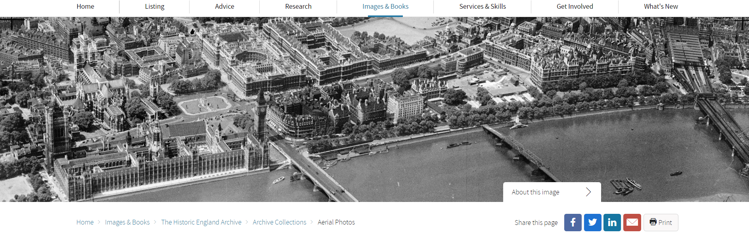
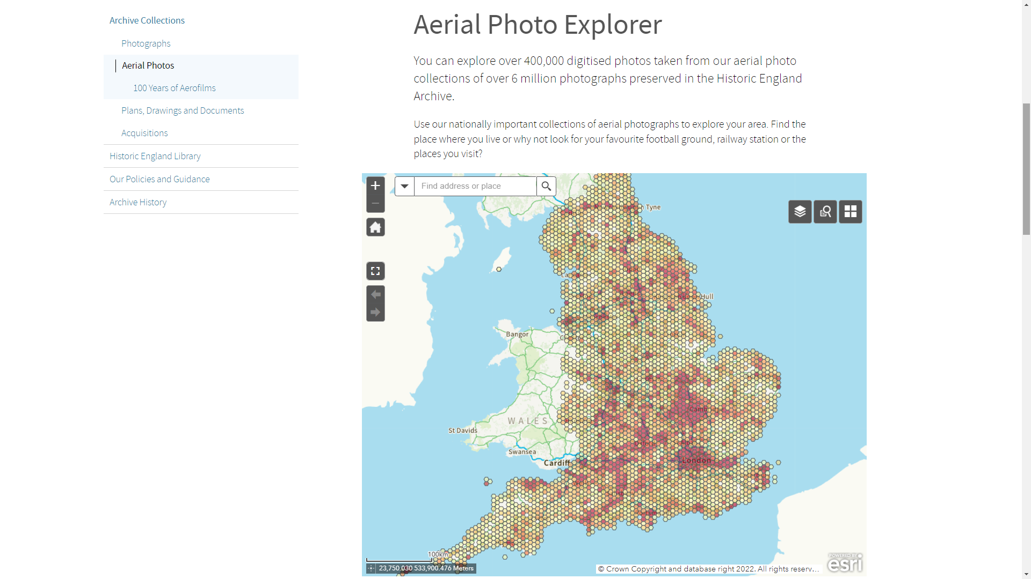
Notes:
Visit the Aerial Photo Explorer: https://historicengland.org.uk/images-books/archive/collections/aerial-photos/

Slide 5
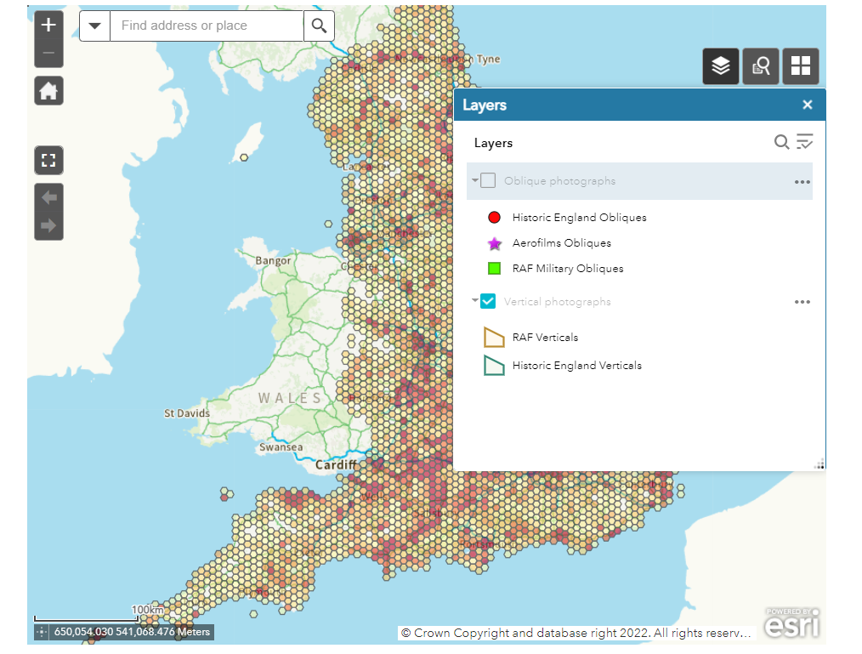
Using the Aerial Photo Explorer
Un-tick the ‘Oblique photographs’ layer
Notes:
Select the ‘layers’ icon and un-tick the ‘Oblique photographs’ box. This means you will only see vertical aerial photos – like most of those shown in this PPT. This is because most of the oblique photos on the Aerial Photo Explorer are NOT from during the Second World War, where as most of the RAF Verticals on the site are from the 1940s or the war. You can go back later a re-tick the ‘Oblique photographs’ box to see all the photos for you area.

Slide 6
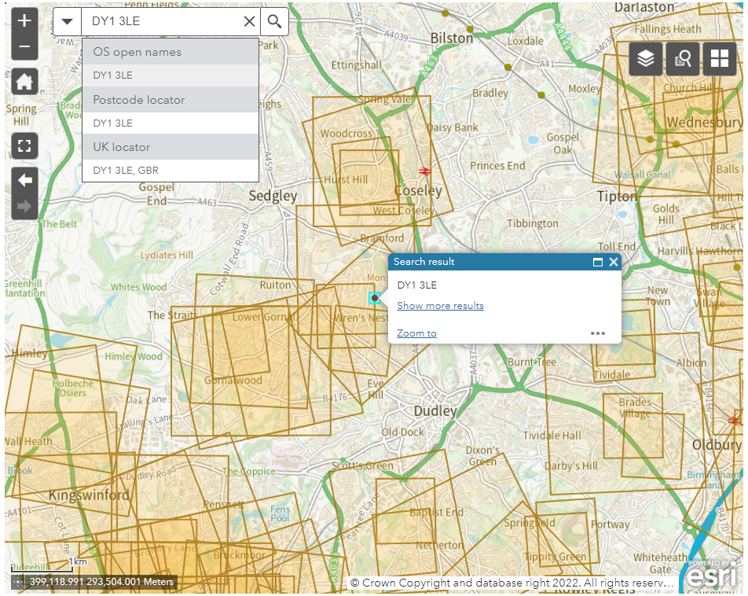
Using the Aerial Photo Explorer
Put in your school’s postcode
Notes:
Put in your school’s postcode to see what RAF Veritcal aerial photos there are.

Slide 7
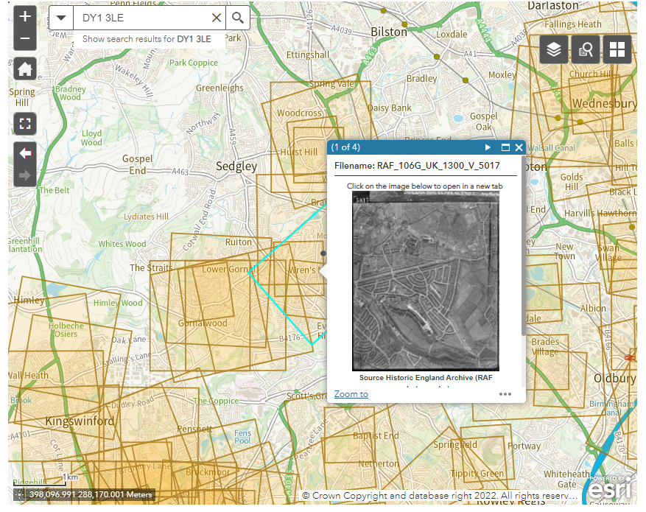
Using the Aerial Photo Explorer
Click on an orange square to see the photos
Notes:
Once you’ve searched on your postcode you can then click on any of the orange squares to see the photos available – you can scroll through to see all the photos. Clicking on any photo will open a larger version of it in a new page.
NB: If there are no already digitised results for the area of your school you can order one of our Local History Packs

Slide 8
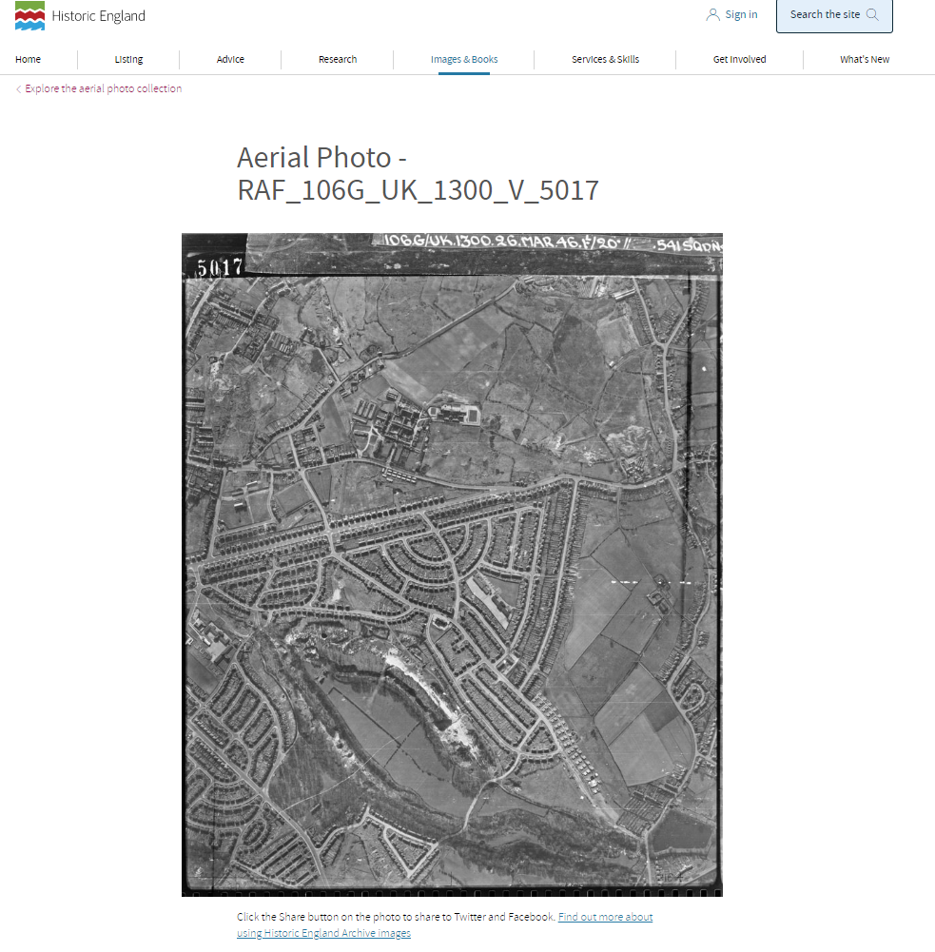
Using the Aerial Photo Explorer
Compare your local photos to those shown on the following slides.
How many Second World War features you can spot?
Notes:
This allows you to see the whole image, which you can then look at to see if any of the Second World War features shown on the following slides feature on your local photos.

Slide 9
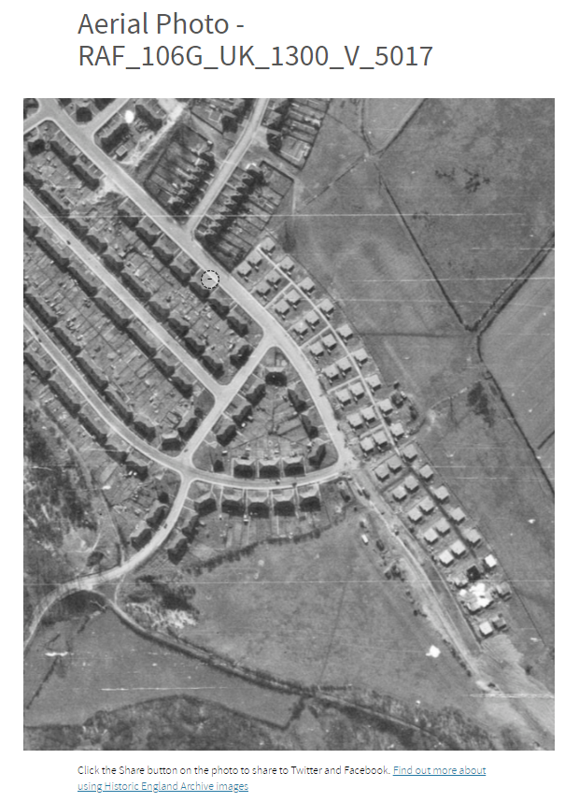
Using the Aerial Photo Explorer
You can click on the image to zoom in and really search the photo in detail!
Notes:
You can also click on the image to keep zooming-in to see any features in much greater detail. In this case the rows of newly built ‘prefabs’ – pre-fabricated houses on the right of the photo.

Slide 10
Air raid shelters
In 1938 the Air Raid Precautions Act together with the following year’s Civil Defence Act, legally obliged government, local authorities and places of work to formulate plans to protect civilians from enemy attack.
On the outbreak of the Second World War in September 1939, the Ministry for Home Security was created with Sir John Anderson as Home Secretary and Minister of Home Security. The Ministry was responsible for all central and regional civil defence organisations.
He gave his name to the most well known type of domestic shelter – the Anderson Shelter. 2,300,878 Anderson shelters had been issued by September 1940, many free of charge to poorer families. Due to their size and the fact they were often covered in soil they are unlikely to be seen on aerial photos.
However, probably the most common type of structure built was the 50-person public shelter; it is thought that some 16,747 were built in the Leeds area alone. Because of their size and location, in the middle of urban streets and parks, these are the most likely to be visible on aerial photographs from the 1940s.
From May 1945 the civil defence organisation was stood down. The demolition of the vast majority of the 50-person public shelters commenced virtually as soon as the local authorities obtained permission. Many stood on public roads, pavements and back lanes, forming hazards to vehicles and pedestrians.
Notes:
Find more information in- Civil Defence: From the First World War to the Cold War - Introductions to Heritage Assets: https://historicengland.org.uk/images-books/publications/iha-civil-defence/

Slide 11
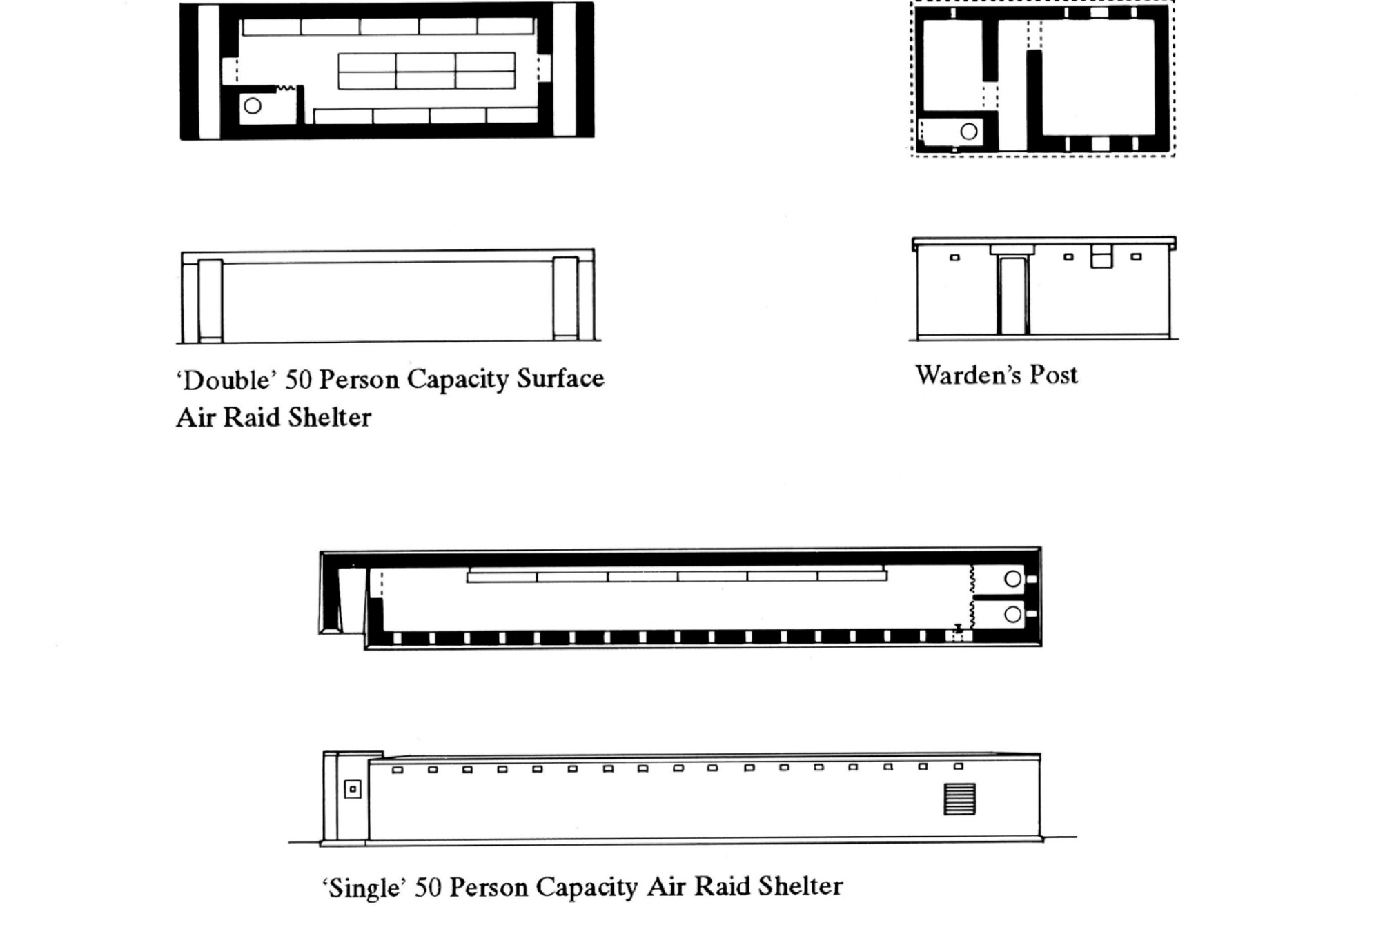
‘50 person’ public shelters
Plan view of inside
the shelter
Side view of outside of the shelter
Plan view of inside
the shelter
Side view of outside of the shelter

Slide 12
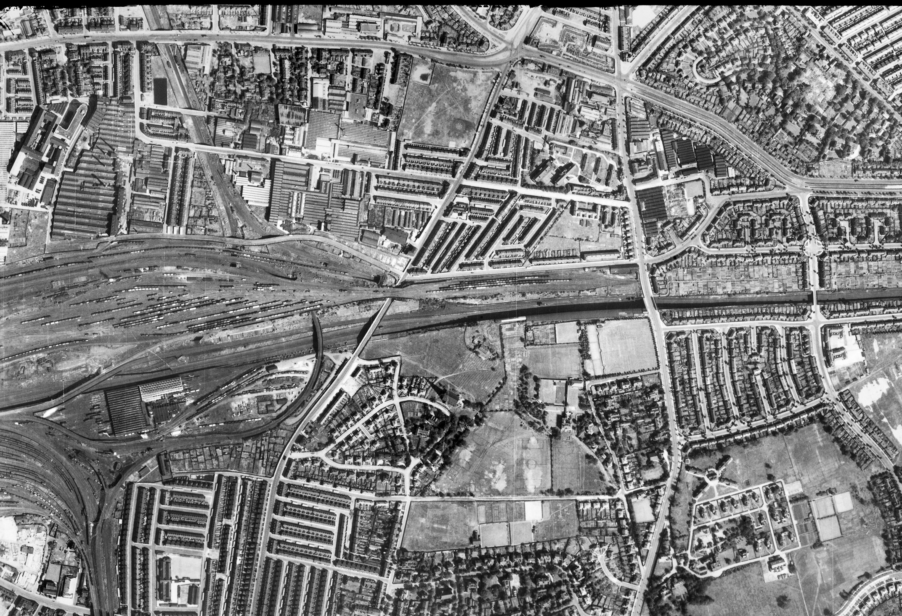
Air raid shelters in urban streets - Wavertree, Liverpool
(& Barrage Balloon tether site)
Notes:
Image: raf_106g_uk_626_rs_4165 – 10th August 1945 - Historic England Archive (RAF photography)

Slide 13
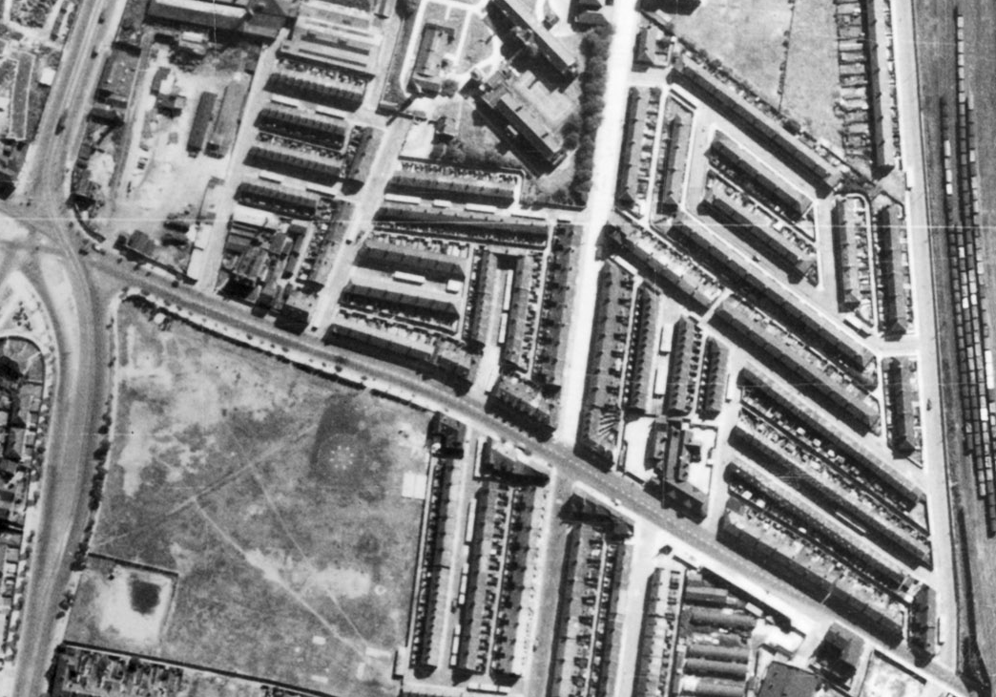
Air raid shelters in urban streets - Wavertree, Liverpool
(& Barrage Balloon tether site)
Notes:
Image: raf_106g_uk_626_rs_4165 – 10th August 1945 - Historic England Archive (RAF photography). Close-up of slide 4 with features highlighted. See Slides 36-39 for more information about Barrage Balloons

Slide 14
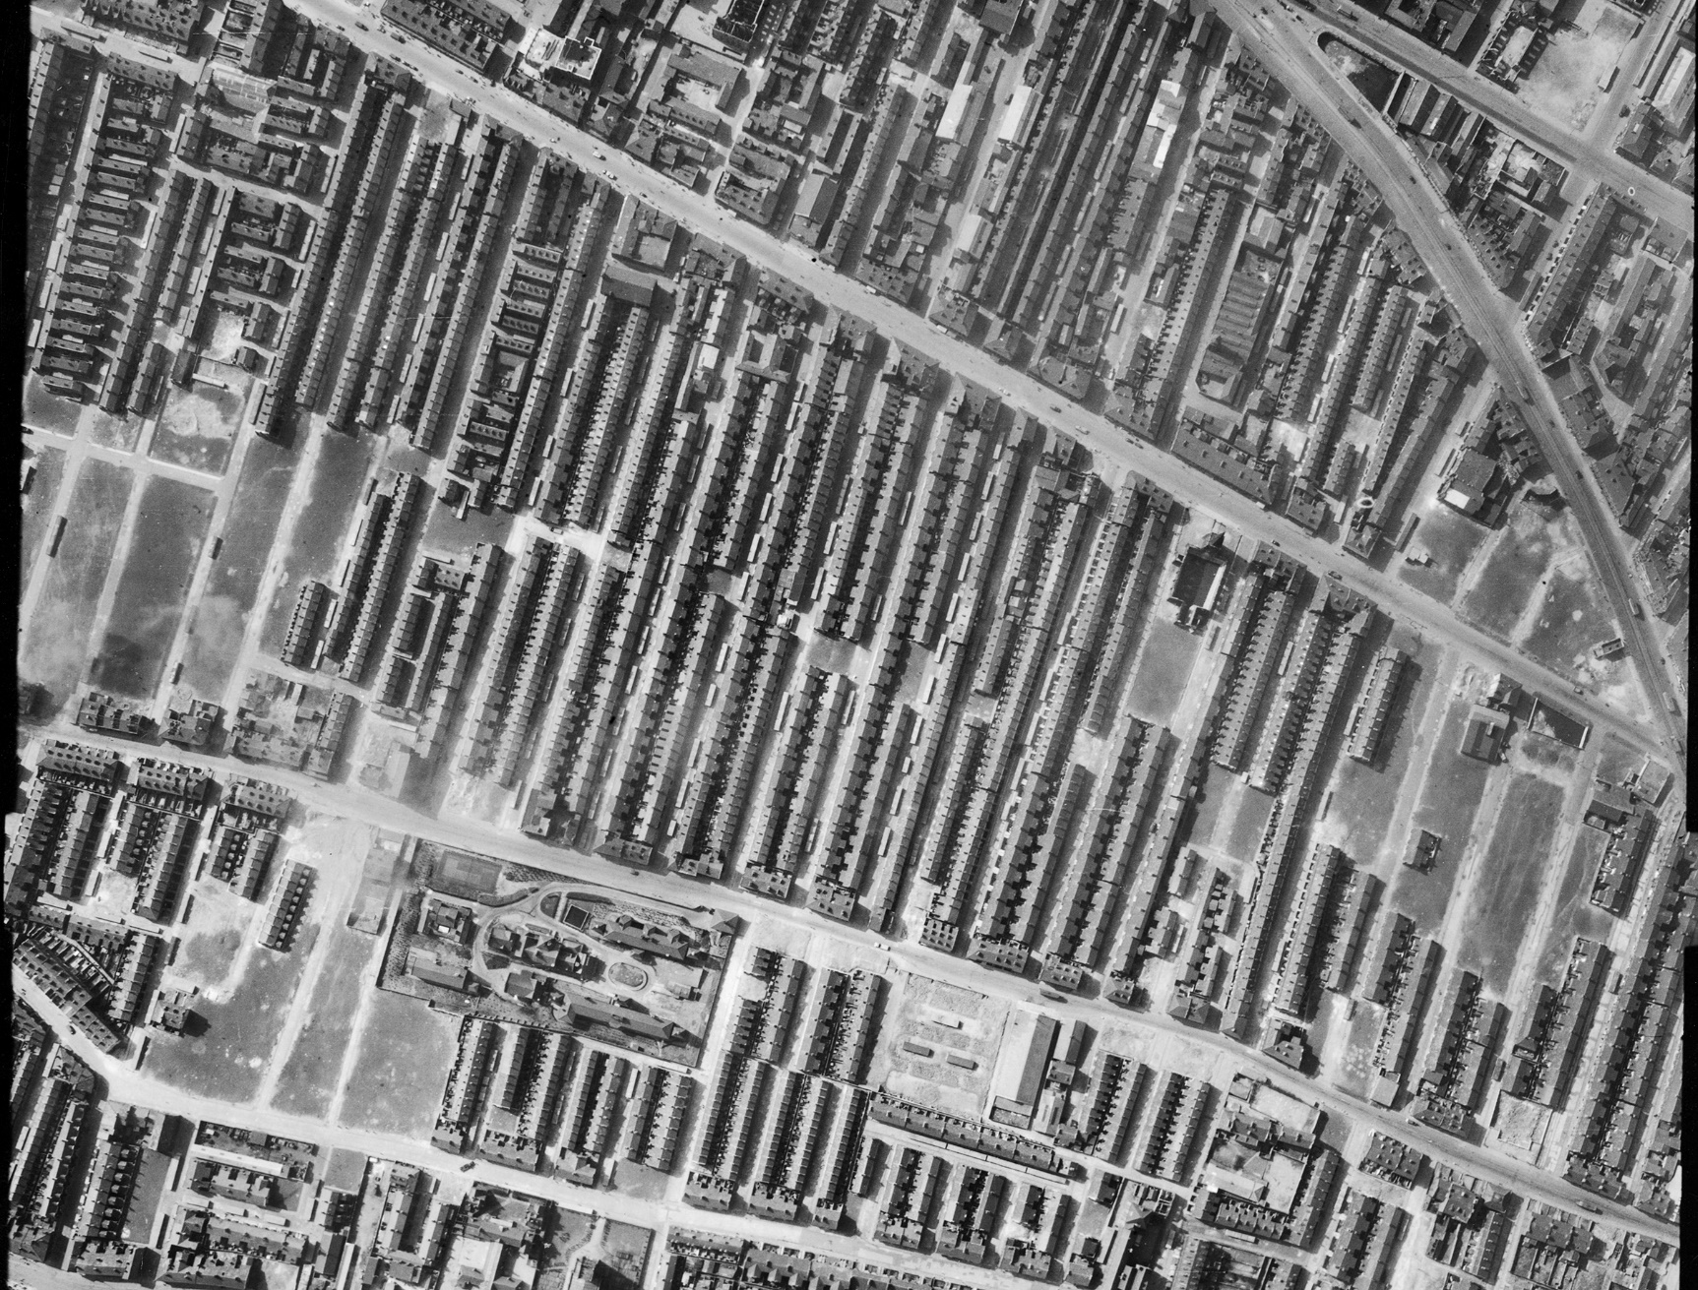
Air raid shelters in urban streets - Everton, Liverpool
(& bomb damaged sites of terraced houses)
Notes:
Image: raf_3g_tud_uk_107_vp2_5184 – 1st April 1946 - Historic England Archive (RAF photography)

Slide 15
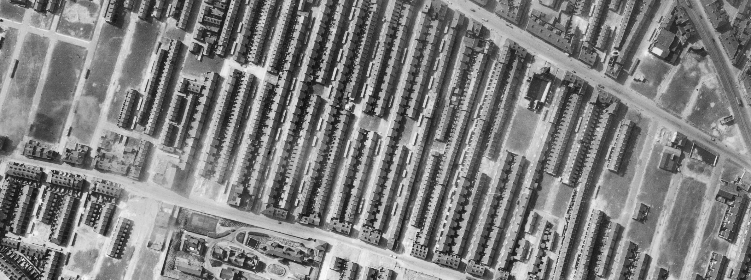
Air raid shelters in urban streets - Everton, Liverpool
(& bomb damaged sites of terraced houses)
Notes:
Image: raf_3g_tud_uk_107_vp2_5184 – 1st April 1946 - Historic England Archive (RAF photography). Close-up of slide 6 with features highlighted

Slide 16
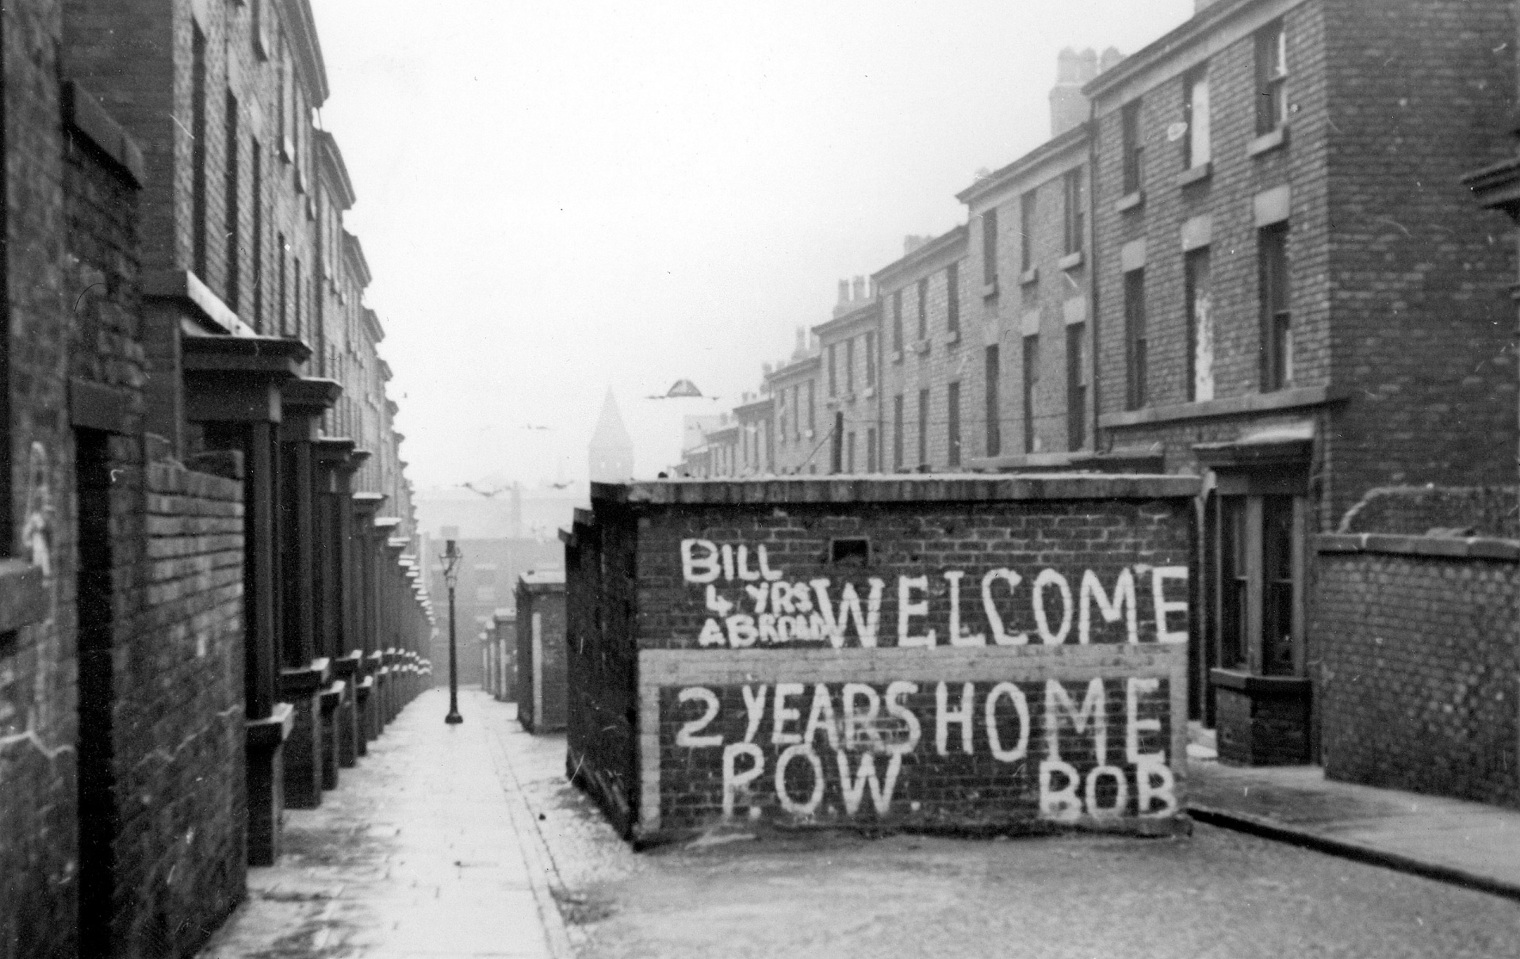
Air raid shelters in urban streets - Paddington, Liverpool
Notes:
Image: BB88_07273 ©Historic England Archive c1945
These street shelters were built during World War Two to provide protection for the people of Liverpool during the Blitz. Here they have had welcome home messages painted on them for returning soldiers.

Slide 17
Airfields
The British Army was using hot air balloons from 1890, while airships were under development from around 1911. The first flight by a British Army aeroplane took place in 1908 when Col S F Cody flew at Farnborough (Hampshire). In 1910 a permanent flying school and factory was opened at Larkhill, on Salisbury Plain (Wiltshire).
About 250 flying stations or aerodromes existed in 1918, this increased to 740 during the Second World War, including those used by the Americans. Many aerodromes, which were subject to rebuilding in the inter-war period, were front-line operational bases which played a part in the Battle of Britain (1940) or the strategic bomber offensive (1940-1945).
Types of aerodrome varied considerably, from operational stations to training bases; from bomber aerodromes to home defence or fighter use. Almost all were built to standard Air Ministry designs.
Airfields were increasingly given concrete runways for all-weather flying: the scale of the wartime construction enterprise in this area was vast. It is estimated that in the first 5 years of the war the total area of concrete laid in building new airfields was equivalent to building a 9,000-mile-long, 30-foot-wide road from London to Beijing!
Vast amounts of short-lived hutted accommodation was put up at airfields during the Second World War. Most of this no longer survives but can be identified through aerial photographs, documentation and archaeology.
Notes:
Find more information in - Historic Military Aviation Sites: Conservation Guidance https://historicengland.org.uk/images-books/publications/historic-military-aviation-sites/
and - Nine Thousand Miles of Concrete: A Review of Second World War Temporary Airfields in England https://research.historicengland.org.uk/Report.aspx?i=15802

Slide 18
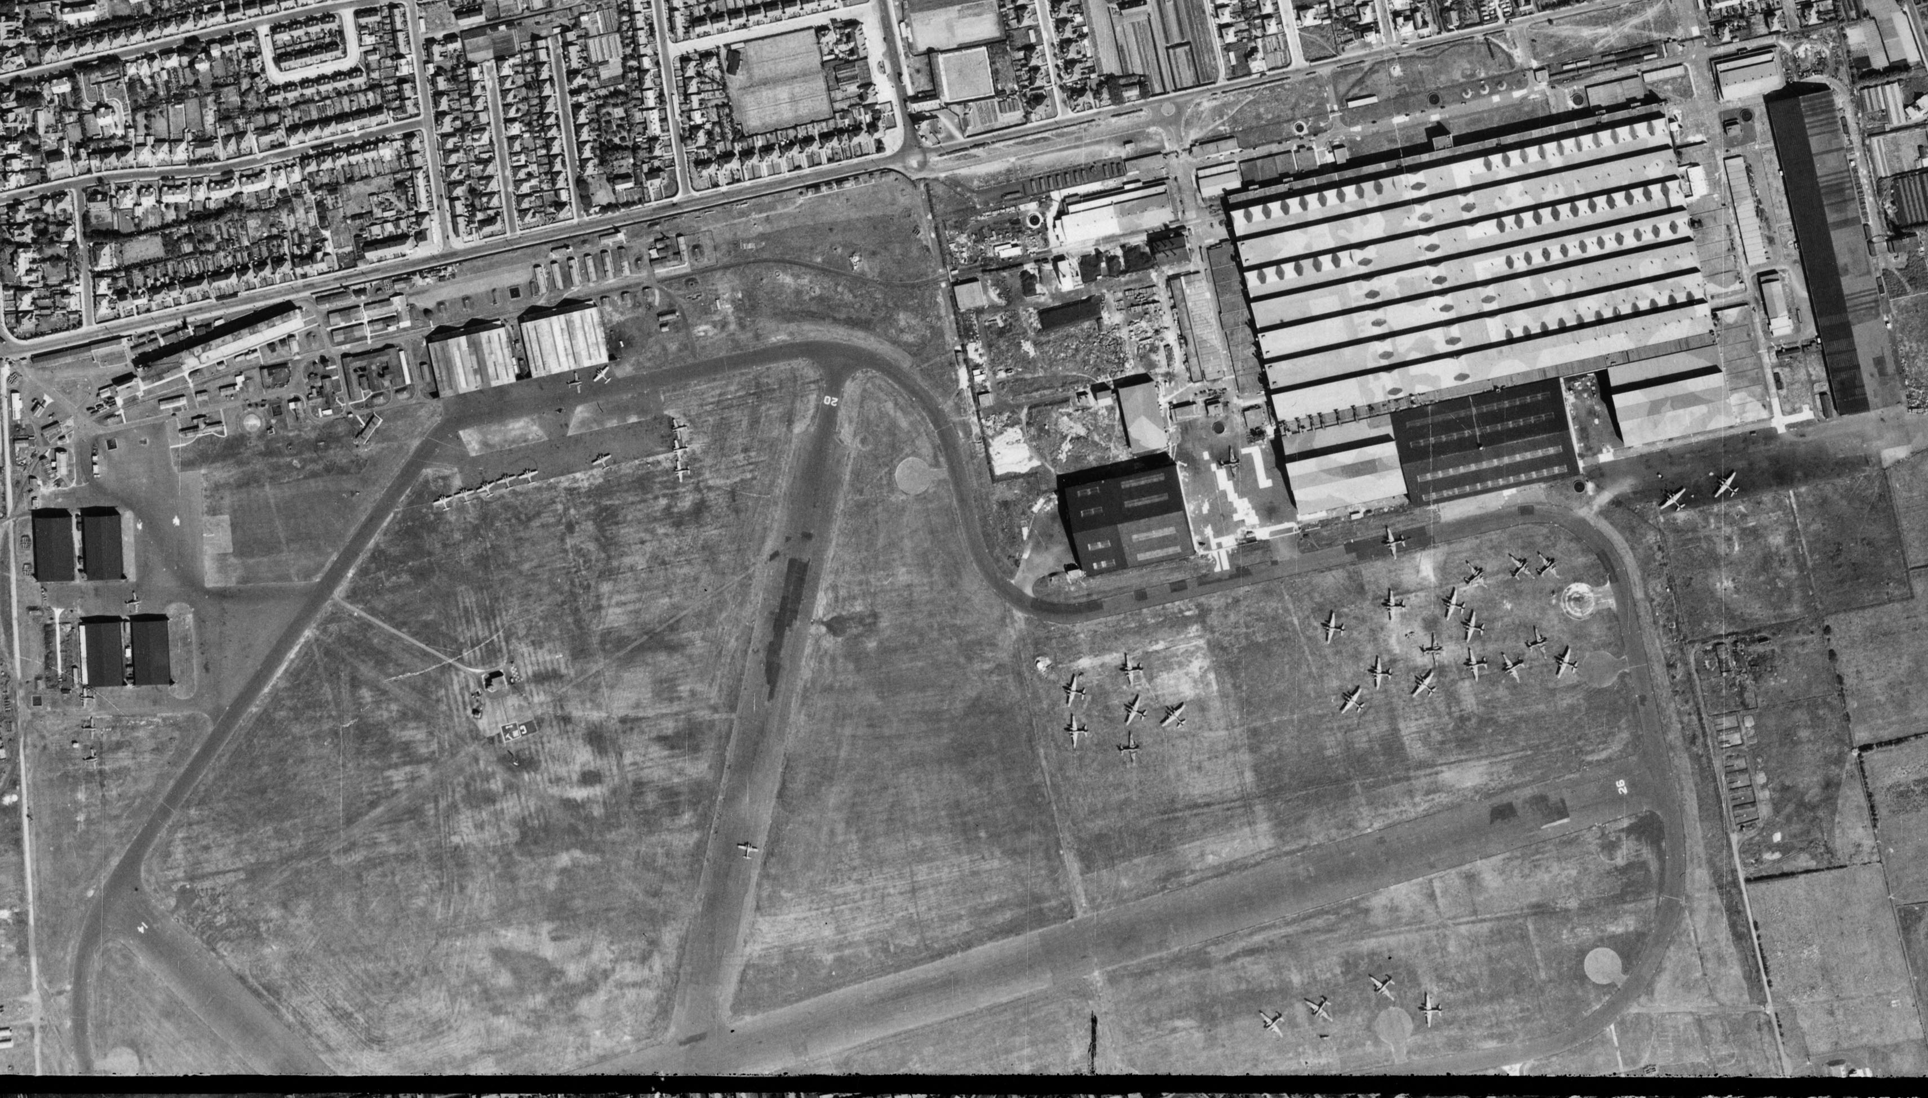
Blackpool Airfield – now Blackpool Airport
Notes:
Image: raf_106g_uk_625_rs_4061 – 10th August 1945 - Historic England Archive (RAF photography)

Slide 19
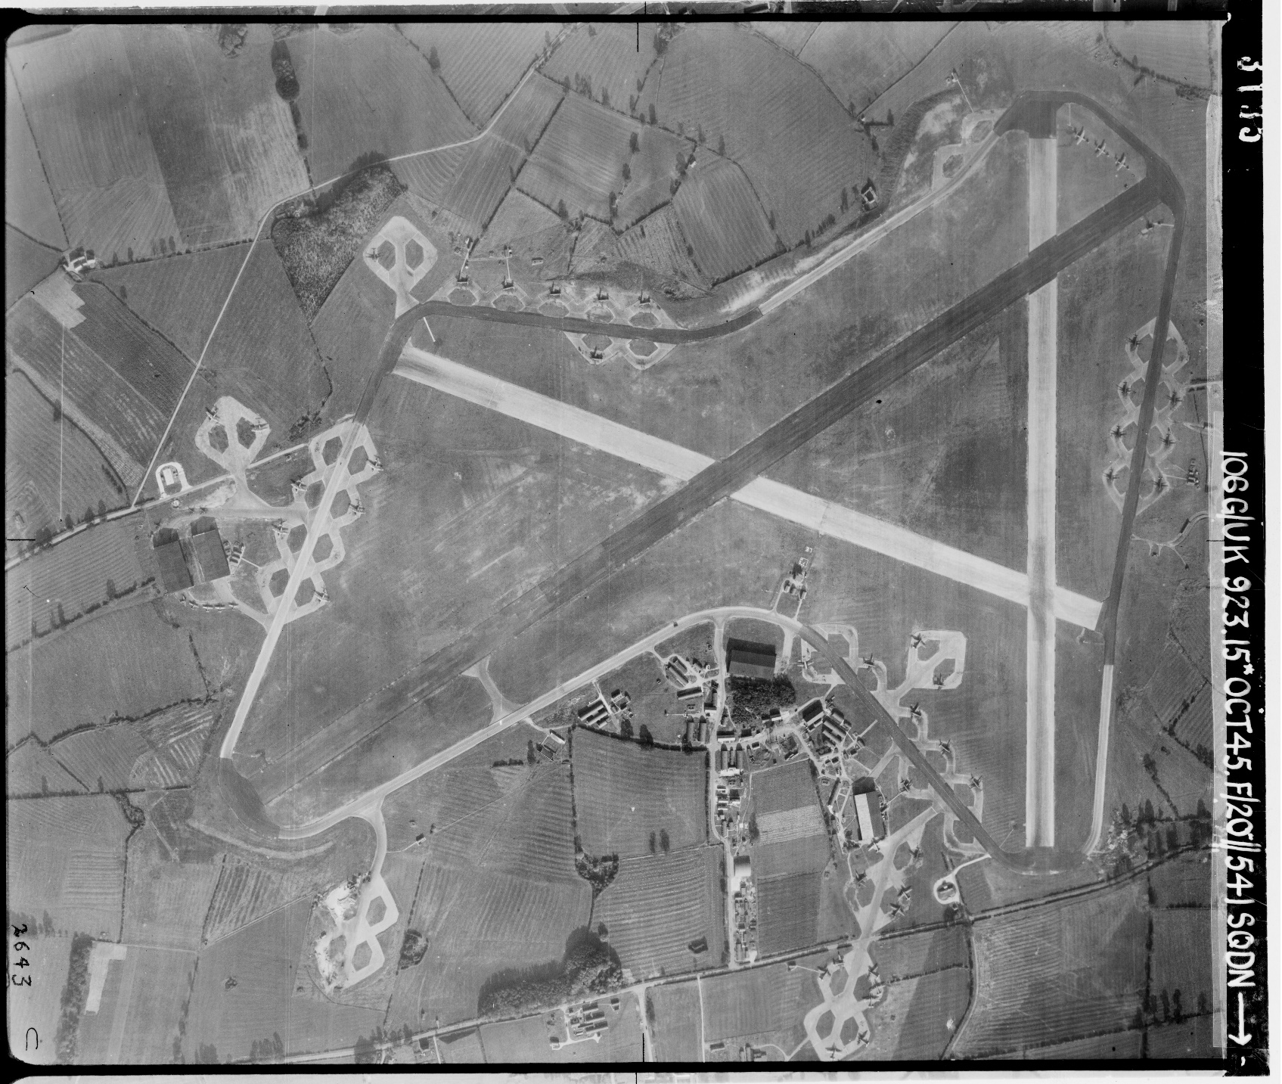
Leicester Airfield – now Leicester Airport
Notes:
Image: raf_106g_uk_923_rp_3135 – 15th October 1945 - Historic England Archive (RAF photography)

Slide 20
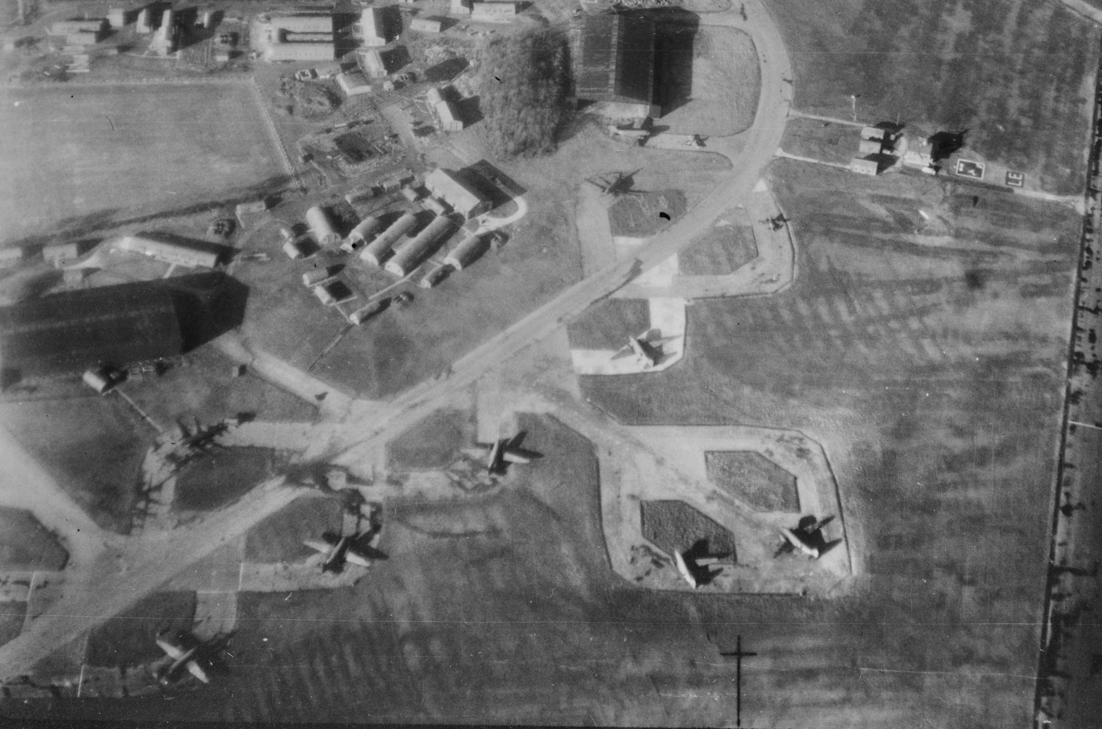
Leicester Airfield – now Leicester Airport
Notes:
Image: raf_106g_la_68_po_0018 - 4th December 1944 - Historic England Archive (RAF photography)

Slide 21
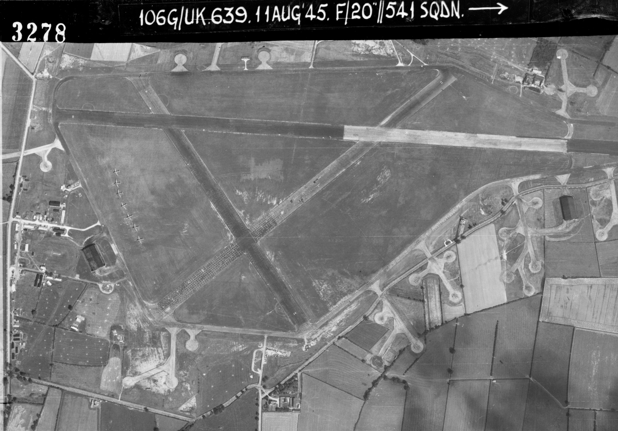
Diseworth Airfield – now East Midlands Airport
Notes:
Image: raf_106g_uk_639_rp_3278 – 11th August 1945 - Historic England Archive (RAF photography)

Slide 22
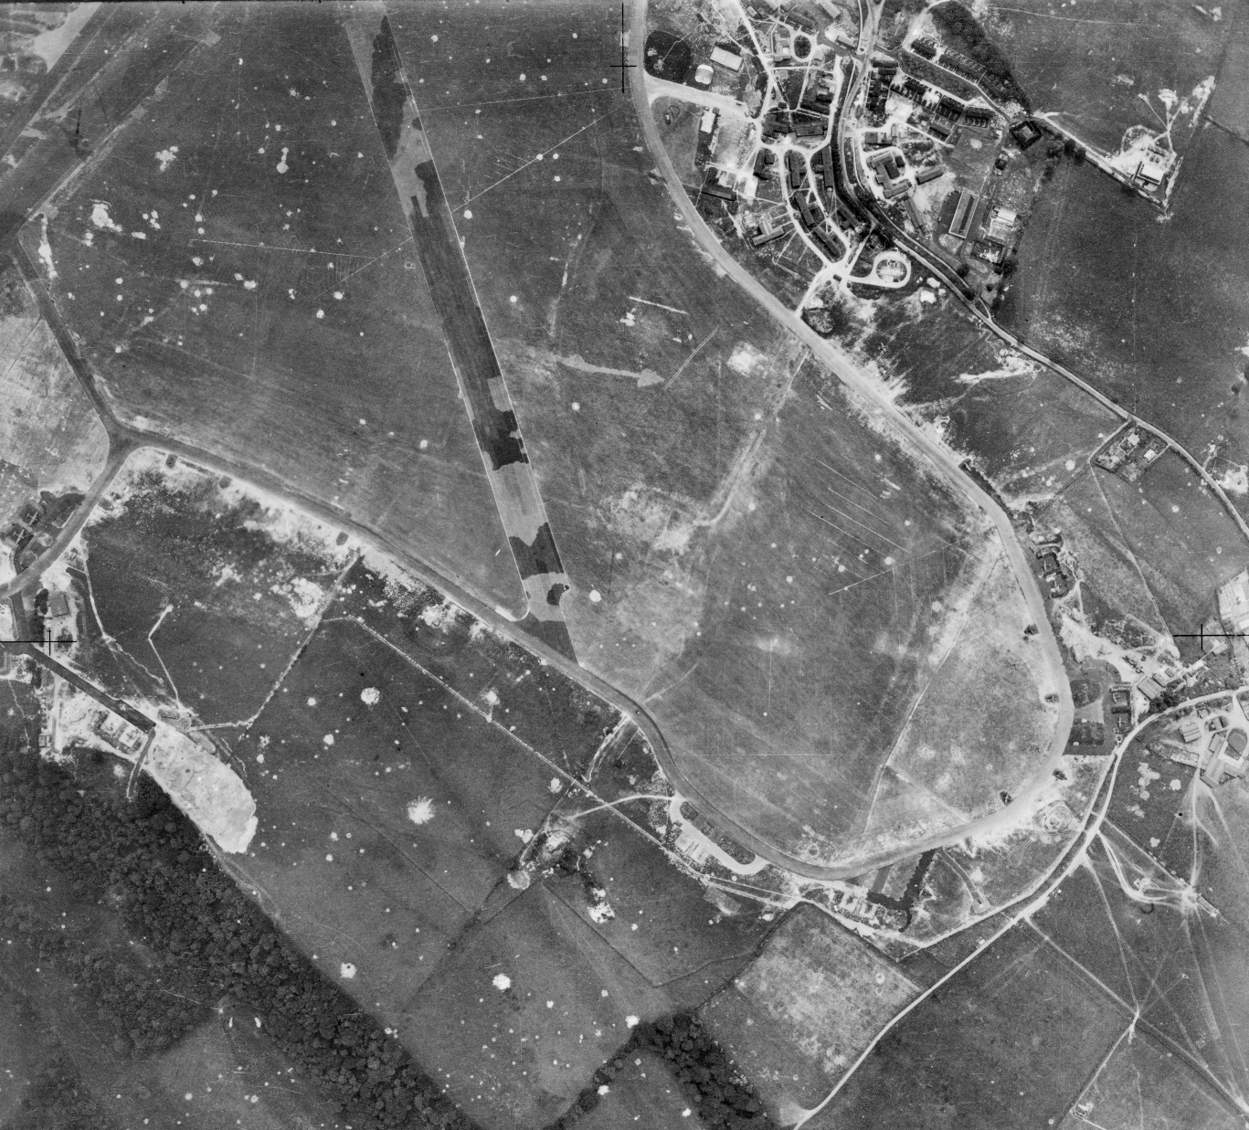
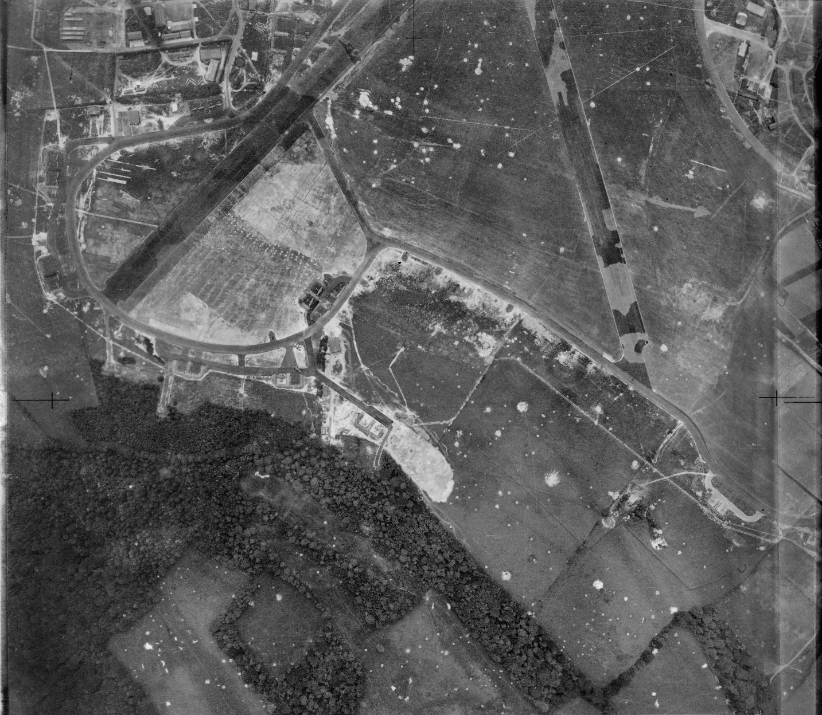
Biggin Hill Airfield – now London Biggin Hill Airport
Notes:
Image: raf_241_ac9_v_0072 & raf_241_ac9_v_0073 – 27th June 1941 - Historic England Archive (RAF photography)
Note the camouflage paint on the runways to try and disguise them.

Slide 23
Allotments
At the start of the Second World War Britain imported around three quarters of its food by ship. Attacks on these ships at the start of the war created a shortage in the supply of food to Britain.
In October 1939 the government launched its Dig For Victory campaign to encourage people to grow more fruit and vegetables to help meet the short fall. As well as people’s gardens there was also a move to turn public parks, golf courses and any other suitable spaces into allotments and help the ‘war effort’
"We want not only the big man with the plough but the little man with the spade to get busy this autumn. Let 'Dig for Victory' be the motto of everyone with a garden,“ Rob Hudson, Minister for Agriculture, in October 1939.
In January 1940 the government also introduced rationing, making it even more important for people to try to grow their own food.
Through out the campaign monthly gardening guides were issued, along with a large selection of leaflets – available free on request – to help people make the most of their allotment. A large number of these leaflets are available to download at: https://dig-for-victory.org.uk/growing-advice/dig-victory-leaflets-ww2/, if you have school veg patch why not download some and try out their techniques for the best vegetables!
Notes:
Find more information at - https://heritagecalling.com/2017/04/13/allotmentitis-how-britain-dug-for-victory/

Slide 24
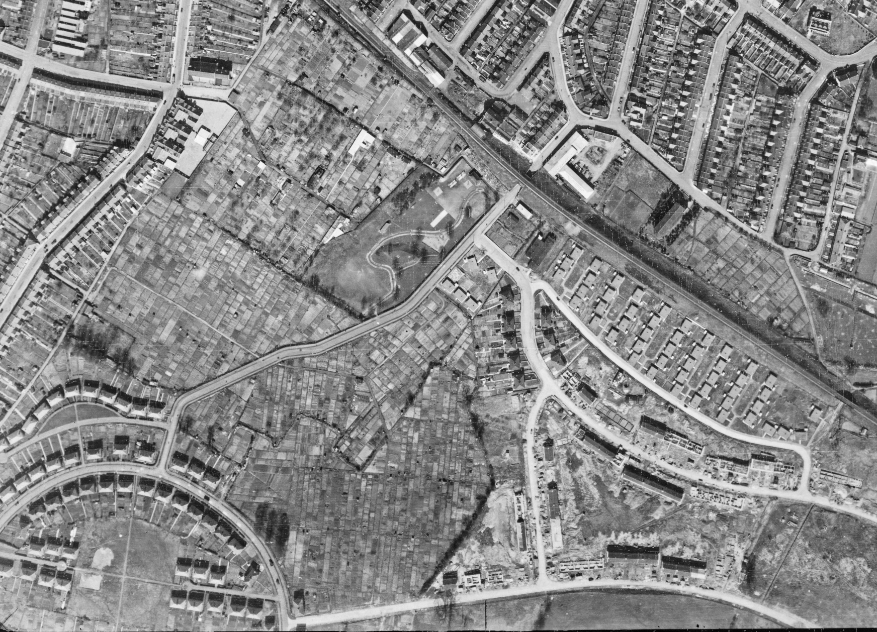
Allotments – Oldfield Park, Bath
(& pre-fab housing)
Notes:
Image: raf_cpe_uk_1988_v_5172 – 12th April 1947 - Historic England Archive (RAF photography)

Slide 25
Anti-aircraft (AA) sites
One of the more significant developments in the evolution of warfare was the start of strategic bombing in World War II. This significance was reflected by the resources invested in defence, both in terms of personnel and the sites on which they served.
During World War II, the number of people in Anti-aircraft Command (AA Command) reached a peak of 274,900 men. Additional to this were the women soldiers of the Auxiliary Territorial Service (ATS), who served on AA gun sites from summer 1941, and the Home Guard who manned many sites later in the war.
Anti-aircraft gun sites divide into three main types: those for heavy guns (HAA sites, clearly visible on aerial photos), light guns (LAA sites, rarely visible on aerial photos) and batteries for firing primitive unguided rockets (ZAA sites, clearly visible on aerial photos). Mobile gun units were also deployed towards the end of the war to help counter the V1 & V2 rocket attacks in the South East.
The Anti-aircraft (AA) guns were used not only for destroying enemy aircraft but, more importantly, to keep all enemy aircraft at a high altitude and to deter them from flying on the straight and even course necessary for accurate bombing.
Another important function of AA guns was to indicate the position of enemy aircraft to their own fighters. Often, when an enemy plane was out of range, the guns would fire one or two rounds to burst as near as possible, simply to draw our own fighter’s attention to the enemy.

Slide 26
Heavy Anti-aircraft sites (HAA)
HAA sites contained big guns with the function of engaging high flying strategic bombers, hence their location around the south and east coasts, and close to large cities and industrial and military targets. Of all the gun sites, these were the most substantially built. There were a variety of designs, but those for 4 or 8 guns were the most common and form the most distinctive shapes on aerial photos.
As well as the four or eight gun emplacements, with their holdfast mountings for the guns, other components of a gun site will generally include operational buildings such as a command post, radar structures including the radar platform, on-site magazines for storing reserve ammunition, gun stores and generating huts, usually one of the standard Nissen hut designs.
Domestic buildings for the military personell stationed there were also a feature of HAA gun sites. These often included huts, ablutions blocks, offices, stores and amenities drawn from a common pool of approved structures. Sites were often also provided with structures for their close defence in case of invasion/ground attacks. Pillboxes are the most common survival of these, though earthwork defences (mounds and ditches) were also used.
The layout of HAA gun sites was distinctive, but changed over time, for example to accommodate the introduction of radar from December 1940, women soldiers from summer 1941, and eight gun layouts from late 1942. Where present, these features can be used to help date the construction of HAA sites on aerial photos.

Slide 27
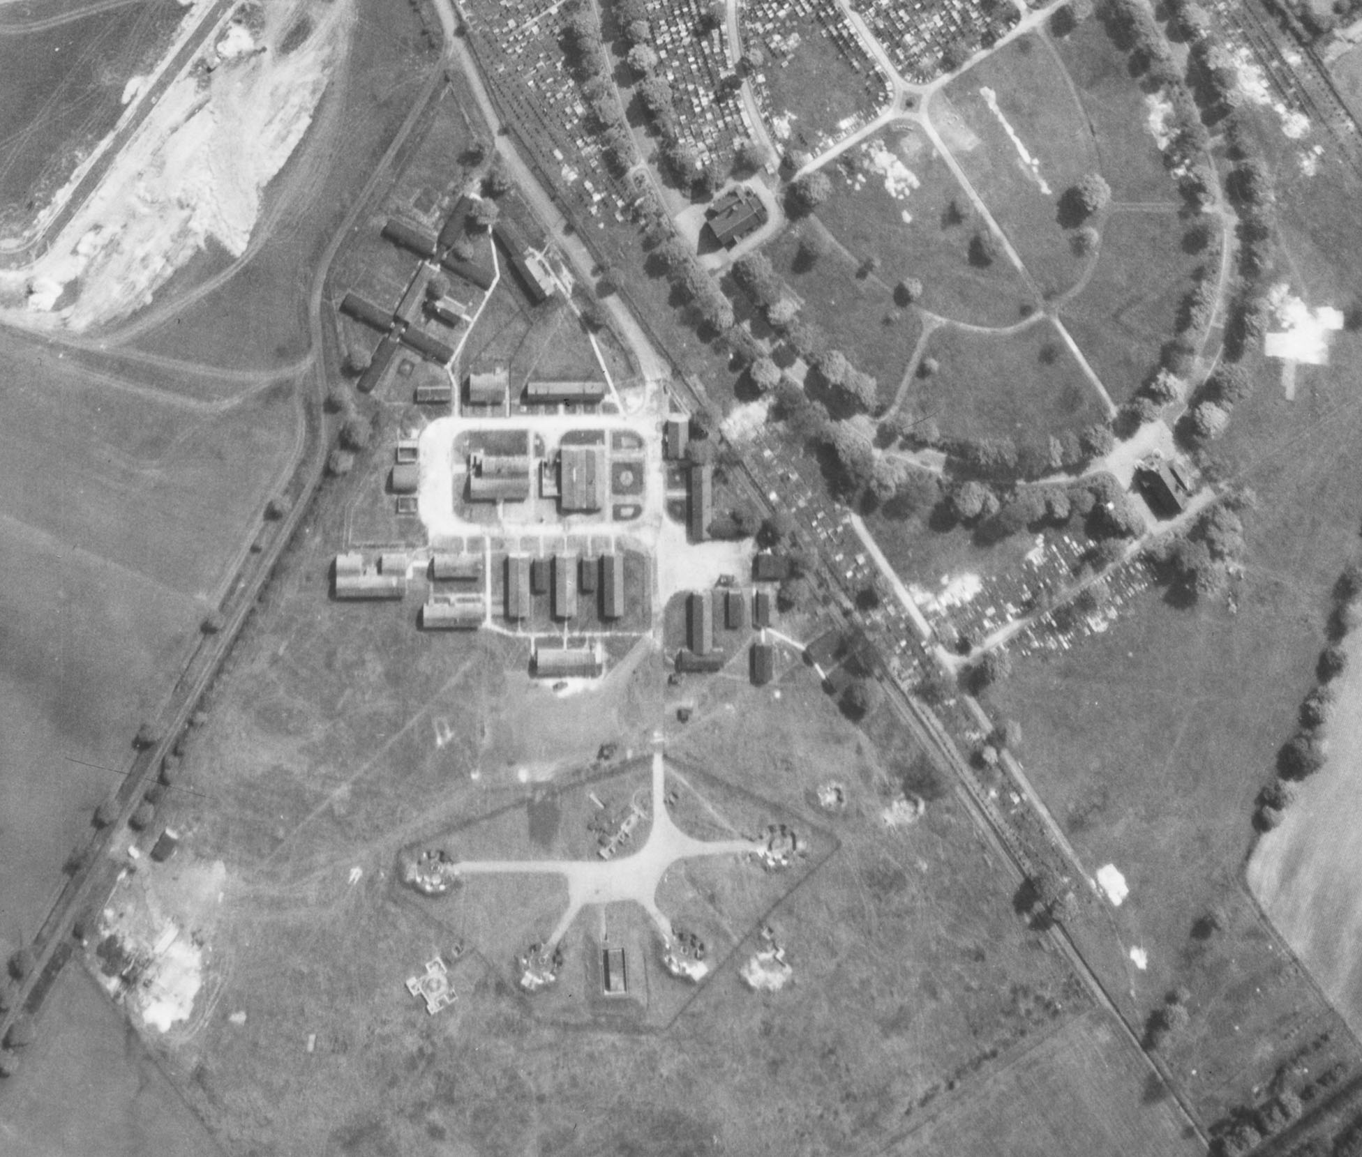
HAA site – Barton Moss, Salford – H1
Additional operational buildings
Standard 4 Gun
Emplacement
Notes:
Image: raf_82_784_vp1_0129 – 13th May 1953 - Historic England Archive (RAF photography)

Slide 28
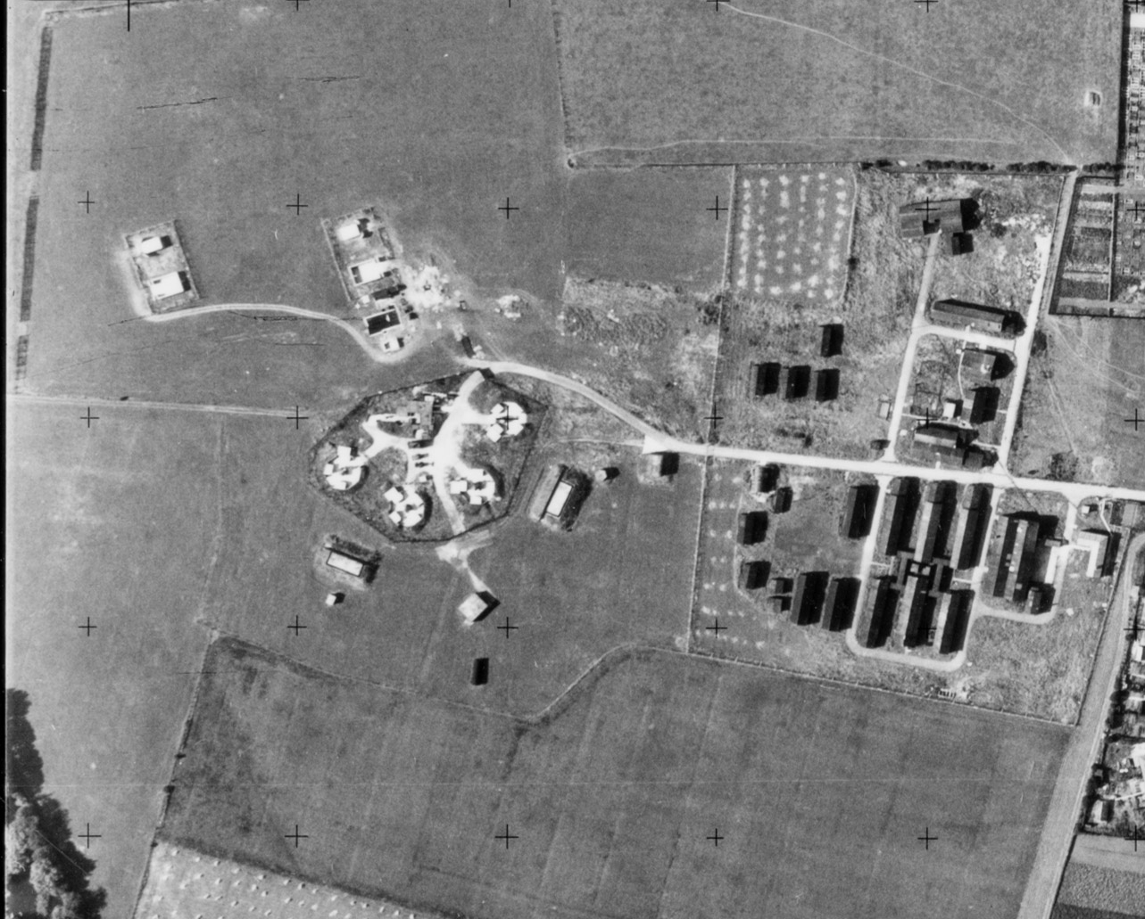
HAA site – Grangetown, Middlesbrough
Standard 4 Gun
Emplacement
Additional operational buildings
Notes:
Image: os_52r49_v_040 – 23rd August 1952 - Historic England Archive (Ordnance Survey photography)

Slide 29
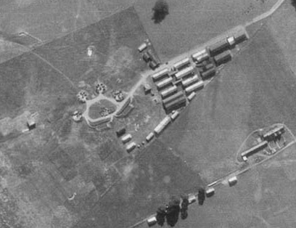
HAA site – Filton, Bristol
Standard 4 Gun
Emplacement
Additional operational buildings
Notes:
Image: raf_hla_313_rv_0606 – 29th September 1941 - Historic England Archive (RAF photography)

Slide 30
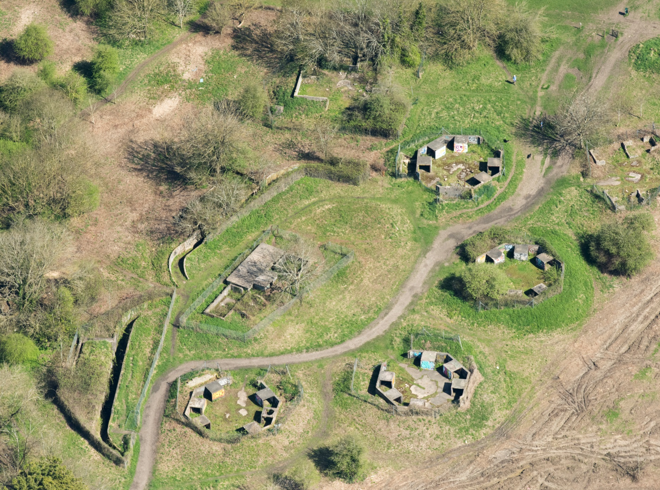
HAA site – Pur Down, Bristol B6
Standard 4 Gun
Emplacement
Notes:
Image: 33483_024 – 19th April 2018 - ©Historic England Archive

Slide 31
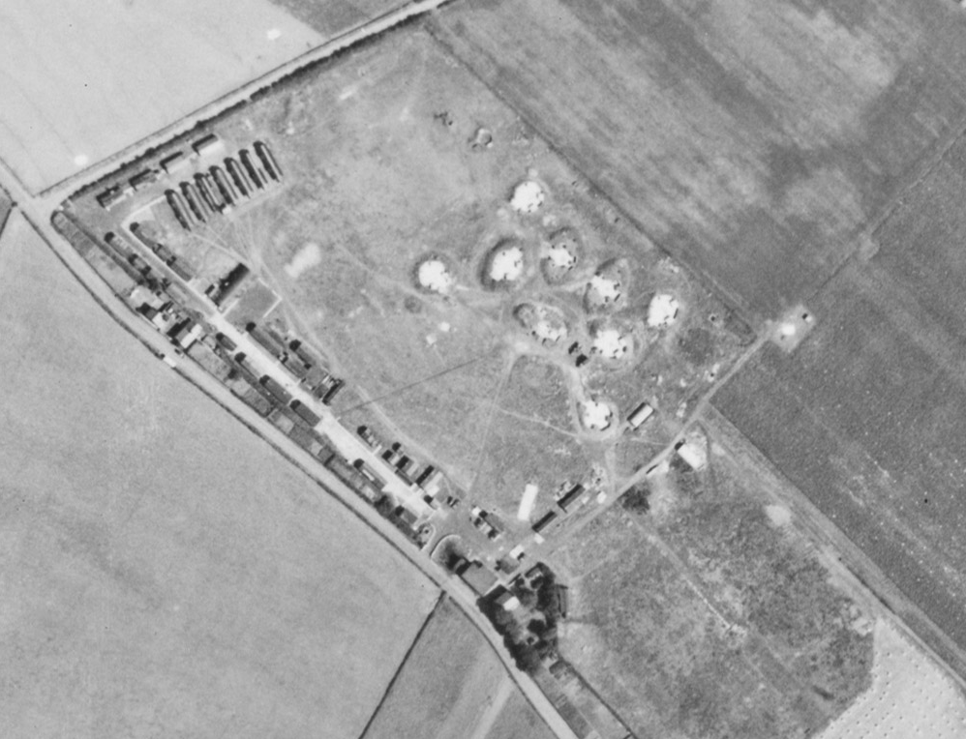
HAA site – Kirkby, Mersey H8
Standard 8 Gun
Emplacement
Additional operational buildings
Notes:
Image: raf_106g_uk_623_rs_4196 – 10th August 1945 - Historic England Archive (RAF photography)

Slide 32
Rocket Anti-aircraft sites (ZAA)
50 ZAA battery sites are known to have been constructed in World War II. The ZAA rocket battery and control buildings were part of a sophisticated system aimed at diverting hostile air attacks away from city centre or military targets, whilst at the same time drawing enemy bombers to within range of other anti-aircraft fire.
They were often used in conjunction with lighting decoys. The lighting decoys, known as QL sites, attempted to simulate city lights, black-out conditions and included devices to mimic the flickering lights of railway marshalling yards as seen from the air. If the decoy was considered to have been successful in attracting aircraft then pre-prepared fires (known as Starfish or QF sites) were electrically ignited to create the illusion of targets having been set alight and convince the German bombers that they had been successful!
The rockets were laid out in a grid pattern (often 8x8 or 64 rockets). Each rocket was mounted on to a concrete base and could be rotated/pointed according to the required direction. Once loaded each rocket could only be fired once. The aim being to fire all the rockets at once.

Slide 33
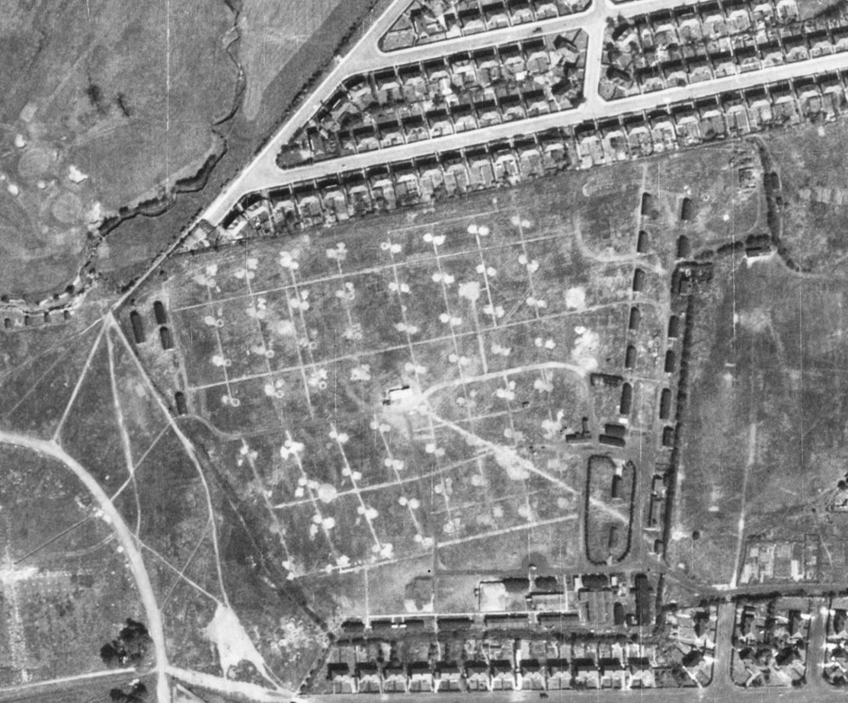
ZAA site – Radcliffe Park, Salford (ZH1)
Notes:
Image: raf_106g_uk_622_rp_3332 - 10th August 1945 - Historic England Archive (RAF photography)

Slide 34
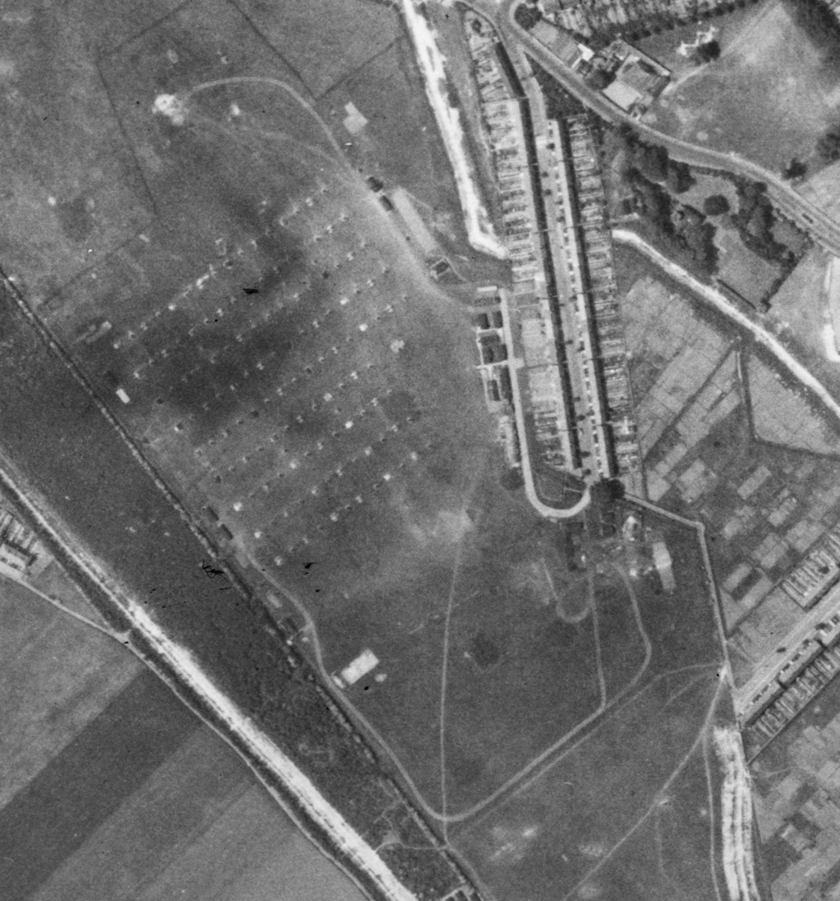
ZAA site – Gillingham, Kent
Notes:
Image: us_7gr_loc348_fs_2055 – 27th May 1944 - Historic England Archive (USAAF photography)

Slide 35
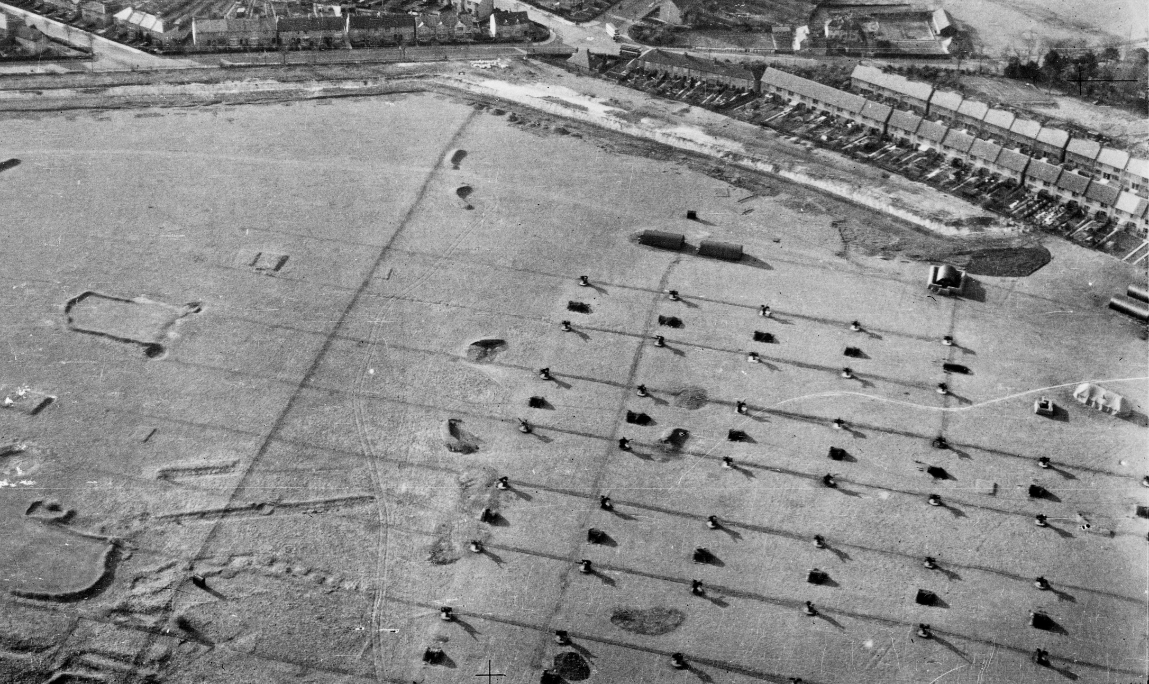
ZAA site – Gillingham, Kent
Notes:
Image: raf_26_uk_920_po_0006 – 23rd March 1942 - Historic England Archive (RAF photography)

Slide 36
Light (LAA) &
mobile Anti-aircraft sites
Light Anti-aircraft (LAA) sites used a range of weapons in defence against lower flying aircraft. They had a particularly wide distribution around the south and east coasts and close to cities, industrial and military targets, such as airfields.
Of all the gun sites, these were the least substantial and have left behind the least remains. Nearly 1,250 LAA gun sites are recorded as having been built during World War II.
Around 50 of these have some remains surviving, though at only around 40 sites are these thought sufficient to provide an understanding of their original form and function. Surviving examples are therefore sufficiently rare to suggest that all 40 examples are of national importance.
Mobile anti-aircraft sites were mostly associated with Operation Diver. This was Anti-aircraft Command’s attempt to defeat the V1 flying-bomb, the first of Nazi Germany’s ‘retribution’ weapons, whose attacks dominated the home front in the final year of the Second World War. Beginning in the week of D-Day, the flying bomb battle lasted for nine months. In that time the men and women of AA Command became a massed, mobile army, shifting a vast carpet of guns to meet the V1’s changing lines of attack. Along with the RAF’s fighter aircraft and the larger air defence system, their mission was to prevent a single flying bomb from reaching London, or any other British city.

Slide 37
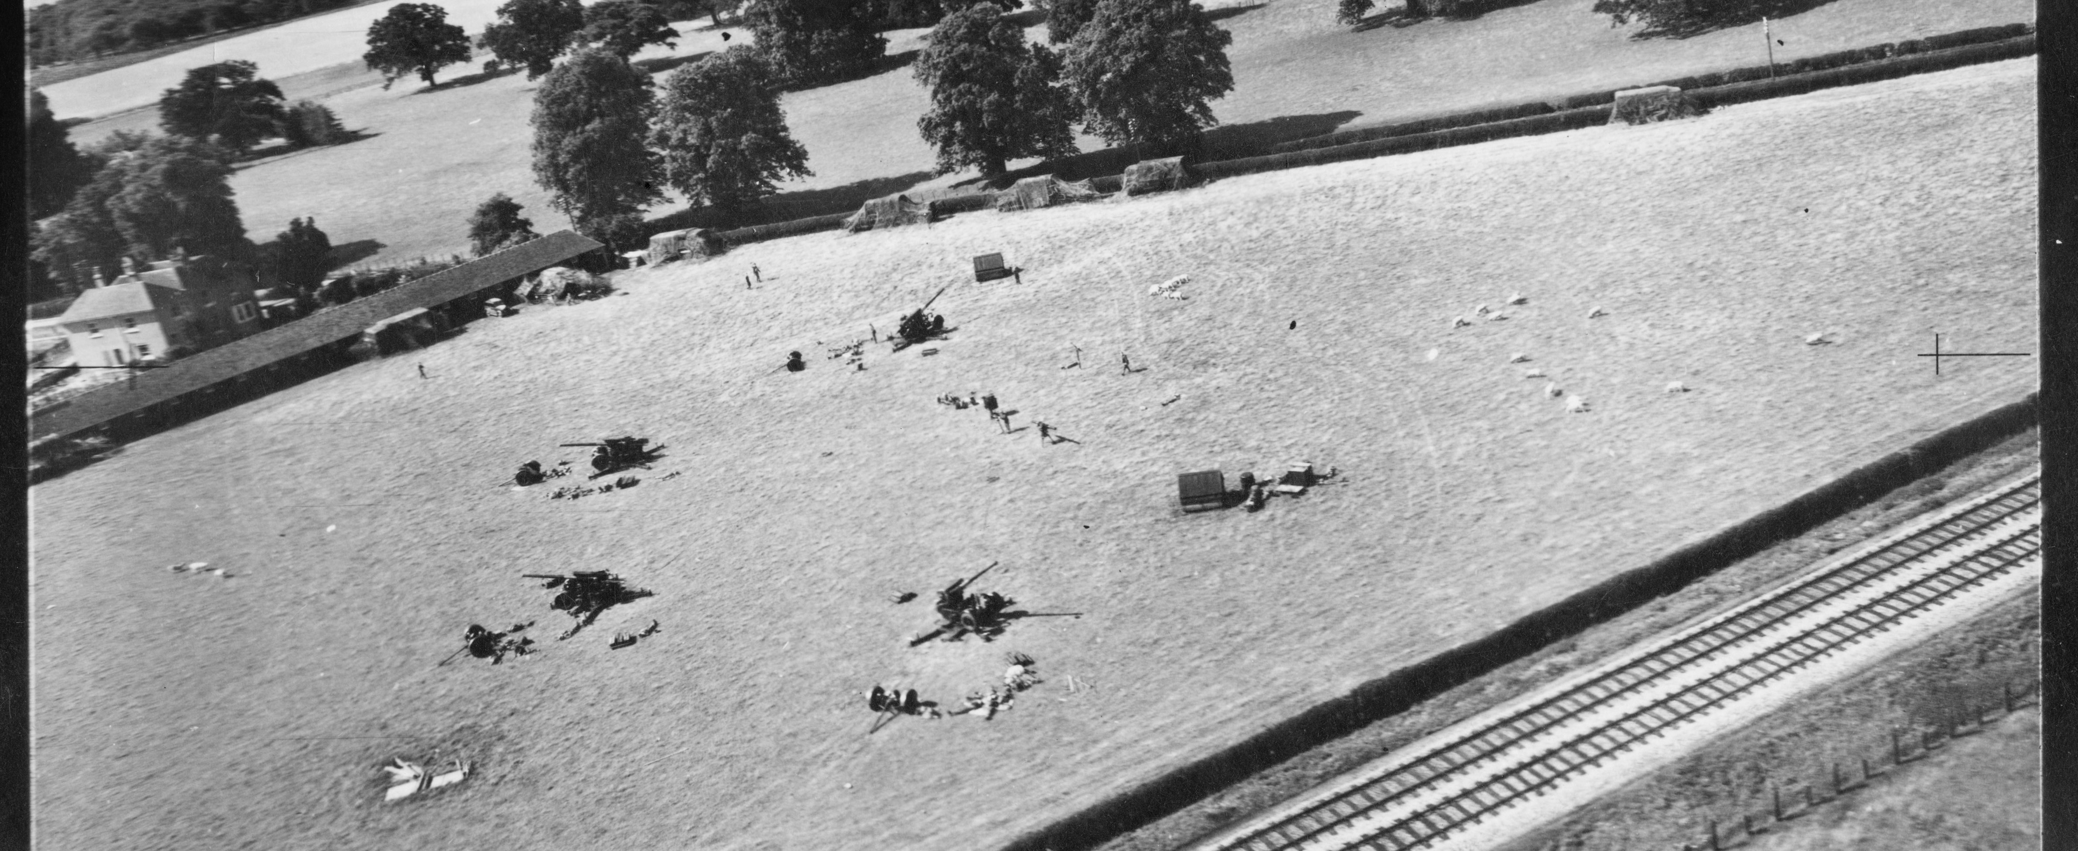
Mobile Anti-aircraft site – Wye, Kent
(note the trucks covered in camouflage netting against the nearby hedge and barns)
Notes:
Image: mso_1416_s372h54_po_02 – 6th August 1941 - Historic England Archive (RAF photography)

Slide 38
Mobile Anti-Aircraft site – Wye, Kent
(close-up of mobile guns being put together/taken apart, a soldier on the right can be seen with a gun barrel over his shoulder)
Notes:
Image: mso_1416_s372h54_po_02 – 6th August 1941 - Historic England Archive (RAF photography)

Slide 39
Anti-glider (landing) trenches
The increased use of aircraft during the Second World War not only increased the threat from bombing, but also of invasion.
Therefore open areas were considered vulnerable to invasion from the air: a landing by paratroopers, glider-borne troops or powered aircraft which could land and take off again. Any open area with a straight length of 500 yards (460 m) or more within five miles (8 km) of the coast or an airfield was considered vulnerable.
Anti-invasion defences were therefore built in vast numbers. One of the main types being zig-zag trenches dug into open areas to prevent aircraft from landing or taking off. They also made the landing of paratroopers potentially more hazardous.
In some areas concrete or wooden posts, even old cars, were used to create obstacles in these open areas and deter enemy landings.

Slide 40
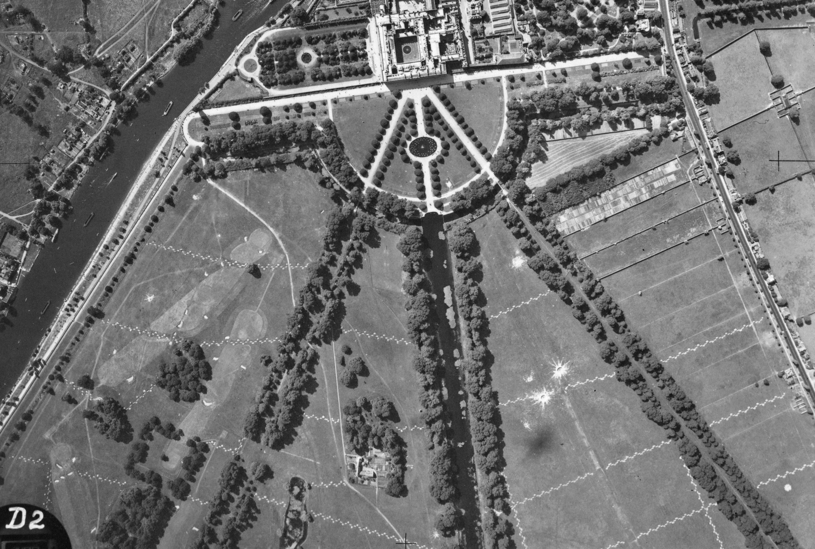
Anti-glider trenches – Hampton Court, London
(& bomb craters too!)
Notes:
Image: raf_241_ac10_v_0041 – 29th June 1941 - Historic England Archive (RAF photography)

Slide 41
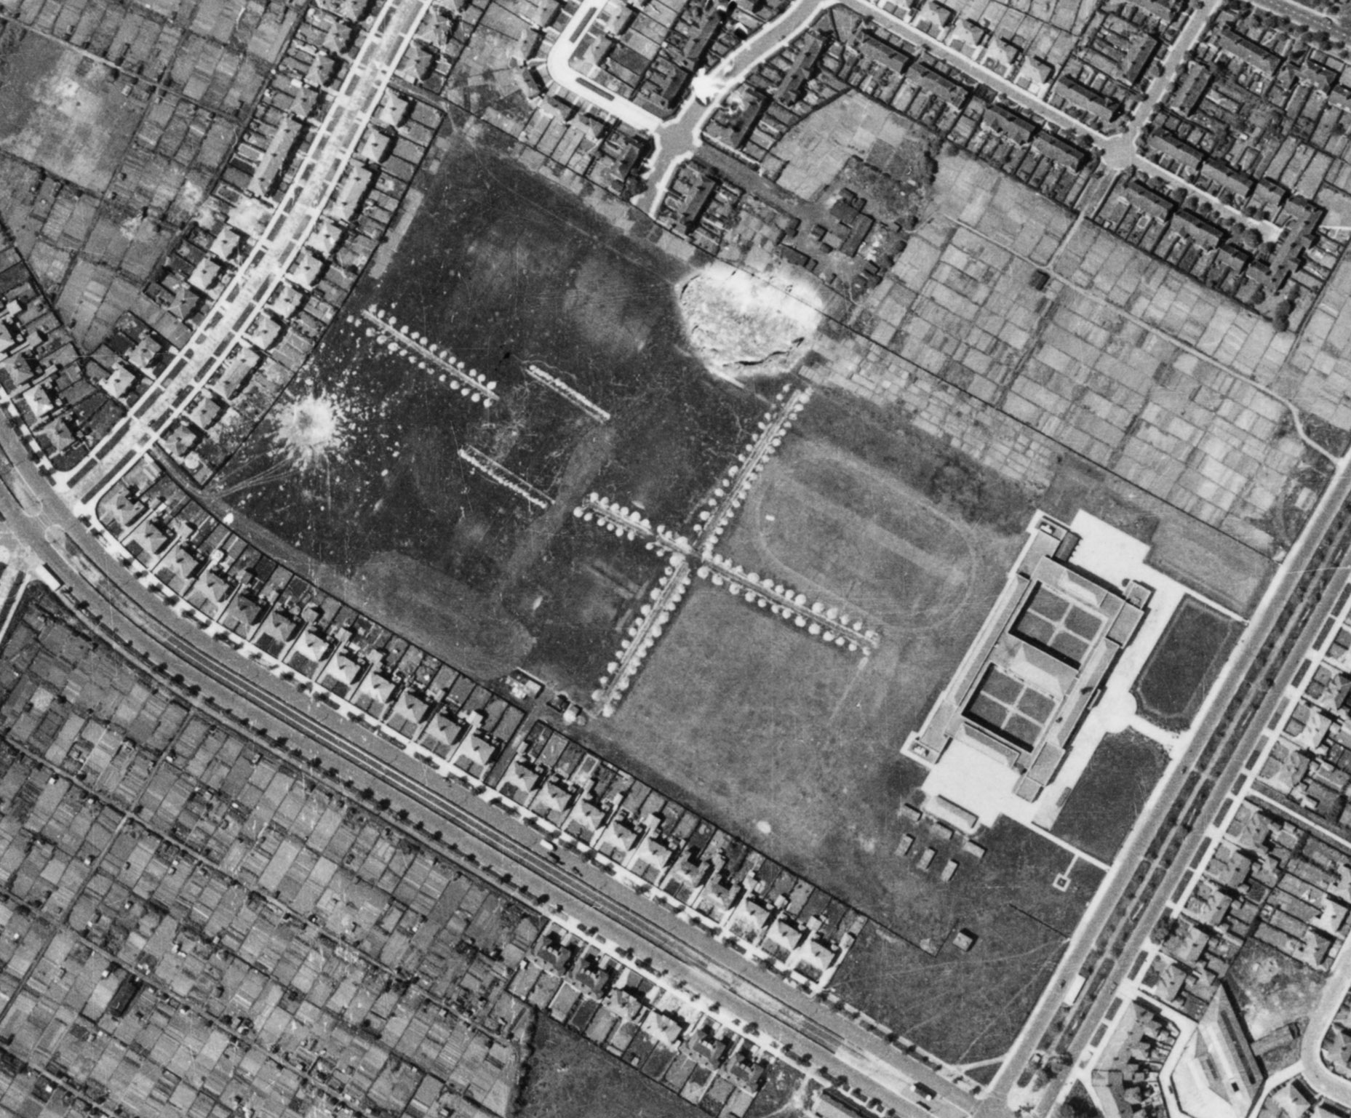
Anti-glider trenches – Childwall, Liverpool
(& a bomb crater too!)
Notes:
Image: raf_13h_uk789_v_0002 – 11th June 1941 - Historic England Archive (RAF photography)

Slide 42
Barracks
Military buildings can be divided into the operational and the ancillary (commonly known in the military as ‘the teeth and the tail’): buildings for fighting, and buildings for living and working.
Vast amounts of short-life hutted accommodation was built in the Second World War, most of which no longer survives but which can be identified through documentation and archaeology.
However, some army camps have continued in use, with early examples of prefabricated hutting being repeatedly modernised and upgraded to suit modern needs.
Notes:
Find out more about military buildings at: https://historicengland.org.uk/images-books/publications/dlsg-military/heag123-military-structures-lsg/

Slide 43
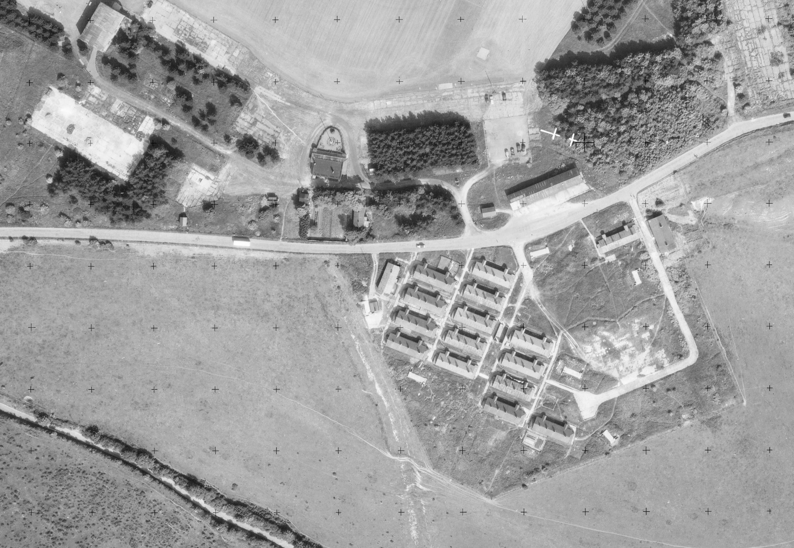
Army Barracks – Dover, Kent
Notes:
Image: os_53t77_v_032 – 10th June 1953 - Historic England Archive (Ordnance Survey photography)

Slide 44
Barrage Balloons
The use of hydrogen-filled barrage balloons as anti-aircraft devices had been developed towards the end of World War I, in order to provide some protection for London from low-level air attack.
The balloons were held to the ground using heavy steel cables. It is the cables that were the main defence as any aircraft flying into the cable would be badly damaged, preventing them from carrying out their mission. This also that meant that by using the balloons all approaching aircraft would have to fly higher than the balloons to avoid the cables, thus making it harder for them to accurately drop their bombs/carry out their intended mission.
By the end of 1938, it was evident that barrage balloons would form an important part of any future defence of Britain, and thus a separate Balloon Command was formed on 1 November 1938. Training was carried out at Balloon Training Units (BTU); by the time of their closure in November 1943, the BTUs had trained around 5,000 RAF balloon operators, the same number of WAAFs, and around 12,000 operators and drivers. 18 balloon depots were established around the country, between 1938 and 1940.
From 1939 to 1945 barrage balloons formed an important part of the country's anti-aircraft defences, guarding strategic military and manufacturing sites, as well as towns and cities.

Slide 45
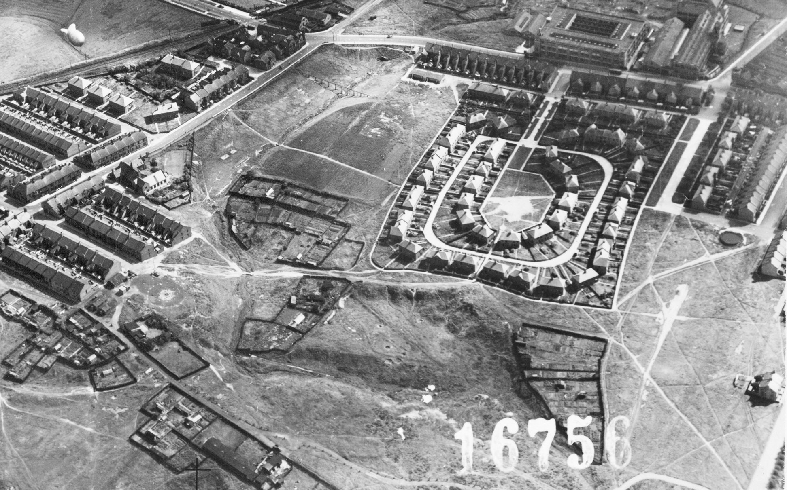
Barrage Balloon – Wardley, Gateshead
(Barrage balloon and tether site, plus Emergency Water Supply)
Notes:
Image: mso_1cu_16000_o_16756 – 23rd August 1943 - Historic England Archive (RAF photography)

Slide 46
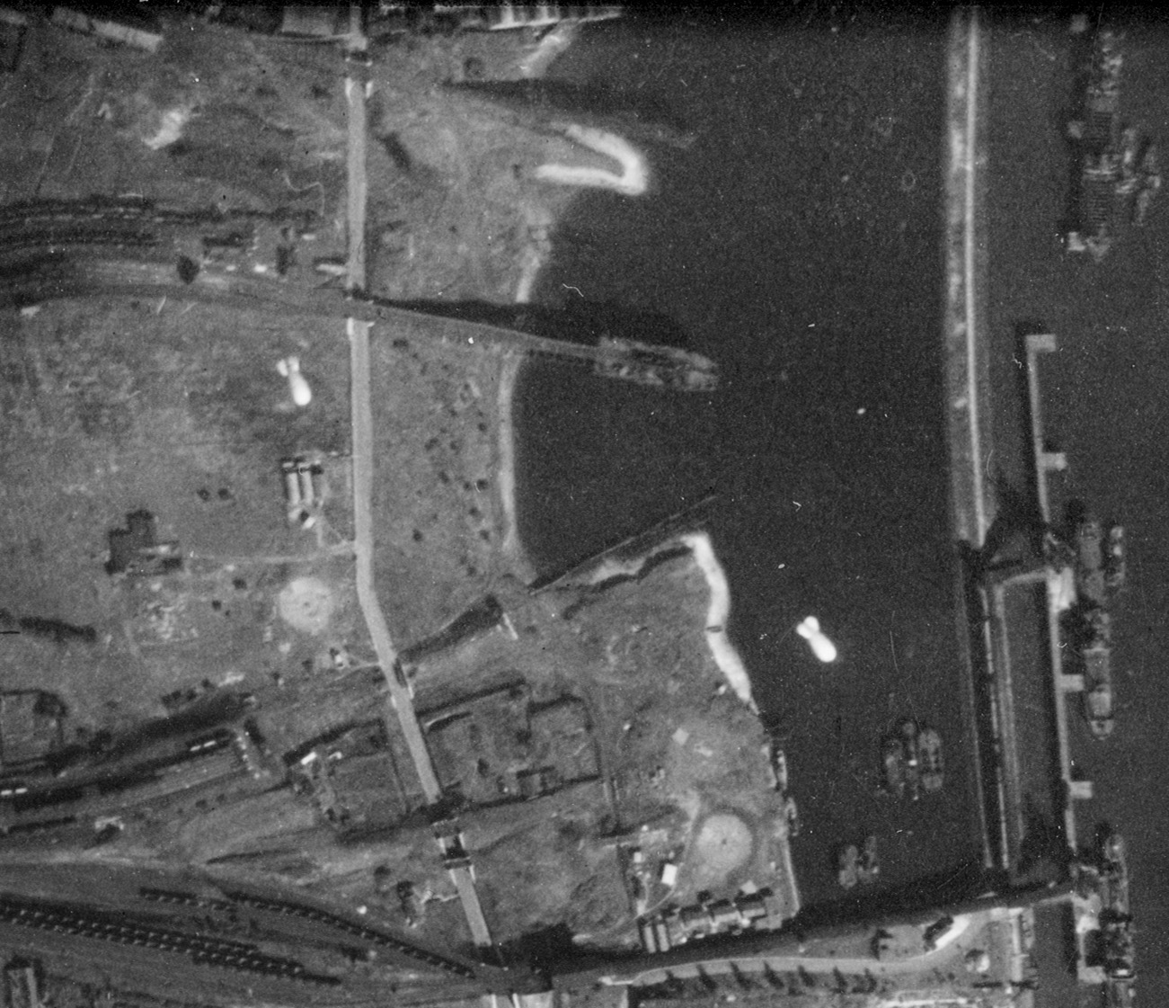
Barrage Balloon – Willington Quay, North Tyneside
(Barrage balloons and tether sites)
Notes:
Image: raf_fno_129_fp_1067 – 1st September 1942 - Historic England Archive (RAF photography)

Slide 47
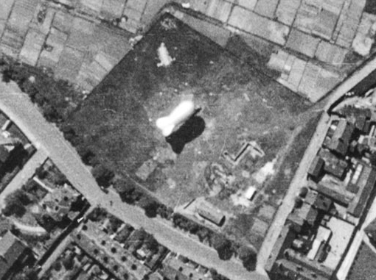
Barrage Balloon on it’s tether site – Wavertree, Liverpool
Notes:
Image: raf_13h_uk789_v_031 – 11th June 1941 - Historic England Archive (RAF photography)

Slide 48
Bomb Damage
The heavy and frequent bombing raids carried out over Britain in 1940 and 1941, known as the Blitz, began with raids on London on 7 September 1940. In September 1940 alone, 5,300 tonnes of high explosives were dropped on London in just 24 nights. The Germans were intent on destroying morale before their planned invasion of Britain. Industrial sites and civilian centres from Plymouth to Liverpool and Portsmouth to Hull were also targeted by the Luftwaffe, the German air force, during the war.
An RAF directive in February 1942 had authorised, for the first time, the targeting of civilian areas in Germany. Air Marshall Sir Arthur (‘Bomber’) Harris, Commander-in-Chief RAF Bomber Command, wrote in his memoirs that the main reason he chose the port city of Lübeck as the first target was: ‘…to learn to what extent a first wave of aircraft could guide a second wave to the aiming point by starting a conflagration.’ The city lacked defences, and in the firestorm 300 residents were killed and almost 1,000 injured, whilst the historic centre was severely damaged.
Between late April and late June 1942, the Luftwaffe deliberately targeted Britain’s historic towns and cities, causing widespread destruction, hundreds of deaths and thousands of injuries. These raids were a direct retaliation for the RAF bombing of the historic German city of Lübeck two months earlier on 28/29 March. The main targets were Exeter, Bath, Norwich, York and Canterbury. These cites were chosen because Baron Gustav Braun von Sturm, a Nazi propagandist, reputedly suggested bombing significant historic sites listed in the Baedeker Guide: a 19th Century set of travel guides published by the Karl Baedeker firm. This spate of bombing became known as the ‘Baedeker Raids’.
Notes:
Find out more at https://historicengland.org.uk/whats-new/features/second-world-war-and-blitz/ and https://heritagecalling.com/2019/07/04/englands-historic-cities-under-attack-the-baedker-raids-1942/

Slide 49
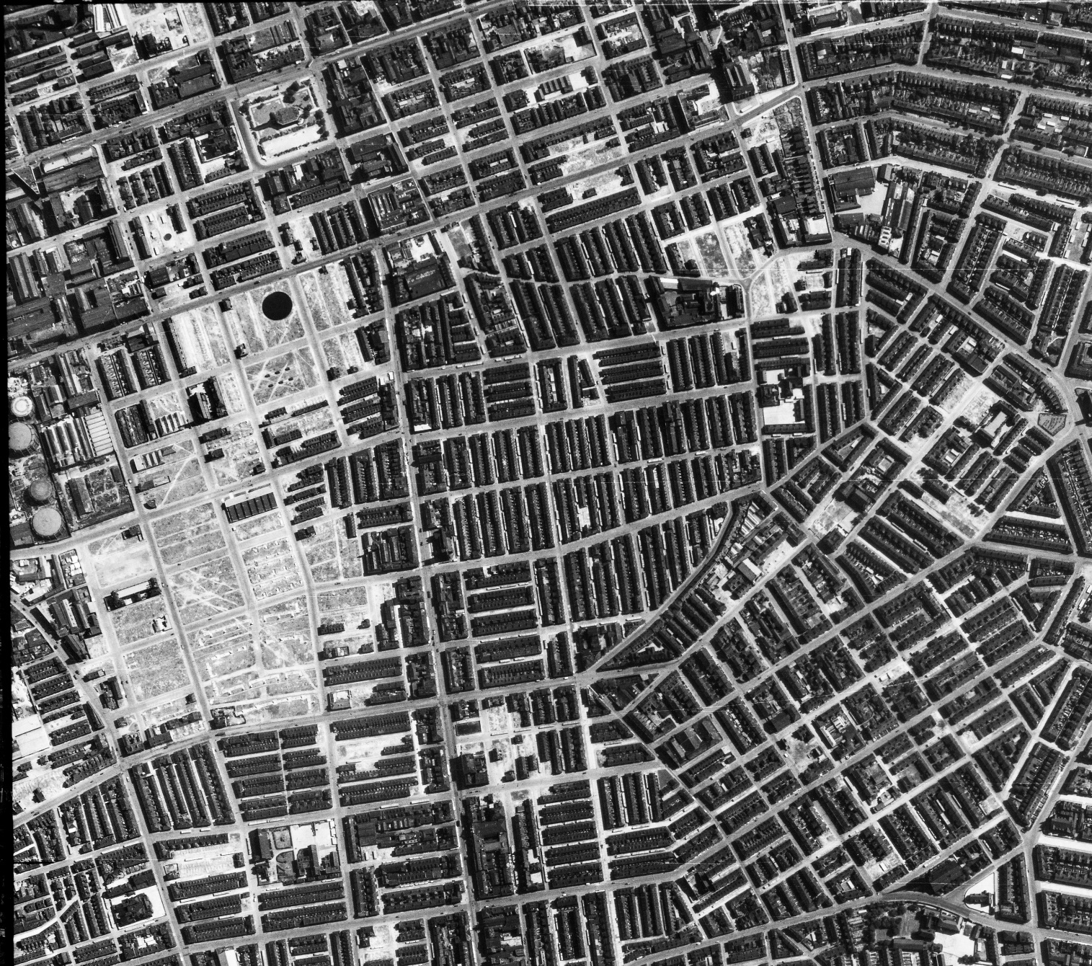
Bomb damage – Rolls Crescent, Manchester
(All the areas that look ‘white’ are areas of demolition caused by bomb damage)
Notes:
Image: raf_106g_uk_622_rs_4375 – 10th August 1945 - Historic England Archive (RAF photography)

Slide 50
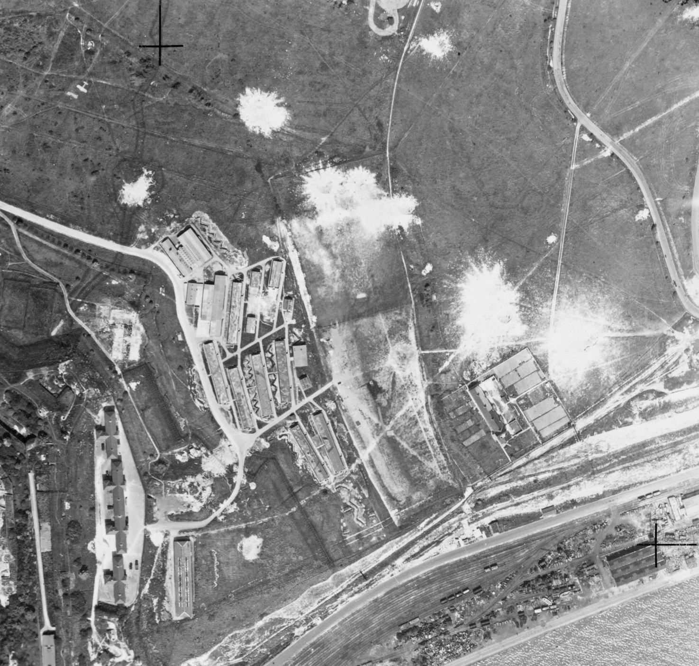
Bomb damage craters – Dover, Kent
Notes:
Image: raf_hla_565_v_6099 – 2nd June 1942 - Historic England Archive (RAF photography)

Slide 51
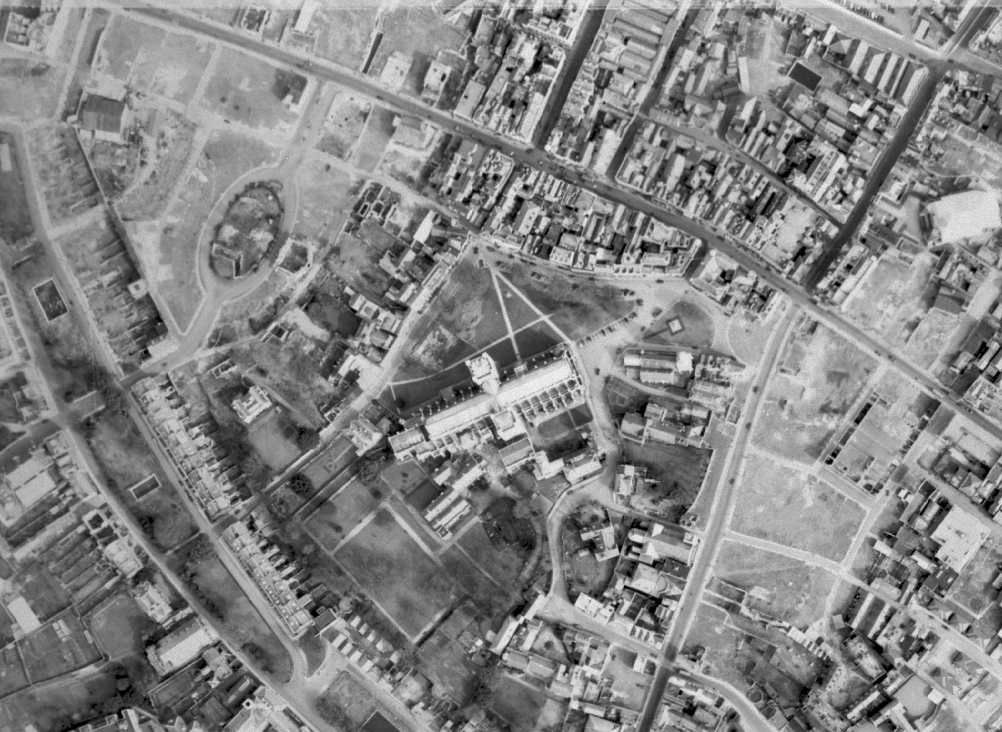
Areas of bomb damage around Exeter Cathedral, Devon
Notes:
Image: raf_106g_uk_1273_v_5037 – 23rd March 1946 - Historic England Archive (RAF photography)

Slide 52
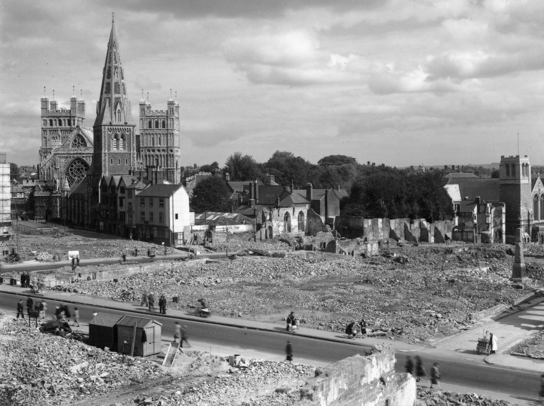
Areas of bomb damage around Exeter Cathedral, Devon
Notes:
Image: op07079 – 1942 - © Reproduced by permission of Historic England Archive

Slide 53
Camouflage Buildings
The British Army School of Camouflage was founded in 1916 and based in London’s Kensington Gardens. The school explored methods of deceiving the enemy on the Western Front.
However, it was the threat of targeted bombing attacks on Britain by the Luftwaffe (the German air force) in the Second World War (1939-1945) that led the British military to use the concealment and deceit of camouflage in more sophisticated and strategic ways.
In some cases, the aim was to deceive an enemy aircraft as it approached from several miles away: from such a distance, camouflage – which appears very basic when viewed from directly above – stopped a potential bombing target standing out.
Camouflage training manuals were widely issued and all military personnel received basic training. Virtually everything of military significance in Britain was camouflaged, including vehicles and even entire airfields.
Enormous amounts of camouflage netting were used in Britain during the Second World War. It was made by cutting up short lengths of green and khaki sacking strips and attaching them to mesh. The netting created patterned shadows, blending into the surrounding environment and made whatever was hidden underneath difficult to spot from the air.
Notes:
Find out more at https://heritagecalling.com/2019/10/07/the-story-of-camouflage-during-the-second-world-war/

Slide 54
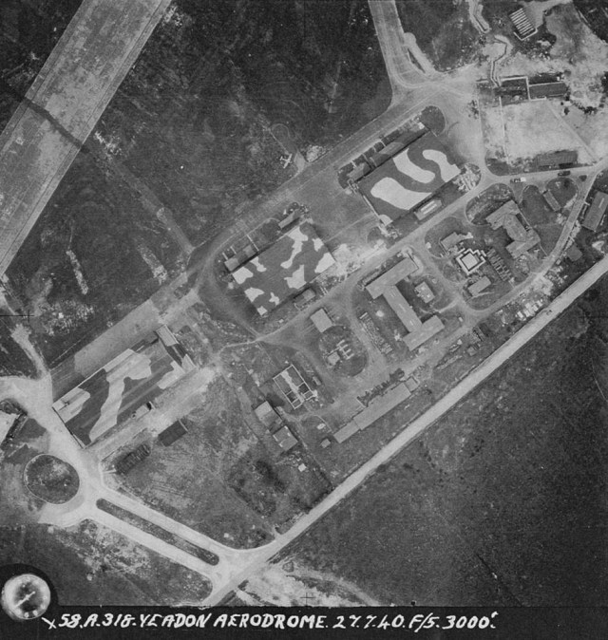
Camouflaged aircraft hangars and ‘fake painted hedge’ to hide the runway RAF Yeadon (now Leeds Bradford Airport), Yorkshire
Notes:
Image: raf_58a_45_v_0318 – 27th July 1940 - Historic England Archive (RAF photography)

Slide 55
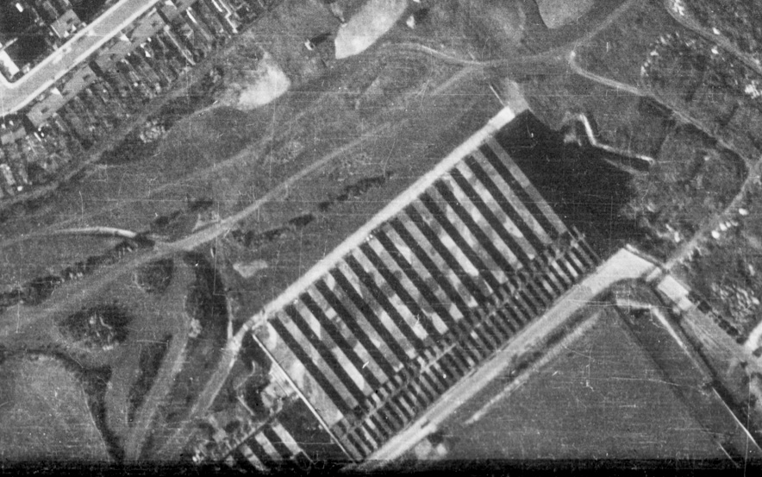
Camouflaged factory – Luton, Bedfordshire
Notes:
Image: raf_cpe_uk_1779_rs_4386 – 10th October 1946 - Historic England Archive (RAF photography)

Slide 56
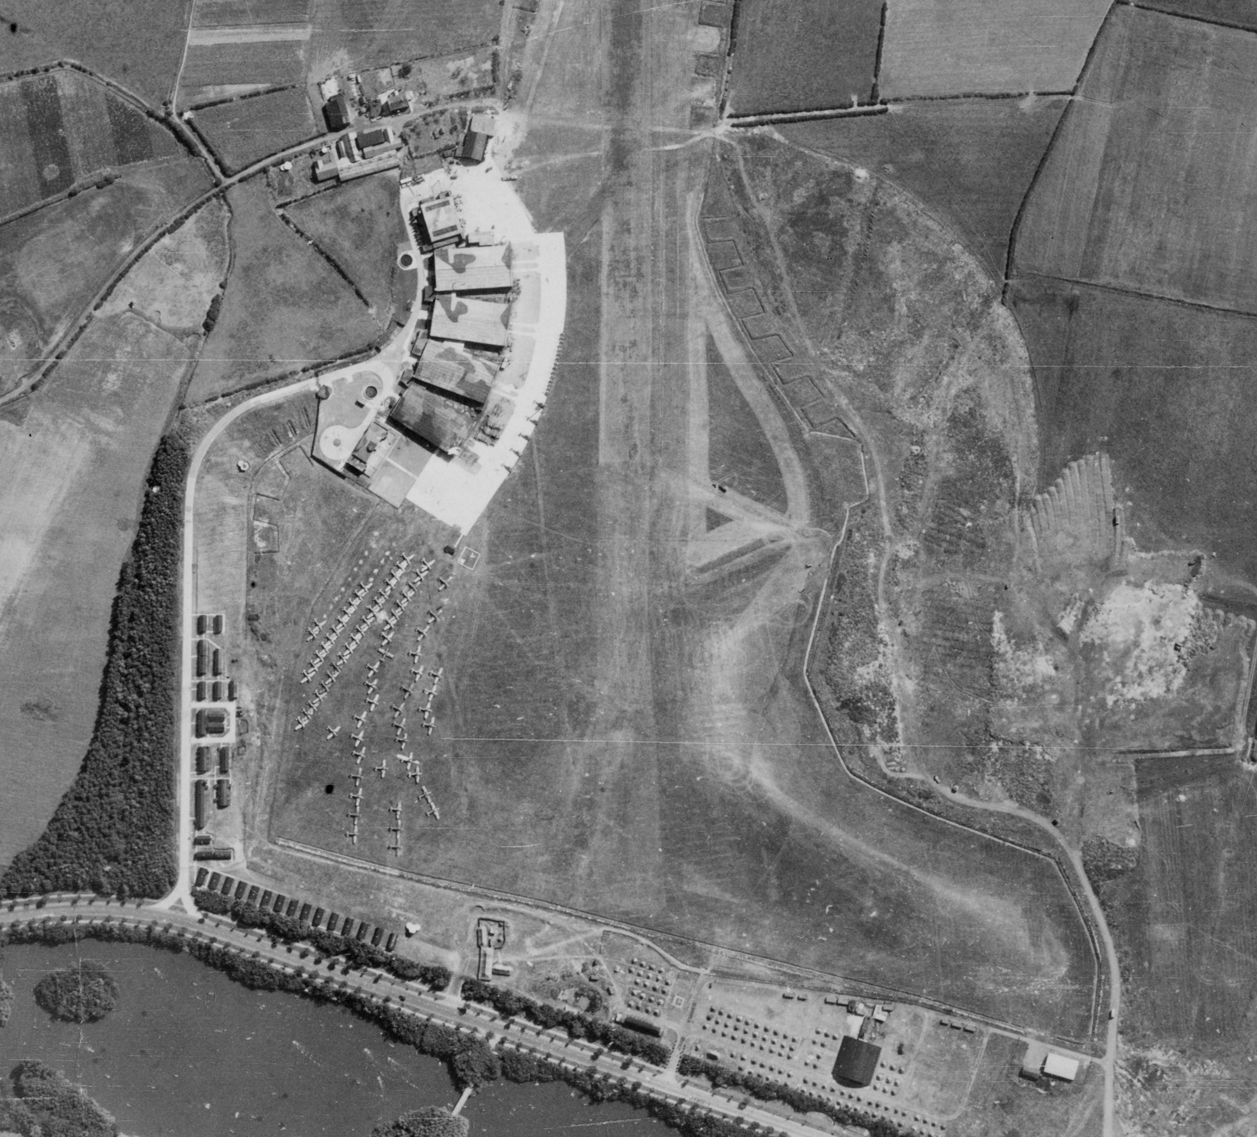
Camouflaged aircraft hangars – Stanley Park, Blackpool
Notes:
Image: raf_106g_uk_625_rp_3022 – 10th August 1945 - Historic England Archive (RAF photography)

Slide 57
Emergency Water Supplies
The provision of emergency water supplies (EWS) to facilitate the rapid extinguishing of fires was an essential component of Civil Defence. A wide variety of designs and materials were used in their construction including rubber, corrugated steel, and pre-fabricated steel panel tanks (Braithwaite tanks). Most would leave little or no trace, being equally easy to assemble or dismantle. Most surviving tanks are at factories and remain in use. The basements of demolished bombed buildings were also pressed into use as static water tanks.

Slide 58
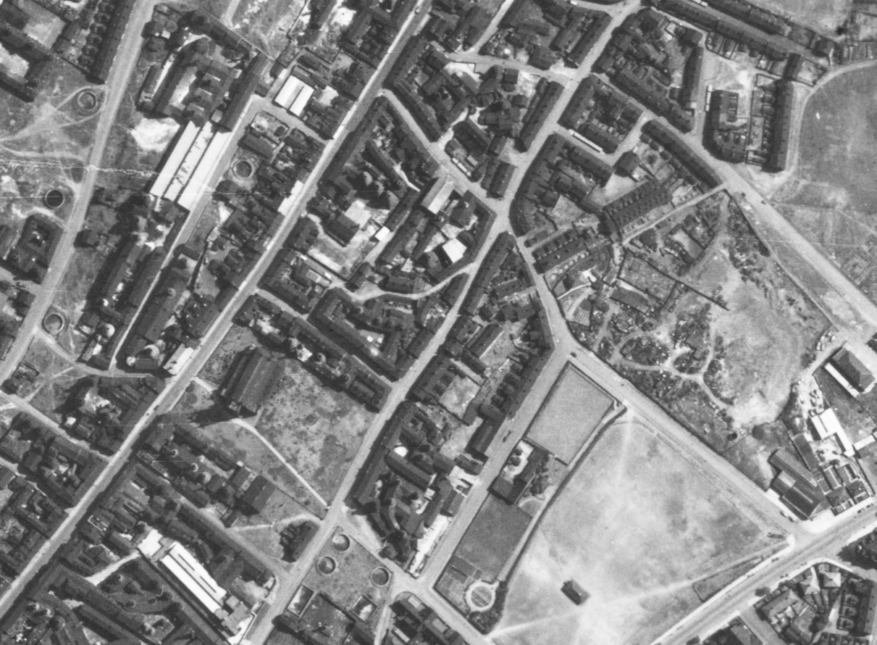
EWS tanks – Longton, Stoke-on-Trent
Notes:
Image: raf_106g_uk_646_rs_4163 – 11th August 1945 - Historic England Archive (RAF photography)

Slide 59
Hospitals
The Emergency Hospital Service (EMS) was established at the outbreak of World War II. The service had to deal with the ‘normal’ population of sick people while freeing- up capacity to deal with injuries attributed to air raids or other attacks.
One of the mains aims of the EMS was to create the anticipated 300,000 extra beds in hospitals for civilian casualties and all sick service personnel. They came up with three main ways of doing this:
  Sending patients home. On the declaration of a state of emergency, all hospitals, even some mental ones, were to discharge those patients no longer in urgent need of hospital treatment as well as moving patients from larger general hospitals in danger areas to more distant hospitals. These moves would free about 100,000 beds within 24 hours.
  Additional beds. An extra 100,000 beds were created by ‘crowding’: putting up extra beds into existing wards. Some private homes were equipped and converted for EMS use.
  Building hutted accommodation. This would be on existing hospital sites and would provide an extra 40,000 beds. The wards would be 144 feet long and 24 feet wide with kitchen, sluice room, two bathrooms, four WCs, sister’s duty room, linen room and the main ward. This would be 108 feet long and would provide 36 beds. This ‘temporary’ accommodation remained in use for many years after the war and is clearly visible on many aerial photographs.
Notes:
Information from and find out more at: https://www.bgs.org.uk/resources/as-we-once-were-the-wartime-emergency-medical-service-and-the-future-nhs-2

Slide 60
Hospitals
These measures would, it was calculated, provide an extra 290,000 beds. To support the system, casualty bureaux were set up to collect information about admissions, deaths, discharges etc. By March 1941 over 80% of hospitals were included in the EMS scheme.
The service paved the way for separate and competing institutions to come together as part of the National Health Service.
Additional hospital camps were also created by the US military to treat their own personal. American units used some standing hospitals in host or occupied countries, but many were a collection of tents or Nissen huts, 20ft by 40ft corrugated tin semi-cylinders. In England, Nissen-hut hospital complexes were often placed on estate grounds, and had concrete floors, flush toilets, clean water, and were heated by coal-burning stoves.
Notes:
Information from and find out more at: https://www.bgs.org.uk/resources/as-we-once-were-the-wartime-emergency-medical-service-and-the-future-nhs-2

Slide 61
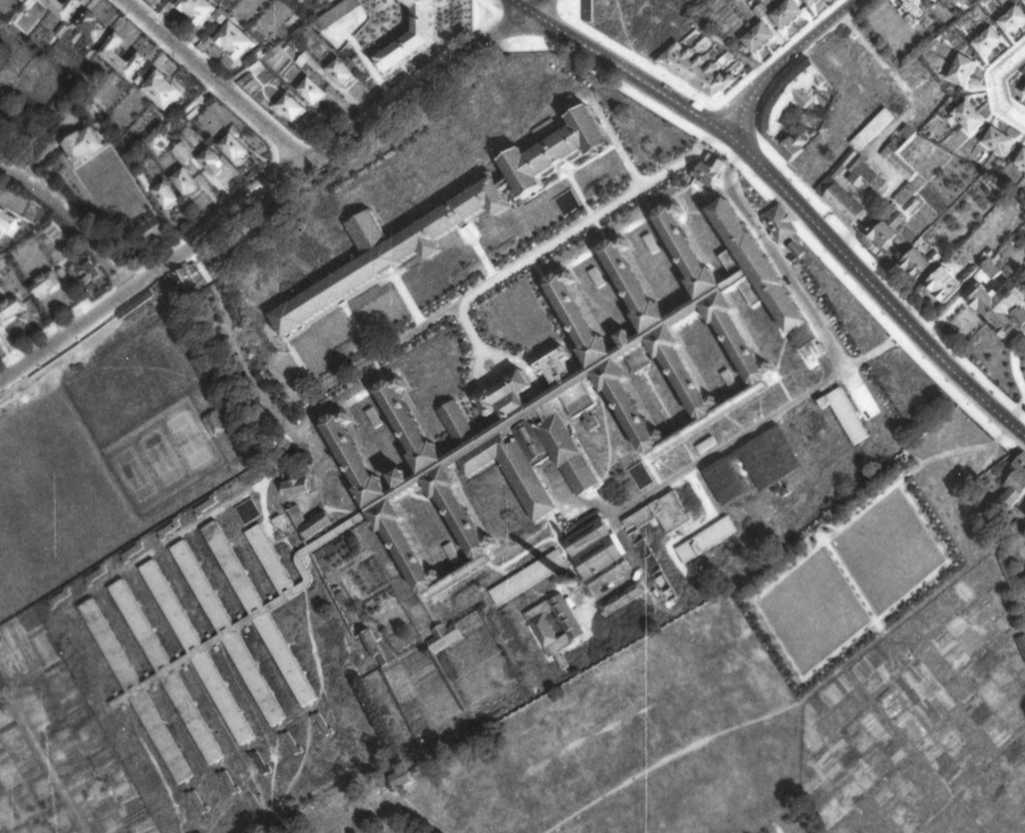
Additional Hospital Buildings – Alder Hey, Liverpool
Notes:
Image: raf_106g_uk_626_rs_4195 – 10th August 1945 - Historic England Archive (RAF photography)

Slide 62
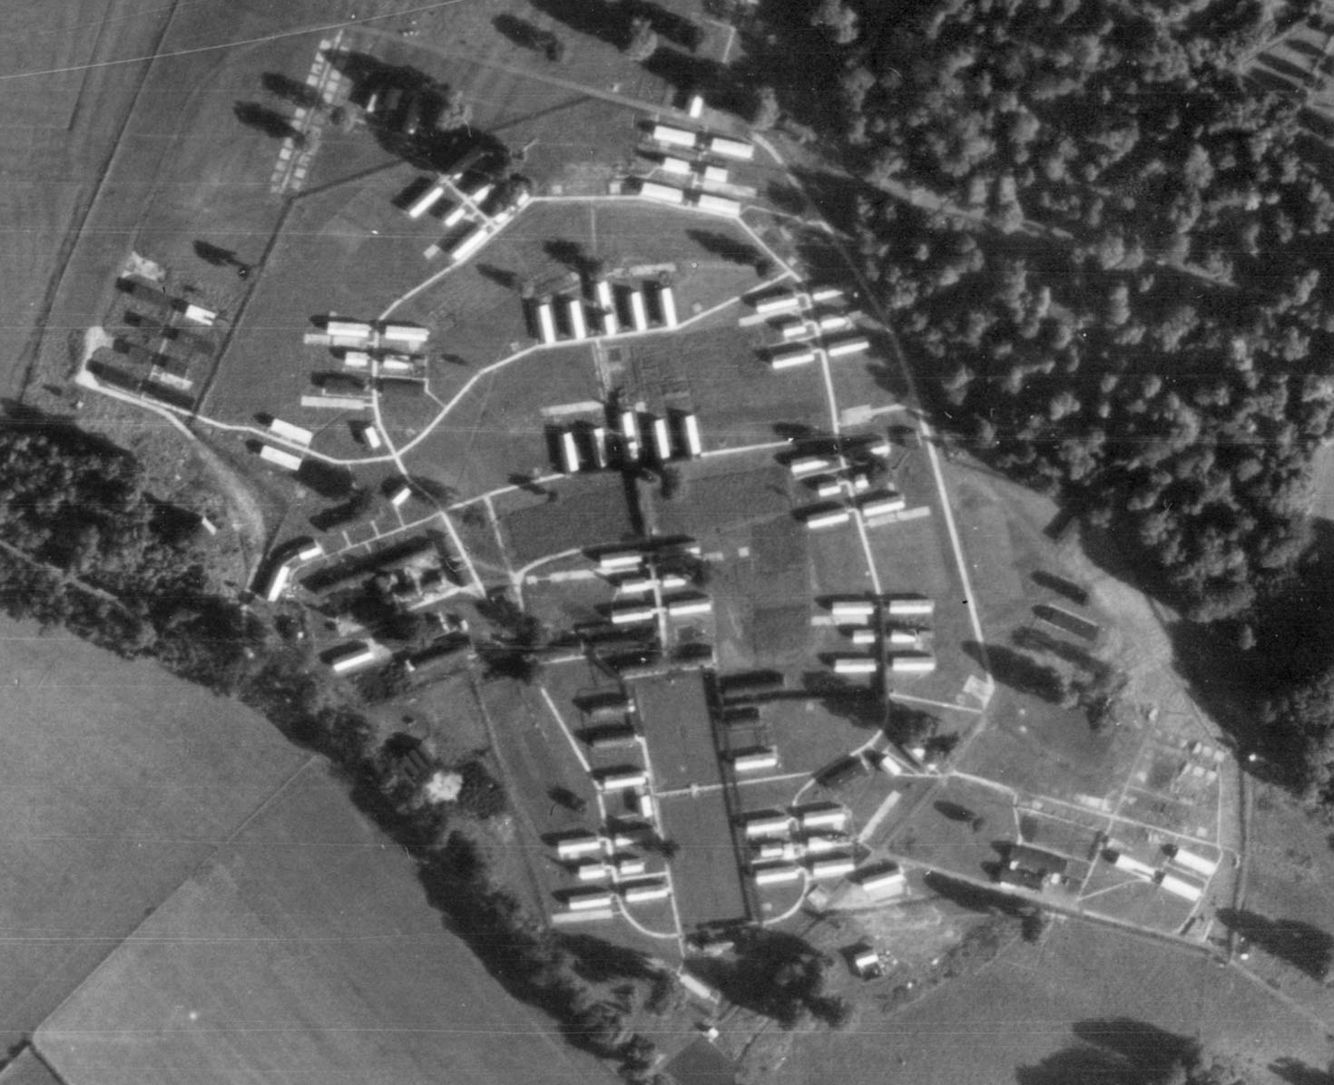
Military Hospital (later PoW camp) – Lydiard Park, Swindon
Notes:
Image: raf_106g_uk_1721_rp_3128 – 6th September 1946 - Historic England Archive (RAF photography)

Slide 63
Munitions Sites
From 1941 onwards a million-plus British women worked in munitions factories until victory in 1945. They worked round the clock, seven days a week in perilous conditions on the production line.
They helped to make the bullets, the bombs, the tanks, the spare parts and the weaponry that the country needed so badly. Without their effort, the outcome of the war could have been very different indeed.
Unlike others in the Forces or the Home Front they were not distinguished by a uniform, so secret was the nature of wartime munitions work. They were not allowed to tell anyone where they worked. Yet the danger they faced each day in the factories and even on their way to work during night time bombing raids in the blackout was huge.
At a munitions site safety rules and regulations dominated everything. Every person working on the factory floor risked their health and their life working with highly toxic chemicals. One tiny mistake could blow everyone up and wreck Britain's war effort. Each day carried the risk of sudden, accidental explosions, causing disfigurement, blindness, loss of limbs or worse.
As well as factories where the munitions were made, there were also depot sites all across the country where the munitions were then stored. This was so they were ready to be used by or transported to the troops who needed them.
Notes:
Information taken from and find out more about women workers in WW2 munitions factories at: https://www.express.co.uk/news/uk/421425/Meet-the-bomb-girls-A-new-book-tells-how-a-secret-army-helped-win-the-Second-World-War

Slide 64
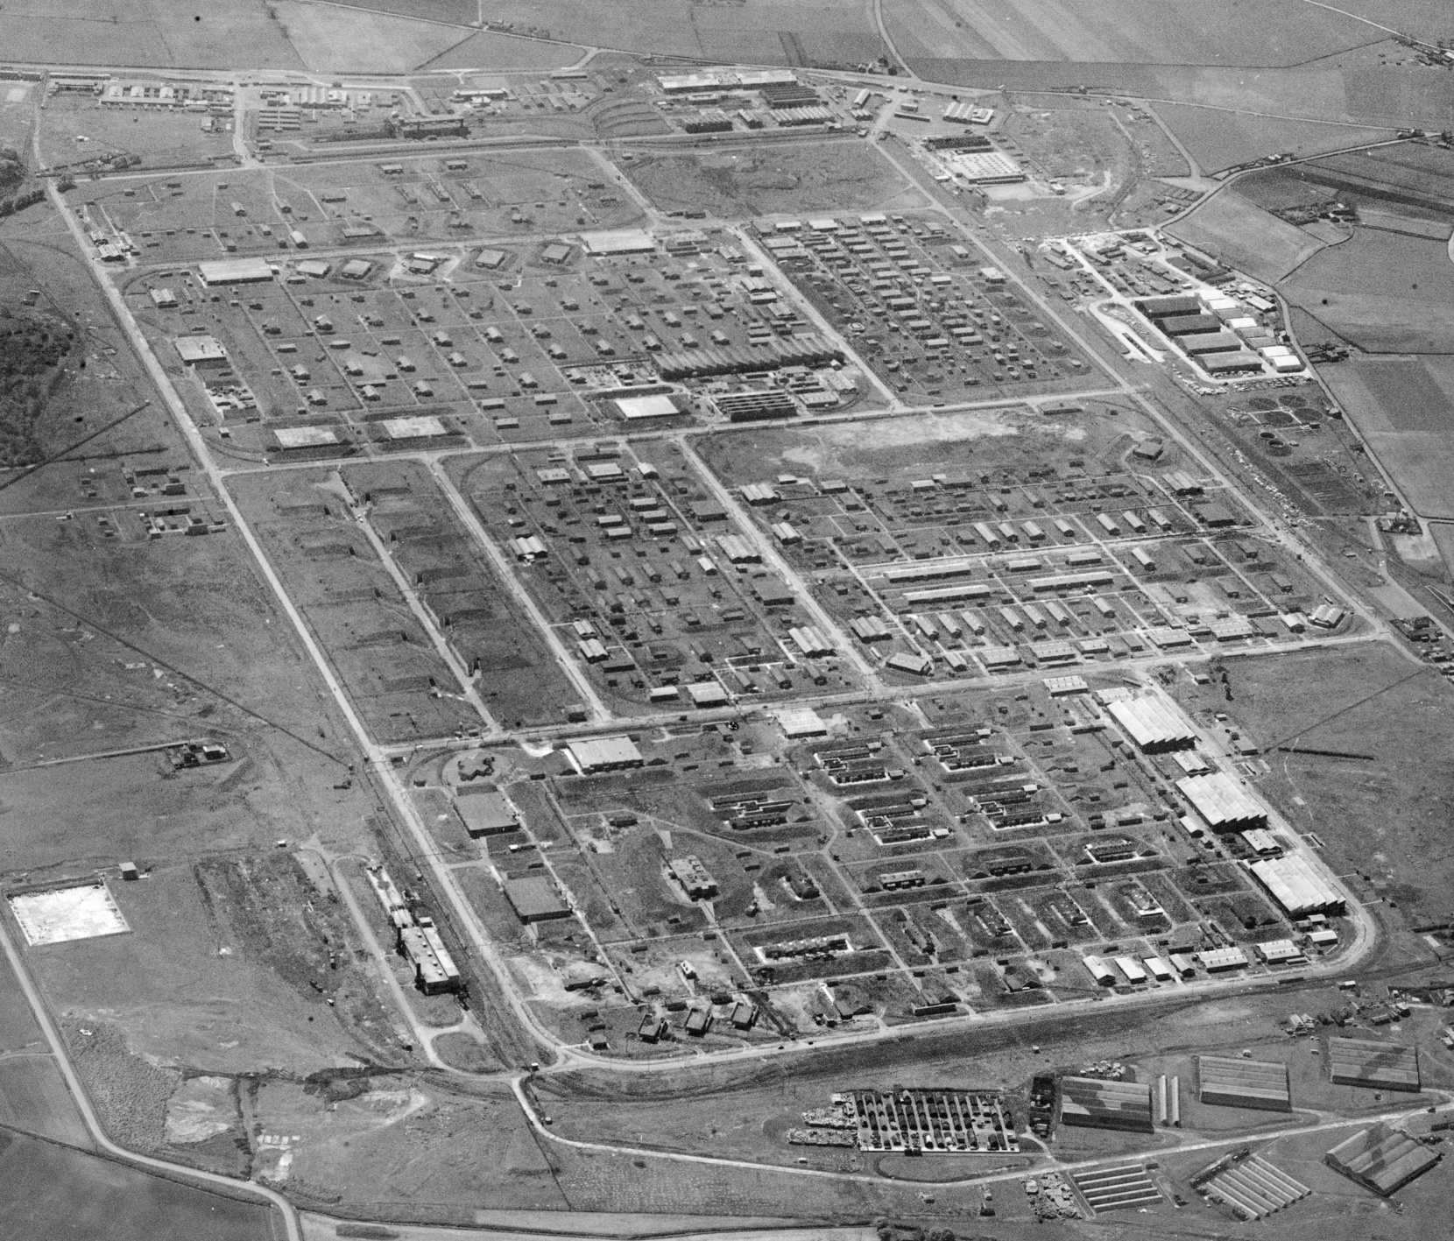
Royal Ordnance Factory (Filling Factory No.7) – Kirkby
Notes:
Image: EAW005653 – 15th May 1947 - © Historic England Archive (Aerofilms Collection)

Slide 65
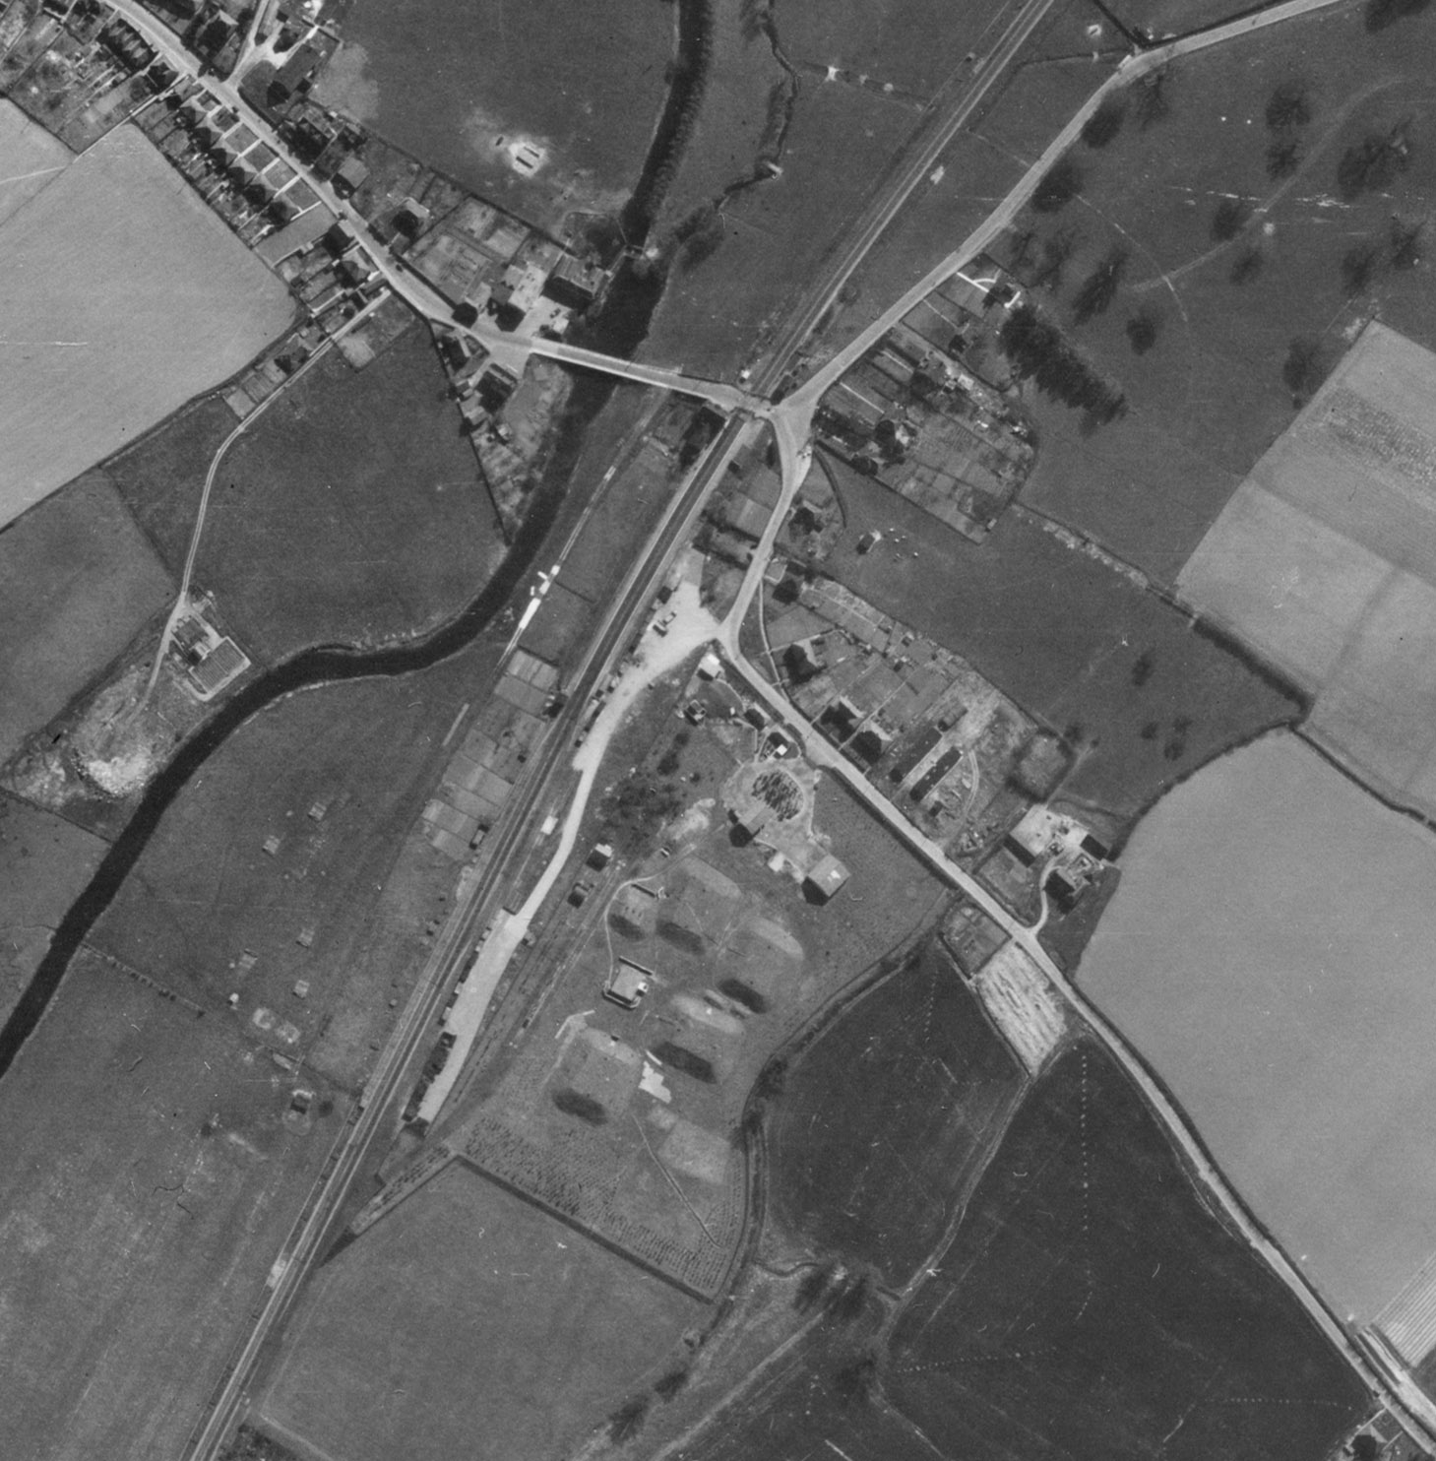
Munitions Depot – Wye, Kent
Notes:
Image: raf_106g_uk_1397_v_5117 – 11th April 1946 - Historic England Archive (RAF photography)

Slide 66
Prisoner of War (PoW) Camps
Contrary to popular belief, most Second World War PoW camps were not purpose-built, and many were in requisitioned country houses, cotton mills, disused airfields, military camps, ordnance depots, anti-aircraft gun sites and military hospitals; some were even in unfinished housing estates.
Purpose-built PoW camps did not become a feature of the British landscape until late 1942, with the arrival of Italian PoWs taken during the North African campaign. They built the majority of the so-called ‘standard’ camps during late 1942 and early 1943, living under canvas until the accommodation huts were built.
Each Prisoner of War camp was allocated an official number during World War II within a prescribed numerical sequence, ranging from Camp 1 (Grizedale Hall, Ambleside) through to Camp 1026 (Raynes Park, Wimbledon).
Such a camp was designed to house 750 prisoners, and consisted of a guards’ compound at the entrance, a 6-acre prisoners’ compound with about 35 huts, a sewage plant, a playing field and vegetable gardens.
Guard towers were not a common feature, only occurring where prisoners were sorted and classified, or where they were considered ardent Nazis.
After 1944 and particularly following the surrender of Germany, many camps were hard pressed to hold the number of prisoners taken; additional accommodation was provided in bell tents erected within the prisoners’ compound.

Slide 67
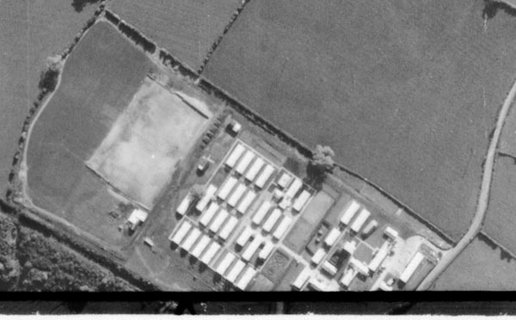
St Martin’s POW Camp – nr Gobowen, Shropshire
Notes:
Image: raf_106g_uk_1517_rs_4392 – 17th May 1946 - Historic England Archive (RAF photography)
‘Standard’ type, German Working Camp

Slide 68
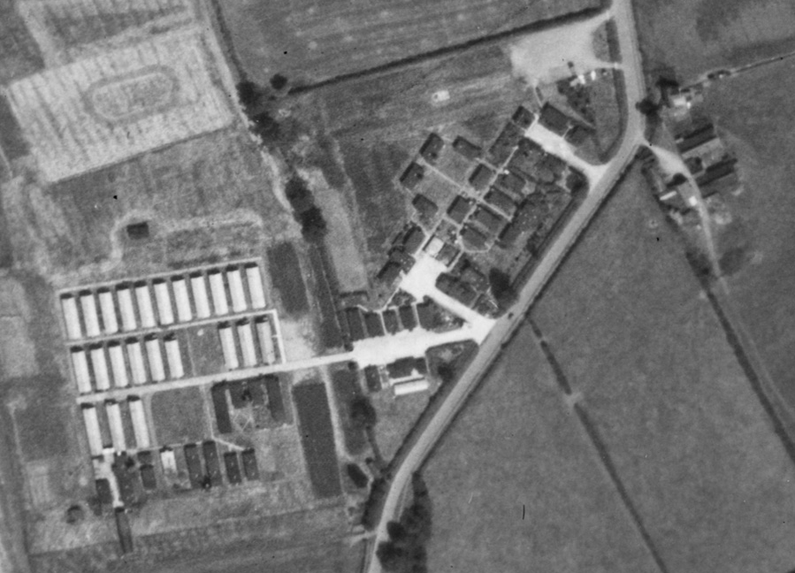
Harrington POW Camp – Harrington, Market Harborough
Notes:
Image: raf_541_602_rs_4220 Historic England Archive (RAF photography)
‘Standard’ type, German Working Camp

Slide 69
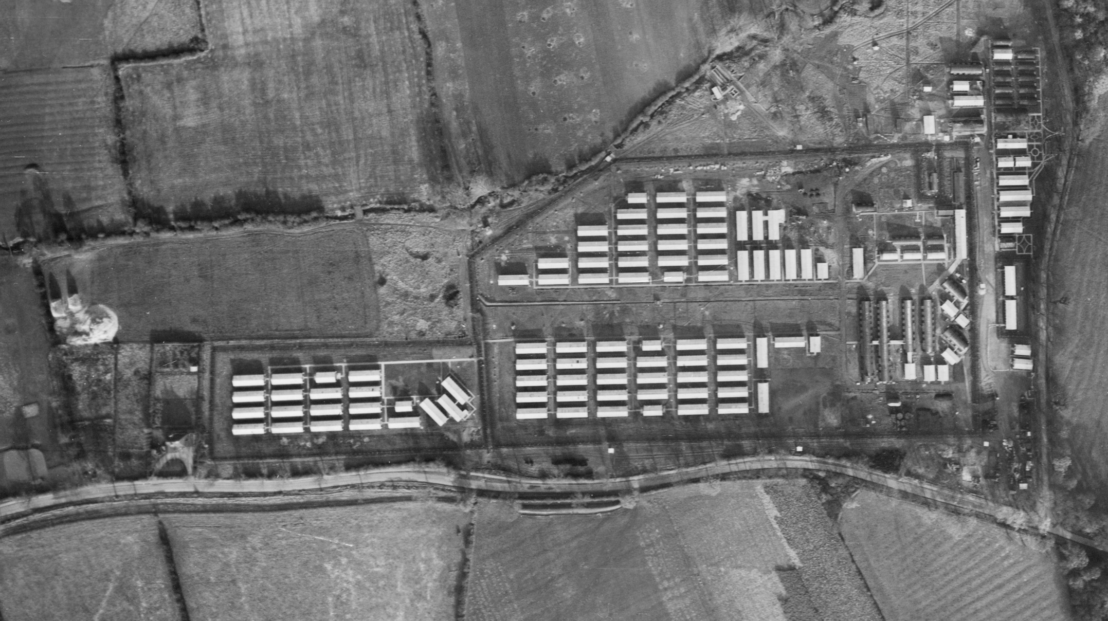
Shady Lane POW Camp – Evington, Leicester
Notes:
Image: raf_106g_uk_1011_fv_7123 Historic England Archive (RAF photography)
Base Camp

Slide 70

Overdale POW Camp – Skipton
Notes:
Image: raf_540_1322_f22_0094 – 3rd June 1954 - Historic England Archive (RAF photography)
‘Standard’ type, German Working Camp

Slide 71

Stamford POW Camp – Stamford
Notes:
Image: raf_540_62_sffo_0074 – 22nd July 1948 - Historic England Archive (RAF photography)
‘Standard’ type, German Working Camp

Slide 72
Pre-Fabricated Houses
Pre-Fabricated Houses, known as “prefabs” were temporary homes that were pre-built (fabricated) in a factory, hence their name. This was so that they could be quickly and easily assembled on site, ready for people to start living in them.
They were built to rehouse those who had lost their homes during the Blitz or servicemen coming back from the war and their young families. More than 156,000 were built all over the country in 1946 and 1947.
Prefabs were planned as early as 1942, three years before the end of the Second World War. In 1942, Churchill’s government had created the Burt Committee named after Sir George Burt. Its aim was to come up with a quick, efficient and modern answer to the looming housing crisis. They came up with a sort-of ideal floor plan of a one-storey bungalow with two bedrooms, inside toilets, a fitted kitchen, a bathroom and a living room. The prefabs would be detached houses, surrounded by a garden to encourage dwellers to grow fruit and vegetables and would have a coal shed.
The public was impressed. A lot of people who lived in big cities like London, which had been heavily bombed, were used to living in shared flats or houses with toilets outside and no hot water. Suddenly they discovered little houses with all the mod cons, which also enjoyed a lot of light and offered the possibility to have a garden all around. Young families mainly coming from working-class backgrounds would have the opportunity to live in a detached house, with a fitted kitchen with a fridge!
Notes:
Find out more at: https://heritagecalling.com/2018/07/24/5-things-you-didnt-know-about-prefabs/

Slide 73

Pre-fabs – Lichfield Road, Cambridge
Notes:
Image: EAW002930 – 1st October 1946 - © Historic England Archive (Aerofilms Collection)

Slide 74

Pre-fab estates – Netherley, Liverpool
Notes:
Image: raf_cpe_uk_1996_fp_1044 – 13th April 1947 - Historic England Archive (RAF photography)

Slide 75
Seafront Defences
Anti-tank obstacles, known colloquially as dragon’s teeth, were built along beaches that were potentially a landing place for German forces in the event of the invasion of Britain.

Slide 76

‘Dragon’s Teeth’ – Isle of Grain, Kent
Notes:
Image: DP076219 – 30th July 2009 - Historic England Archive

Slide 77

Anti-invasion obstacles – Scarborough, North Yorkshire
Notes:
Image: raf_4h_br42_b_v_0092 – 1st August 1940 - Historic England Archive (RAF photography)

Slide 78
Search Light Battery
During the Second World War searchlights were manned by the Royal Artillery and were under the control of the Army's Anti-Aircraft Command. They formed part of a system for detecting enemy aircraft linking locator devices (initially using sound or heat, but eventually using radar), searchlights and anti-aircraft guns (see earlier slide). The locators sent information to the searchlights and guns, which together then tracked and 'locked on' to the approaching aircraft. The idea being the lights would spot the aircraft and the guns would destroy it.
The need for more accurate spotting of enemy aircraft was essential in trying to reduce the amount of ammunition used to destroy the aircraft. In 1940 it took an average of 20,000 rounds of ammunition to down a single enemy aircraft! This needed to be reduced and the use of radar and searchlights was seen as vital to doing this.
Searchlight sites typically comprised a small ring-ditch to provide the crew with shelter during an air raid, a predictor emplacement for calculating the height and range of targets, a light anti-aircraft machine gun pit, a generator and hutted accommodation for the crew.
Notes:
Find out more at: http://www.skylighters.org/howalightworks/

Slide 79

Search Light Battery – Childwall, Liverpool
Notes:
Image: raf_13h_uk789_v_0001 – 11th June 1941 - Historic England Archive (RAF photography)

Slide 80

Search Light Battery – Bedford
Notes:
Image: raf_ac207_v_5050 – 24th February 1943 - Historic England Archive (RAF photography)

Slide 81

Using the Aerial Photo Explorer
Having looked at the ‘Vertical’ RAF photos, go back to the ‘Layer’ tab turn on the ‘Obliques’ layer.
Then look for any green squares or purple stars that will show you historic oblique photos too – repeat the process of looking for evidence of the Second World War
Notes:
You can also click on the image to keep zooming-in to see any features in much greater detail. In this case the rows of newly built ‘prefabs’ – pre-fabricated houses on the right of the photo.

Slide 82
Find more teaching resources at:
HistoricEngland.org.uk/Education

