Slide 1


Breaking New Ground
The John Laing Photographic Collection
What makes a place of worship worth exploring?
Use the John Laing Photographic Collection
& Historic England Archive to explore places of worship
Notes:
A lesson plan & presentation for key stage 2 Religious Education, SMSC and Art & Design classes. It uses photographs from an archive and oral histories produced in KS2 education workshops.

Slide 2

What makes a place of worship worth exploring?
Key Stage 2: History, Design & Technology, Religious Studies & PSHE
Learning Aims and Outcomes
Pupils will:
Use images as a primary source of evidence to explore the historic built environment and the role played by places of worship within it
Understand the role of an architect and the skills they’d need to become one
Develop knowledge and understanding of how the built environment and architecture can be shaped by different religious, ethnic and cultural influences
Use research and an understanding of key features of religious buildings to develop criteria to inform the design of innovative, functional, appealing buildings that are fit for purpose, aimed at particular individuals or groups

Slide 3
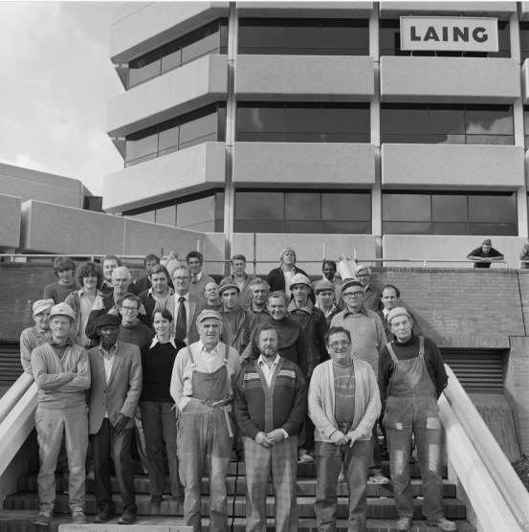
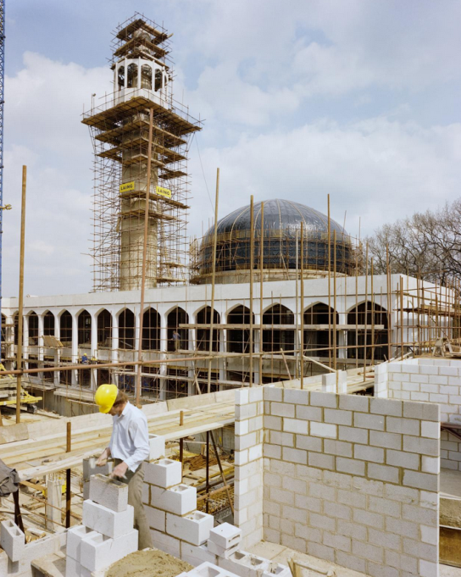
The John Laing Building Company
The construction company John Laing built hundreds of thousands of buildings all across Britain.
They built everything from homes and motorways to shopping centres!
As a company they helped to shape the architecture of Britain.
Notes:
Share or summarise:
The history of the John Laing building company began in 1848 when James Laing (b.1816), his wife Ann and some employees built a single house in Carlisle. They sold it for £150 pounds (around £17,000 today) which allowed them to build two more houses. From these humble beginnings the company grew. Laing were a company who profoundly shaped post-war Britain; they constructed the country’s first motorways, shopping centres and created buildings which housed innovative forms of technology such as Berkeley Nuclear Power Station. They also created Easiform, a non-traditional form of house construction, enabling thousands of new homes to be built quickly after the Second World War.
Learn more here:
https://historicengland.org.uk/images-books/archive/collections/photographs/breaking-new-ground-project/
https://historicengland.org.uk/services-skills/education/teaching-activities/what-makes-a-housing-estate-special/
Images:
Builders of the Berkshire Country HQ - © Historic England Archive. John Laing Photographic Collection – 9 October 1980 Ref: JLP01/09/802896
https://historicengland.org.uk/images-books/photos/item/JLP01/09/802896
M1 Motorway construction - © Historic England Archive. John Laing Photographic Collection – c1958-59 Ref: JLP01/14/00020
https://historicengland.org.uk/images-books/photos/item/JLP01/14/00020
London Central Mosque almost completed - © Historic England Archive. John Laing Photographic Collection – 4 August 1977 Ref: JLP01/10/04820
https://historicengland.org.uk/images-books/photos/item/JLP01/10/04820

Slide 4
What is architecture?
What is an architect?
What do you think an architect actually does?
Notes:
Ask:
This is a good point to ask the pupils what they think architecture might be? What is an architect? What do they think an architect actually does?
Link to the idea that it is an architects job is to try to design buildings, parks, opens spaces etc. to make an area better.
The following 6 slides can then be used to explore with your pupils, in more detail, what architecture is…..

Slide 5
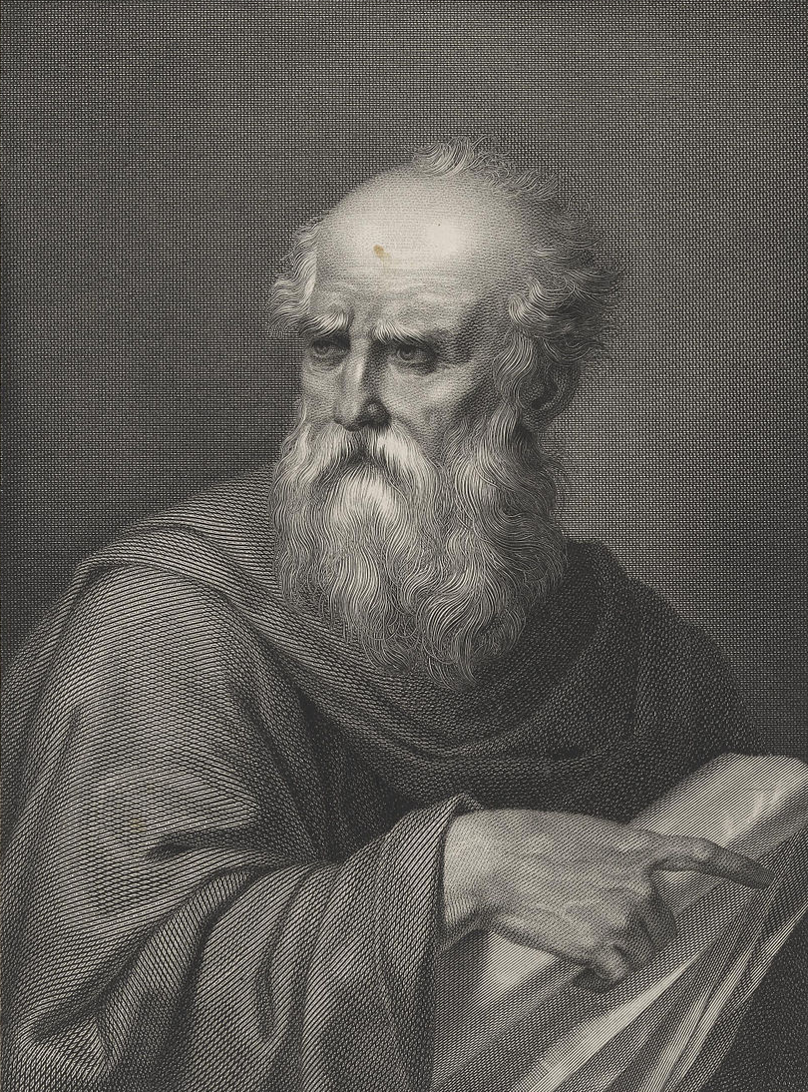
Vitruvius
70 BC
... that’s a really, really long time ago!
Notes:
This is where we introduce an old, but still relevant, set of principals by the Roman architect Vitruvius. Suggest to pupils that they should remember these principals when they think about designing their own architecture project.
Image: https://commons.wikimedia.org/wiki/File:Vitruvio_Pollione_portrait.jpg
Image attribution: Jacopo Bernardi (engraver); Vincenzo Raggio (painter) / Public domain

Slide 6
Firmitas
Utilitas
Venustas
… ummm, does anyone know Latin?
Notes:
Don’t worry - they are in English on the next page!
Image: https://commons.wikimedia.org/wiki/File:Vitruvio_Pollione_portrait.jpg
Image attribution: Jacopo Bernardi (engraver); Vincenzo Raggio (painter) / Public domain

Slide 7
Durable
Useful
Beautiful
Notes:
Phew! So the principals we want to discuss are that architecture should be Durable, Useful and Beautiful. There are examples on the next three pages.
Image: https://commons.wikimedia.org/wiki/File:Vitruvio_Pollione_portrait.jpg
Image attribution: Jacopo Bernardi (engraver); Vincenzo Raggio (painter) / Public domain

Slide 8
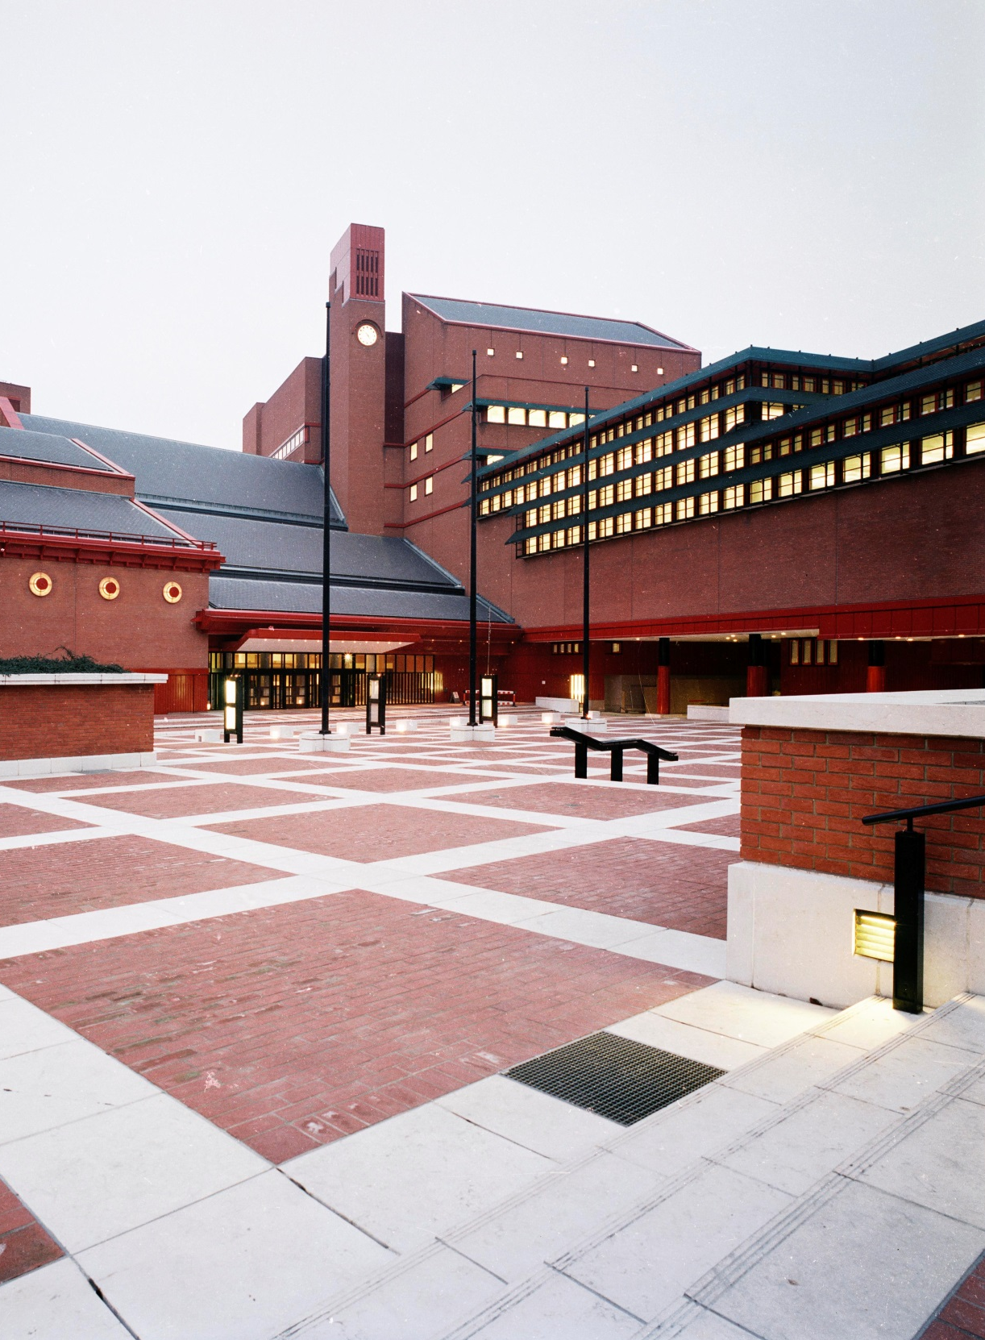
Durable
It should stand up robustly and remain in good condition
Notes:
Durable: A library built by the John Laing Building Company.
Image: Exterior view of the British Library in London lit up at dusk - © Historic England Archive. John Laing Photographic Collection - circa 1997 - 1998 Ref: JLP01/11/60330/02
https://historicengland.org.uk/images-books/photos/item/JLP01/11/60330/02

Slide 9
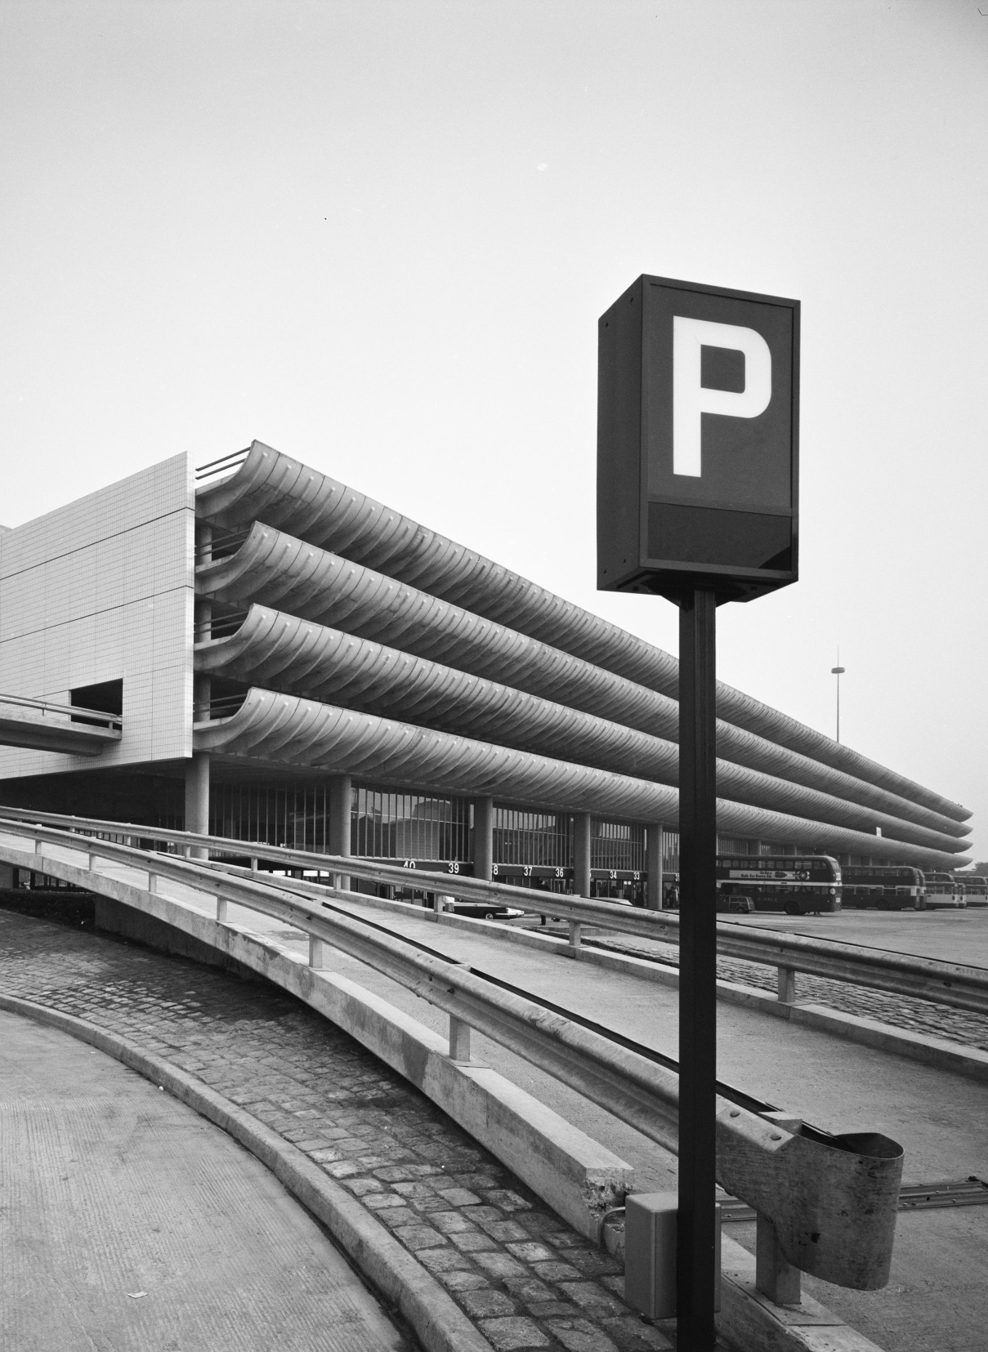
Useful
It should have a use and function well for the people using it
Notes:
Useful: A bus station and car park built by the John Laing building company.
Image: View of Preston Bus Station © Historic England Archive. John Laing Photographic Collection 23 Oct 1969 Ref: JLP01/08/082569
https://historicengland.org.uk/images-books/photos/item/JLP01/10/38132

Slide 10
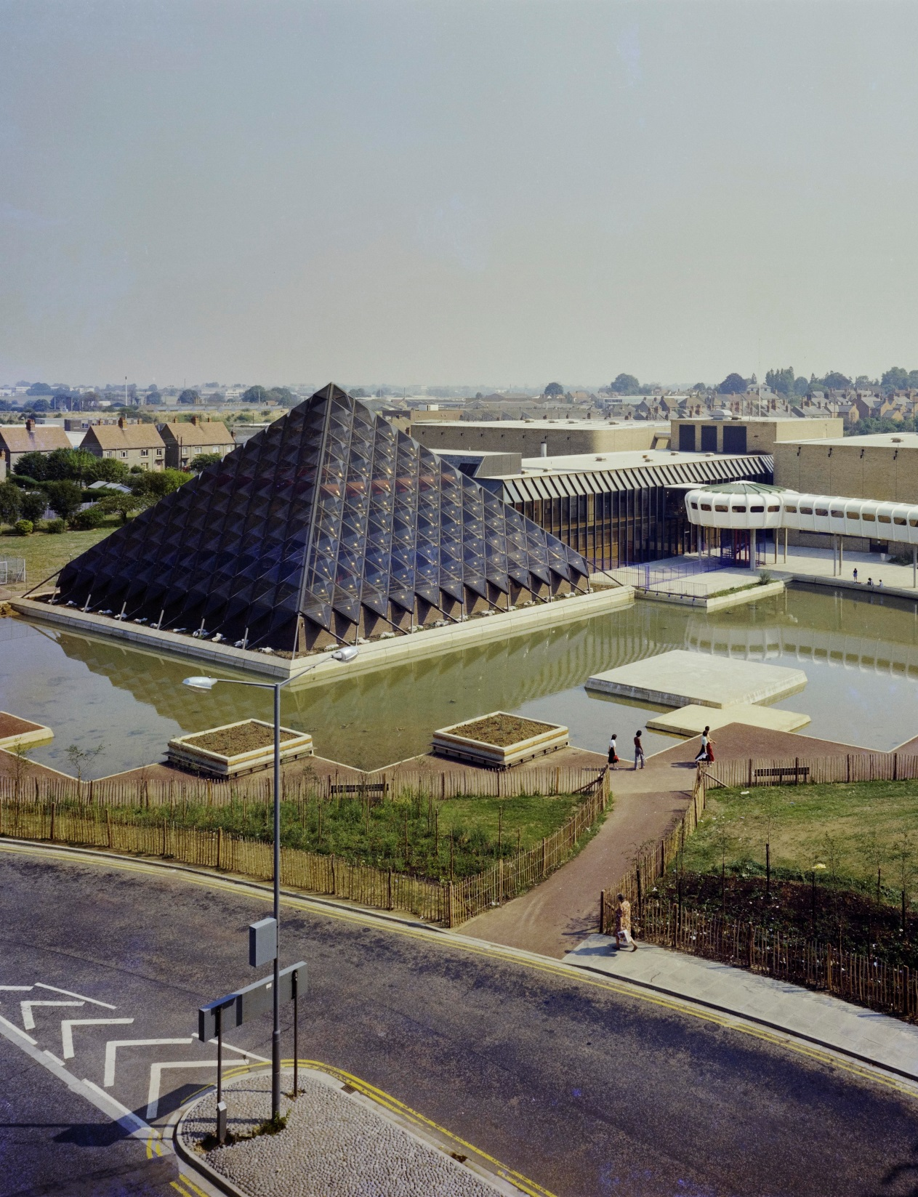
Beautiful
It should delight people and raise their spirits
Notes:
Beautiful - A leisure centre park built by the John Laing building company.
Image:
An elevated view of Bletchley Leisure Centre from the south-west © Historic England Archive. John Laing Photographic Collection - 30 Jul 1975 Ref: JLP01/10/02674
https://historicengland.org.uk/images-books/photos/item/JLP01/10/02674

Slide 11
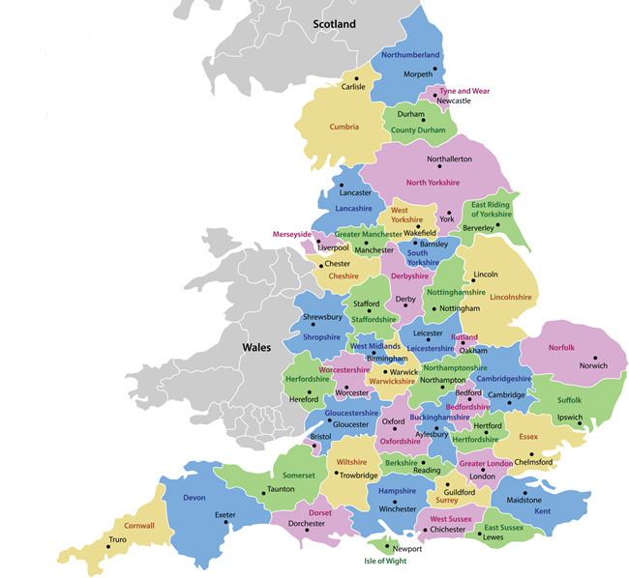
Chapel at West
Cumberland Hospital,
Whitehaven
The John Laing Building Company
Clayton Baptist
Chapel, Bradford
St Mary’s Church,
Peter-borough
Laing also built a lot of places of worship. We’re going to look at examples from different faiths such as: churches, chapels, mosques, synagogues and cathedrals.
Coventry Cathedral
Clifton Cathedral
London Central Mosque
Liberal Jewish Synagogue
Church of Latter-day Saints, Slough
Notes:
Share or summarise.
In the 20th century, especially after the Second World War, there were a lot of new religious buildings built in England. Cathedrals, churches, mosques, gurdwaras and synagogues were built across the country. These religious buildings both reflected and contributed to great social and political changes. In the 1940s and 50s, many former colonial subjects migrated to England to help rebuild the country. Many sought to practise the religion of their birthplaces and subsequently religious sites were built to cater for their needs. Places such as the London Central Mosque, built in 1977 became crucial community hubs for new arrivals to England.
Religious buildings not only served a practical use, but also a political purpose. The new Coventry Cathedral, which was completed in 1962, came to symbolise the country’s attempts at post-war regeneration. The old cathedral, reduced into rubble during the war, was rebuilt in a striking new style. Instead of traditional spires and stained glass windows, the Cathedral opted for a flat roof, wide-open glass windows and it was adorned with giant, colourful tapestries. The building was unapologetically ‘modern’ and fitted in with the spirit of the decade - particularly how Britain was trying to forge a new path in the world using the ‘white-heat’ of technology.
www.HistoricEngland.org.uk/BreakingNewGround

Slide 12
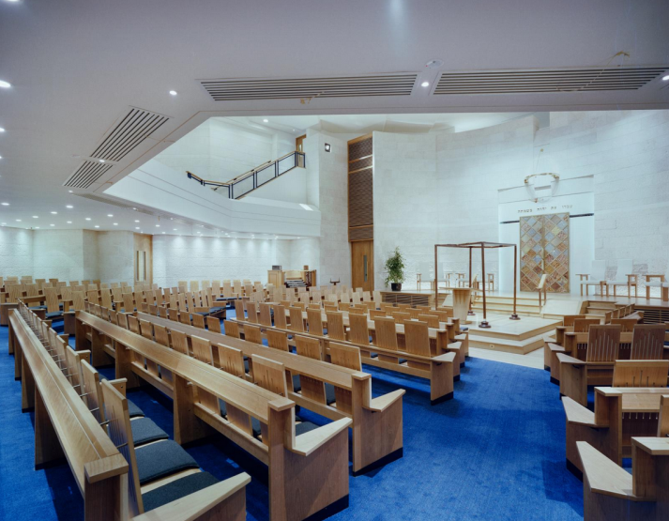
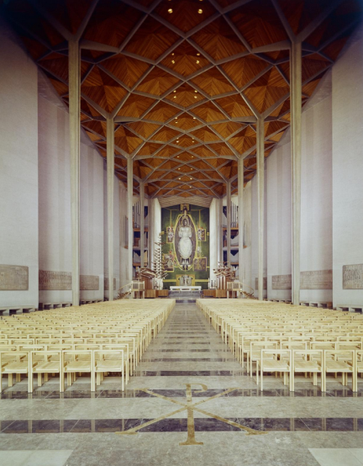
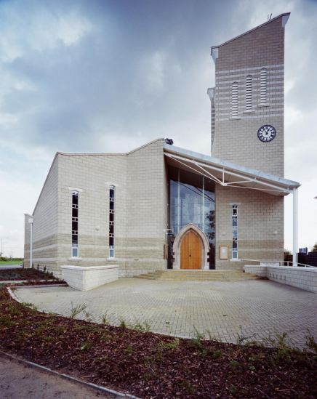
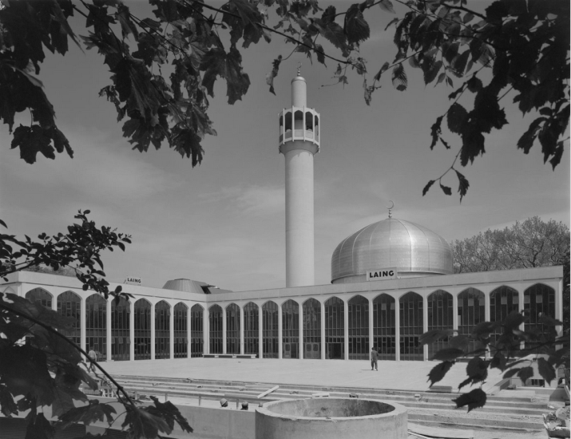
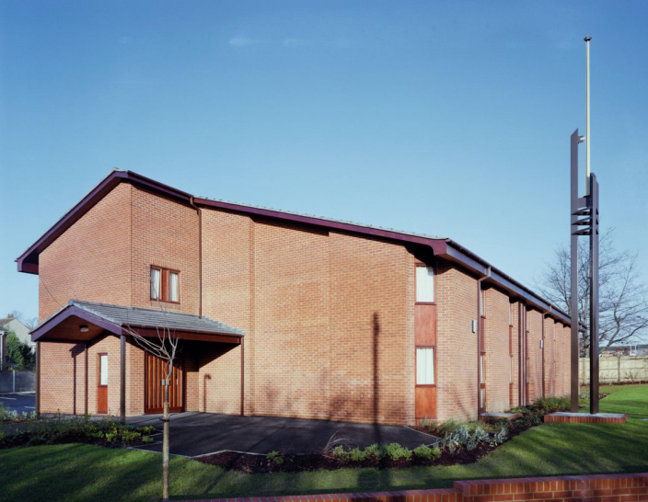
What are places of worship?
Do you have a place of worship in your area?
Notes:
Ask: What is a place of worship? Do you have a place of worship in your area?
Share: Students can talk about places of worship they are part of, or this might be something they write down privately.
If students are unclear about what a place of worship is, you can watch this film up to 2min12sec: https://www.reonline.org.uk/specials/places-of-worship/introduction_video.htm
Images:
The interior of the Olivet Deptford Baptist Church, showing the brickwork and joinery of the sloping walls © Historic England Archive. John Laing Photographic Collection -
19 Jan 1981 Ref: JLP01/09/810140
https://historicengland.org.uk/images-books/photos/item/JLP01/09/810140
A view of the octagonal sanctuary in the Liberal Jewish Synagogue, showing seating arranged around the bimah © Historic England Archive. John Laing Photographic Collection -
30 Jan 1991 Ref: JLP01/10/48154
https://historicengland.org.uk/images-books/photos/item/JLP01/10/48154
The interior of Coventry Cathedral looking from the nave towards the chancel © Historic England Archive. John Laing Photographic Collection - May 1964 - Ref: JLP01/10/01156
https://historicengland.org.uk/images-books/photos/item/JLP01/10/01156
St Mary's Church viewed from the north-west soon after its completion © Historic England Archive. John Laing Photographic Collection - 18 Oct 1991 - Ref: JLP01/10/51481
https://historicengland.org.uk/images-books/photos/item/JLP01/10/51481
London Central Mosque and The Islamic Cultural Centre © Historic England Archive. John Laing Photographic Collection - 3 Jun 1977 - Ref: JLP01/09/771229
https://historicengland.org.uk/images-books/photos/item/JLP01/09/771229
The Church of Jesus Christ of Latter-day Saints viewed from the south-east, showing the entrance © Historic England Archive. John Laing Photographic Collection -
15 Dec 1986 - Ref: JLP01/10/25237
https://historicengland.org.uk/images-books/photos/item/JLP01/10/25237

Slide 13
Visiting a Place of Worship
Can you find at least 5 distinctive features or symbols inside or outside the building that are particular to that religion / religious denomination?
What different building materials are used in the construction of the place of worship? Why do you think these have been chosen?
Identify interesting details in the design of the building
Take photographs of the building from the inside and outside
Research: Can you find out about the history of the building – When was it built? Who was the main architect? Who built it?
Notes:
Note to teacher:
If possible use a visit to a place of worship to explore distinctive features in a building constructed to serve a particular religion.
Ask the pupils:
Which features would be essential for an architect to include in any design for a place of worship for this particular religion or denomination?
Which features may an architect have more flexibility regarding design?
If a ‘real’ visit is not possible consider taking pupils on a ‘virtual’ visit to a place of worship – use the internet to find one near you or an icon building such as St Paul’s Cathedral: https://www.360cities.net/image/inside-st-paul-s-cathedral

Slide 14
Activity
What do you know and what can you work out from an image of a place of worship?
What symbols can you see?
What features do these buildings have?
What is the same or different about these places of worship?
Notes:
Activity: In groups ask pupils to look at the following images of places of worship built by the John Laing building company. Give each group a different building. Once they’ve looked at their own building bring the class back together and discuss their buildings.
Ask: As pupils discuss their images you may also ask them to: Think about the person who leads a service, where do they stand/sit and what do they do? Does it matter what the building looks from the outside? Or just the inside?
Pupils can zoom in on and find out more about the images, including location and a description by using the links below each image.

Slide 15
Things I’d like to know/find out more about
Things I can infer (work out)
Things I know/features I can see
Notes:
Note to teacher: You could select images and put them into a ‘square of inference’ to help pupils structure their thinking in answering the questions

Slide 16
Note to teacher:
In addition to the questions suggested in the ‘square of inference’ activity pupils can also make their own observations:
Which buildings do they like?
What building materials have been used?
Do all the buildings look like places of worship?
What do the different designs represent?
What are the functions of individual features in each place of worship?
What can we learn from the religion from this image?
What features must an architect include for this place of worship?
What aspects of the design provide more flexibility for the architects?
Which designs do pupils not like as much?
Some suggested specific questions are also provided for each of the buildings. Some of these are very building-specific and some may transfer to other images in the collection.
Some of the buildings are re-built versions of a previous place of worship or re-purposed buildings. You may explore, with pupils, the decisions that people have to make when a place of worship is destroyed or falls into decay. What has to go all together? Which features may be retained? How can these be incorporated into the new design and building?
Notes:
You may also want to draw out themes within the buildings such as music, lighting, seating and symbols.

Slide 17
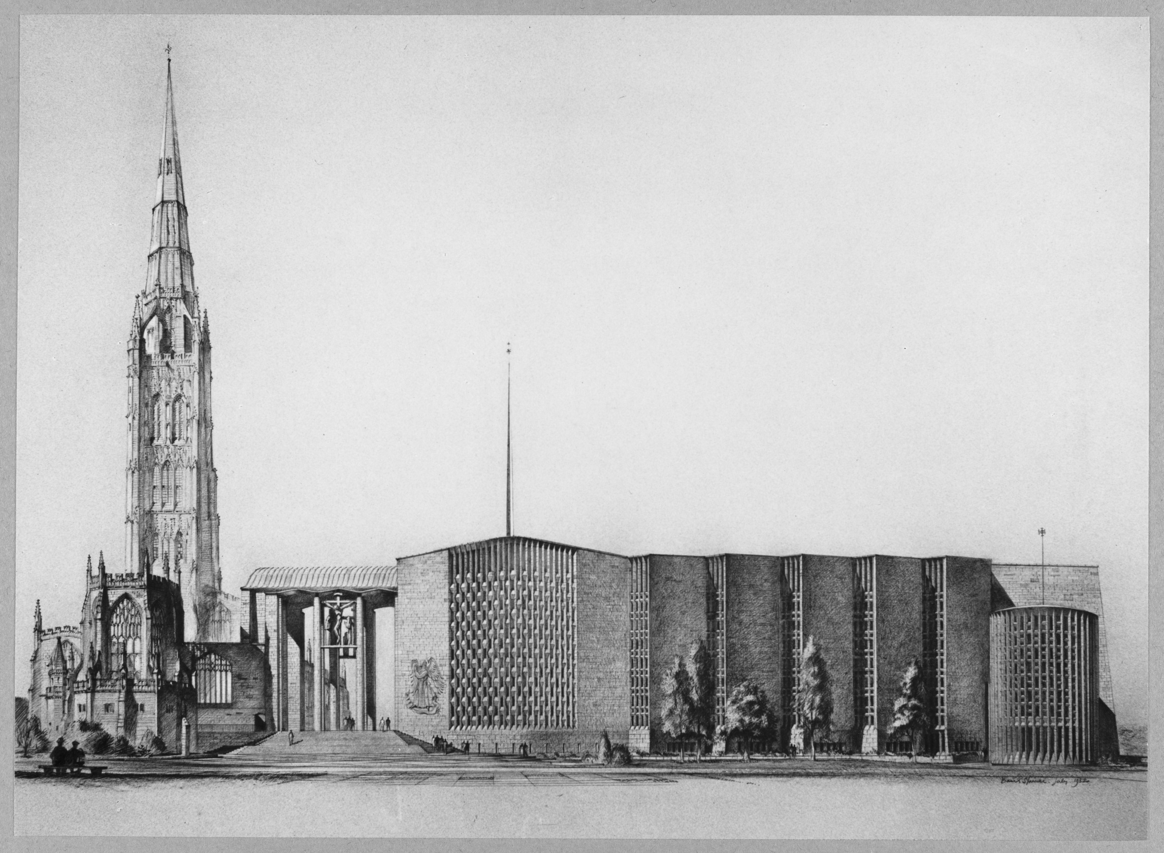
Coventry Cathedral
Coventry Cathedral
Notes:
Activity: In your pair/group note down:
Things I know/features I can see.
Things I can infer/work out/guess at.
Things I’d like to know/find out more about.
Image:
A photographic reproduction of a design drawing of Coventry Cathedral by Basil Spence © Historic England Archive. John Laing Photographic Collection - Jul 1952 Ref: JLP01/01/026/68
https://historicengland.org.uk/images-books/photos/item/JLP01/01/026/68

Slide 18
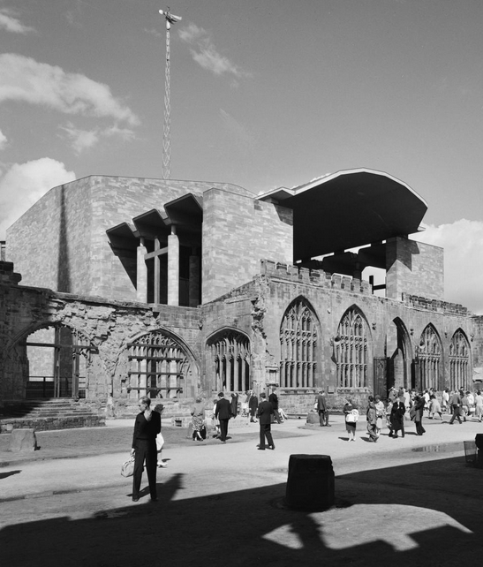
Notes:
Activity: In your pair/group note down:
Things I know/features I can see.
Things I can infer/work out/guess at.
Things I’d like to know/find out more about.
Key Question:
Why do you think it was decided to leave the ruined Church of St Michael standing, even though a new Cathedral was built?
Image:
A (cropped) view of people exploring the ruins of the Cathedral Church of St Michael with the new Coventry Cathedral in the background © Historic England Archive. John Laing Photographic Collection - 16 Aug 1962 Ref: JLP01/08/063345
https://historicengland.org.uk/images-books/photos/item/JLP01/08/063345

Slide 19

Notes:
Activity: In your pair/group note down:
Things I know/features I can see.
Things I can work out/guess at.
Things I’d like to know/find out more about.
Key Question:
Identify the different building materials you can see in this photograph?
NB: Note the vertical tubular metal pipes of the organ to either side of the alter, so music can be heard throughout the church.
Image: The interior of Coventry Cathedral looking from the nave towards the chancel © Historic England Archive. John Laing Photographic Collection - May 1964 Ref: JLP01/10/01156
https://historicengland.org.uk/images-books/photos/item/JLP01/10/01156

Slide 20
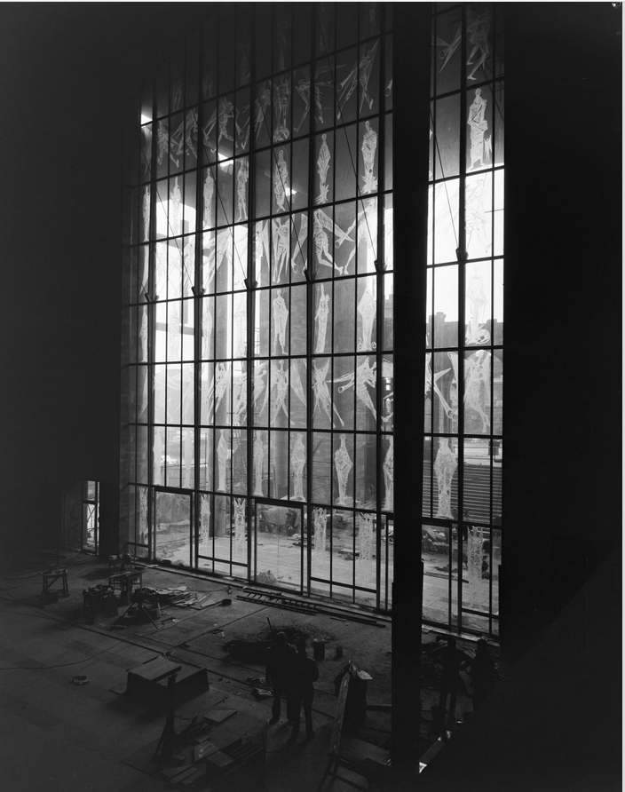
Notes:
Activity: In your pair/group note down:
Things I know/features I can see.
Things I can infer/work out/guess at.
Things I’d like to know/find out more about.
Research Question:
Can you find out who the figures etched into the glass windows represent? Can you find out how this etching process was carried out?
Image: A view of the West Screen at Coventry Cathedral from inside the cathedral © Historic England Archive. John Laing Photographic Collection – 30 Jan 1962 Ref: JLP01/08/061802A
https://historicengland.org.uk/images-books/photos/item/JLP01/08/061802A

Slide 21
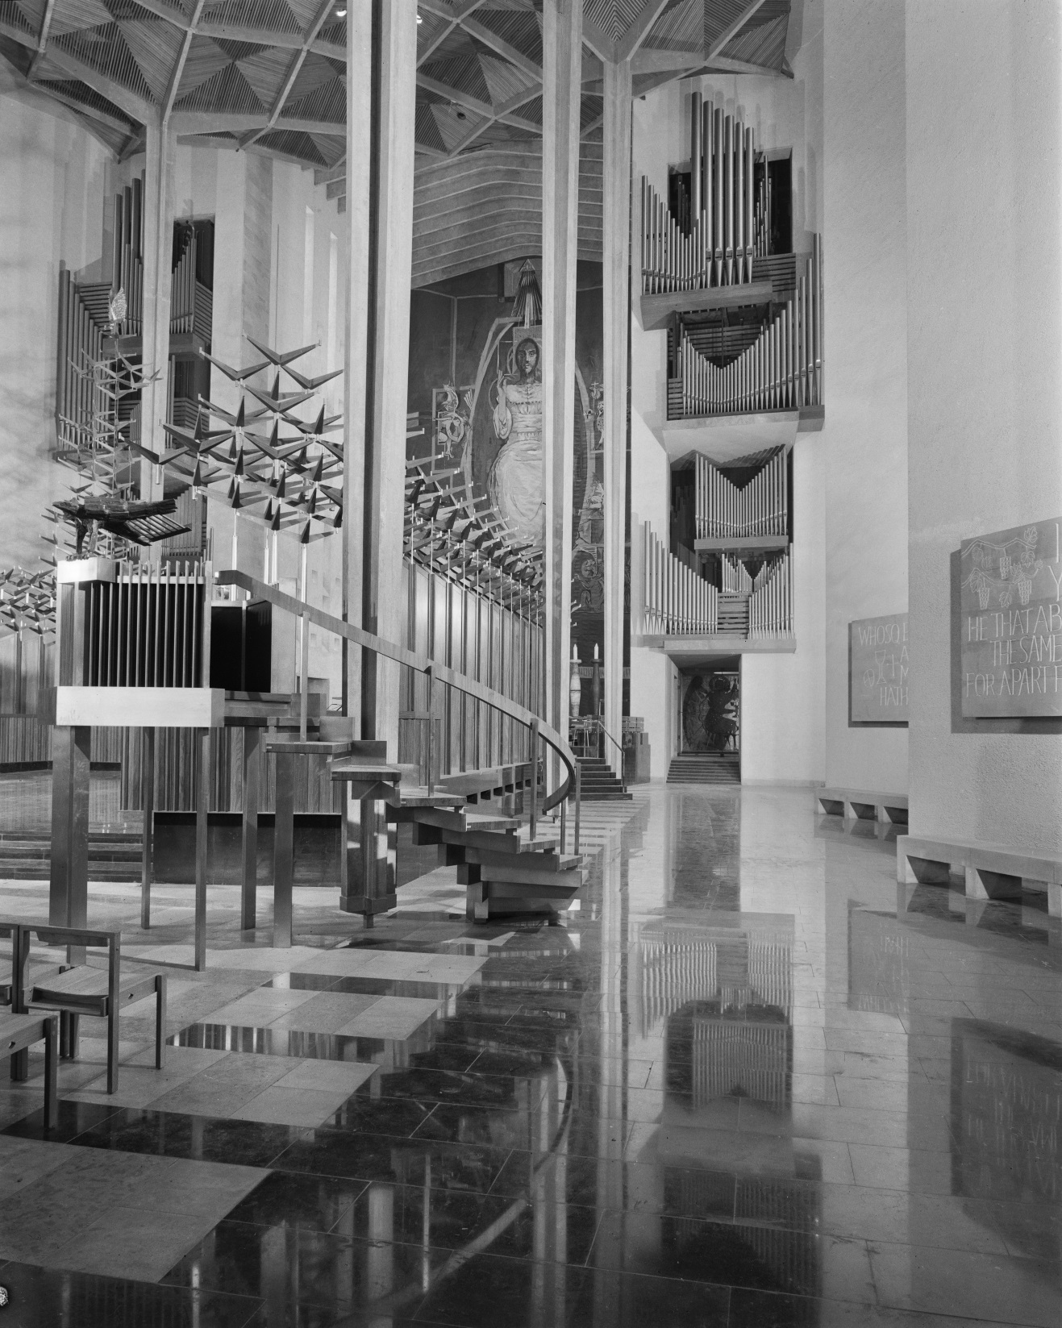
Notes:
Activity: In your pair/group note down:
Things I know/features I can see.
Things I can work out/guess at.
Things I’d like to know/find out more about.
Key Question:
What makes this an effective image? Can you spot the organ in this photograph? Can you find other examples of musical instruments in other places of worship in this collection of photographs? In the centre right of the photograph is the pulpit. Behind it is the choir stall. What do you think the design of the choir stall represents?
Another image can be found at: https://historicengland.org.uk/images-books/photos/item/DP082332
NB: Note the vertical tubular metal pipes of the organ to either side of the alter, so music can be heard throughout the church.
Image:
An interior view of Coventry Cathedral showing the eagle lectern, by sculptor Elizabeth Frink, in the foreground cathedral © Historic England Archive. John Laing Photographic Collection - 23 May 1962 Ref: JLP01/08/062577
https://historicengland.org.uk/images-books/photos/item/JLP01/08/062577

Slide 22
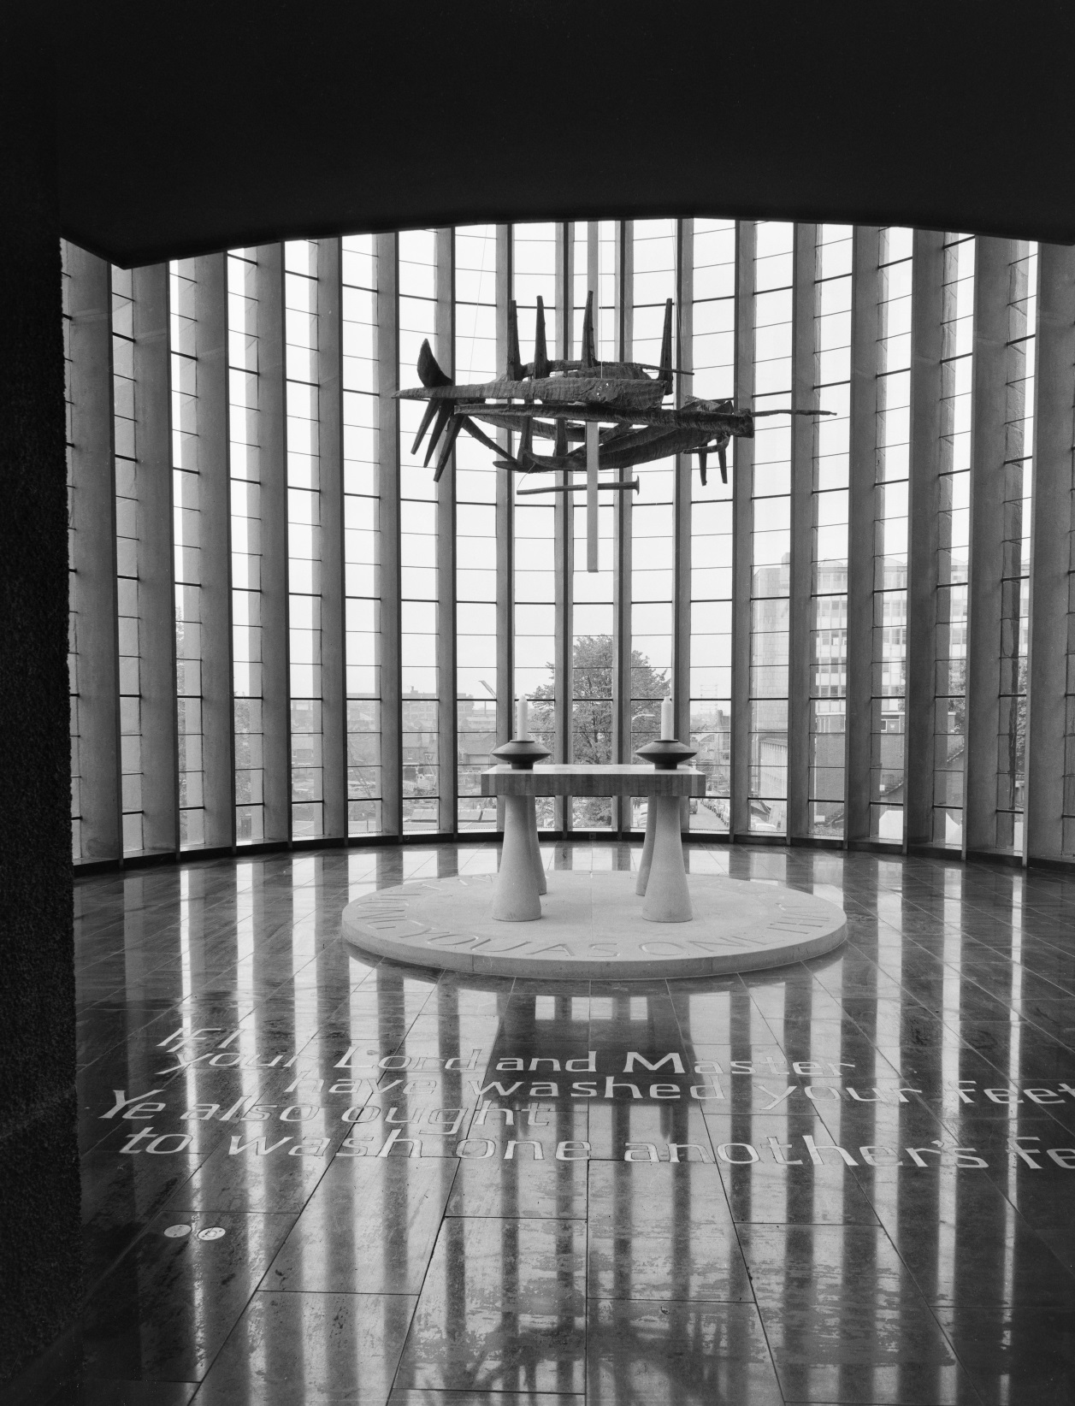
Notes:
Activity: In your pair/group note down:
Things I know/features I can see.
Things I can work out/guess at.
Things I’d like to know/find out more about.
Image:
The interior of the Chapel of Christ the Servant at Coventry Cathedral © Historic England Archive. John Laing Photographic Collection - 23 May 1962 Ref: JLP01/08/062597
https://historicengland.org.uk/images-books/photos/item/JLP01/08/062597

Slide 23
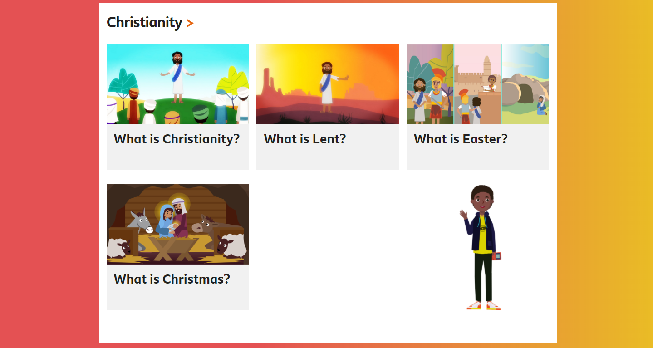
This is a Christian place of worship – learn more about Christianity
Notes:
Use the BBC Bitesize pages on Religious Education to find out more about this religion https://www.bbc.co.uk/bitesize/subjects/z7hs34j
Also see: https://www.reonline.org.uk/

Slide 24

London Central Mosque
Notes:
Activity: In your pair/group note down:
Things I know/features I can see.
Things I can infer/work out/guess at.
Things I’d like to know/find out more about.
Key Question:
Can you name the key features of the Mosque building in this image and find out the purpose of each?
(https://www.bbc.co.uk/bitesize/guides/zvm96v4/revision/7)
Which different building materials do you think have been sued to build this structure?
Image:
London Central Mosque and The Islamic Cultural Centre - © Historic England Archive. John Laing Photographic Collection – 3 Jun 1977 - Ref: JLP01/09/771229
https://historicengland.org.uk/images-books/photos/item/JLP01/09/771229

Slide 25
Notes:
Activity: In your pair/group note down:
Things I know/features I can see.
Things I can infer/work out/guess at.
Things I’d like to know/find out more about.
Key Question:
Which part of the Mosque is this? How can you tell?
What materials do you think have been used to make the blue design going around the bottom of the dome? (mosaic tiles)
Image:
Interior view of the mosque's prayer hall, showing its qibla wall with mihrab niche, and a chandelier above - © Historic England Archive - 28 Feb Ref: DP148088
https://historicengland.org.uk/images-books/photos/item/DP148088
Note: This image is not from the John Laing Photographic Collection.

Slide 26
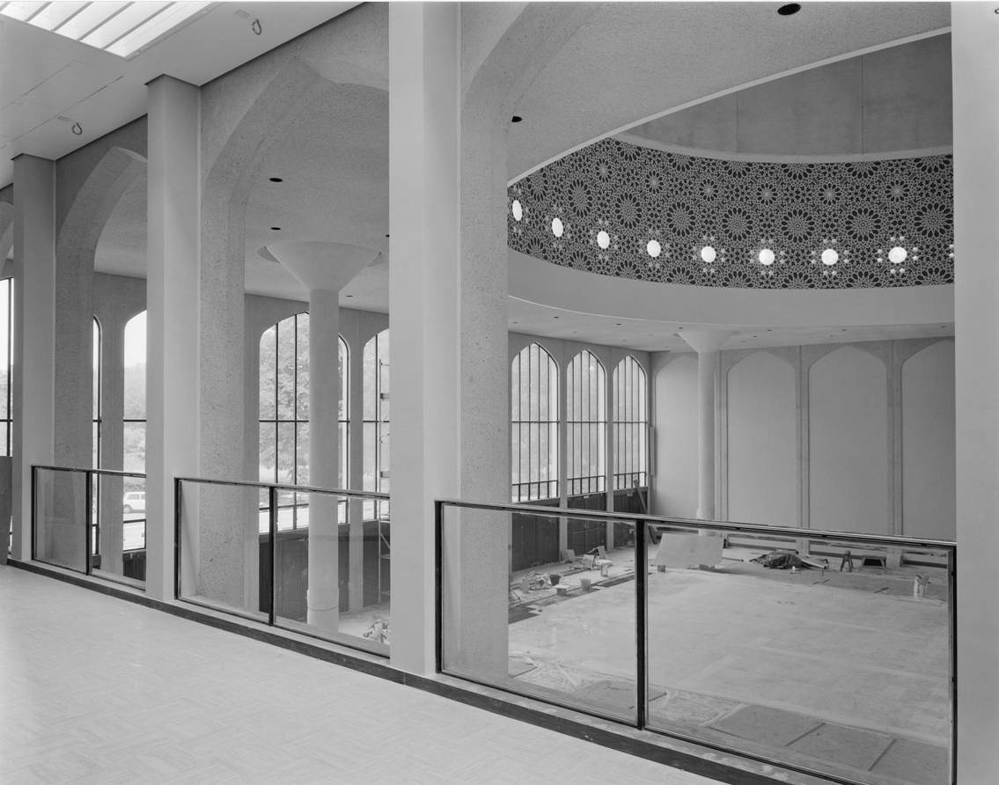
Notes:
Activity: In your pair/group note down:
Things I know/features I can see.
Things I can infer/work out/guess at.
Things I’d like to know/find out more about.
Image:
A view from the women's balcony into the main prayer space at the London Central Mosque, prior to the installation of wooden screens to separate the two areas © Historic England Archive. John Laing Photographic Collection - 22 Jun 1977 Ref: JLP01/09/771264
https://historicengland.org.uk/images-books/photos/item/JLP01/09/771264

Slide 27
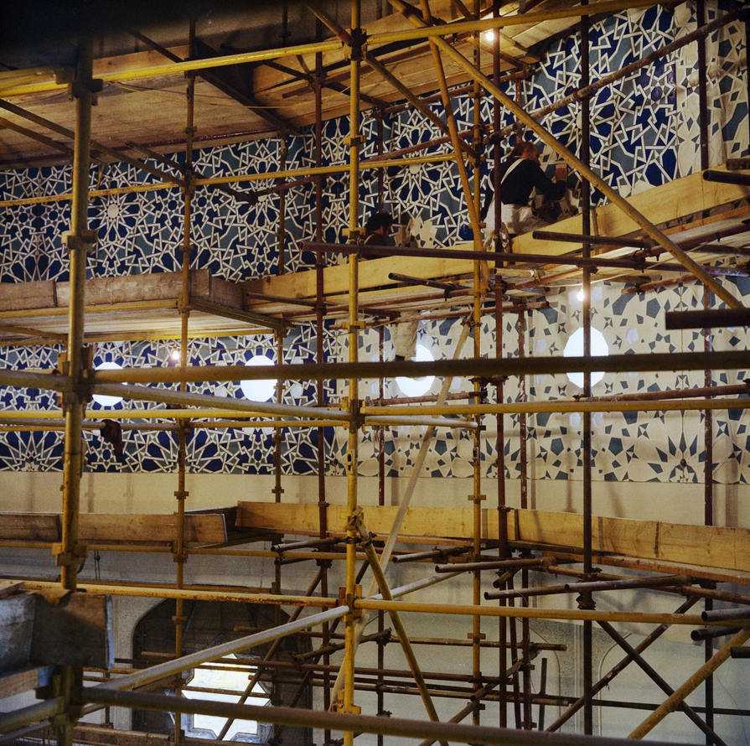
Notes:
Activity: In your pair/group note down:
Things I know/features I can see.
Things I can infer/work out/guess at.
Things I’d like to know/find out more about.
Image:
Workers on scaffolding decorating the ceiling of the main prayer hall at the London Central Mosque with geometric patterns © Historic England Archive. John Laing Photographic Collection - 14 Apr 1977 Ref: JLP01/10/04403
https://historicengland.org.uk/images-books/photos/item/JLP01/10/04403

Slide 28
Notes:
Activity: In your pair/group note down:
Things I know/features I can see.
Things I can infer/work out/guess at.
Things I’d like to know/find out more about.
Key Question:
What happens in this room and why was it an essential part of the architect’s design?
Image:
A view of a wash room for ritual ablutions at the London Central Mosque © Historic England Archive. John Laing Photographic Collection - 22 Jun 1977 Ref: JLP01/09/771260
https://historicengland.org.uk/images-books/photos/item/JLP01/09/771260

Slide 29
Notes:
Activity: In your pair/group note down:
Things I know/features I can see.
Things I can work out/guess at.
Things I’d like to know/find out more about.
Key Question:
What adjectives would you use to describe this room and its design?
Image:
Interior view of the mosque's prayer hall, with an ornate chandelier above © Historic England Archive. John Laing Photographic Collection - 28 Feb 2012Ref: DP148090
https://historicengland.org.uk/images-books/photos/item/DP148090

Slide 30
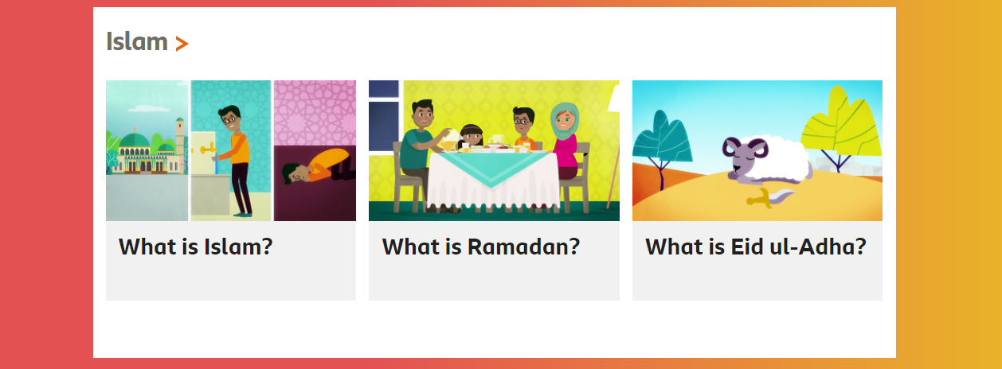
This is an Islamic place of worship – learn more about Islam
Notes:
Use the BBC Bitesize pages on Religious Education to find out more about this religion https://www.bbc.co.uk/bitesize/subjects/z7hs34j
Also see: https://www.reonline.org.uk/

Slide 31

Liberal Jewish Synagogue, London
Notes:
Activity: In your pair/group note down:
Things I know/features I can see.
Things I can infer/work out/guess at.
Things I’d like to know/find out more about.
Key Question:
How old do you think this building is?
Research:
This modern building replaced the original Liberal Jewish Synagogue. One original feature was retained from the original building. Can you find what it is?
Find out more about the interesting history of this building.
https://www.ljs.org/the-ljs.html
https://images.shulcloud.com/1575/uploads/PDFs/Building-Guide-2020.pdf
Image:
A view of the octagonal sanctuary in the Liberal Jewish Synagogue, showing seating arranged around the bimah © Historic England Archive. John Laing Photographic Collection
- 30 Jan 1991 Ref: JLP01/10/48154
https://historicengland.org.uk/images-books/photos/item/JLP01/10/48154

Slide 32
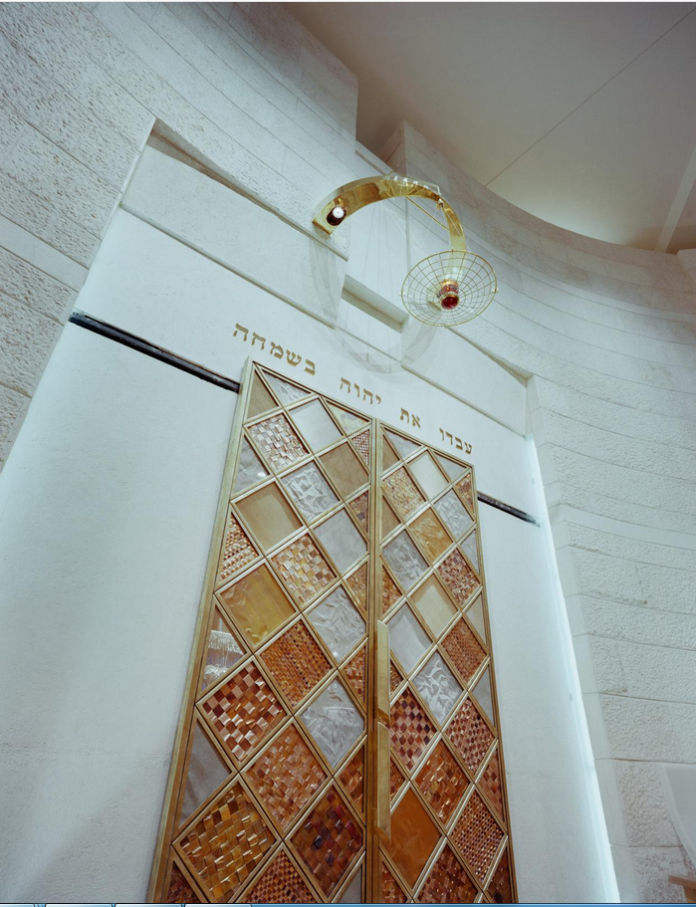
Notes:
Activity: In your pair/group note down:
Things I know/features I can see.
Things I can infer/work out/guess at.
Things I’d like to know/find out more about.
Key Question:
What is this part of the Synagogue called? What is its importance?
Image:
The ner tamid and doors of the ark in the Liberal Jewish Synagogue © Historic England Archive. John Laing Photographic Collection - 30 Jan 1991 Ref: JLP01/10/48152
https://historicengland.org.uk/images-books/photos/item/JLP01/10/48152

Slide 33
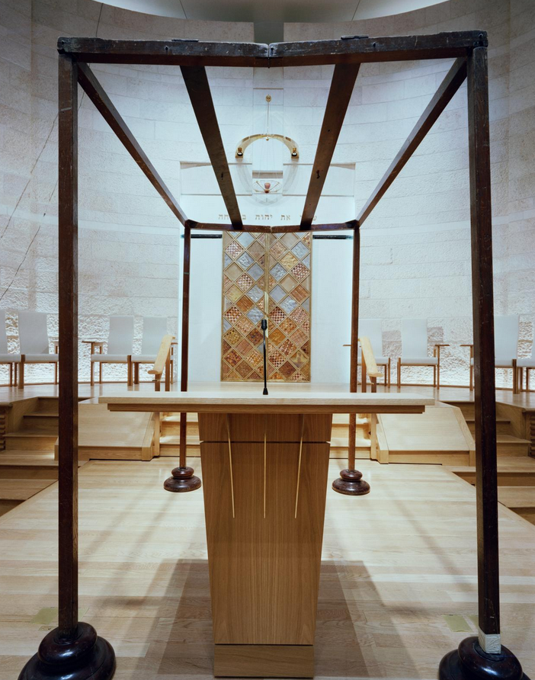
Notes:
Activity: In your pair/group note down:
Things I know/features I can see.
Things I can infer/work out/guess at.
Things I’d like to know/find out more about.
Key Question:
What is this part of the Synagogue called? What is its importance?
Image:
The chuppah on the bimah, with the doors of the ark and ner tamid beyond, in the Liberal Jewish Synagogue © Historic England Archive. John Laing Photographic Collection - 30 Jan 1991 - Ref: JLP01/10/48151
https://historicengland.org.uk/images-books/photos/item/JLP01/10/48151

Slide 34
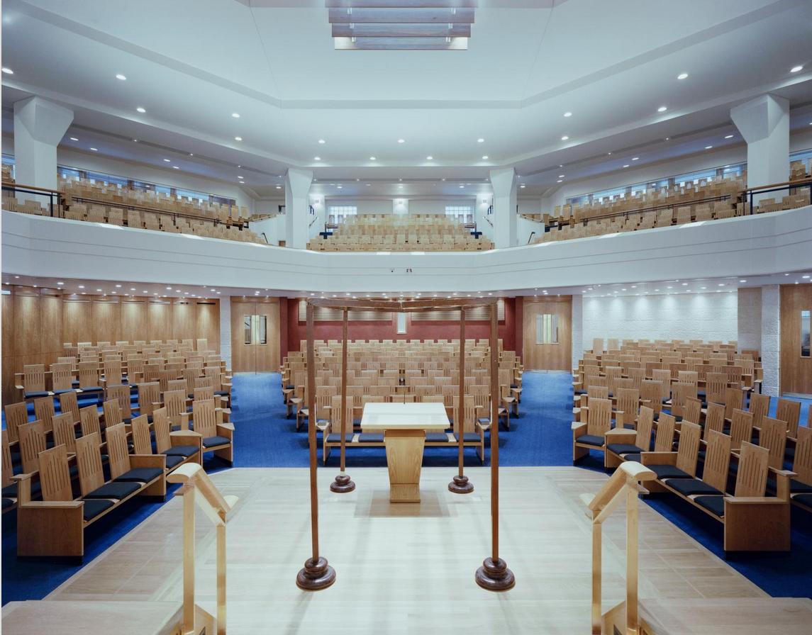
Notes:
Activity: In your pair/group note down:
Things I know/features I can see.
Things I can work out/guess at.
Things I’d like to know/find out more about.
Key Question:
Does this look like you would expect a place of worship to appear like?
If you did not know it was a place of worship, what other type of building might you think it could be?
Image:
A view from the bimah, looking out over the sanctuary with the chuppah in the foreground, in the Liberal Jewish Synagogue © Historic England Archive. John Laing Photographic Collection - 30 Jan 1991 Ref: JLP01/10/48150
https://historicengland.org.uk/images-books/photos/item/JLP01/10/48150

Slide 35
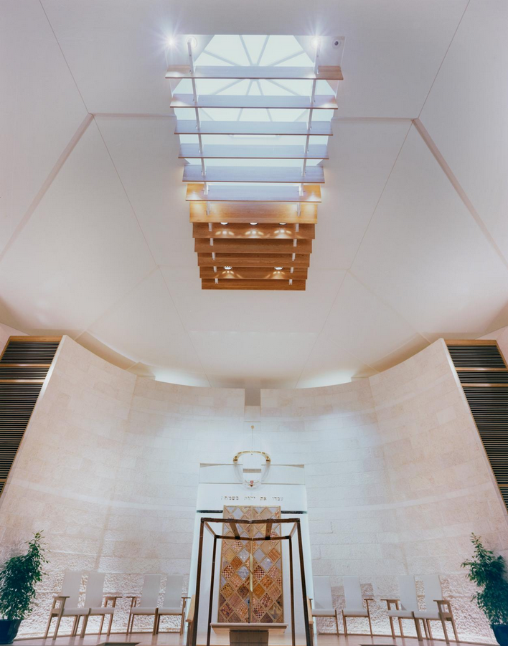
Notes:
Activity: In your pair/group note down:
Things I know/features I can see.
Things I can infer/work out/guess at.
Things I’d like to know/find out more about.
Key Question:
What do you notice about the roof light? What do you think might be significant about this design?
Image:
The ark, ner tamid, chuppah and bimah chairs in the Liberal Jewish Synagogue, with the shaded octagonal roof light above © Historic England Archive. John Laing Photographic Collection - 30 Jan 1991 Ref: JLP01/10/48147
https://historicengland.org.uk/images-books/photos/item/JLP01/10/48147

Slide 36
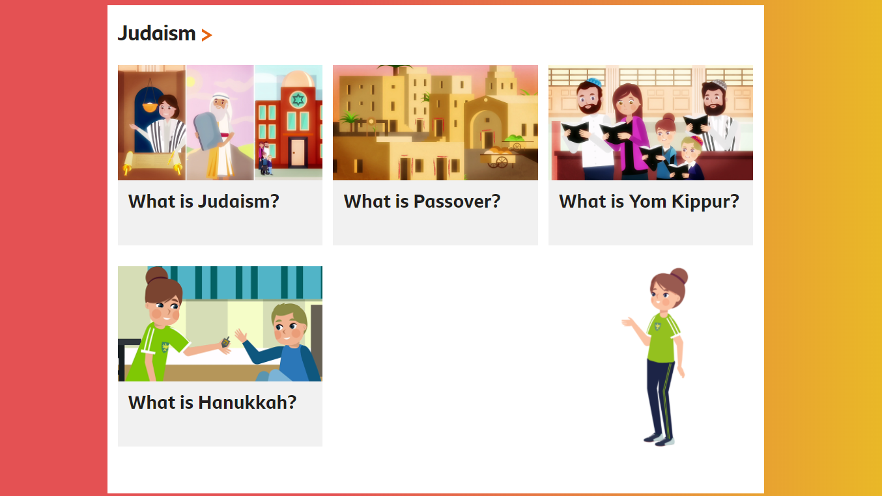
This is a Jewish place of worship – learn more about Judaism
Notes:
Use the BBC Bitesize pages on Religious Education to find out more about this religion https://www.bbc.co.uk/bitesize/subjects/z7hs34j
Also see: https://www.reonline.org.uk/

Slide 37
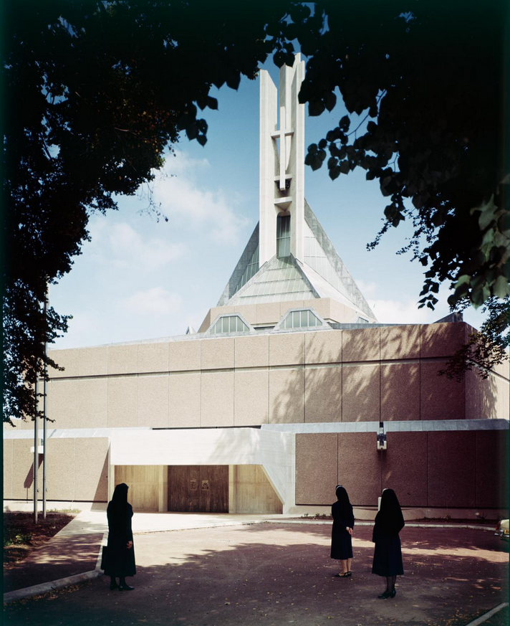
Clifton Cathedral
Notes:
Activity: In your pair/group note down:
Things I know/features I can see.
Things I can infer/work out/guess at.
Things I’d like to know/find out more about.
Key Question:
How would you describe the exterior design of this cathedral? What do you notice about this design? (For example, pupils may notice a lack of windows)
Image:
Three nuns viewing the completed exterior of the Roman Catholic Cathedral of Saints Peter and Paul, Clifton, Bristol © Historic England Archive. John Laing Photographic Collection – 1 Aug 1973 Ref: JLP01/10/01192C
https://historicengland.org.uk/images-books/photos/item/JLP01/10/01192C

Slide 38
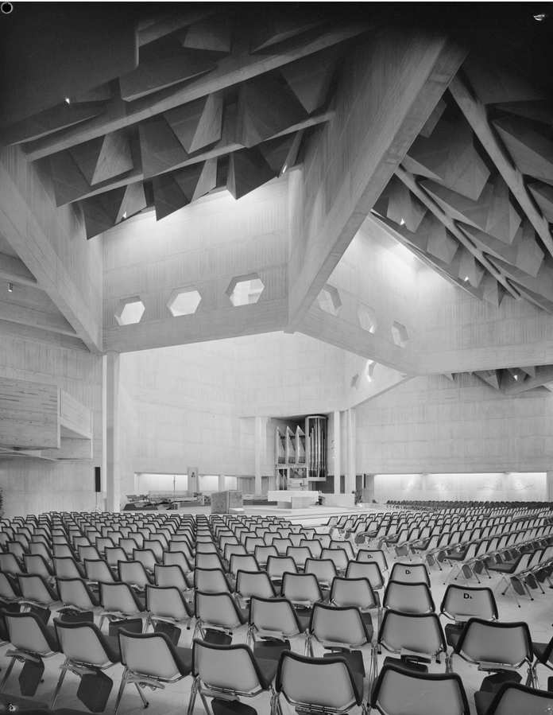
Notes:
Activity: In your pair/group note down:
Things I know/features I can see.
Things I can infer/work out/guess at.
Things I’d like to know/find out more about.
Key Question:
How would you describe the design of the ceiling structure in this cathedral? Why do you think the architect designed it this way?
Image:
Looking across the nave towards the sanctuary and altar in Clifton Cathedral © Historic England Archive. John Laing Photographic Collection – 2 Aug 1973 Ref: JLP01/08/095985
https://historicengland.org.uk/images-books/photos/item/JLP01/08/095985

Slide 39
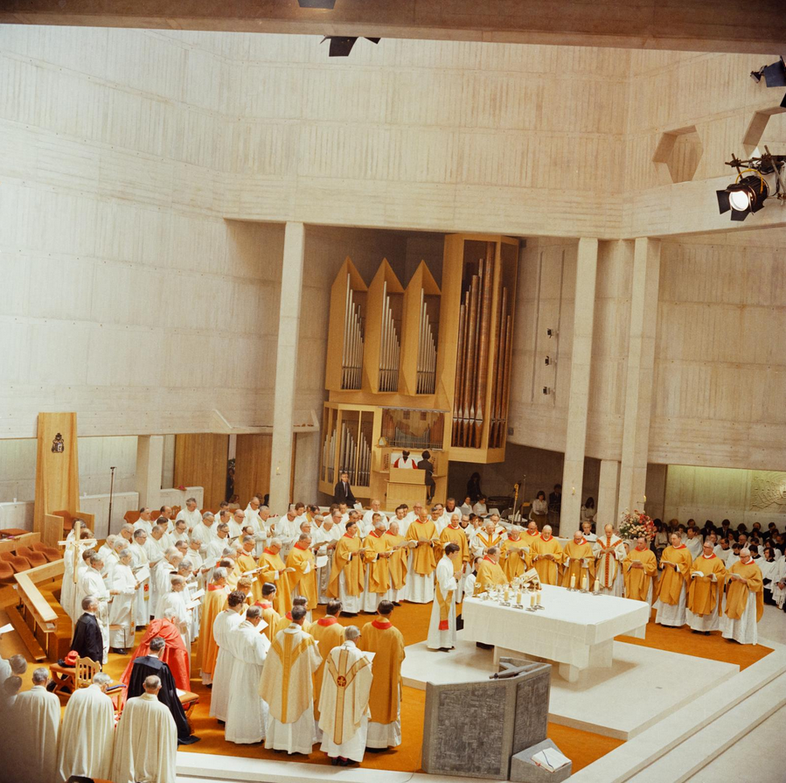
Notes:
Activity: In your pair/group note down:
Things I know/features I can see.
Things I can work out/guess at.
Things I’d like to know/find out more about.
Key Questions:
How would you describe the inside of this cathedral?
Which building materials can you see have been used?
Image:
Members of the clergy gathered around the altar in Clifton Cathedral during the consecration ceremony, with the organ in the background © Historic England Archive. John Laing Photographic Collection – 29 Jun 1973 Ref: JLP01/10/01163/06
https://historicengland.org.uk/images-books/photos/item/JLP01/10/01163/06

Slide 40
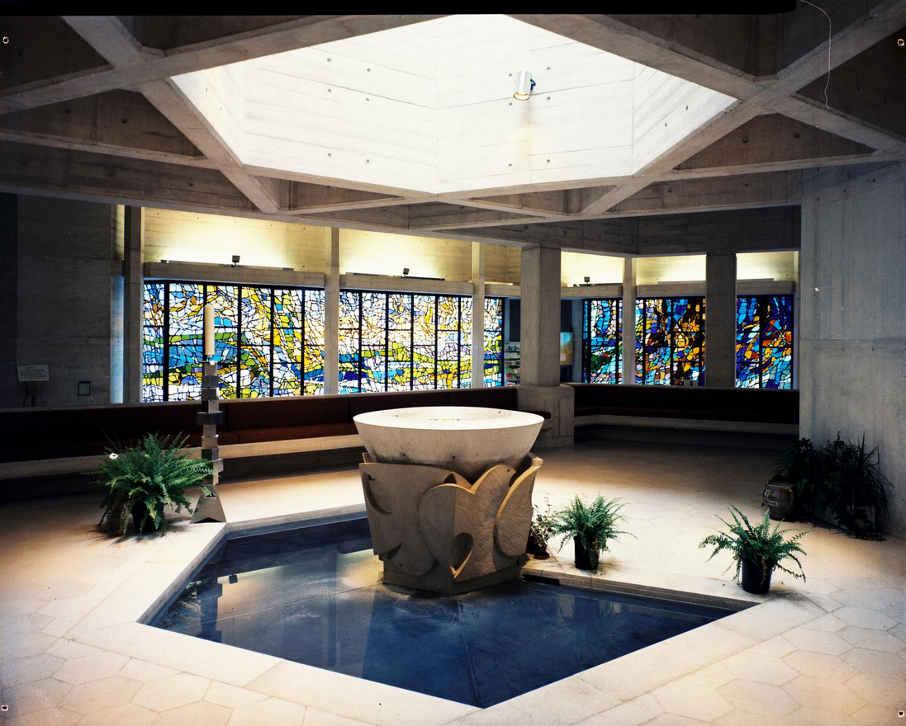
Notes:
Activity: In your pair/group note down:
Things I know/features I can see.
Things I can work out/guess at.
Things I’d like to know/find out more about.
Key Questions:
What do you think the design around the font represents? (Doves; peace)
Describe the ceiling design and what you think it may represent.
What are the similarities and differences between this image and the other images of this cathedral?
Image:
Interior view of the completed Roman Catholic Cathedral of Saints Peter and Paul, Clifton, Bristol showing the font and stained glass windows © Historic England Archive. John Laing Photographic Collection – 1 Aug 1973 - Ref: JLP01/10/01197
https://historicengland.org.uk/images-books/photos/item/JLP01/10/01197

Slide 41
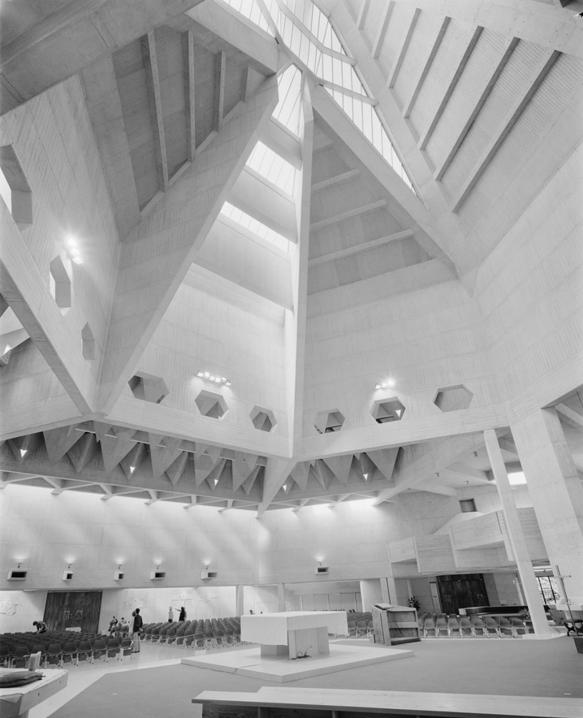
Notes:
Activity: In your pair/group note down:
Things I know/features I can see.
Things I can infer/work out/guess at.
Things I’d like to know/find out more about.
Key Question:
Which adjectives could you use to describe the internal design of this cathedral?
Image:
The interior of Clifton Cathedral showing the sanctuary and altar with the complex beam structure in the roof above © Historic England Archive. John Laing Photographic Collection - 1 Jun 1973 Ref: JLP01/08/095339
https://historicengland.org.uk/images-books/photos/item/JLP01/08/095339

Slide 42
This is a Christian place of worship – learn more about Christianity
Notes:
Use the BBC Bitesize pages on Religious Education to find out more about this religion https://www.bbc.co.uk/bitesize/subjects/z7hs34j
Also see: https://www.reonline.org.uk/

Slide 43
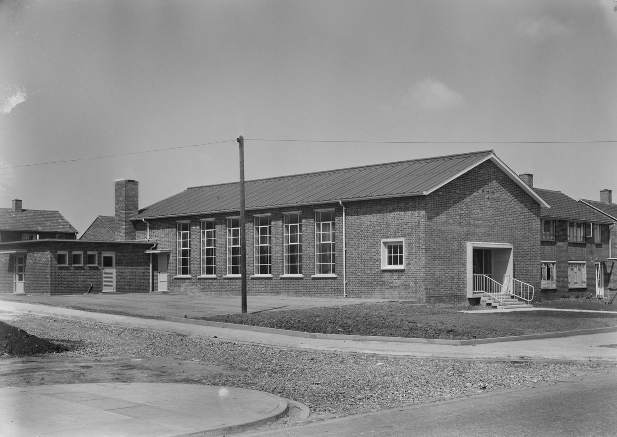
Manor Way Evangelical Church
Notes:
Activity: In your pair/group note down:
Things I know/features I can see.
Things I can infer/work out/guess at.
Things I’d like to know/find out more about.
Key Question:
What adjectives would you use to describe this church? If you visited this building, is it immediately obvious it is a church or does it look like another type of building? What symbol can you see that tells you that it is a church? (a cross above the front door – quite hard to spot)
Image:
A view of Manor Way Evangelical Church from the south-east © Historic England Archive. John Laing Photographic Collection – 12 May 1953 Ref: JLP01/08/008653
https://historicengland.org.uk/images-books/photos/item/JLP01/08/008653

Slide 44
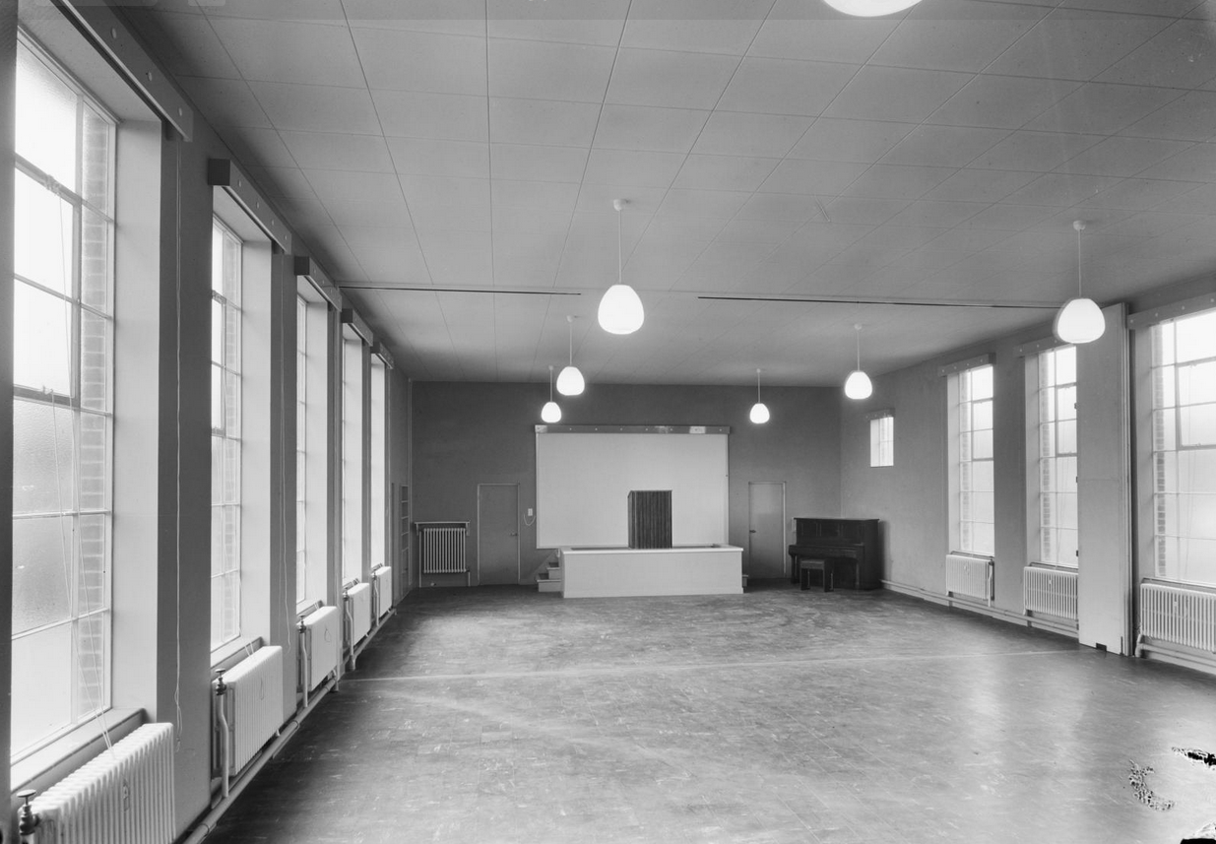
Notes:
Activity: In your pair/group note down:
Things I know/features I can see.
Things I can infer/work out/guess at.
Things I’d like to know/find out more about.
Key Question:
What observations would you make about this room?
Why do you think it has been designed like this? (Perhaps this is to allow the space to be used for purposes other than religious services)
NB: Note the piano at the front, so music can be heard throughout the church.
Image:
A view of the interior of Manor Way Evangelical Church, showing the stage at the west end of the church © Historic England Archive. John Laing Photographic Collection – 9 May 1953 Ref: JLP01/08/008682
https://historicengland.org.uk/images-books/photos/item/JLP01/08/008682

Slide 45
This is a Christian place of worship – learn more about Christianity
Notes:
Use the BBC Bitesize pages on Religious Education to find out more about this religion https://www.bbc.co.uk/bitesize/subjects/z7hs34j
Also see: https://www.reonline.org.uk/

Slide 46
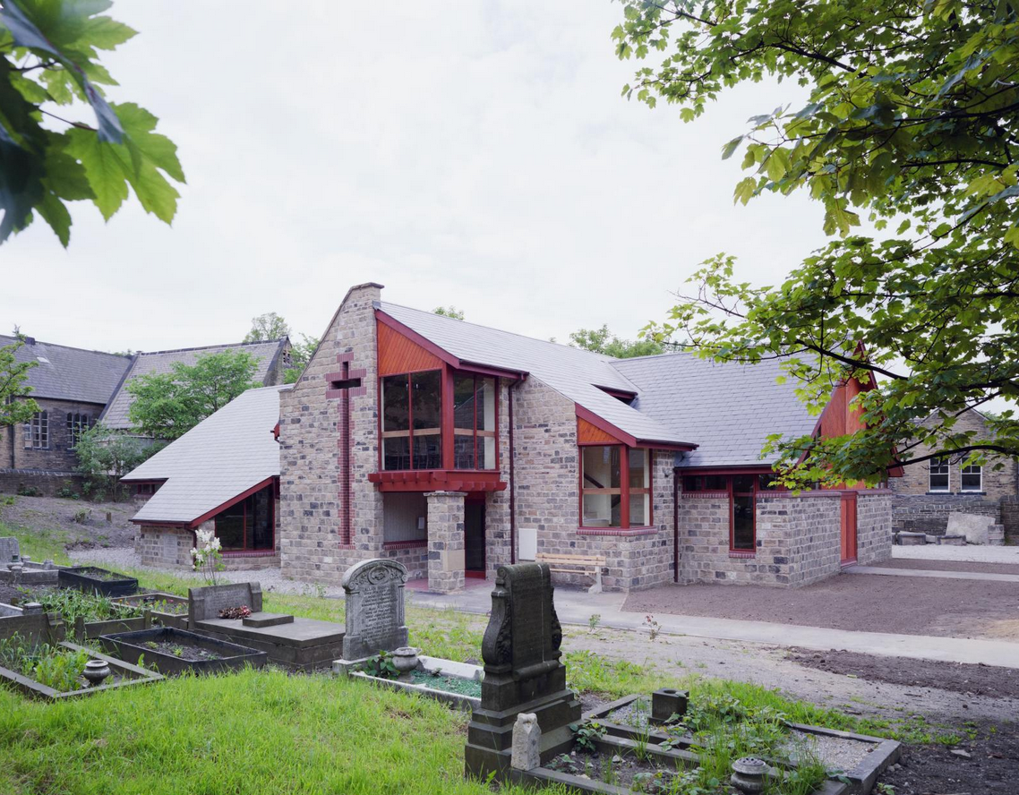
Clayton Baptist Church
Notes:
Activity: In your pair/group note down:
Things I know/features I can see.
Things I can work out/guess at.
Things I’d like to know/find out more about.
Image:
Clayton Baptist Church viewed from the east © Historic England Archive. John Laing Photographic Collection © Historic England Archive. John Laing Photographic Collection – Jan 1985 Ref: JLP01/10/19130
https://historicengland.org.uk/images-books/photos/item/JLP01/10/19130

Slide 47
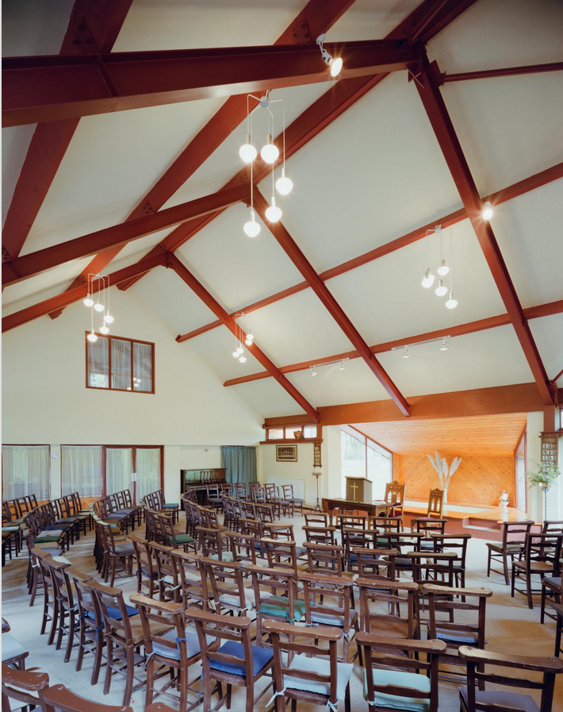
Notes:
Activity: In your pair/group note down:
Things I know/features I can see.
Things I can work out/guess at.
Things I’d like to know/find out more about.
Key Questions:
How does this look different from other churches you have seen?
(Note how the chairs for both congregation, and those leading the service, are at the same level)
NB: Note the piano on the left, so music can be heard throughout the church.
Image:
The interior of the worship hall in Clayton Baptist Church, showing seating beneath the roof trusses © Historic England Archive. John Laing Photographic Collection – Jan 1985 Ref: JLP01/10/19131
https://historicengland.org.uk/images-books/photos/item/JLP01/10/19131

Slide 48
This is a Christian place of worship – learn more about Christianity
Notes:
Use the BBC Bitesize pages on Religious Education to find out more about this religion https://www.bbc.co.uk/bitesize/subjects/z7hs34j
Also see: https://www.reonline.org.uk/

Slide 49
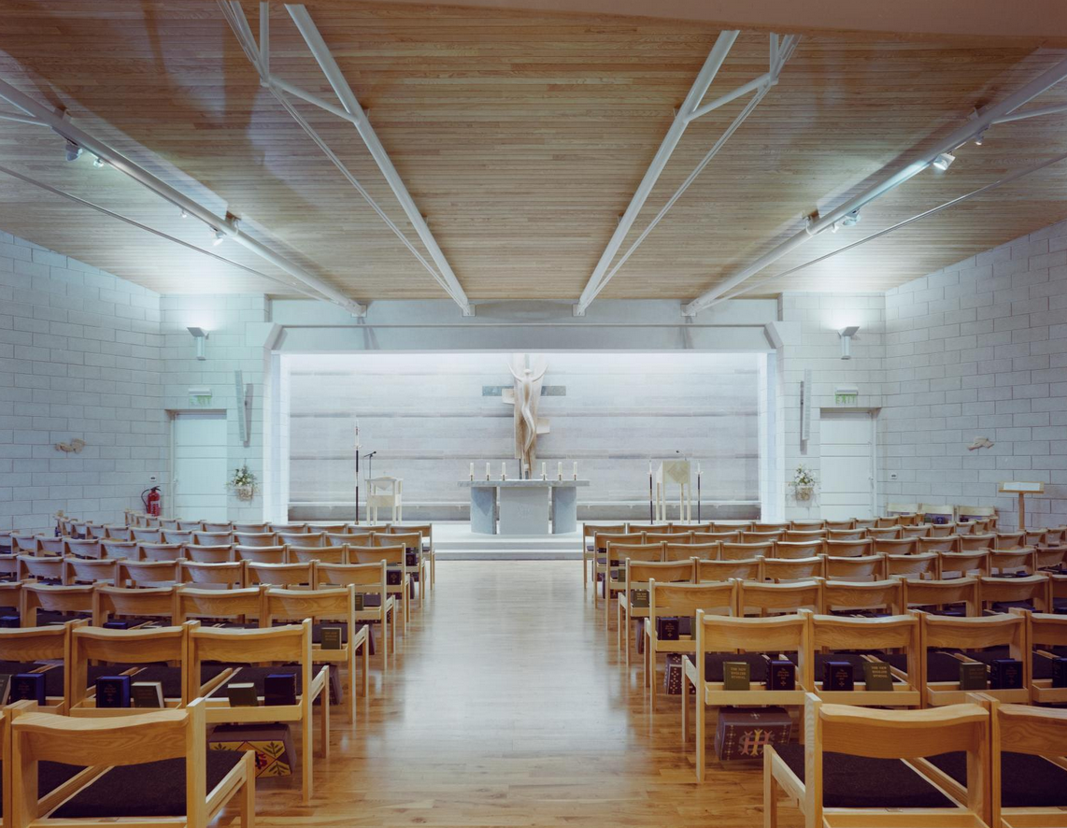
St Mary’s Church, Peterborough
Notes:
Activity: In your pair/group note down:
Things I know/features I can see.
Things I can infer/work out/guess at.
Things I’d like to know/find out more about.
Image:
A view looking down the central aisle towards the altar in St Mary's Church © Historic England Archive. John Laing Photographic Collection - 20 Nov 1991 – Ref: JLP01/10/51857
https://historicengland.org.uk/images-books/photos/item/JLP01/10/51857

Slide 50

Notes:
Activity: In your pair/group note down:
Things I know/features I can see.
Things I can infer/work out/guess at.
Things I’d like to know/find out more about.
Key Questions:
Which aspects of this design make this recognisable as modern church building?
Which aspects of this design do you think are more traditional?
What clues suggest this building replaced an earlier site? (Door and clock came from the previous Church of St Mary that had to be demolished and replaced by the new building. See: https://www.peterborough-stmarys.org.uk/about-us/history)
Image: St Mary's Church viewed from the north-west soon after its completion © Historic England Archive. John Laing Photographic Collection – 18 Oct 1991 Ref: JLP01/10/51481
https://historicengland.org.uk/images-books/photos/item/JLP01/10/51481

Slide 51
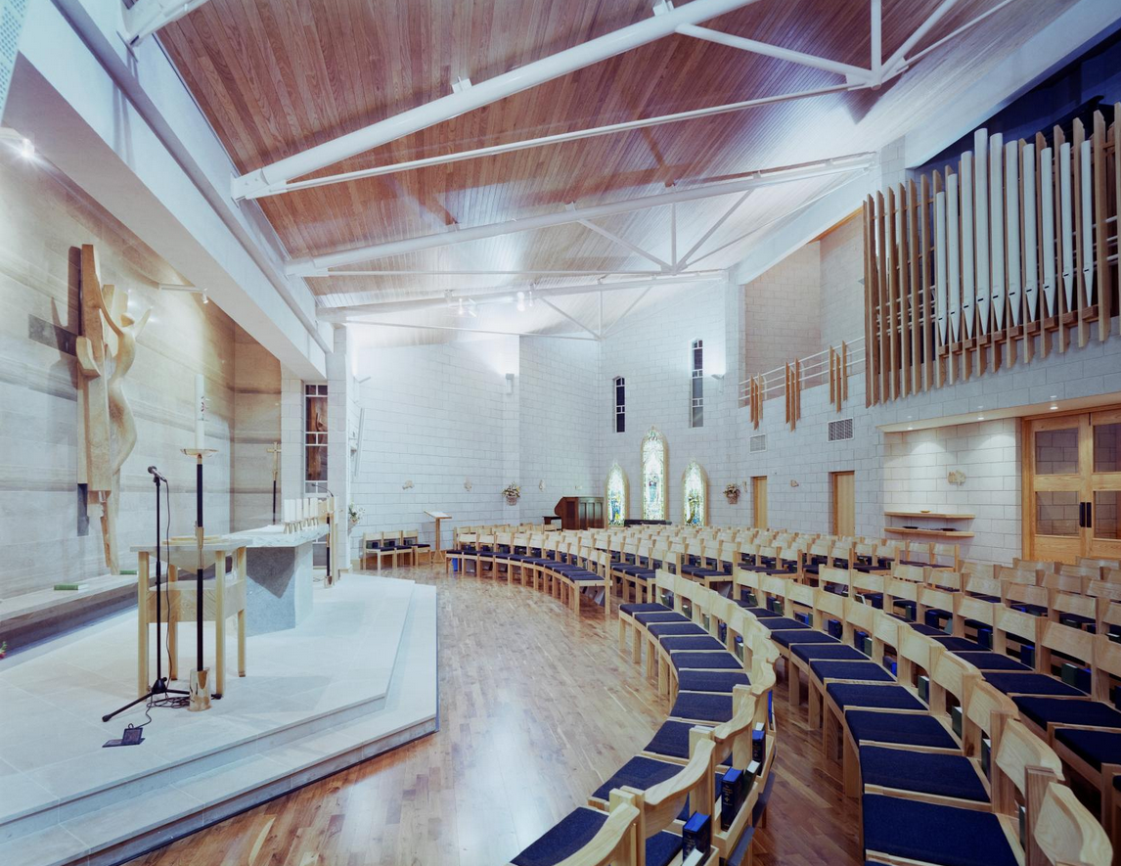
Notes:
Activity: In your pair/group note down:
Things I know/features I can see.
Things I can infer/work out/guess at.
Things I’d like to know/find out more about.
Key Questions:
How would you describe this design?
Which ‘traditional’ features of a church can you recognise?
Which design features are different from what you would expect to see in a ‘traditional’ church building
NB: Note the vertical tubular metal pipes of the organ on the back wall, so music can be heard throughout the church.
Image: The general view of the interior of St Mary's Church, showing the sanctuary and altar, seating and organ © Historic England Archive. John Laing Photographic Collection - 20 Nov 1991 - Ref: JLP01/10/51853 https://historicengland.org.uk/images-books/photos/item/JLP01/10/51853

Slide 52
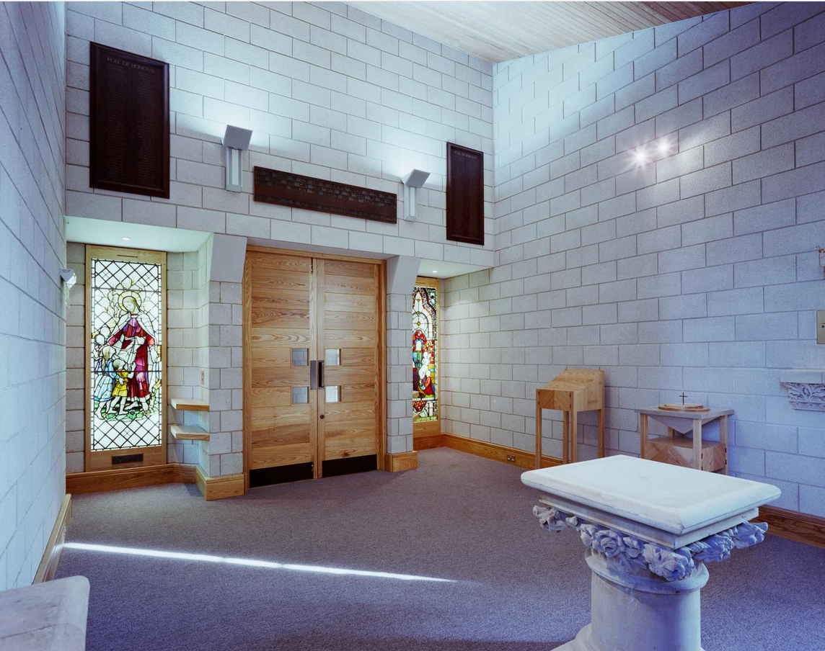
Notes:
Activity: In your pair/group note down:
Things I know/features I can see.
Things I can infer/work out/guess at.
Things I’d like to know/find out more about.
Key Question:
Can you identify the features that were from the original Church of St Mary, built in 18860, before being replaced by the new building?
Image: The interior of the chapel of St Mary's Church, showing original stained glass and the new entrance doors © Historic England Archive. John Laing Photographic Collection - 18 Oct 1991 Ref: JLP01/10/51482
https://historicengland.org.uk/images-books/photos/item/JLP01/10/51482

Slide 53
This is a Christian place of worship – learn more about Christianity
Notes:
Use the BBC Bitesize pages on Religious Education to find out more about this religion https://www.bbc.co.uk/bitesize/subjects/z7hs34j
Also see: https://www.reonline.org.uk/

Slide 54
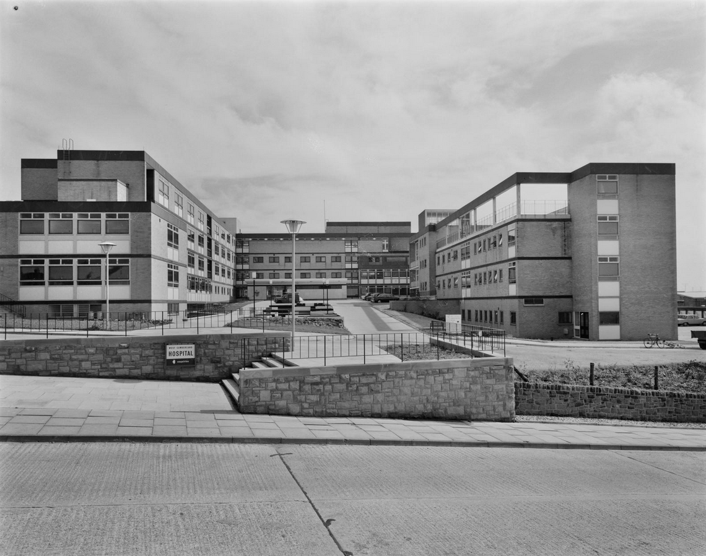
West Cumberland Hospital Chapel
Notes:
Activity: In your pair/group note down:
Things I know/features I can see.
Things I can infer/work out/guess at.
Things I’d like to know/find out more about.
Image:
The main entrance to West Cumberland Hospital, Whitehaven, looking south east across Homewood Road © Historic England Archive. John Laing Photographic Collection –
27 Aug 1964 Ref: JLP01/08/069243
https://historicengland.org.uk/images-books/photos/item/JLP01/08/069243

Slide 55
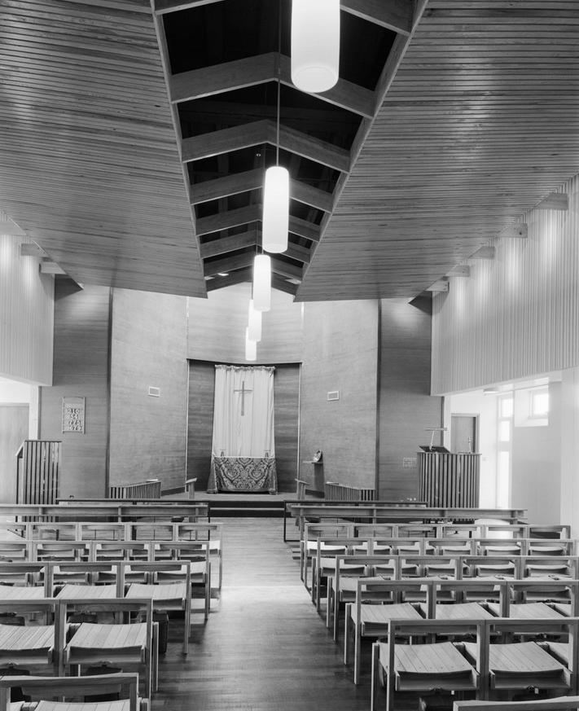
Notes:
Activity: In your pair/group note down:
Things I know/features I can see.
Things I can infer/work out/guess at.
Things I’d like to know/find out more about.
Image:
The interior of the chapel at West Cumberland Hospital, Whitehaven © Historic England Archive. John Laing Photographic Collection – 27 Aug 1964 - Ref: JLP01/08/069257
https://historicengland.org.uk/images-books/photos/item/JLP01/08/069257

Slide 56
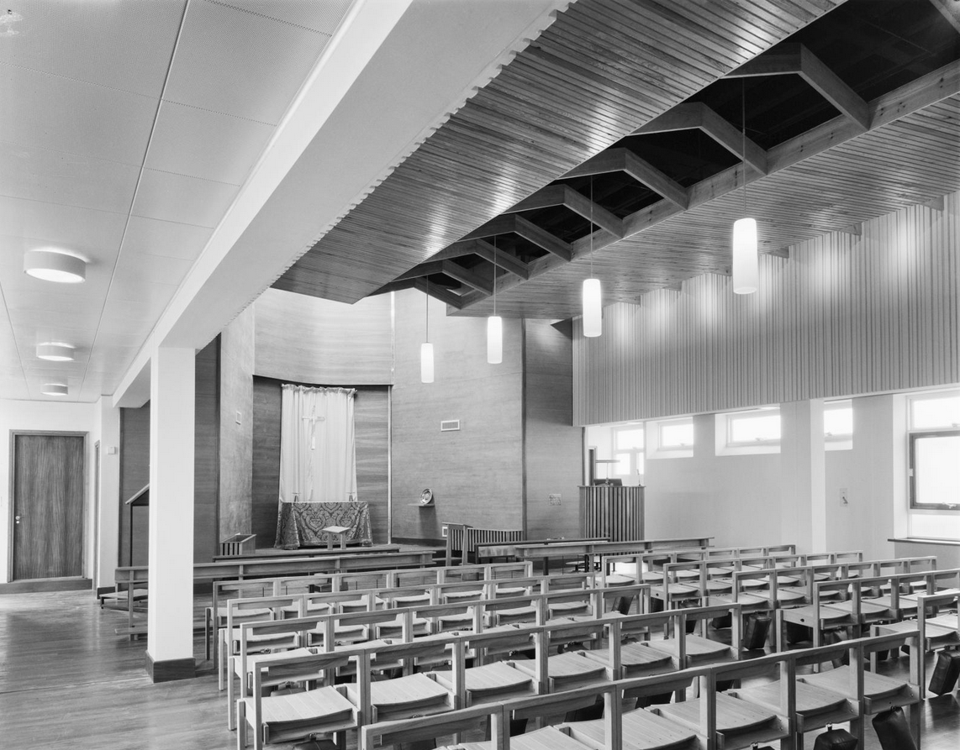
Notes:
Activity: In your pair/group note down:
Things I know/features I can see.
Things I can infer/work out/guess at.
Things I’d like to know/find out more about.
Key Question:
Why would you find a chapel in a hospital?
Research Questions:
Are hospital chapels just for Christians?
Can you find out any other links between religion and medicine throughout history or examples of developments in medicine being affected by religious beliefs?
Notes for teacher:
Medicine Through Time is a GCSE in-depth study, followed by many schools. A short research project into the impact on religion in the development of medicine would be a useful ‘preview’ study for pupils who may study these themes when they move into KS4.
Some examples may include mummification and Egyptian’s understanding of anatomy; forbidding of dissection in Ancient Rome, Islam and early Christian world, slowing down the gathering of anatomical knowledge; the Greek God of Healing Asclepios (the image staff and snake of Asclepios can often be seen on the front ambulances and nurses’ pin badges); beliefs about causes of the Black Death; the role of the Medieval Church and infirmaries.
https://www.bbc.co.uk/bitesize/guides/zxg6wxs/revision/1
https://schoolshistory.org.uk/topics/medicine-through-time/
Image:
The interior of the chapel at West Cumberland Hospital, Whitehaven © Historic England Archive. John Laing Photographic Collection – 27 Aug 1964 Ref: JLP01/08/069258
https://historicengland.org.uk/images-books/photos/item/JLP01/08/069258

Slide 57

Church of Jesus Christ of Latter-day Saints
Notes:
Activity: In your pair/group note down:
Things I know/features I can see.
Things I can work out/guess at.
Things I’d like to know/find out more about.
Image:
The Church of Jesus Christ of Latter-day Saints viewed from the south-east, showing the entrance © Historic England Archive. John Laing Photographic Collection - 15 Dec 1986 - Ref: JLP01/10/25237
https://historicengland.org.uk/images-books/photos/item/JLP01/10/25237

Slide 58
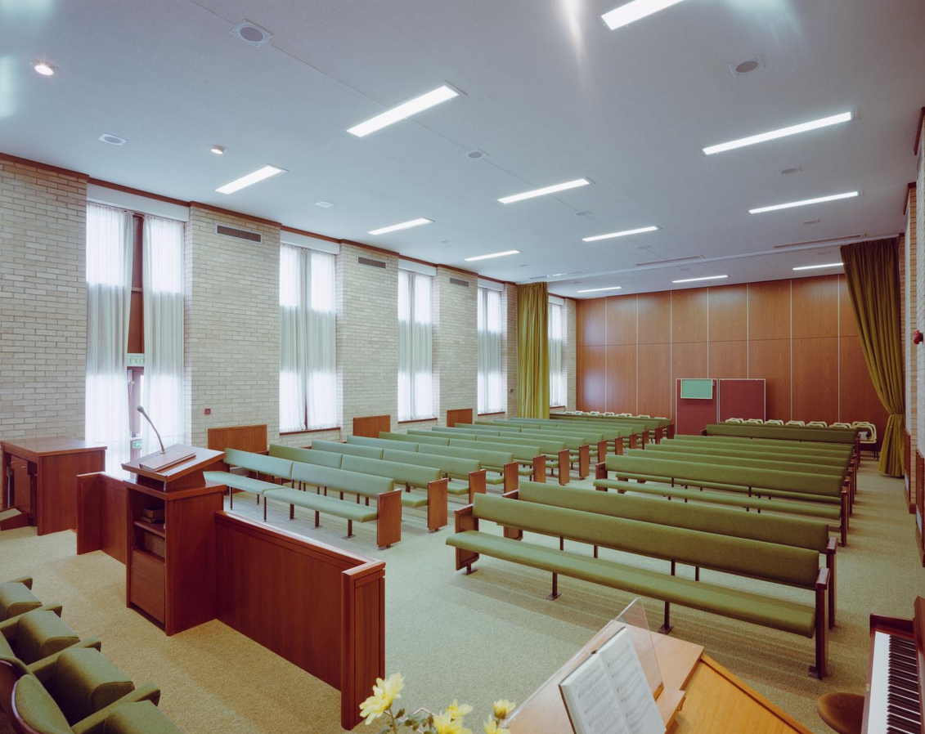
Notes:
Activity: In your pair/group note down:
Things I know/features I can see.
Things I can infer/work out/guess at.
Things I’d like to know/find out more about.
Activity
Study the 2 photos Looking at the inside of the Church of the Latter Day Saints.
Describe the ways in which it is similar with other Christian places of worship?
Can you identify some differences between the design of this building and what you would expect to see in other Christian places of worship?
Compare and contrast this with another Place of worship from a non-Christian religion.
Image:
The interior of the Church of Jesus Christ of Latter-day Saints, showing rows of seating in front of the lectern and raised dais © Historic England Archive. John Laing Photographic Collection - 7 Sep 1987 Ref: JLP01/10/28615
https://historicengland.org.uk/images-books/photos/item/JLP01/10/28615

Slide 59
Answers
What features do these buildings have?
Notes:
Activity: Use this slide to record all the different features that pupils have identified in the places of worship built by the John Laing building company.

Slide 60
Answers
What symbols can you see?
Notes:
Activity: Use this slide to record all the different symbols that pupils have identified in the places of worship built by the John Laing building company.

Slide 61
Answers
What is the same or different about these places of worship?
Same | Different
Notes:
Activity: Use this slide to record the similarities and differences that pupils have identified in the places of worship built by the John Laing building company.

Slide 62
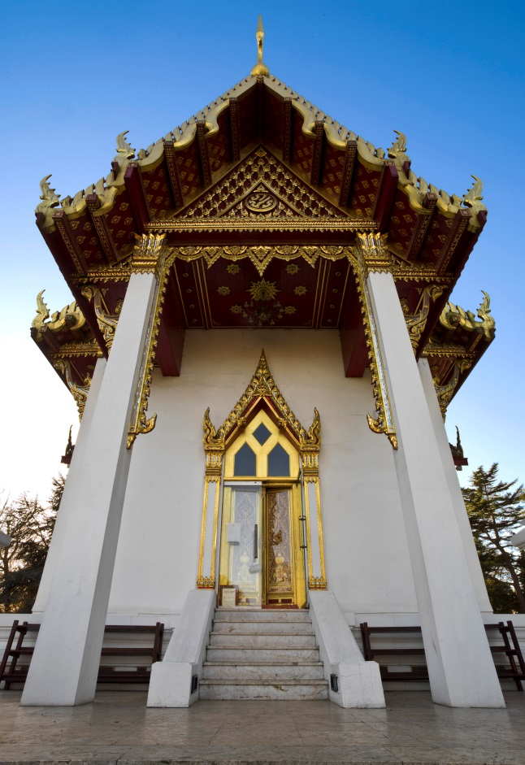
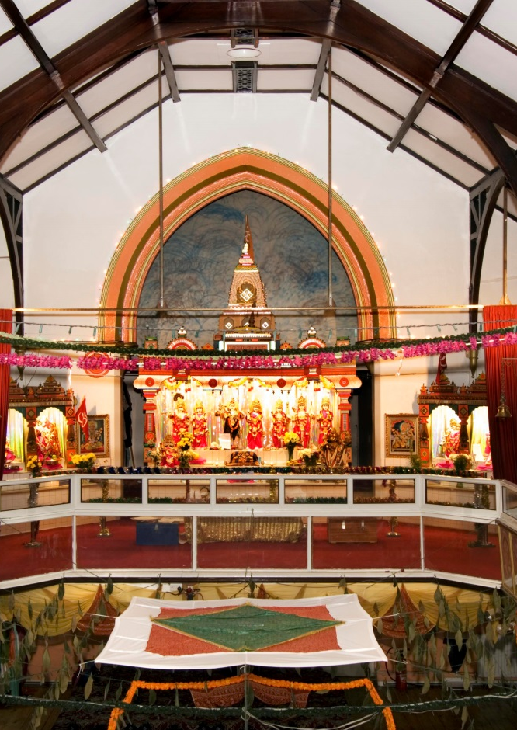
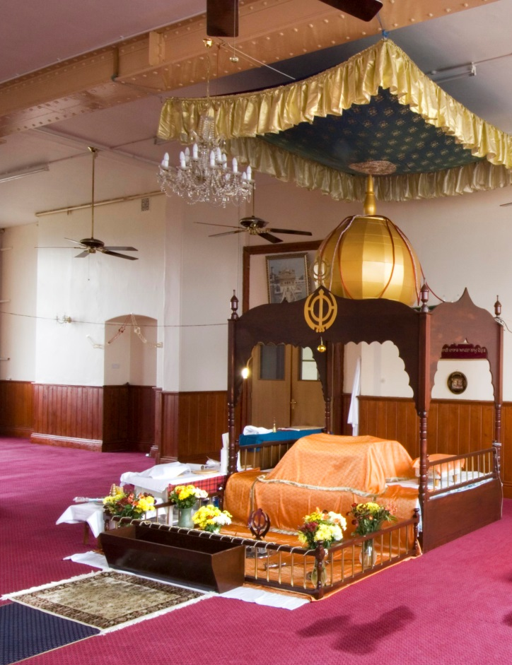
Other Places of Worship
John Laing
Notes:
While the John Laing building company worked on a mosque, cathedrals, churches and a synagogue, the were not asked to build places of worship for every faith. These are some of the places of worship in the Historic England Archive that they didn’t build.
What do you know? What is this building built for? Can you find 5 features in the place of worship in the Archive using the links below?
Images:
Exterior view looking up at the entrance to the Buddhapadipa Temple from the north-east © Historic England Archive 9 Dec 2012 Ref: DP134169
https://historicengland.org.uk/images-books/photos/item/DP134169
Interior view of the Hindu Temple, Redfield, Bristol © Historic England Archive 14 Feb 2007 Ref: DP035185
https://historicengland.org.uk/images-books/photos/item/DP035185
Interior view of the Gurdwara (Sikh Temple), 301-303 Church Road, St George, Bristol © Historic England Archive 27 Apr 2007 Ref: DP035410
https://historicengland.org.uk/images-books/photos/item/DP035410
See more pictures of the Buddhist temple:
https://historicengland.org.uk/images-books/photos/results/?searchType=HE+Archive+New&search=buddhist&filteroption=images
See more pictures of the Hindu temple:
https://historicengland.org.uk/images-books/photos/results/?searchType=HE+Archive+New&search=hindu&filteroption=images
See more pictures of the Sikh temple:
https://historicengland.org.uk/images-books/photos/results/?searchType=HE+Archive+New&search=sikh+temple&filteroption=images

Slide 63
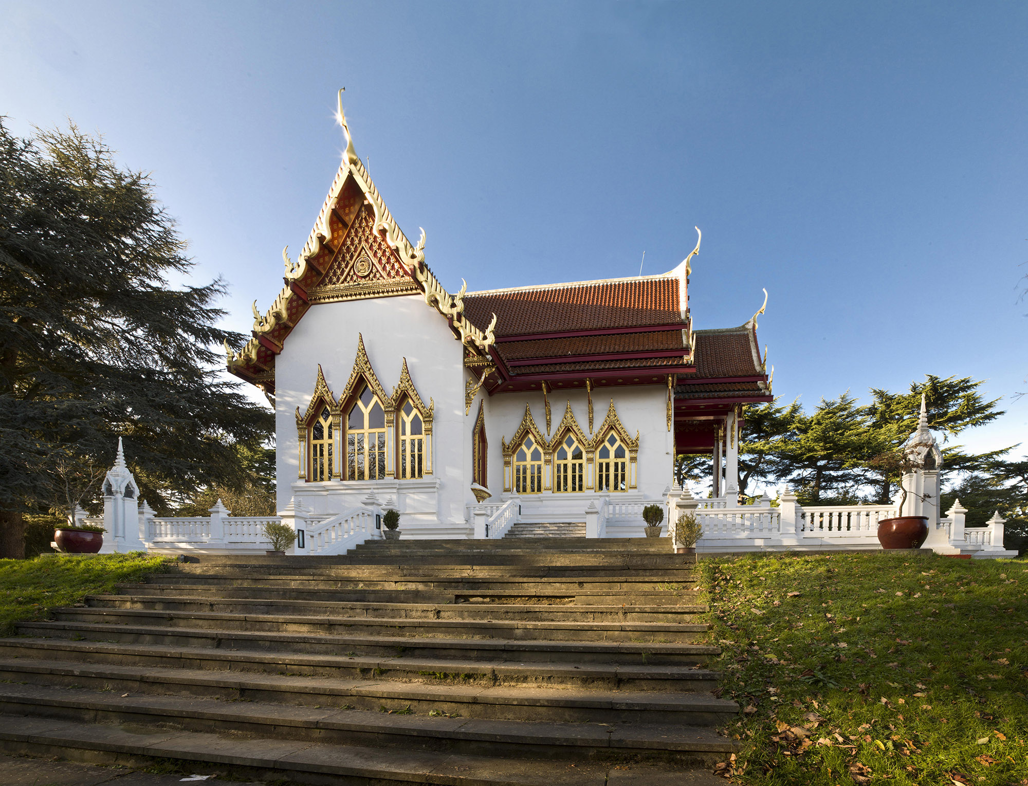
Buddhapadipa Temple, Wimbledon
Notes:
Activity: In your pair/group note down:
Things I know/features I can see.
Things I can infer/work out/guess at.
Things I’d like to know/find out more about.
Image:
Exterior view of the Buddhapadipa Temple from the south-east © Historic England Archive – 9 December 2012 Ref: DP134174
https://historicengland.org.uk/images-books/photos/item/DP134174

Slide 64

Notes:
Activity: In your pair/group note down:
Things I know/features I can see.
Things I can infer/work out/guess at.
Things I’d like to know/find out more about.
Image:
Exterior view looking up at the entrance to the Buddhapadipa Temple from the north-east © Historic England Archive – 9 December 2012 Ref: DP134169
https://historicengland.org.uk/images-books/photos/item/DP134169

Slide 65
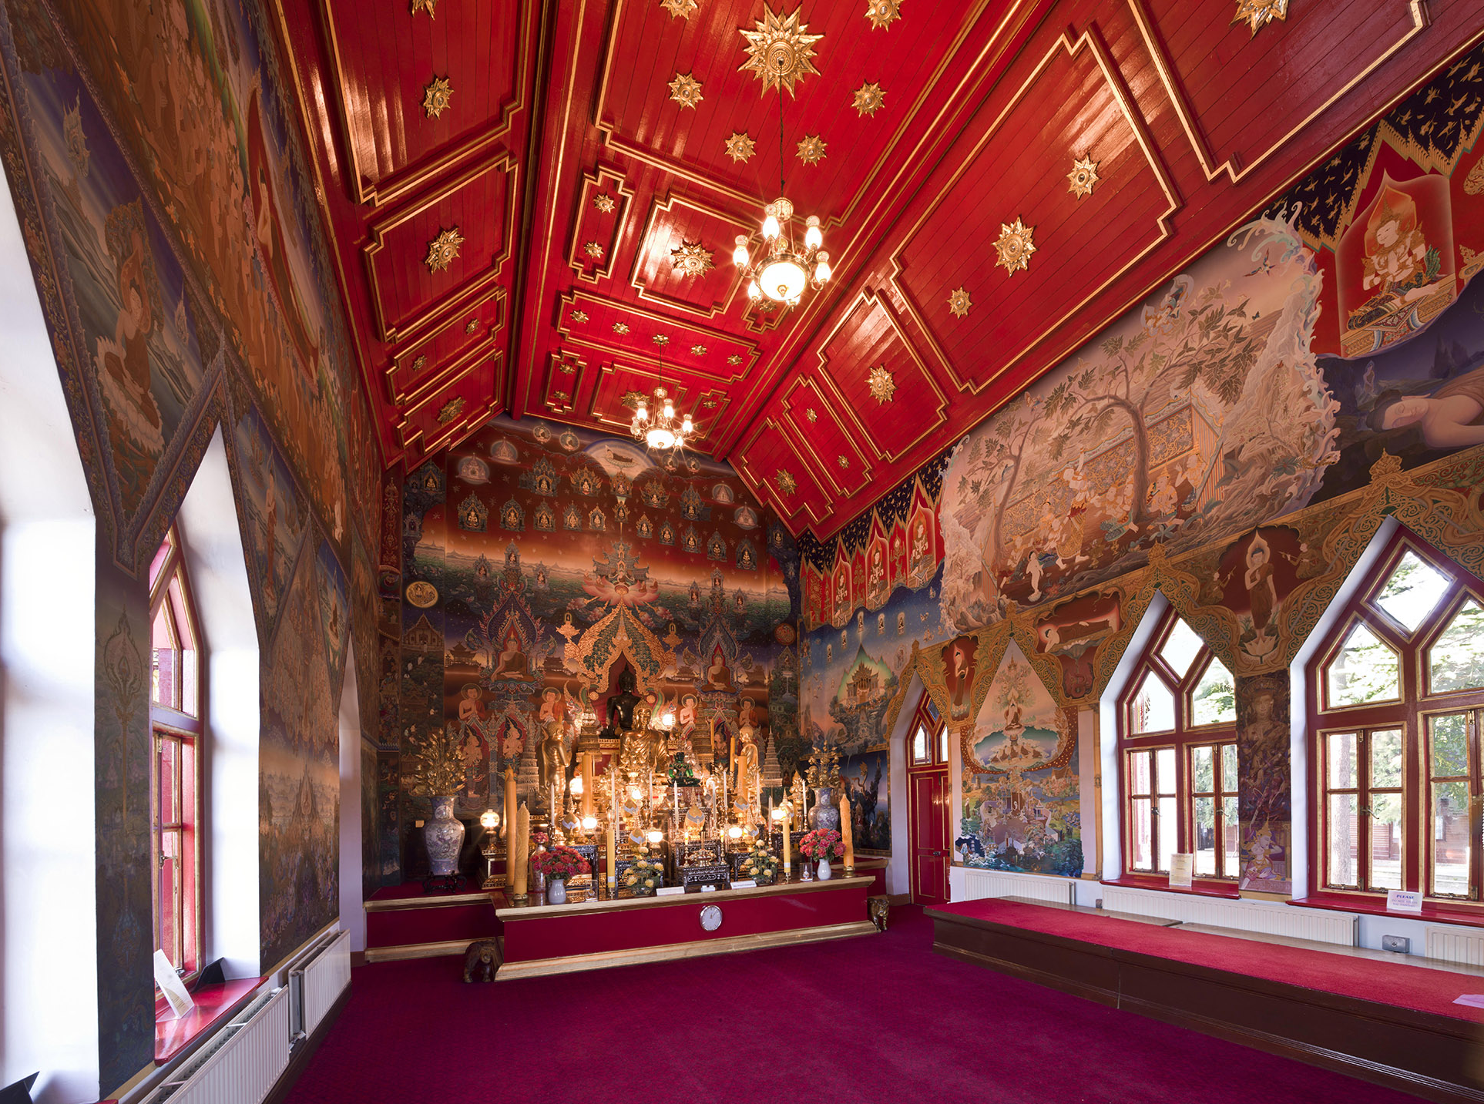
Notes:
Activity: In your pair/group note down:
Things I know/features I can see.
Things I caninfer/ work out/guess at.
Things I’d like to know/find out more about.
Image:
Interior view of the Buddhapadipa Temple, showing the uposatha or shrine hall © Historic England Archive – 9 December 2012 Ref: DP134180
https://historicengland.org.uk/images-books/photos/item/DP134180

Slide 66
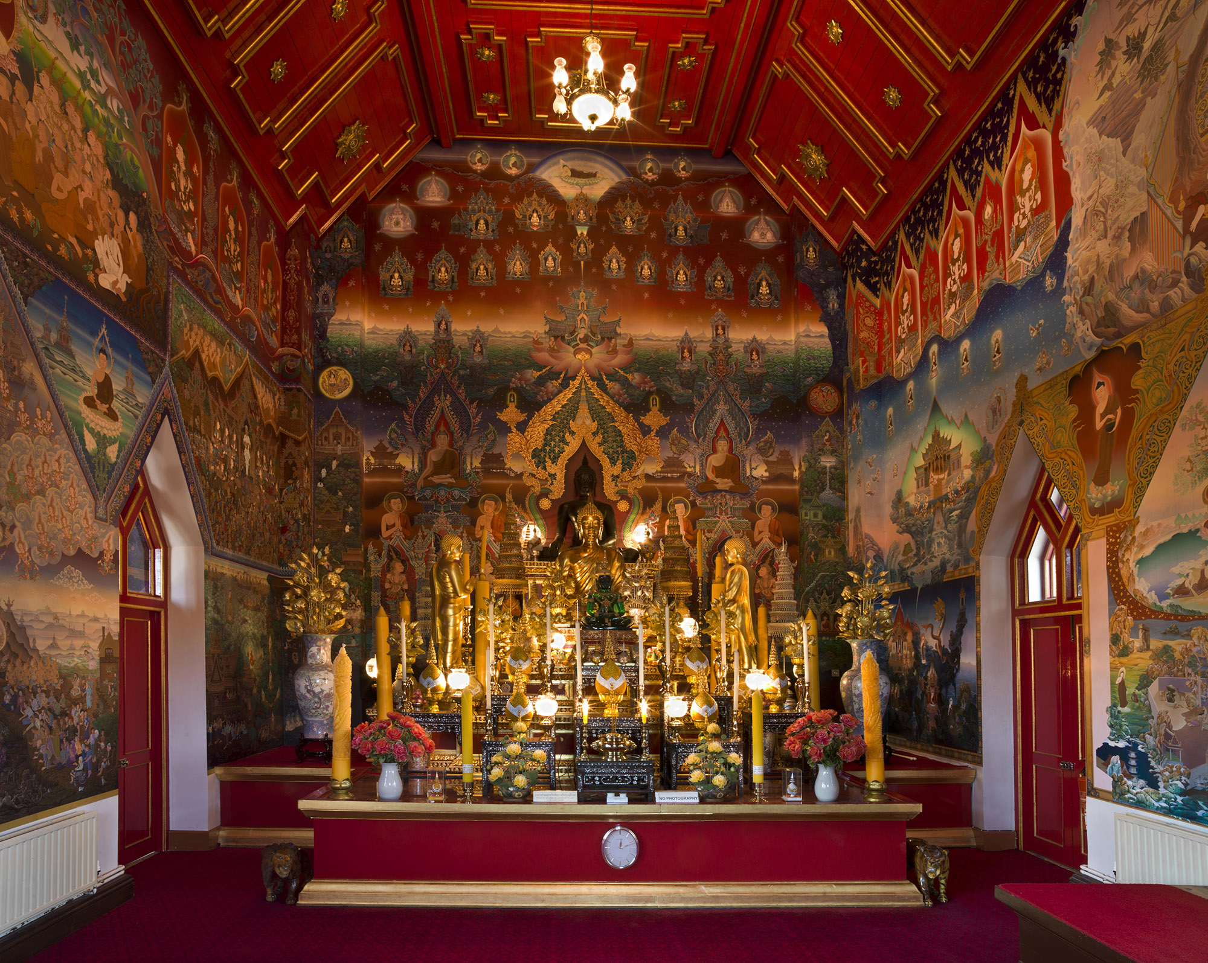
Notes:
Activity: In your pair/group note down:
Things I know/features I can see.
Things I can infer/work out/guess at.
Things I’d like to know/find out more about.
Activity:
Describe this image, as clearly as you can, to someone who cannot see this photograph.
Image:
Interior view of the Buddhapadipa Temple, showing the uposatha or shrine hall © Historic England Archive – 9 December 2012 Ref: DP134181
https://historicengland.org.uk/images-books/photos/item/DP134181

Slide 67
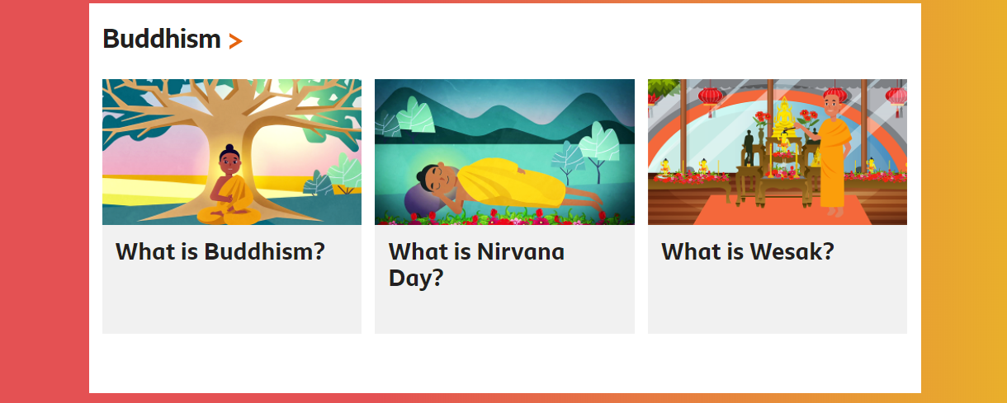
This is a Buddhist place of worship – learn more about Buddhism
Notes:
Use the BBC Bitesize pages on Religious Education to find out more about this religion https://www.bbc.co.uk/bitesize/subjects/z7hs34j
Also see: https://www.reonline.org.uk/

Slide 68
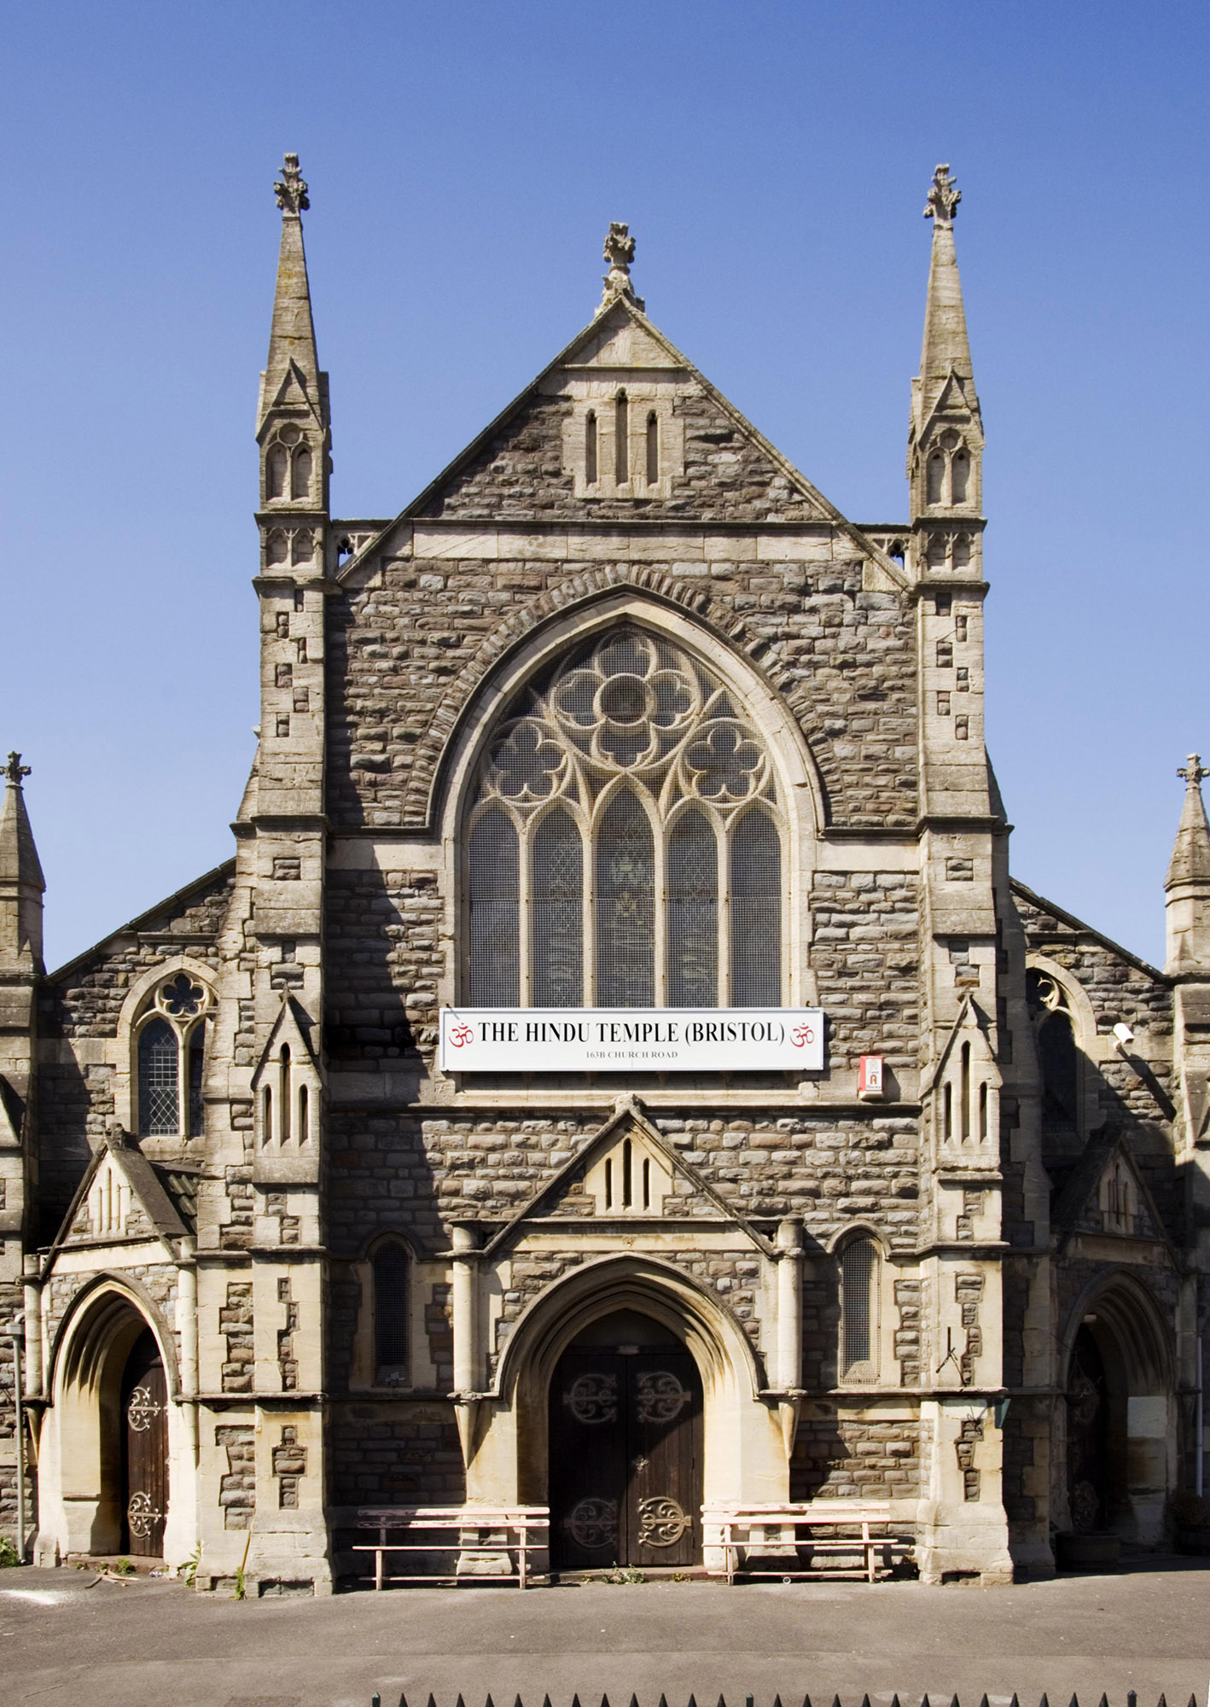
Hindu Temple, Bristol
Notes:
Activity: In your pair/group note down:
Things I know/features I can see.
Things I can infer/work out/guess at.
Things I’d like to know/find out more about.
Key Question:
Do you think this building was always a Hindu temple? What do you think the original purpose of this building was?
Image:
Exterior view of the Hindu Temple, Redfield, Bristol © Historic England Archive – 1 May 2007 Ref: DP035355
https://historicengland.org.uk/images-books/photos/item/DP035355

Slide 69

Notes:
Activity: In your pair/group note down:
Things I know/features I can see.
Things I can infer/work out/guess at.
Things I’d like to know/find out more about.
Key Question:
Are there any clues from the internal architecture about what time period / era this building was constructed?
What does this change in the building’s purpose tell us about the changes in our culture and ethnic influences on our society, especially since the Second World War?
Image:
Interior view of the Hindu Temple, Redfield, Bristol © Historic England Archive – 14 February 2007 Ref: DP035185
https://historicengland.org.uk/images-books/photos/item/DP035185

Slide 70

Notes:
Activity: In your pair/group note down:
Things I know/features I can see.
Things I can work out/guess at.
Things I’d like to know/find out more about.
Key Question:
In what ways is this similar / different from the other places of worship you see in this selection of photographs?
Image:
Detail view of a shrine in the Hindu Temple, Redfield, Bristol © Historic England Archive – 14 February 2007 Ref: DP035189
https://historicengland.org.uk/images-books/photos/item/DP035189

Slide 71

Notes:
Activity: In your pair/group note down:
Things I know/features I can see.
Things I can work out/guess at.
Things I’d like to know/find out more about.
Image:
Interior view of the Hindu Temple, showing a shrine, Redfield, Bristol © Historic England Archive – 14 February 2007 Ref: DP035191
https://historicengland.org.uk/images-books/photos/item/DP035191

Slide 72

This is a Hindu place of worship – learn more about Hinduism
Notes:
Use the BBC Bitesize pages on Religious Education to find out more about this religion https://www.bbc.co.uk/bitesize/subjects/z7hs34j
Also see: https://www.reonline.org.uk/

Slide 73

Sikh Temple, Bristol
Notes:
Activity: In your pair/group note down:
Things I know/features I can see.
Things I can infer/work out/guess at.
Things I’d like to know/find out more about.
Key Question:
Do you think this was built as a Sikh Temple or do you think this building originally had another purpose? Explain your answer.
Can you find any other local places of worship that have been re-purposed
Image:
Exterior view from the south west of the Gurdwara (Sikh Temple), 301-303 Church Road, St George, Bristol © Historic England Archive – 1 May 2007 Ref: DP035407
https://historicengland.org.uk/images-books/photos/item/DP035407

Slide 74

Notes:
Activity: In your pair/group note down:
Things I know/features I can see.
Things I can infer/work out/guess at.
Things I’d like to know/find out more about.
Image:
Interior view of the Gurdwara (Sikh Temple), 301-303 Church Road, St George, Bristol © Historic England Archive – 27 April 2007 Ref: DP035408
https://historicengland.org.uk/images-books/photos/item/DP035408

Slide 75

Notes:
Activity: In your pair/group note down:
Things I know/features I can see.
Things I can infer/work out/guess at.
Things I’d like to know/find out more about.
Key Question:
Look at the details in this photograph. What similarities can you find when comparing it with other places of worship featured in this selection of photographs?
Image:
Interior view of the Gurdwara (Sikh Temple), 301-303 Church Road, St George, Bristol © Historic England Archive – 27 April 2007 Ref: DP035410
https://historicengland.org.uk/images-books/photos/item/DP035410

Slide 76

Notes:
Activity: In your pair/group note down:
Things I know/features I can see.
Things I can infer/work out/guess at.
Things I’d like to know/find out more about.
Image:
Detail view of an altar in the Gurdwara (Sikh Temple), 301-303 Church Road, St George, Bristol © Historic England Archive – 27 April 2007 Ref: DP035417
https://historicengland.org.uk/images-books/photos/item/DP035417

Slide 77

This is a Sikh place of worship – learn more about Sikhism
Notes:
Use the BBC Bitesize pages on Religious Education to find out more about this religion https://www.bbc.co.uk/bitesize/subjects/z7hs34j
Also see: https://www.reonline.org.uk/

Slide 78
Re-Purposing Places of Worship
Many of our places of worship have been re-purposed, meaning they have a different purpose from the one they were built for.
Can you find examples of local buildings that were built as places of worship but now have a different purpose?
Can you find some local places of worship that were originally built to serve a different religion?
Can you find local buildings that now serve as a place of worship but were not originally designed as a religious building?

Slide 79

Let’s be architects!
Notes:
We’re now going to be architects of our own place of worship. Start by watching this film.
Watch: BBC ‘Proud to be an architect’ to learn more about the role of an architect or start exploring the images
https://www.bbc.co.uk/teach/class-clips-video/pshe-ks1-ks2-proud-to-be-an-architect/zbf76v4

Slide 80

Let’s be architects!
Using what you’ve learnt about the key features of the places of worship built by John Laing as inspiration,
you’re now going to become ‘Honorary Architects’ and design your own places of worship!
Notes:
Activity: Create a place of worship. Draw, build, collage with the photographs, or you could even use Minecraft to build a place of worship. List 5 features that make it unique. Think about the things you discovered in the John Laing Photographic Collection.
Image:
London Central Mosque almost completed - © Historic England Archive. John Laing Photographic Collection – 4 August 1977 Ref: JLP01/10/04820
https://historicengland.org.uk/images-books/photos/item/JLP01/10/04820

Slide 81

Where does an ‘Honorary Architect’ start?
Notes:
This is a good point to ask what they think an architect might do on a project like this.
Then as a class watch this inspiring film about Architecture (Note: some of the words will be new to students, so you may wish to stop and discuss the different ideas)

Slide 82

Hear from someone who built a place of worship
Watch a video of Thomas Lai
& students at the London Central Mosque
Notes:
Watch a video of Thomas Lai (an architect for John Laing) & students discussing the building of the dome at the London Central Mosque https://vimeo.com/452243675
What do you learn from Thomas?
What architecture does he mention? The materials, problems they faced, how he over came them.
What parts do the students like the most about the Mosque?

Slide 83



Step 1: Investigate
Notes:
We’ve already investigated some places of worship. What did you learn about the places of worship you’ve look at?
Can you use your work to create a set of criteria for your place of worship? You may ask your pupils to design a completely new place of worship for a religion of their choice; you may focus on a religion you are studying in RE; you may decide to re-design / design a new version of a place of worship that is near to your school.
Extension Activity:
Pupils may also research other buildings designed by architects who designed some of the Laing buildings. These include: Sir Basil Spence, James Stirling, the Percy Thomas Partnership (Ronald Weeks, E S Jennett and Antoni Poremba), L Siwani and D C Loader of Sir Frederick Gibberd and Partners). Pupils may also look into the work of other notable architects such as Norman Foster, Zaha Hadid and Augustus Pugin.
Image:
Students from London School look at images of the London Central Mosque from the Historic England Archive. © Historic England Archive
Students from Coventry School look at images of the Coventry Cathedral from the Historic England Archive. © Historic England Archive
Students from London School look at images of the London Central Mosque from the Historic England Archive. © Historic England Archive

Slide 84
Honorary Architects Challenge
Imagine you are an architect.
You have been commissioned to design a new place of worship.
Think about how you can assemble your ideas and come up with a stunning design for a place of worship that is durable, useful and beautiful
You can create the criteria that you would need to follow to make your design successful
Notes:
Activity: Create a place of worship. Draw, build, collage with the photographs, or you could even use Minecraft to build a place of worship. Think about the things you discovered in the John Laing Photographic Collection.
Research:
Pupils may research the designs of other buildings designed by architects who designed some of the Laing buildings. These include: Sir Basil Spence, James Stirling, the Percy Thomas Partnership (Ronald Weeks, E S Jennett and Antoni Poremba), L Siwani and D C Loader of Sir Frederick Gibberd and Partners). Pupils may also look into the work of other notable architects such as Norman Foster, Zaha Hadid and Augustus Pugin.
Image:
London Central Mosque almost completed - © Historic England Archive. John Laing Photographic Collection – 4 August 1977 Ref: JLP01/10/04820
https://historicengland.org.uk/images-books/photos/item/JLP01/10/04820

Slide 85
Example:
Success Criteria for Honorary Architects
Your building must clearly serve as a place of worship for a specific religion or religious denomination you building
Your design must contain at least 5 key features that belong in a place of worship for that religion
Your design must be durable, useful and beautiful
Your design must be original
Notes:
Activity: With your class, before you start designing you places of worship, establish what the ‘success criteria’ will be for each building – above is an example.

Slide 86



Step 2: Think
Notes:
Think about your ideas for reimagining the site. You may want to re-watch the inspiring film about Architecture
In pairs develop your ideas for reimaging and redesigning the site you are working on. You could create a “mood board” including mind maps of your ideas, sketches and drawings, cut out pieces from the images you’ve seen or find others

Slide 87
Task Guidelines for Honorary Architects
Decide for which religion or religious denomination your building will be a place of worship
Decide if this is a brand new building or replacing an existing place of worship. Will you incorporate aspects of the original building?
Consider at least 5 key features that belong in a place of worship for that religion and must be included in your design
Study a range of other examples of places or worship, non-religious buildings or the work of famous architects to get some inspiration and ideas.
Consider which different building materials you would like to use and why these would be suitable for your building
Consider how to make your design durable, useful and beautiful
Consider how you will present your ideas: pencil sketches, paintings, Minecraft, PowerPoint, architect’s technical drawing
Notes:
Activity: Create a place of worship. Draw, build, collage with the photographs, or you could even use Minecraft to build a place of worship. List 5 features that make it unique. Think about the things you discovered in the John Laing Photographic Collection.
Research:
Pupils may research the designs of other buildings designed by architects who designed some of the Laing buildings. These include: Sir Basil Spence, James Stirling, the Percy Thomas Partnership (Ronald Weeks, E S Jennett and Antoni Poremba), L Siwani and D C Loader of Sir Frederick Gibberd and Partners). Pupils may also look into the work of other notable architects such as Norman Foster, Zaha Hadid and Augustus Pugin.
Image:
London Central Mosque almost completed - © Historic England Archive. John Laing Photographic Collection – 4 August 1977 Ref: JLP01/10/04820
https://historicengland.org.uk/images-books/photos/item/JLP01/10/04820

Slide 88

Step 3: Model
Notes:
Anything can be used to model and imagine the spaces. You can often model things that you cannot draw. Use a range of materials such as cardboard boxes, plastic bottles etc.
Minecraft and Lego make great building materials too!
Check out some of the models made by John Laing Building Company for inspiration: https://historicengland.org.uk/images-books/photos/results/?searchType=HE+Archive+New&search=jlp01+model
Image:
Laing staff in the Clifton Cathedral site office examining an architect's model of the cathedral © Historic England Archive. John Laing Photographic Collection – 7 Dec 1971, Bristol Ref: JLP01/08/089942
https://historicengland.org.uk/images-books/photos/item/JLP01/08/089942
An architect's model of a reactor at Berkeley Nuclear Power Station © Historic England Archive. John Laing Photographic Collection – 29 May 1958, Bristol Ref: JLP01/08/051732
https://historicengland.org.uk/images-books/photos/item/JLP01/08/051732

Slide 89

Step 4: Share
Notes:
Describe or present your designs to the rest of the class. Remember to return to the original ‘success criteria’ you created in step one and use these as the reference point for peer assessment.
You could vote on your preferred design for each site?
Why not have a class exhibition and invite other students, staff and parents to see your work!
Image:
Students from Patchway School hold up images from the John Laing Photographic Collection in the Clifton Cathedral © Historic England Archive

Slide 90

Find more teaching resources at:
HistoricEngland.org.uk/Education
Notes:
Image:
Students and former John Laing building company employees at the Clifton Cathedral © Historic England Archive

