Slide 1


Breaking New Ground
The John Laing Photographic Collection
What makes a housing estate special?
Using the John Laing Photographic Collection
to explore Easiform housing in your community
Notes:
A one hour lesson plan & presentation
There is also a film to accompany this lesson: https://vimeo.com/434831476

Slide 2

What makes a housing estate special?
Key Stage 2: Local History Study
Learning Aims and Outcomes
Pupils will:
Develop a sense of pride in where they live
Understand their local heritage and how it relates to a national story
Understand what a photographic archive is & how it could be used
Use primary sources
Select and organise relevant historical information
Explore changes in post-war Britain
Look at their own identity within a local case study
Devise historically valid questions (oral history)
This PowerPoint relates to the following Teaching Activity: https://historicengland.org.uk/services-skills/education/teaching-activities/what-makes-a-housing-estate-special

Slide 3
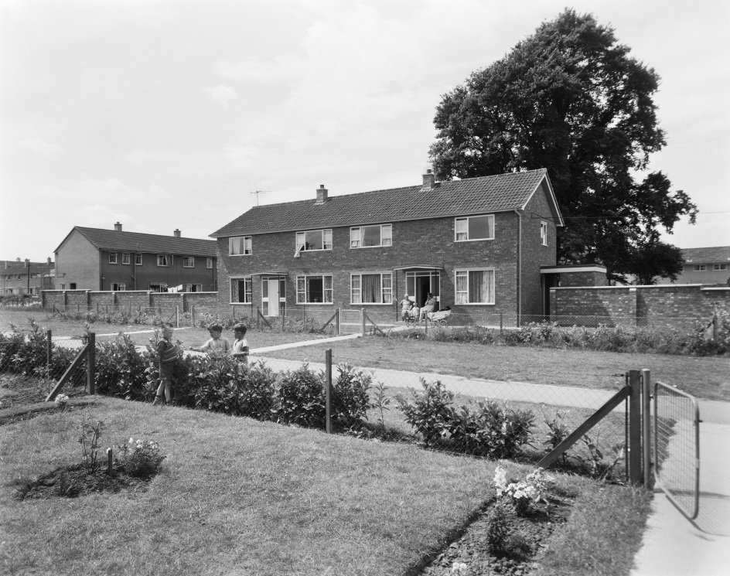
Who walked to school today?
Is your house historical?
How old do you think your house is?
Notes:
Ask: Who walked to school? Is your house historical? How old do you think your house is? Get suggestions about how they might find out or who they could ask.
Images:
Easiform housing – Swindon © Historic England Archive. John Laing Photographic Collection - 21 October 1960 Ref: jlp01/08/060441
https://historicengland.org.uk/images-books/photos/item/JLP01/08/060441
Easiform housing – Swindon © Historic England Archive. John Laing Photographic Collection - 21 October 1960 Ref: jlp01/08/058462
https://historicengland.org.uk/images-books/photos/item/JLP01/08/058462

Slide 4
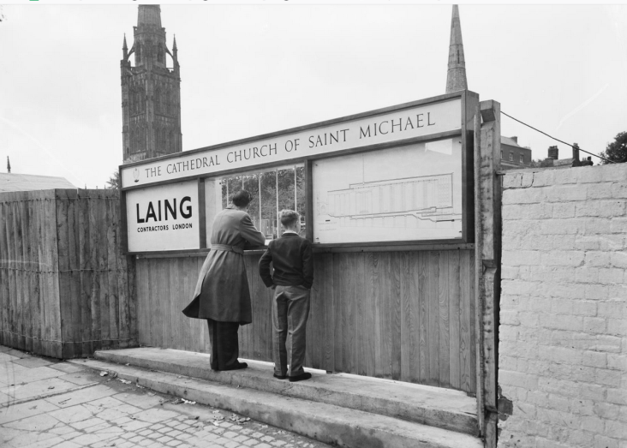
Why are photos a good historical source?
What do you know/can you gather from these photos?
Notes:
Ask: Why are photos a good historical source? What do you know/can you gather from these photos?
Share: Historical England was given 230,000 images from the John Laing building company. They chose 10,000 images, including these ones, to be put onto a website. The original photographs are all kept in the archive in Swindon, a big fridge. These are pictures of the building of the M1 Motorway, Coventry Cathedral, a group of Laing workers in Reading, a stonemason at the Carlisle Cathedral and the London Central Mosque. They show us places, people, and progress in England from after the Second World War.
Note: you may wish to choose images of sites the students would recognise or relating to previous study. See final slide for how to find images online.
Images:
M1 Motorway construction - © Historic England Archive. John Laing Photographic Collection – c1958-59 Ref: JLP01/14/00020
https://historicengland.org.uk/images-books/photos/item/JLP01/14/00020
Coventry Cathedral construction - © Historic England Archive. John Laing Photographic Collection – 6 September 1955 Ref: JLP01/08/044594
https://historicengland.org.uk/images-books/photos/item/JLP01/08/044594
Builders of the Berkshire Country HQ - © Historic England Archive. John Laing Photographic Collection – 9 Ref: JLP01/09/802896
https://historicengland.org.uk/images-books/photos/item/JLP01/09/802896
Carlisle Cathedral Stonemason - © Historic England Archive. John Laing Photographic Collection – 19 July 1983 Ref: JLP01/10/13959
https://historicengland.org.uk/images-books/photos/item/JLP01/10/13959
London Central Mosque almost completed - © Historic England Archive. John Laing Photographic Collection – 4 August 1977 Ref: JLP01/10/04820
https://historicengland.org.uk/images-books/photos/item/JLP01/10/04820

Slide 5
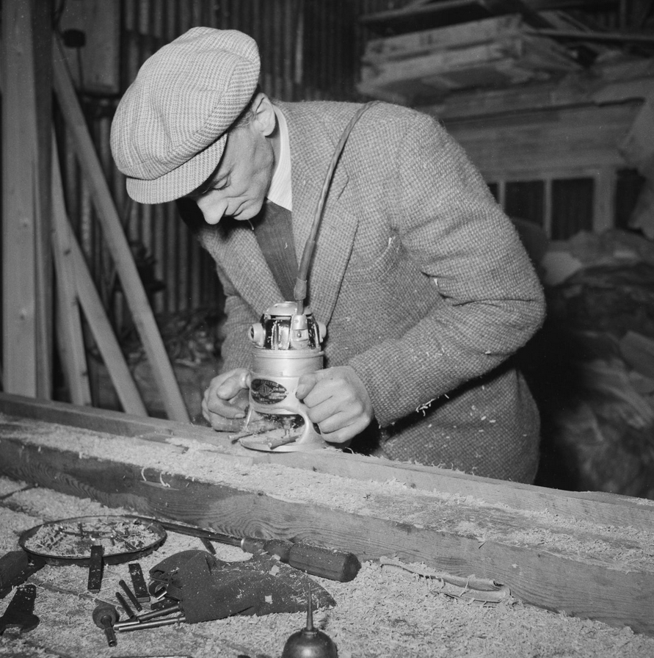
What do you know
&
what can you gather
from this photo?
Notes:
Activity: Print and hand out copies of slides 5-15 (or copy them into a new PPT for pupils to use if they are learning from home). Start by giving students the photos without the description (below). This can be used later as part of an additional activity, as suggested on Slide 22.
Ask: What evidence does this photo give us? What do you know? What do you think is happening? What would you like to find out?
Students could swap images and look for differences or see if the images relate to each other.
Image: © Historic England Archive. John Laing Photographic Collection - Ref: jlp01/08/008345
https://historicengland.org.uk/images-books/photos/item/JLP01/08/008345
Description:
A man using an electric planer during the construction of a porch for an Easiform house
Date: 10 Mar 1953
Location: Swindon

Slide 6
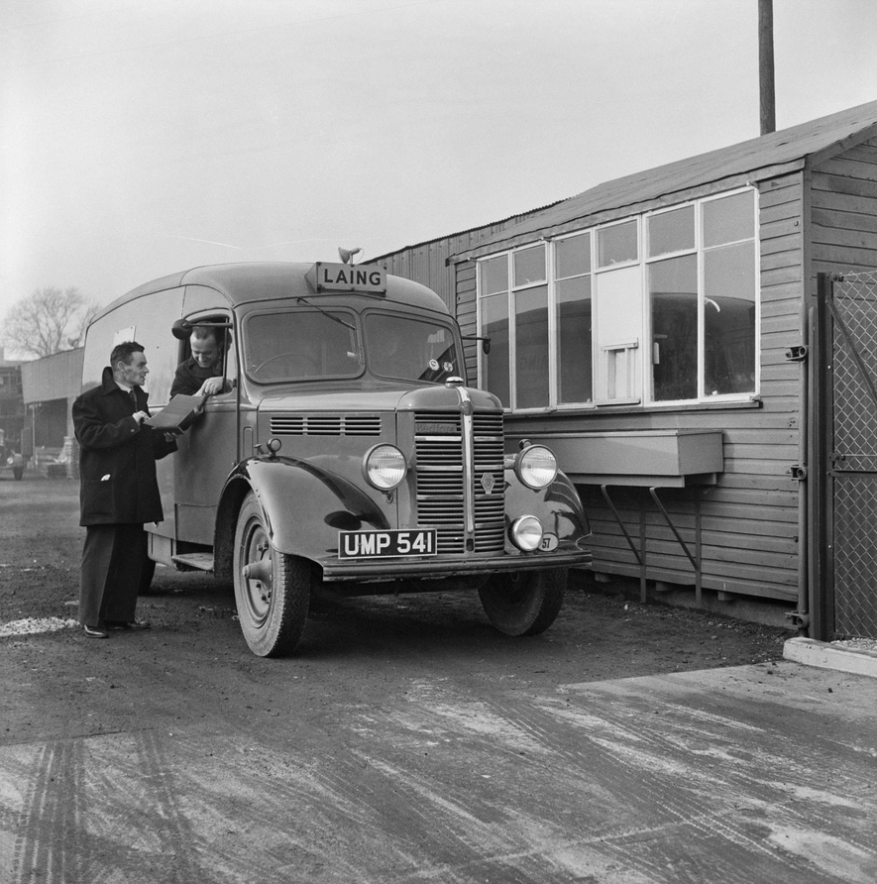
What do you know
&
what can you gather
from this photo?
Notes:
Activity: Print and hand out copies of slides 5-15 (or copy them into a new PPT for pupils to use if they are learning from home). Start by giving students the photos without the description (below). This can be used later as part of an additional activity, as suggested on Slide 22.
Ask: What evidence does this photo give us? What do you know? What do you think is happening? What would you like to find out?
Students could swap images and look for differences or see if the images relate to each other.
Image:© Historic England Archive. John Laing Photographic Collection - Ref: jlp01/08/020344
https://historicengland.org.uk/images-books/photos/item/JLP01/08/020344
Description:
A Laing vehicle delivering supplies to the Easiform Depot in Elstree
Date: 5 Jan 1954
Location: Hertsmere, Hertfordshire

Slide 7
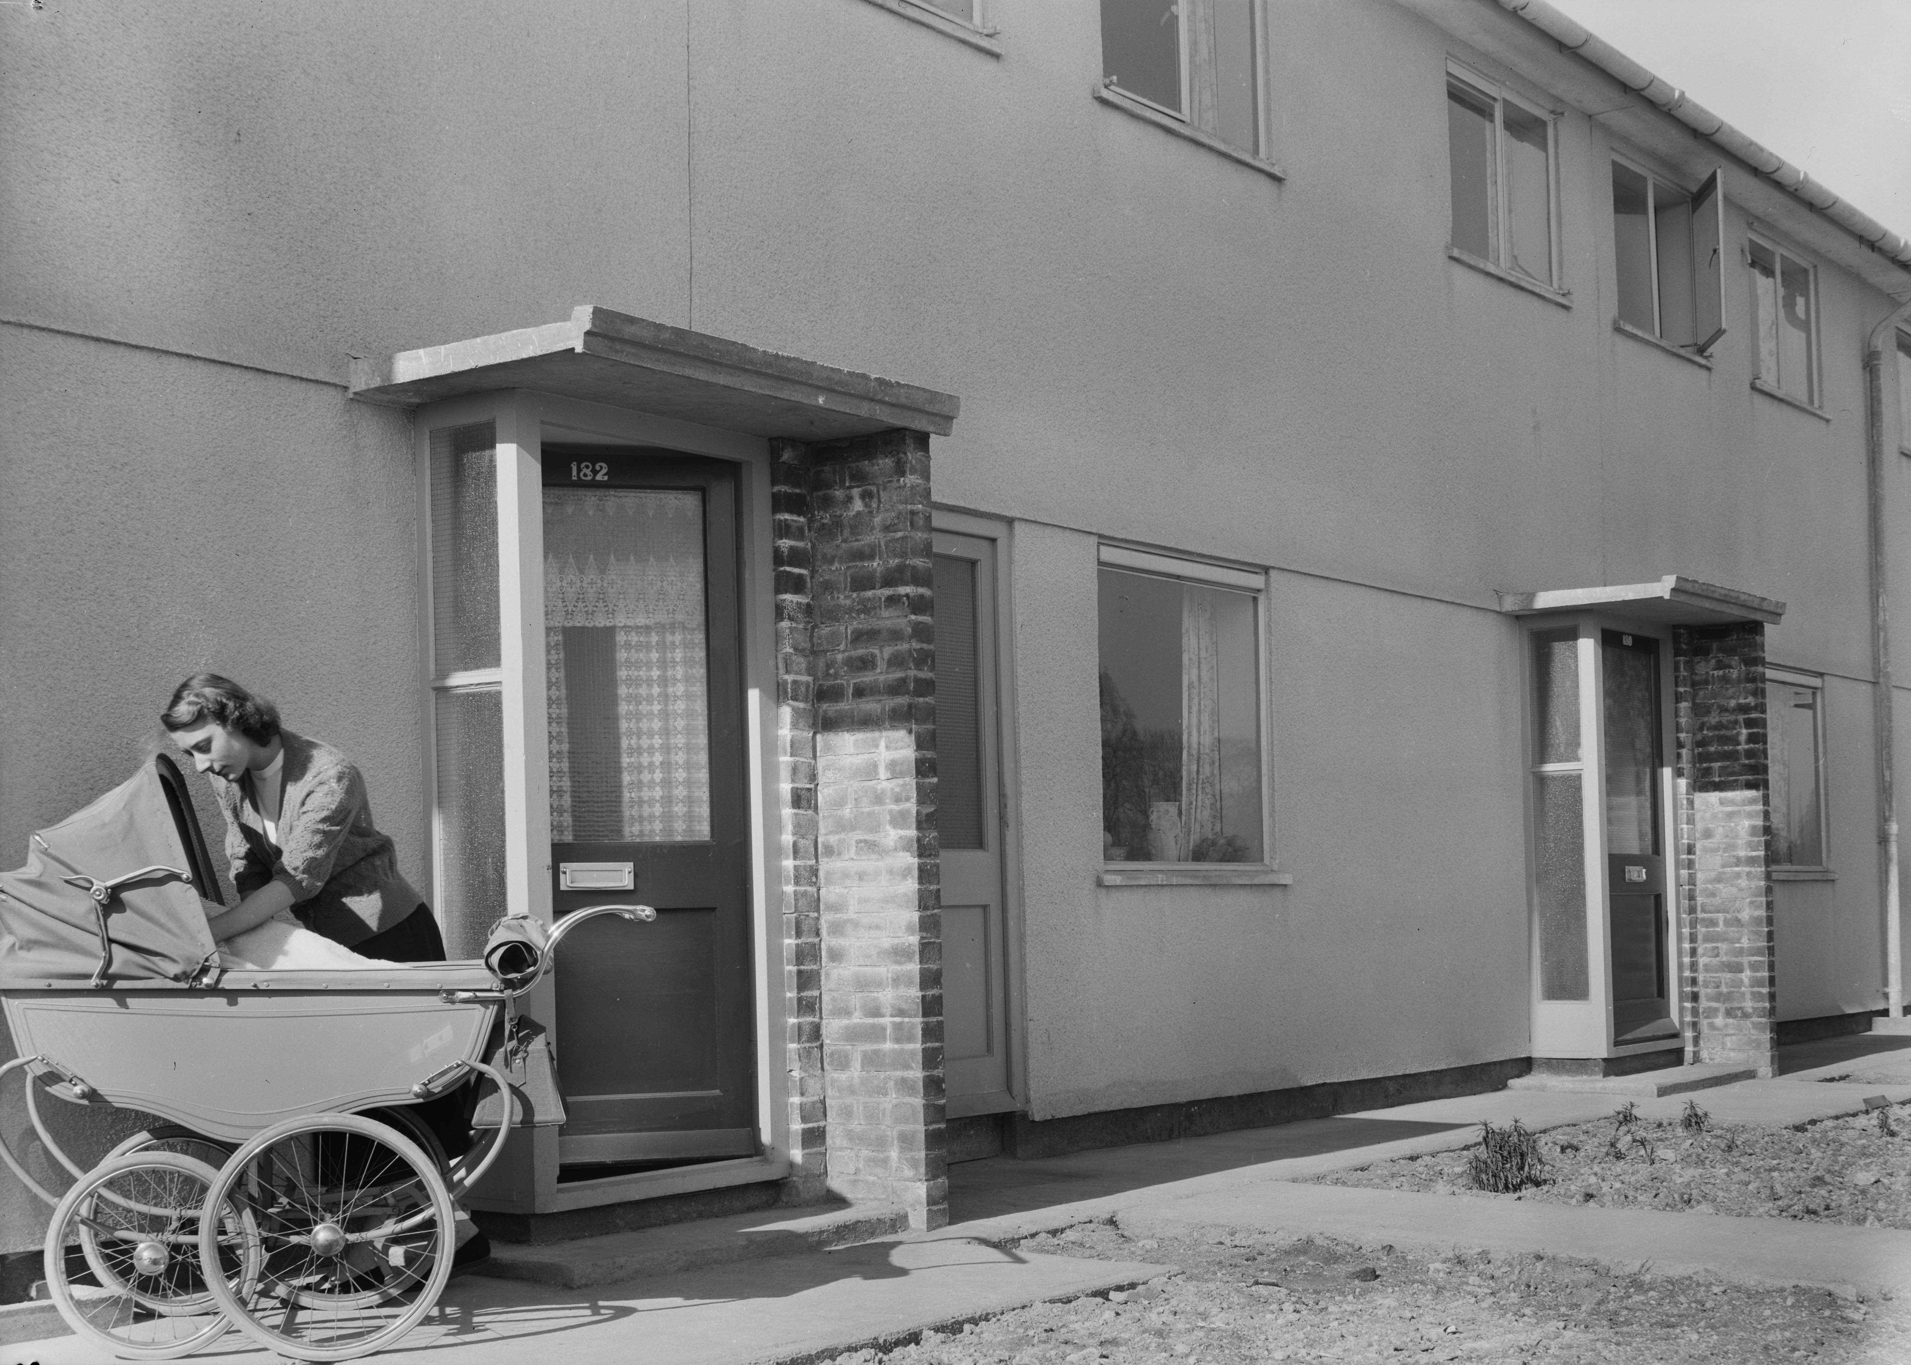
What do you know & what can you gather from this photo?
Notes:
Activity: Print and hand out copies of slides 5-15 (or copy them into a new PPT for pupils to use if they are learning from home). Start by giving students the photos without the description (below). This can be used later as part of an additional activity, as suggested on Slide 22.
Ask: What evidence does this photo give us? What do you know? What do you think is happening? What would you like to find out?
Students could swap images and look for differences or see if the images relate to each other.
Image: © Historic England Archive. John Laing Photographic Collection - Ref: jlp01/08/008260A
https://historicengland.org.uk/images-books/photos/item/JLP01/08/008260A
Description:
A woman looking into a pram outside the front door of 182 Penhill Drive, a Laing Easiform house on the Penhill Estate, with number 180 visible to the right
Date: 9 Mar 1953
Location: Swindon

Slide 8
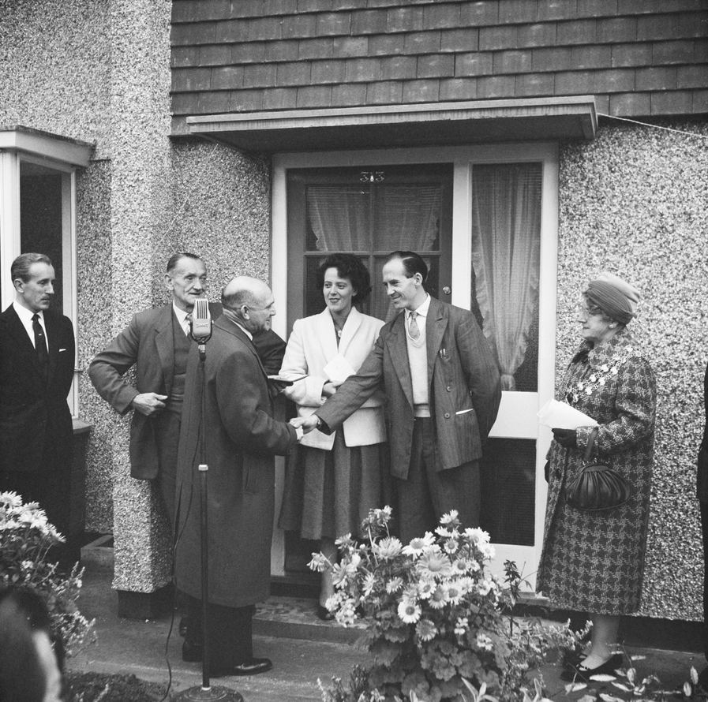
What do you know
&
what can you gather
from this photo?
Notes:
Activity: Print and hand out copies of slides 5-15 (or copy them into a new PPT for pupils to use if they are learning from home). Start by giving students the photos without the description (below). This can be used later as part of an additional activity, as suggested on Slide 22.
Ask: What evidence does this photo give us? What do you know? What do you think is happening? What would you like to find out?
Students could swap images and look for differences or see if the images relate to each other.
Image: © Historic England Archive. John Laing Photographic Collection - Ref: jlp01/08/058455
https://historicengland.org.uk/images-books/photos/item/JLP01/08/058455
Description:
A group of dignitaries with the tenants of 313 Welcombe Avenue, the 4000th post-war house to be constructed in Swindon, on the day the house was ceremonially opened.
When 313 Welcombe Avenue was handed over, it was one of 3,000 Easiform houses built in Swindon by John Laing & Son Ltd; the rest mostly being of traditional design. The tenants were a couple with three young children. Sir William Kirby Laing is on the far left of this image, and the Mayor of Swindon, Miss E. C. M. Millin, on the far right.
Date: 21 Oct 1960
Location: Swindon

Slide 9
What do you know
&
what can you gather
from this photo?
Notes:
Activity: Print and hand out copies of slides 5-15 (or copy them into a new PPT for pupils to use if they are learning from home). Start by giving students the photos without the description (below). This can be used later as part of an additional activity, as suggested on Slide 22.
Ask: What evidence does this photo give us? What do you know? What do you think is happening? What would you like to find out?
Students could swap images and look for differences or see if the images relate to each other.
Image: © Historic England Archive. John Laing Photographic Collection - Ref: jlp01/08/049095
https://historicengland.org.uk/images-books/photos/item/JLP01/08/049095
Description:
A group portrait of Laing workers from the shutter team at an Easiform housing site in Taunton
Date: 1 Mar 1957
Location: Taunton Deane, Somerset

Slide 10
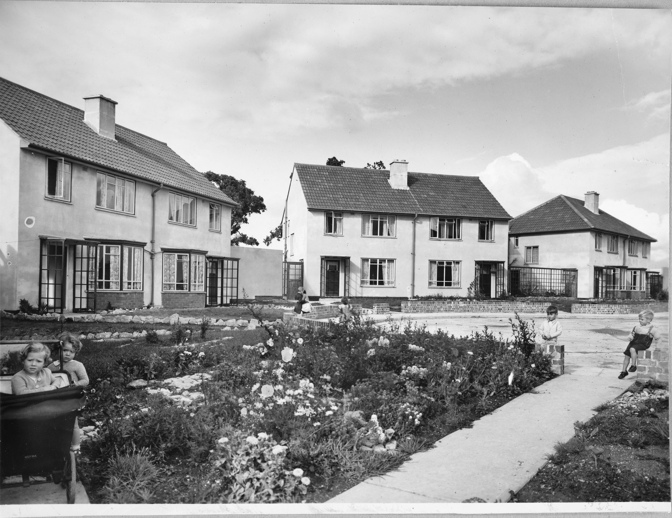
What do you know & what can you gather from this photo?
Notes:
Activity: Print and hand out copies of slides 5-15 (or copy them into a new PPT for pupils to use if they are learning from home). Start by giving students the photos without the description (below). This can be used later as part of an additional activity, as suggested on Slide 22.
Ask: What evidence does this photo give us? What do you know? What do you think is happening? What would you like to find out?
Students could swap images and look for differences or see if the images relate to each other.
Image: © Historic England Archive. John Laing Photographic Collection - Ref: jlp01/01/055/86
https://historicengland.org.uk/images-books/photos/item/JLP01/01/055/86
Description:
View of some small children playing in the garden and street of a new Easiform housing estate
Date: circa 1946
Location: Unknown

Slide 11
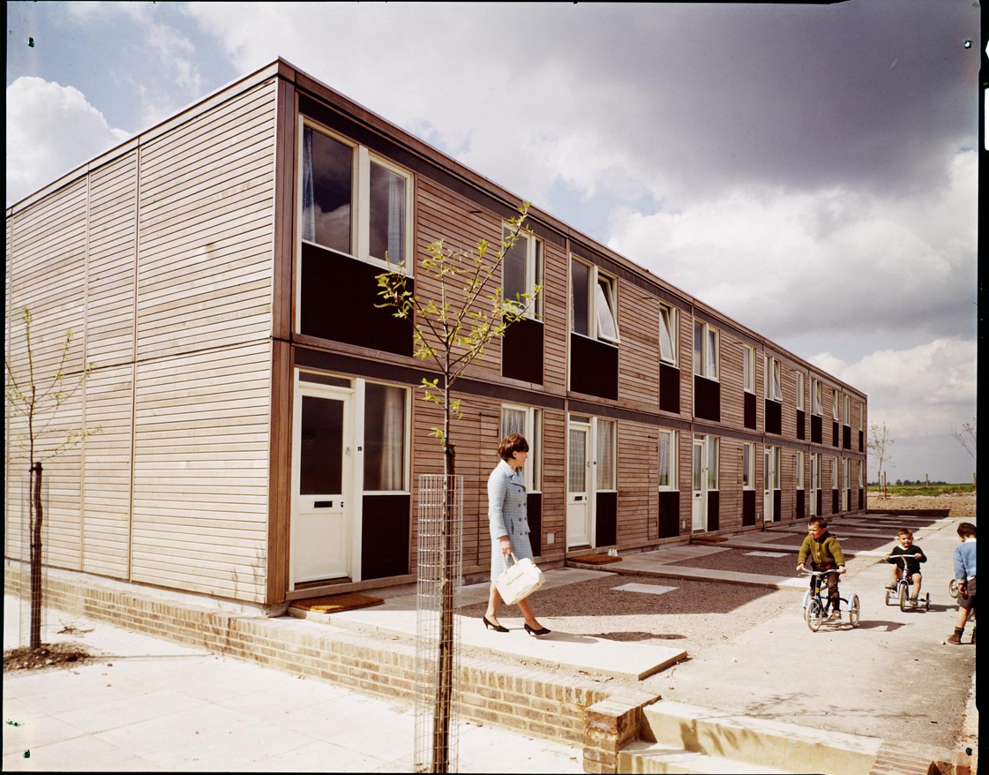
What do you know & what can you gather from this photo?
Notes:
Activity: Print and hand out copies of slides 5-15 (or copy them into a new PPT for pupils to use if they are learning from home). Start by giving students the photos without the description (below). This can be used later as part of an additional activity, as suggested on Slide 22.
Ask: What evidence does this photo give us? What do you know? What do you think is happening? What would you like to find out?
Students could swap images and look for differences or see if the images relate to each other.
Image: © Historic England Archive. John Laing Photographic Collection - Ref: jlp01/10/00109
https://historicengland.org.uk/images-books/photos/item/JLP01/10/00109
Description:
View of a woman with small children in front yard of completed 2-storey housing block at 19-24 Armitage Square, Larkhill built by John Laing and Son Ltd using the 'Jesperson' building system. In 1963 John Laing and Son Ltd bought the rights to the Danish industrialised building system for flats known as ‘Jesperson’. The company built factories in Scotland, Hampshire and Lancashire to produce Jesperson prefabricated parts.
Date: Jun 1967
Location: Larkhill, Wiltshire

Slide 12
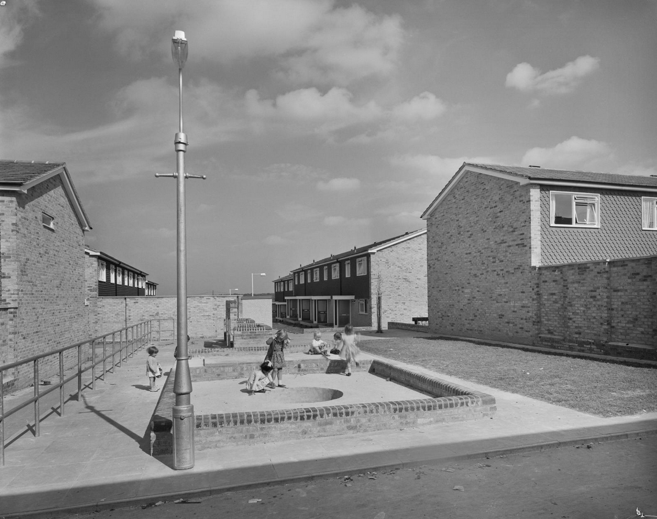
What do you know & what can you gather from this photo?
Notes:
Activity: Print and hand out copies of slides 5-15 (or copy them into a new PPT for pupils to use if they are learning from home). Start by giving students the photos without the description (below). This can be used later as part of an additional activity, as suggested on Slide 22.
Ask: What evidence does this photo give us? What do you know? What do you think is happening? What would you like to find out?
Students could swap images and look for differences or see if the images relate to each other.
Image: © Historic England Archive. John Laing Photographic Collection - Ref: jlp01/08/074583
https://historicengland.org.uk/images-books/photos/item/JLP01/08/074583
Description:
A group of children playing in a play area on an Easiform housing estate in Croydon
Date: 9 Sep 1966
Location: Croydon, Greater London Authority

Slide 13
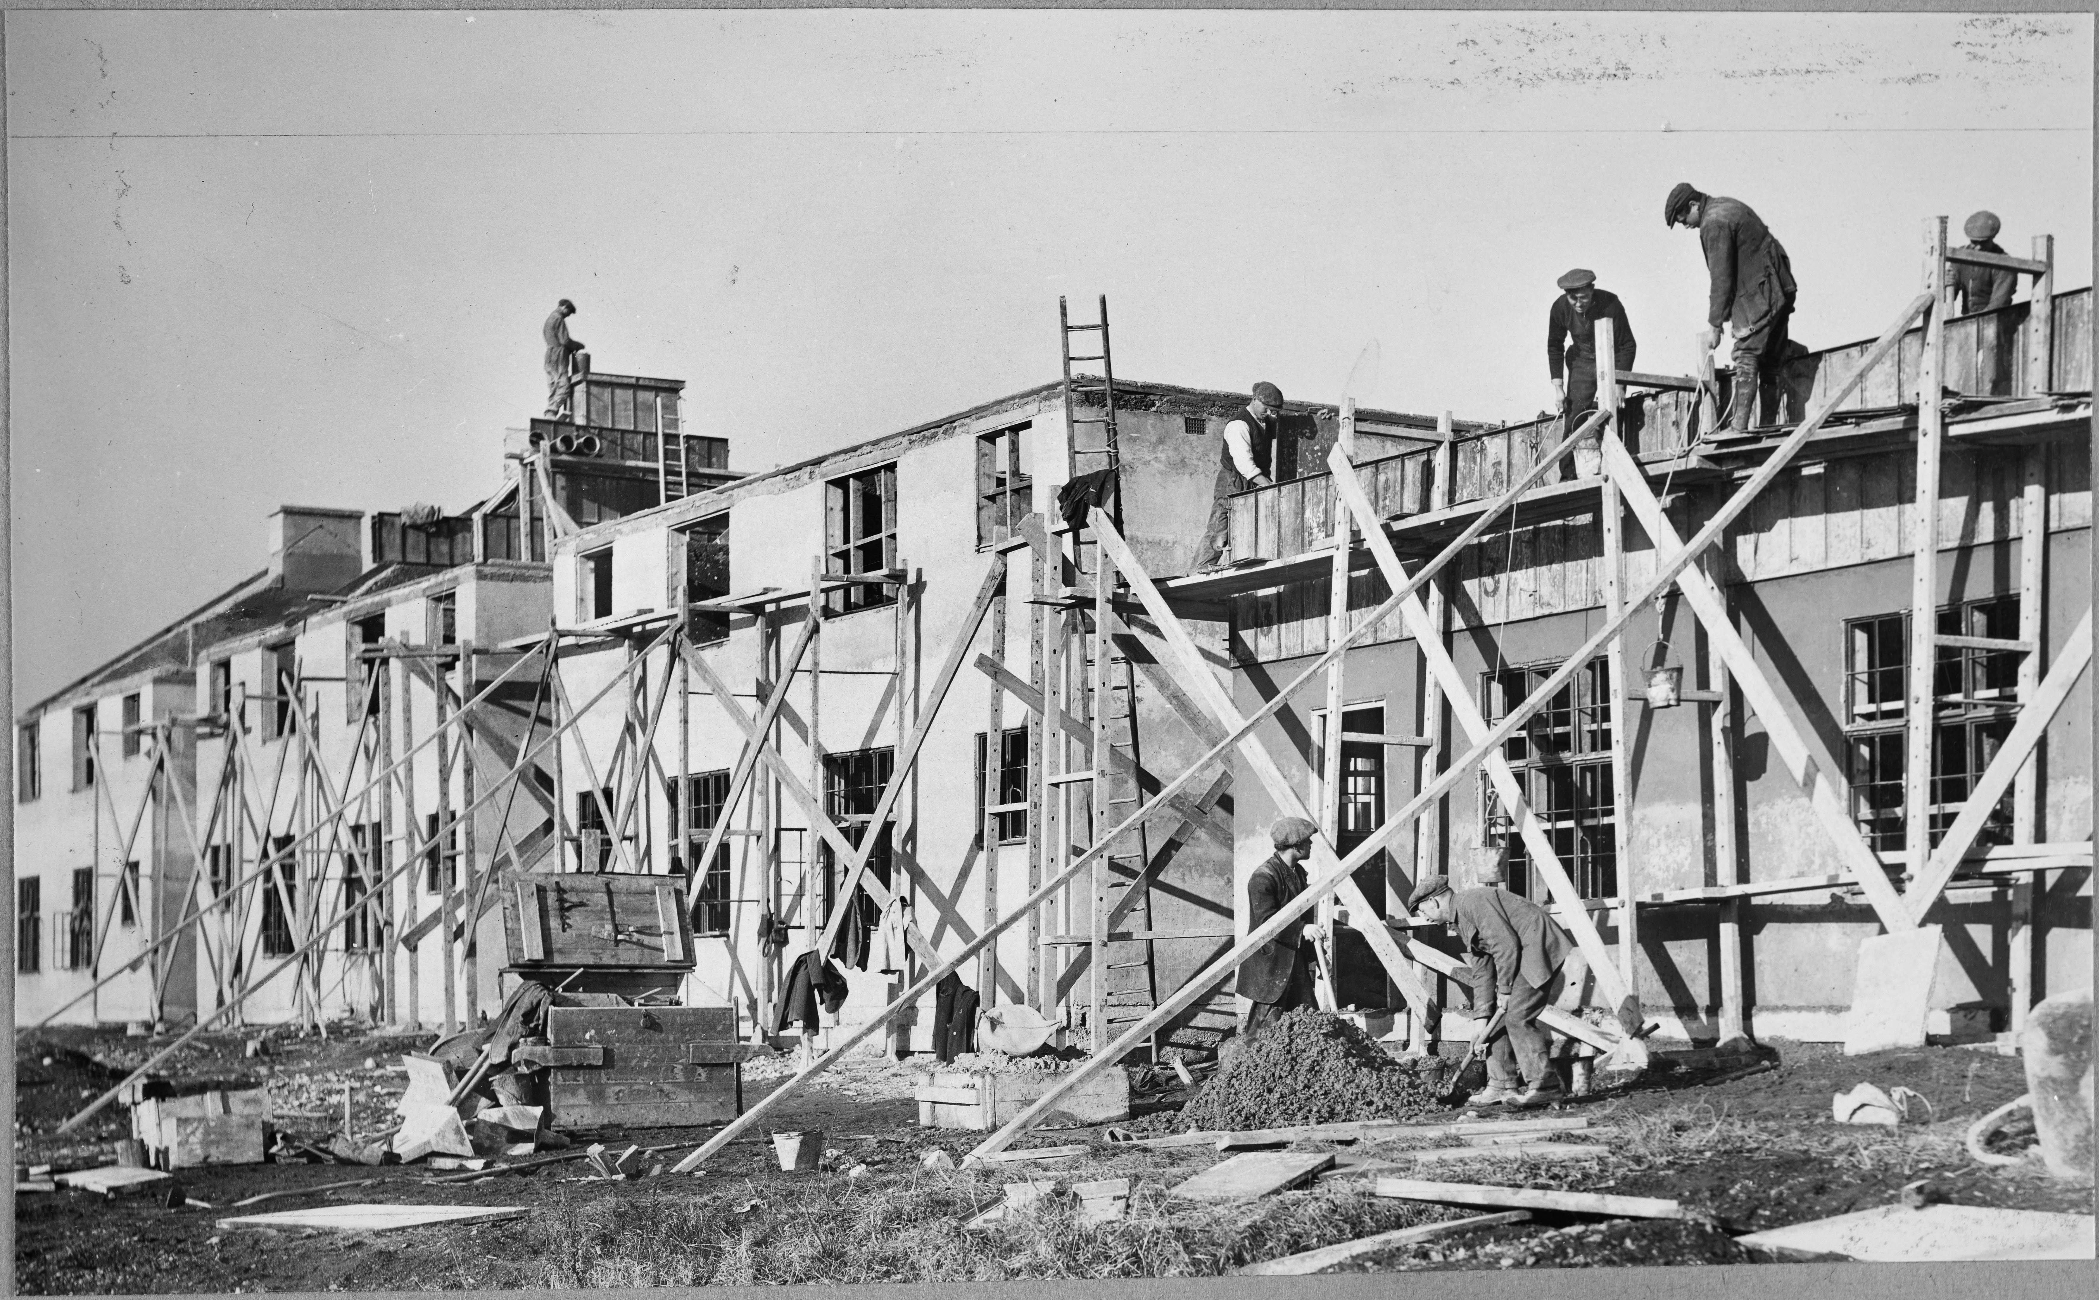
What do you know & what can you gather from this photo?
Notes:
Activity: Print and hand out copies of slides 5-15 (or copy them into a new PPT for pupils to use if they are learning from home). Start by giving students the photos without the description (below). This can be used later as part of an additional activity, as suggested on Slide 22.
Ask: What evidence does this photo give us? What do you know? What do you think is happening? What would you like to find out?
Students could swap images and look for differences or see if the images relate to each other.
Image: © Historic England Archive. John Laing Photographic Collection - Ref: jlp01/01/055/40
https://historicengland.org.uk/images-books/photos/item/JLP01/01/055/40
Description:
Easiform housing being constructed at an unidentified location
Date: 1926
Location: Unknown

Slide 14
What do you know
&
what can you gather
from this photo?
Notes:
Activity: Print and hand out copies of slides 5-15 (or copy them into a new PPT for pupils to use if they are learning from home). Start by giving students the photos without the description (below). This can be used later as part of an additional activity, as suggested on Slide 22.
Ask: What evidence does this photo give us? What do you know? What do you think is happening? What would you like to find out?
Students could swap images and look for differences or see if the images relate to each other.
Image: © Historic England Archive. John Laing Photographic Collection - Ref: jlp01/08/007482
https://historicengland.org.uk/images-books/photos/item/JLP01/08/007482
Description:
Two women admiring a fridge in the kitchen of the 3000th Easiform dwelling to be completed in Bristol, on the day of the ceremonial opening. Hareclive Road.
Date: 30 Nov 1952
Location: Hartcliffe, City of Bristol

Slide 15
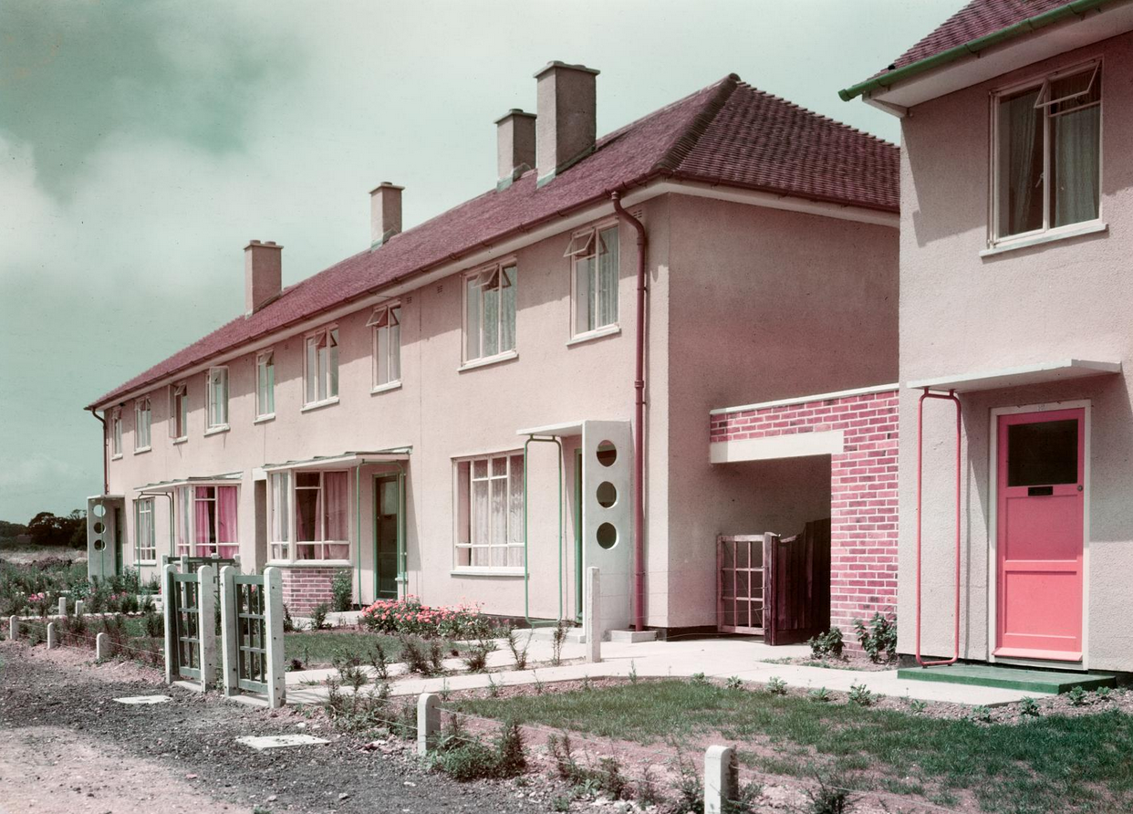
What do you know & what can you gather from this photo?
Notes:
Activity: Print and hand out copies of slides 5-15 (or copy them into a new PPT for pupils to use if they are learning from home). Start by giving students the photos without the description (below). This can be used later as part of an additional activity, as suggested on Slide 22.
Ask: What evidence does this photo give us? What do you know? What do you think is happening? What would you like to find out?
Students could swap images and look for differences or see if the images relate to each other.
Image: © Historic England Archive. John Laing Photographic Collection - Ref: jlp01/12/012
https://historicengland.org.uk/images-books/photos/item/JLP01/12/012
Description:
Exterior view of Easiform housing at Gosport
Date: circa 1949 - 1950
Location: Gosport, Hampshire

Slide 16
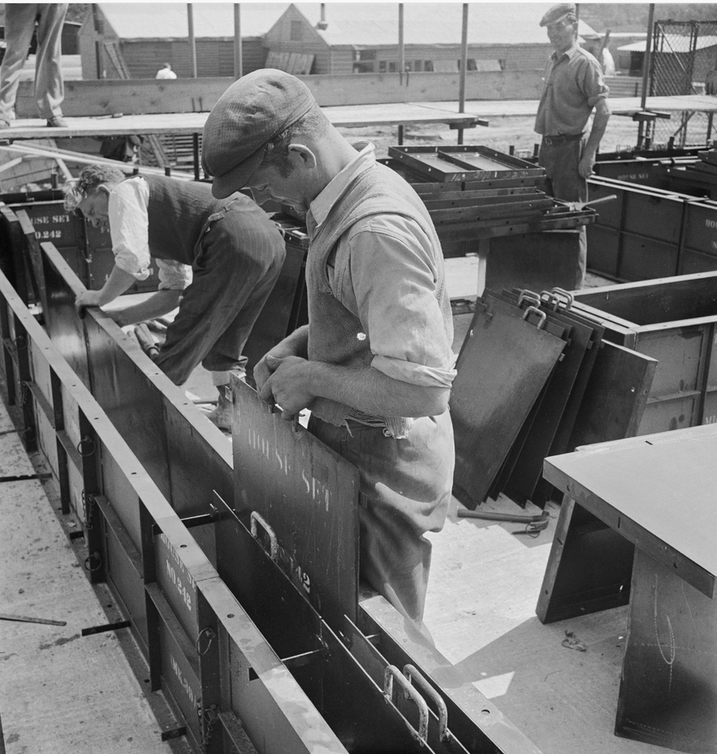
What do you know
&
what can you gather
from this photo?
Notes:
Activity: Print and hand out copies of slides 5-15 (or copy them into a new PPT for pupils to use if they are learning from home). Start by giving students the photos without the description (below). This can be used later as part of an additional activity, as suggested on Slide 22.
Ask: What evidence does this photo give us? What do you know? What do you think is happening? What would you like to find out?
Students could swap images and look for differences or see if the images relate to each other.
Image: © Historic England Archive. John Laing Photographic Collection - Ref: jlp01/08/001317
https://historicengland.org.uk/images-books/photos/item/JLP01/08/001317
Description:
Men building the shuttering for the construction of an Easiform house on a housing estate in Hastings, Hollington.
Date: 1 Jul 1949
Location: Hastings, East Sussex

Slide 17
What do you know
&
what can you gather
from this photo?
Notes:
Activity: Print and hand out copies of slides 5-15 (or copy them into a new PPT for pupils to use if they are learning from home). Start by giving students the photos without the description (below). This can be used later as part of an additional activity, as suggested on Slide 22.
Ask: What evidence does this photo give us? What do you know? What do you think is happening? What would you like to find out?
Students could swap images and look for differences or see if the images relate to each other.
Image:© Historic England Archive. John Laing Photographic Collection - Ref: jlp01/08/045876
https://historicengland.org.uk/images-books/photos/item/JLP01/08/045876
Description:
A group portrait of five Laing workers involved in the construction of three-storey blocks of flats for the 'Plymouth 20' Easiform housing contract
Date: 12 Apr 1956
Location: City Of Plymouth

Slide 18
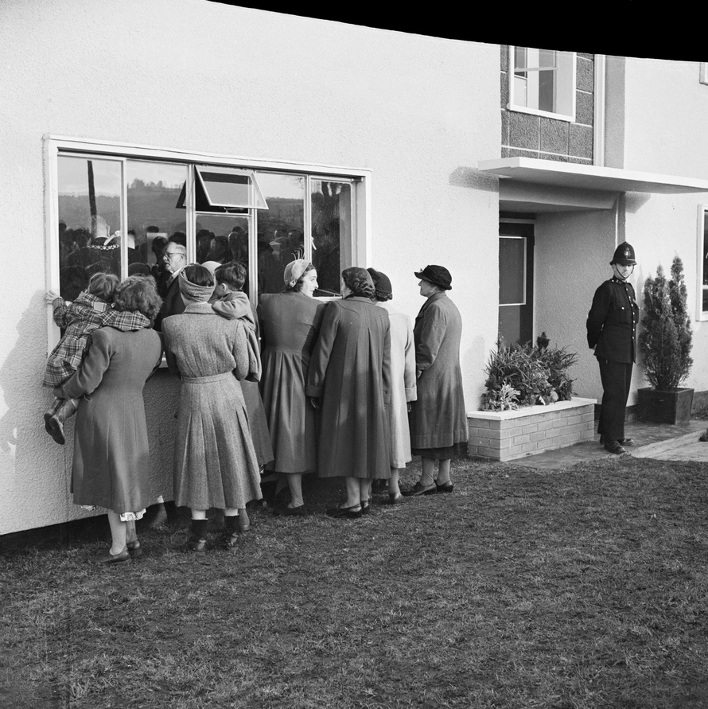
What do you know
&
what can you gather
from this photo?
Notes:
Activity: Print and hand out copies of slides 5-15 (or copy them into a new PPT for pupils to use if they are learning from home). Start by giving students the photos without the description (below). This can be used later as part of an additional activity, as suggested on Slide 22.
Ask: What evidence does this photo give us? What do you know? What do you think is happening? What would you like to find out?
Students could swap images and look for differences or see if the images relate to each other.
Image: © Historic England Archive. John Laing Photographic Collection - Ref: jlp01/08/007475
https://historicengland.org.uk/images-books/photos/item/JLP01/08/007475
Description:
A group of women looking through the window of an Easiform flat, the 3000th Easiform dwelling to be completed in Bristol, as a policeman guards the entrance on the day of the opening ceremony. Hareclive Road.
Date: 30 Nov 1952
Location: Hartcliffe, City of Bristol

Slide 19
What do you know
&
what can you gather
from this photo?
Notes:
Activity: Print and hand out copies of slides 5-15 (or copy them into a new PPT for pupils to use if they are learning from home). Start by giving students the photos without the description (below). This can be used later as part of an additional activity, as suggested on Slide 22.
Ask: What evidence does this photo give us? What do you know? What do you think is happening? What would you like to find out?
Students could swap images and look for differences or see if the images relate to each other.
Image: © Historic England Archive. John Laing Photographic Collection - Ref: jlp01/08/049096
https://historicengland.org.uk/images-books/photos/item/JLP01/08/049096
Description:
A portrait of Tony Morris, the General Foreman of an Easiform housing site in Taunton, posed on a bicycle
Date: 1 Mar 1957
Location: Taunton Deane, Somerset

Slide 20
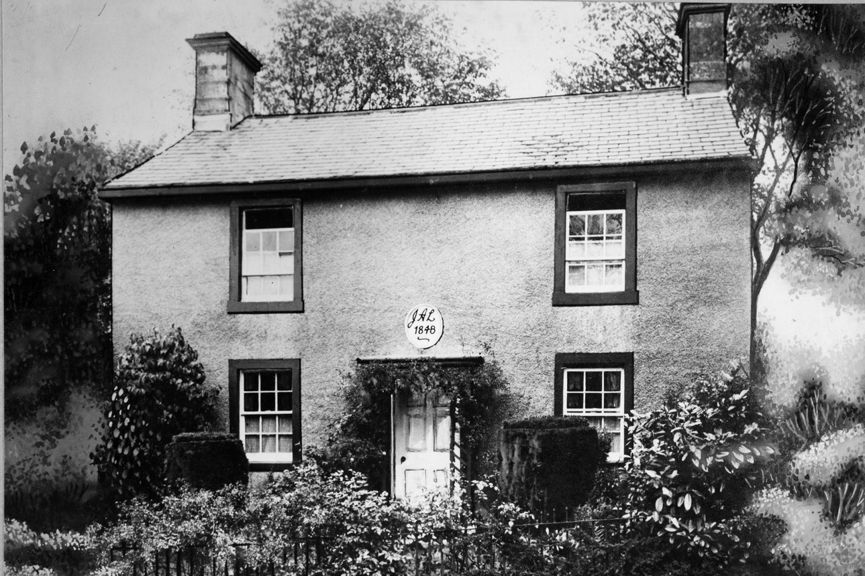
What do you know & what can you gather from this photo?
Notes:
Activity: Print and hand out copies of slides 5-15 (or copy them into a new PPT for pupils to use if they are learning from home). Start by giving students the photos without the description (below). This can be used later as part of an additional activity, as suggested on Slide 22.
Ask: What evidence does this photo give us? What do you know? What do you think is happening? What would you like to find out?
Students could swap images and look for differences or see if the images relate to each other.
Image: © Historic England Archive. John Laing Photographic Collection - Ref: jlp01/01/113/38
https://historicengland.org.uk/images-books/photos/item/JLP01/01/113/38
Description:
First house built by James and Ann Laing in 1848 at Sebergham
Date: circa 1920 - 1949
Location: Caldew House, Sebergham, Allerdale, Cumbria

Slide 21
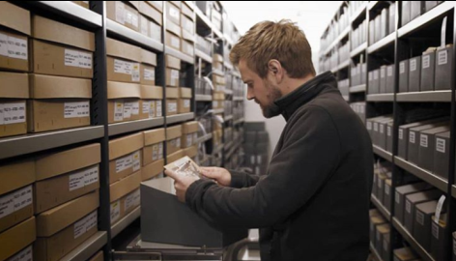
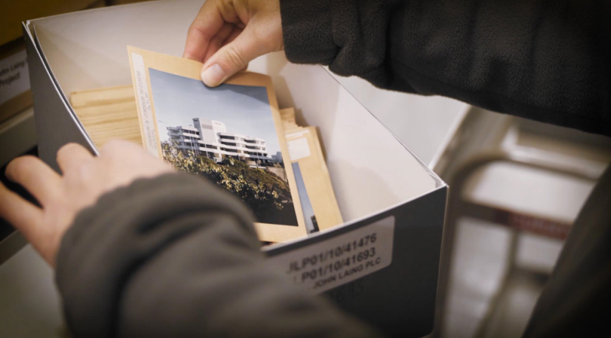
Could you be an Archive Image Selector?
Jack, the Archive Image Selector for the John Laing project, had to pick the ‘best’ 10,000 photos from a collection of 230,000 photos!
These are two things he had to look for:
Images showing the places before, during, and after they were built.
Images showing people at work at all levels, e.g labourers, site managers, architects etc.
Notes:
Read: Jack (pictured here) was the Archive Image Selector for the John Laing project, he had to pick the ‘best’ 10,000 photos from a collection of 230,000 photos!
These are two of the things he had to look for:
Images showing the places before, during, and after they were built.
Images showing people at work at all levels, e.g labourers, site managers, architects etc.

Slide 22
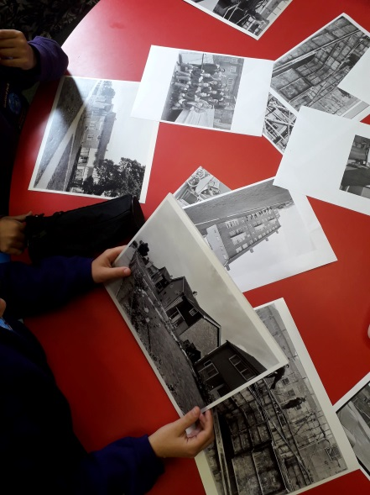
Your turn to be an Archive Image Selector
Which of your photographs tell the best story?
What evidence do they give us as historians?
Can you create a set of criteria and then select the best images?
Pick just 5 images.
Notes:
Activity – In groups students will select 5 from the 15 photographs using the criteria: Which photographs tell the best story? They should also consider what evidence do they give us as historians. This is a chance for them to share their observations of the images, discuss their case for what should be selected and share their selections.
Share back with the class.
With additional time: After they’ve sorted the photographs share with students the captions for each image (these are under the pictures and available online following the link with each photograph). Does this change what they’ve selected and why?
Prompts for the teacher: Jack, the image selector had the following selection criteria:
Images showing the sites/buildings before, during, and on completion of construction
Images showing employees at work at all levels, eg labourers, site managers, architects etc
Images documenting the design, marketing and subsequent use of the buildings
Images showing the distinctive identity and ethos of the company in post war Britain
Although selection of some images that show detailed construction techniques (eg concrete samples etc) may be relevant, these should be kept to a minimum and should also be aesthetically pleasing.
Extension activity: Once the images are selected write a short description for each image. These should be less than 20 words. (This replicates the process we undertook to get them prepared for online publication)

Slide 23
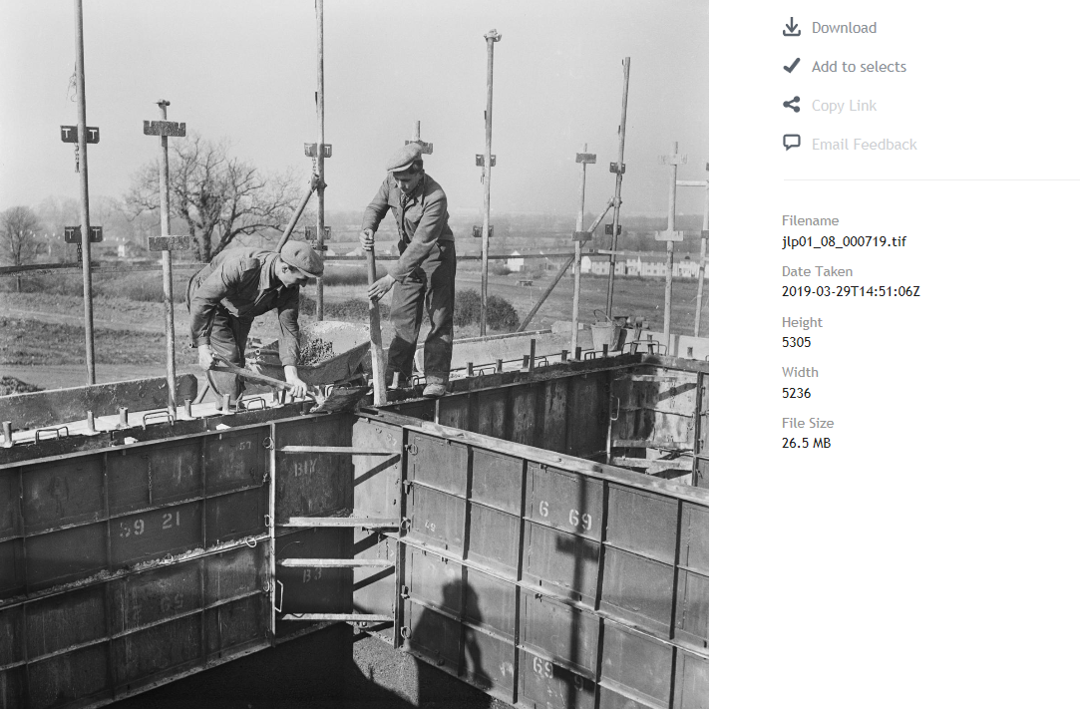

Easiform housing
Created & built by
Notes:
Ask: Who do you think built all of these places in your images?
Answer: John Laing was the building company who built all the places you’ve seen in the pictures. They took pictures of the buildings they created and the people that helped build them. The John Laing building company profoundly shaped post-war Britain. They built outstanding sites of worship like Coventry Cathedral and the London Central Mosque, some of the country’s first motorways, including the M1, the Barbican & British Library, buildings which housed pioneering forms of technology such as Berkeley Nuclear Power Station and all across England, thousands of Easiform homes.
The history of the John Laing building company began in 1848 when James Laing (b.1816), his wife Ann and some employees built a single house in Carlisle (slide 20). They sold it for £150 pounds (around £17,000 in today’s money) which allowed them to build two more houses. They built houses until 2001, for 156 years.
These pictures form part of the John Laing Photographic Collection. The images provide a unique insight into the origins of iconic British buildings as well as the new modes of living they initiated. The images display a variety of themes and exhibit a true kaleidoscope of British people, places and progress.
Images:
Easiform under construction: © Historic England Archive. John Laing Photographic Collection - Ref: jlp01/08/000719
https://historicengland.org.uk/images-books/photos/item/JLP01/08/000719
Group of Laing employees on Easiform site: © Historic England Archive. John Laing Photographic Collection - Ref: jlp01/08/049095
https://historicengland.org.uk/images-books/photos/item/JLP01/08/049095

Slide 24
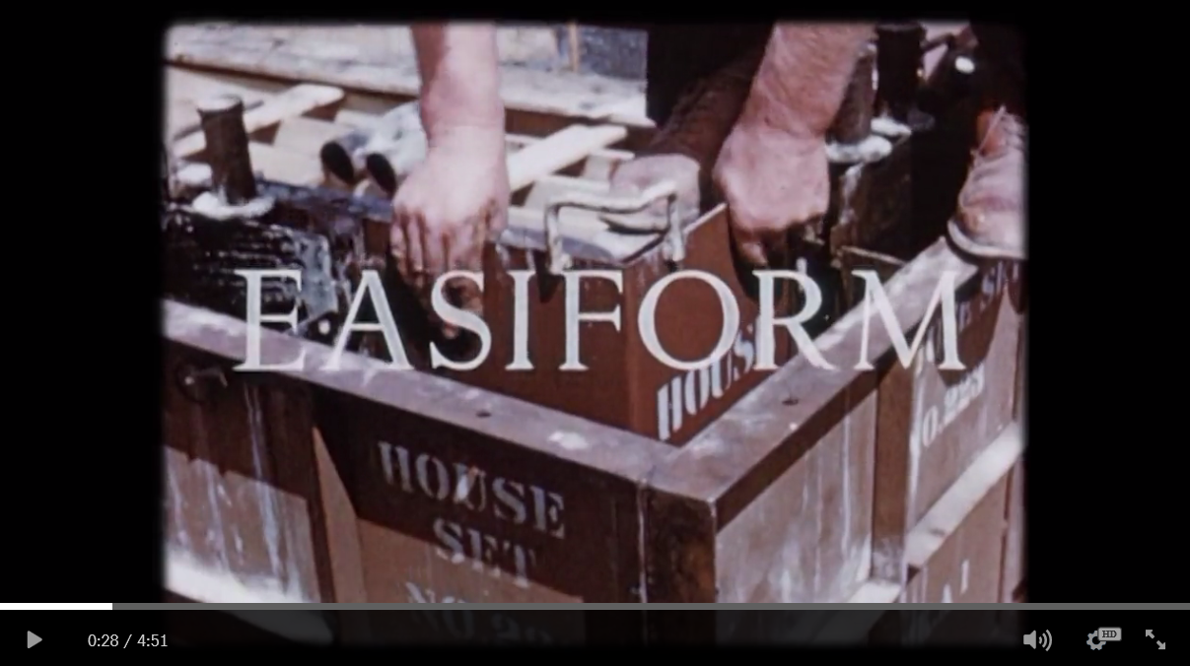
Watch John Laing at work
What did you notice? What did you learn?
Notes:
Watch: Easiform the Easiform film available from the Heritage Schools Education vimeo page: https://vimeo.com/434978506
Ask: What did you notice? What did you learn?
Find more local heritage films on: https://vimeo.com/heritageschools

Slide 25
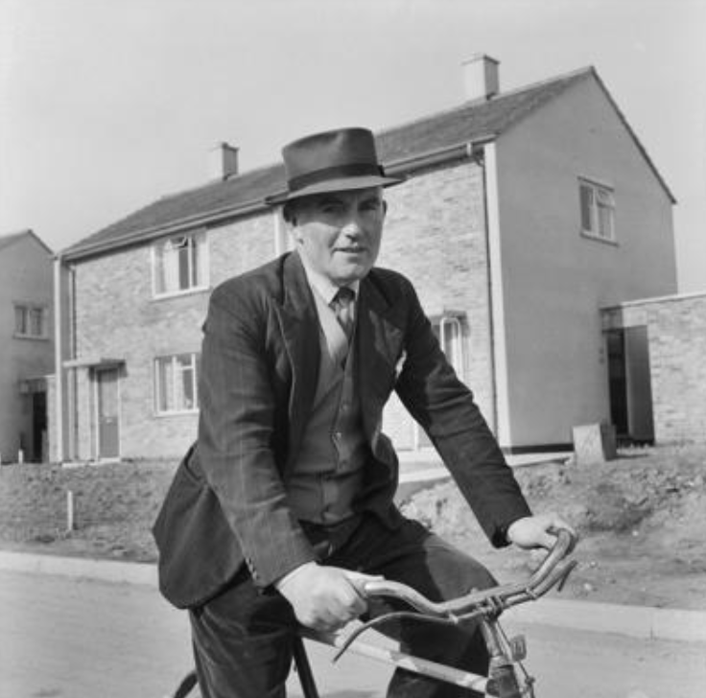
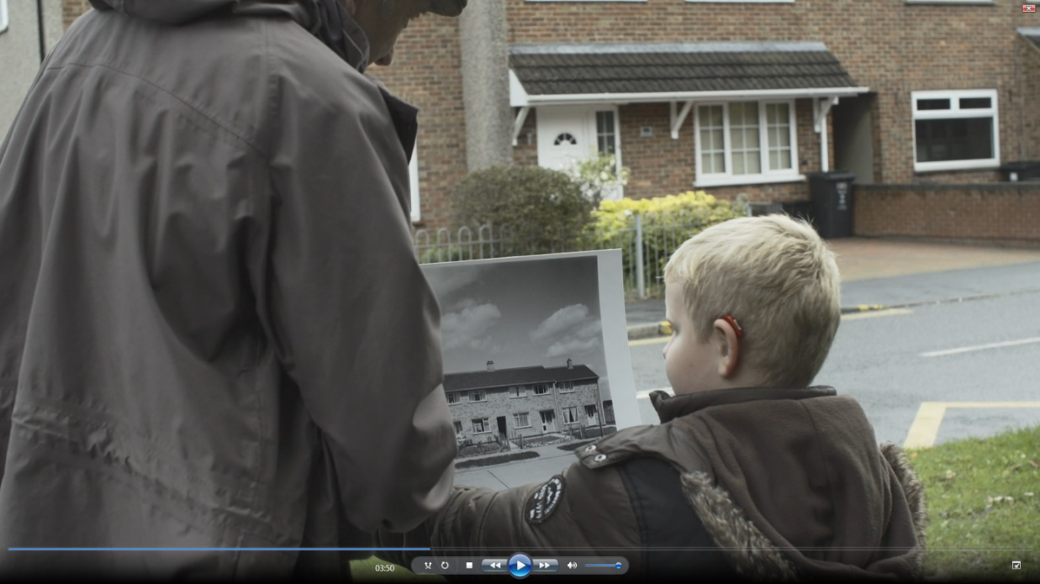
Are photos a good historical source?
What have you discovered?
Do you have historical houses in your area?
Notes:
Ask: Are photos a good historical source? What have you discovered? Do you have historical houses in your area?
The lesson can be finished here – or carry on with the oral history interview section.
For assessment: have students completed the Learning Aims and Outcomes?
Develop a sense of pride in where they live
Understand their local heritage and how it relates to a national story
Understand what a photographic archive is & how it could be used
Use primary sources
Devise historically valid questions (oral history)
Select and organise relevant historical information
Explore changes in post-war Britain
Look at their own identity within a local case study

Slide 26
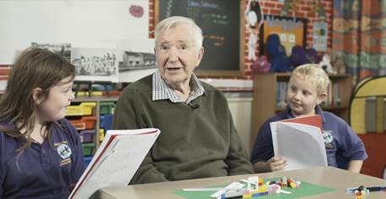
Imagine you could interview someone who built the houses
What would you ask them?
How do we ask good questions?
Notes:
Share: Now imagine you could interview someone that built or lived in Easiform houses. What would you ask them? How do we ask good (open) questions?
Link:Doing Oral Histories & Easiform Swindon Film
Activity: Spend some time writing/asking questions. Share with the class.
If you have a person who can answer these, invite them into your classroom and find out more.
If you don’t, listen to the interviews from these former Laing employees (LINK) and write down and share one thing you learnt with someone. Share with the class.

Slide 27
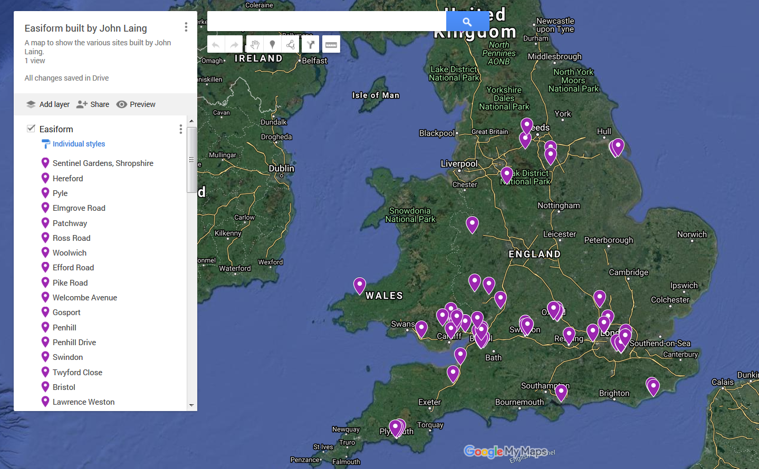
Search the Google Map for
Easiform in the John Laing Photographic Collection
Notes:
Visit: https://www.google.com/maps/d/edit?mid=1IOWT4FxndBa_i92AAh6e4RPWuVFYsxUN&usp=sharing to search your area for Easiform from the John Laing Photographic Collection

Slide 28
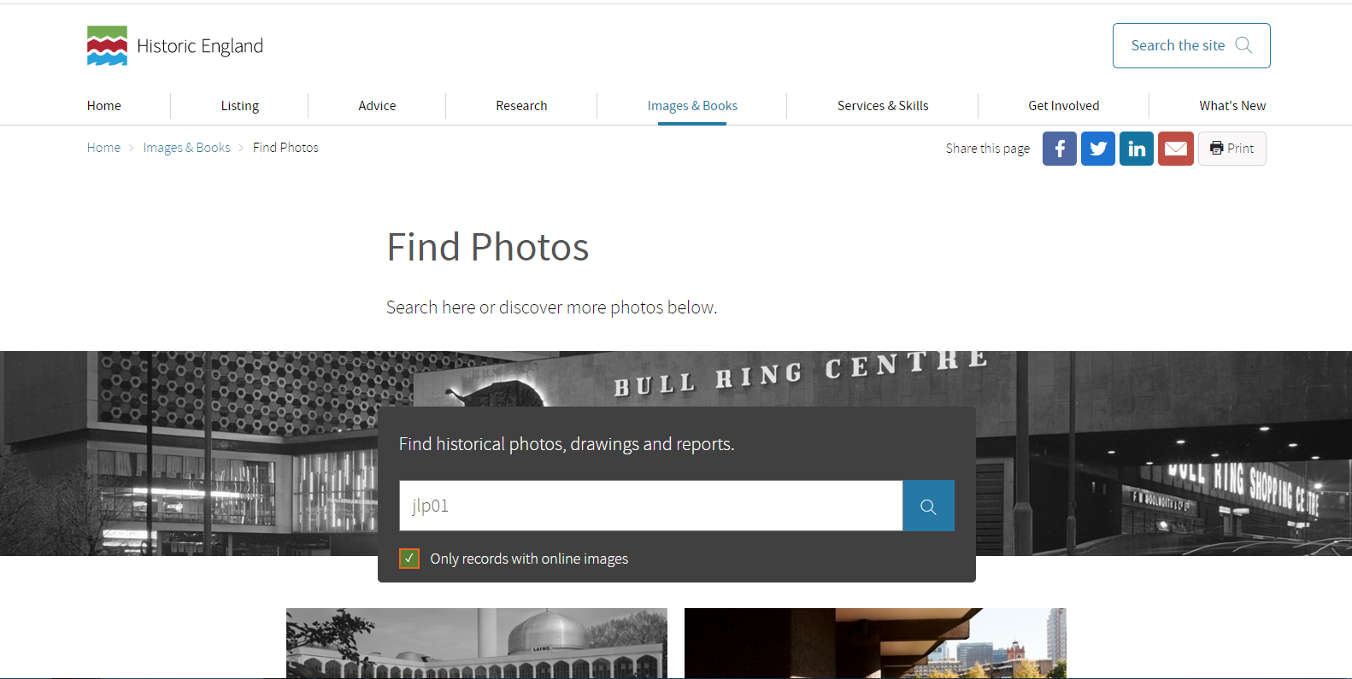
Search the John Laing Photographic Collection online. Go to: https://historicengland.org.uk/images-books/photos/
Type ‘jlp01’ and tick ‘only records with online images’
Notes:
Searching the John Laing Photographic Collection online.

Slide 29
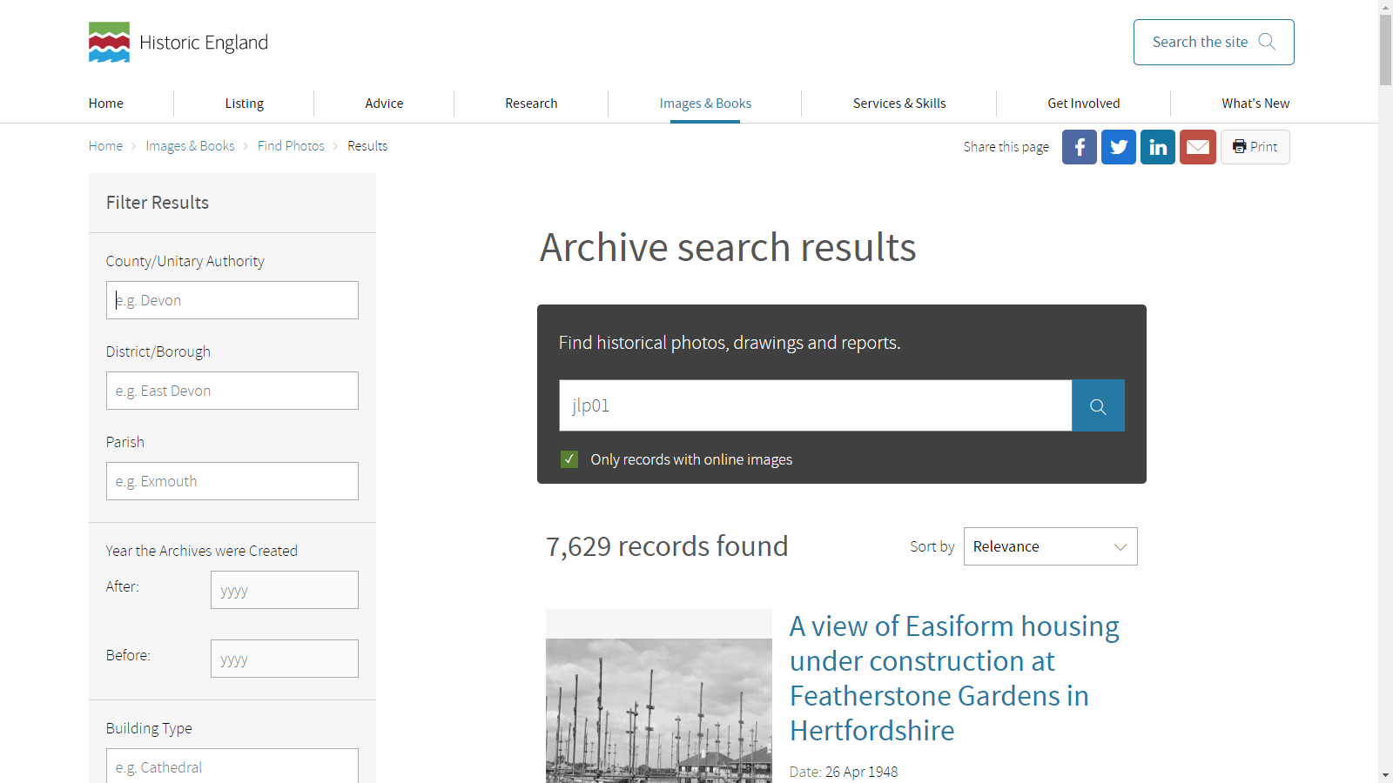
Use the location filters to find photos in your area
Notes:
Searching the John Laing Photographic Collection online.

Slide 30
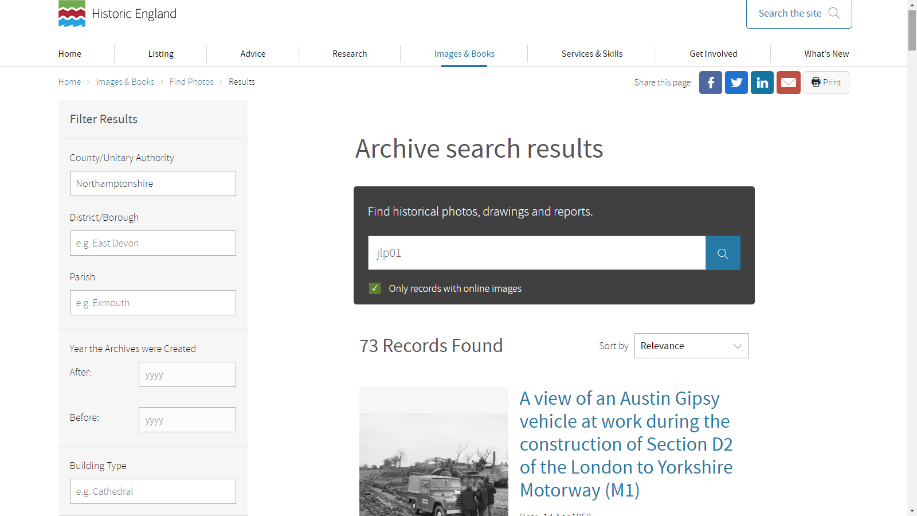
Use the location filters to find photos in your area
Notes:
Searching the John Laing Photographic Collection online.

Slide 31
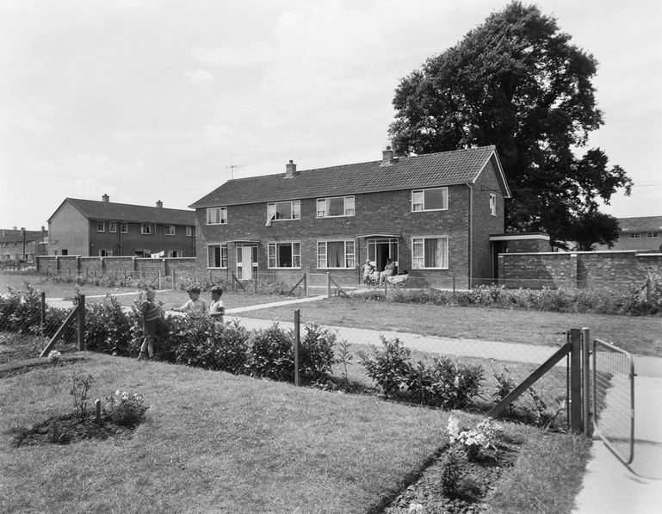
Notes:
For more information visit: https://historicengland.org.uk/services-skills/education/

