Slide 1

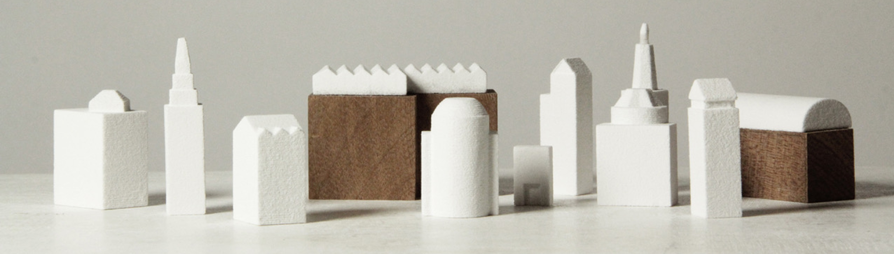
Rochdale Reimagined
Rochdale Reimagined encourages pupils to look at new ways to use historic buildings and spaces in Rochdale. Pupils become “honorary architects” to design something amazing and regenerate spaces, to make their town centre a vibrant place for everyone to enjoy.
This PowerPoint relates to Teaching Activity: https://historicengland.org.uk/services-skills/education/teaching-activities/rochdale-reimagined

Slide 2
Rochdale Reimagined
Additional resources to support this PowerPoint include:
Rochdale Reimagined Scheme of work
Student Workbooks for the 5 sites
Notes:
Scheme of work: https://historicengland.org.uk/content/docs/education/explorer/rochdale-reimagined-scheme-of-work-doc
Scheme The 5 Student Workbooks can be downloaded from this page: https://historicengland.org.uk/services-skills/education/teaching-activities/rochdale-reimagined

Slide 3
How can we find out what our area was like in the past, think about what it’s like now and reimagine it for the future?
Key Stage 2: History
Learning Aims and Outcomes
To develop our local history and geography skills by using maps, plans and historical evidence to find out about our area in the past
To investigate why key historical sites in our local area are important
To think about, describe and explain how we can care about historic sites in our local area and can continue to use them in the future
This PowerPoint relates to this Teaching Activity: https://historicengland.org.uk/services-skills/education/teaching-activities/rochdale-reimagined

Slide 4
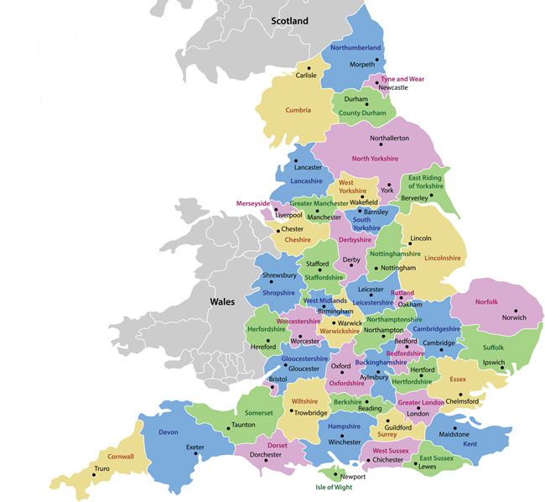
What do you think about where you live?
What do you like about the area in which you live?
What do you dislike about the area in which you live?
How would you make it better?
Rochdale
Notes:
Try to encourage students to think about specific buildings or sites, as well as their more general opinions.
What is good about where they live?
What is not so good?
What would they like to change?
You could do this as a written activity or simply have a class discussion and note down ideas on the white board.

Slide 5
What is architecture?
What does an architect do?
What is ‘good’ architecture?
Notes:
This is a good point to ask the students what they think architecture might be? What do they think is good architecture? What do they think an architect actually does?
Link to the idea that it is an architects job to try to design buildings , parks, opens spaces etc to make an area better.
The following 6 slides can then be used to explore with your students, in more detail, what architecture is…..

Slide 6
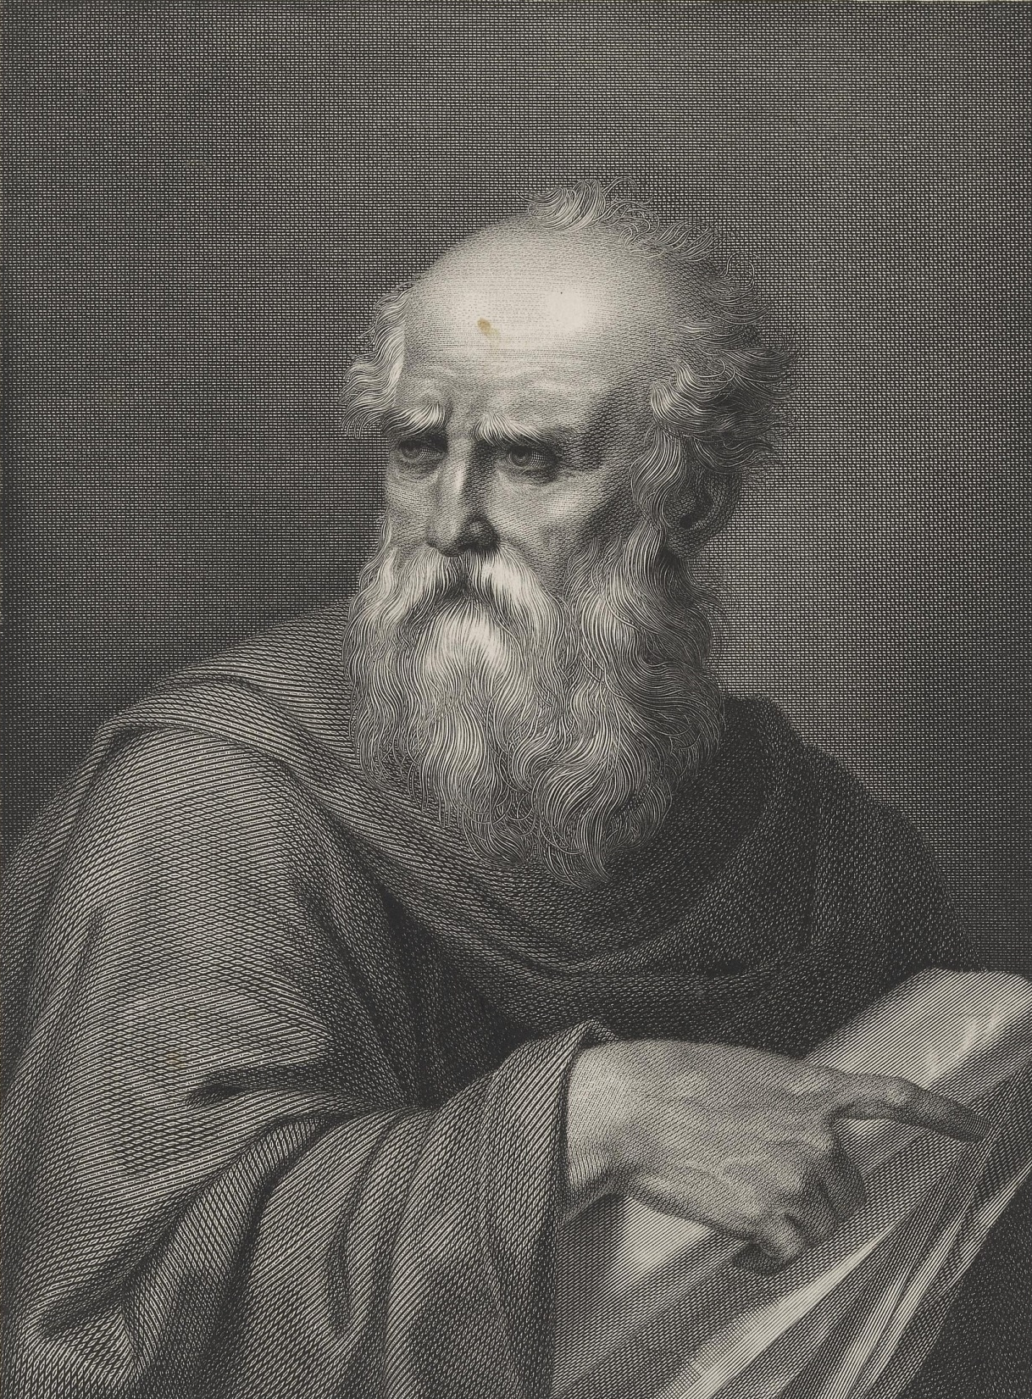
Vitruvius
70 BC
... that’s a really, really long time ago!
Notes:
This is where we introduce an old, but still relevant, set of principals by the Roman architect Vitruvius. Suggest to say pupils that they should remember these principals when they think about designing their own architecture project.

Slide 7
Firmitas
Utilitas
Venustas
… ummm, does anyone know Latin?
Notes:
Don’t worry - they are in English on the next page!

Slide 8
Durable
Useful
Beautiful
Notes:
Phew! So the principals we want to discuss are that architecture should be Durable, Useful and Beautiful. There are examples on the next three pages.

Slide 9
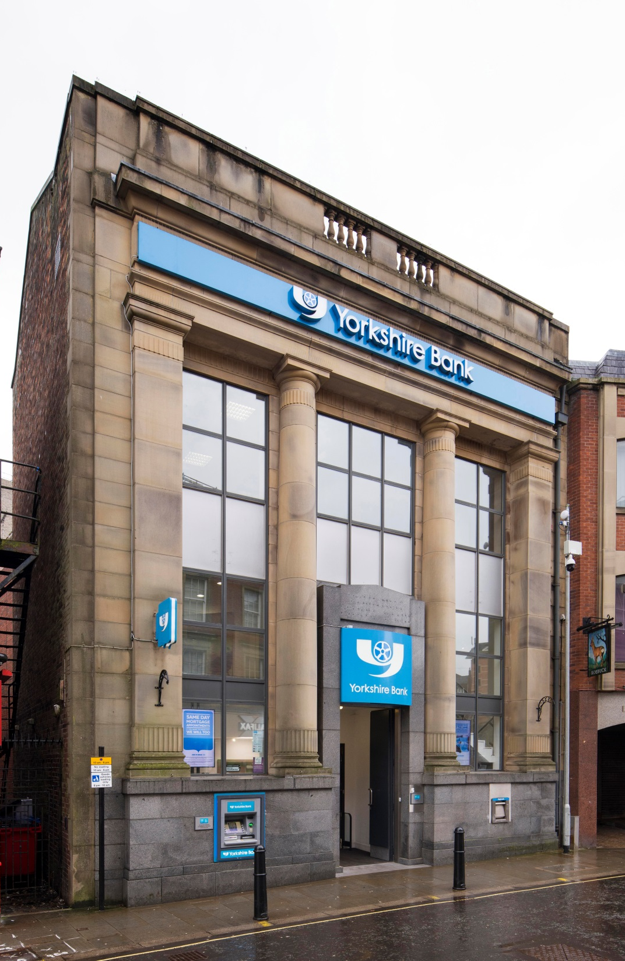
Durable
It should stand up robustly and remain in good condition
Notes:
Image: General view of the bank, Yorkshire Bank, 9-11 Yorkshire Street, Rochdale, 2 March 2019 © Source: Historic England Archive ref: DP221828
https://historicengland.org.uk/images-books/photos/item/DP221828

Slide 10
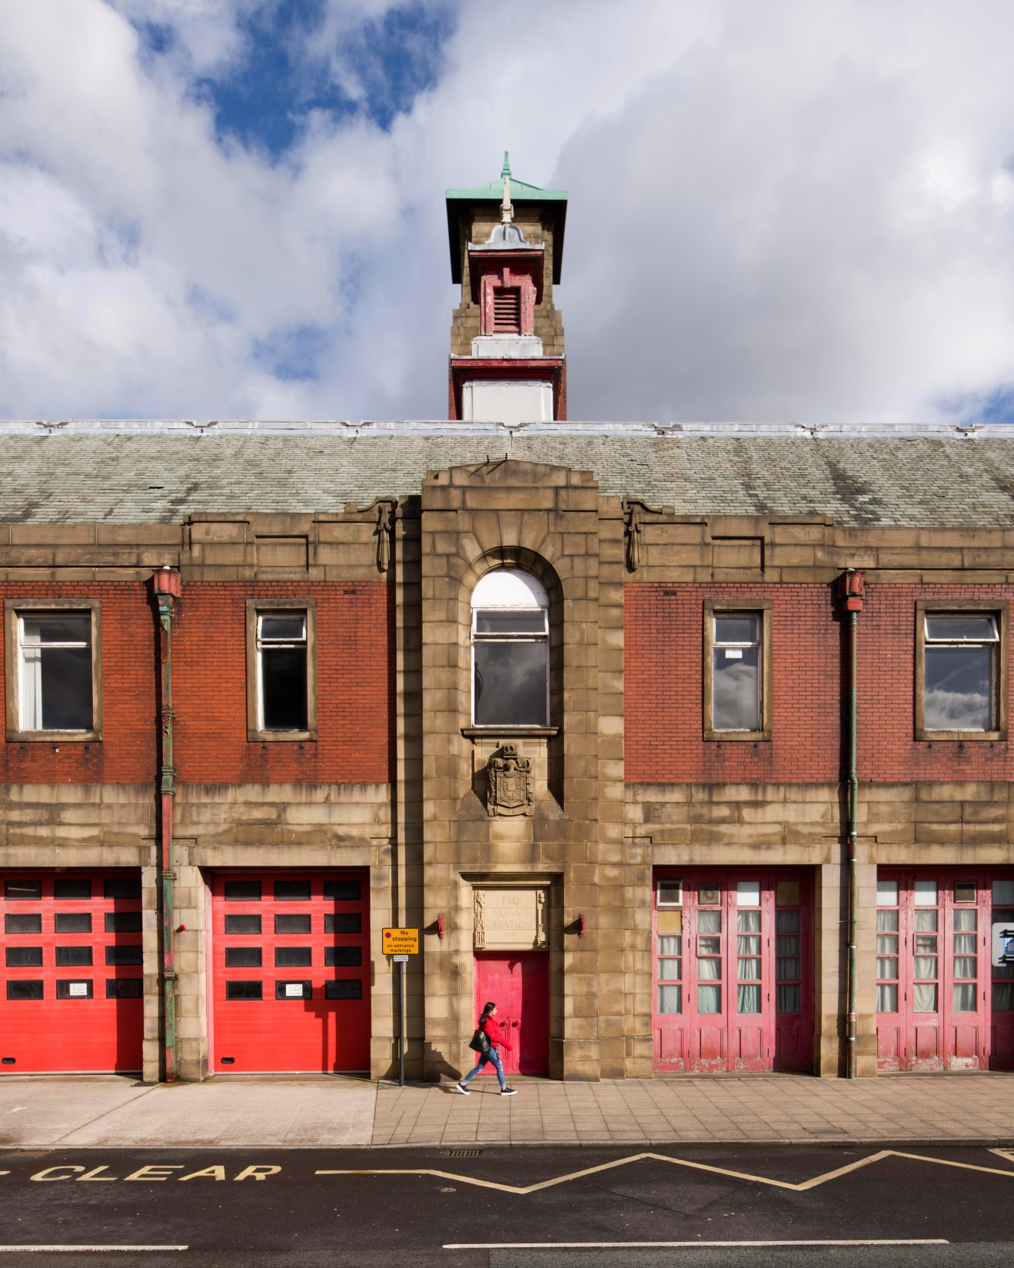
Useful
It should have a use and function well for the people using it
Notes:
Image: Former Rochdale Fire Station, Maclure Road, Rochdale, 3 March 2019 © Source: Historic England Archive ref: DP221911
https://historicengland.org.uk/images-books/photos/item/DP221911

Slide 11
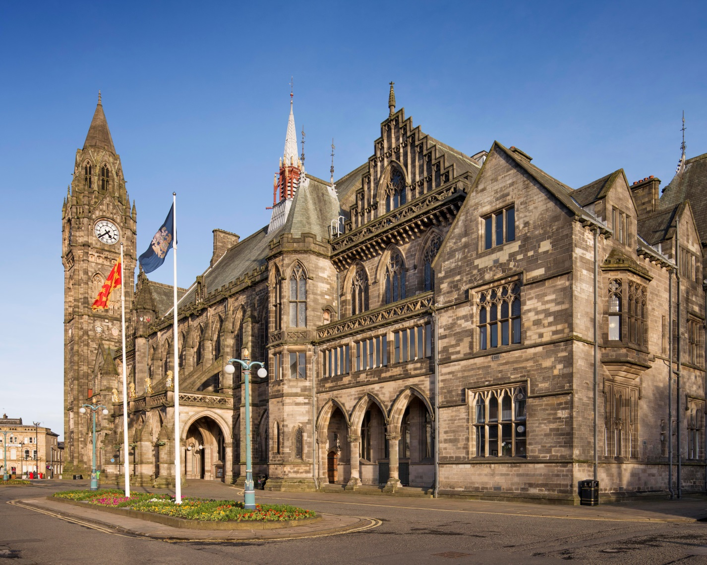
Beautiful
It should delight people and raise their spirits
Notes:
Image: Town Hall, The Esplanade, Rochdale, 3 March 2019 © Source: Historic England Archive ref: DP221955
https://historicengland.org.uk/images-books/photos/item/DP221955
Look at the 3 chosen photos of Rochdale – do pupil’s agree with this choice? Are there other local building they’d like to suggest to represent Durable, Useful & Beautiful?

Slide 12
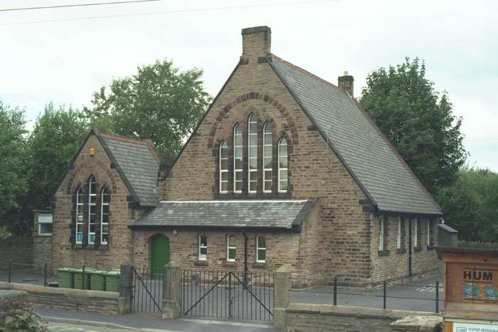
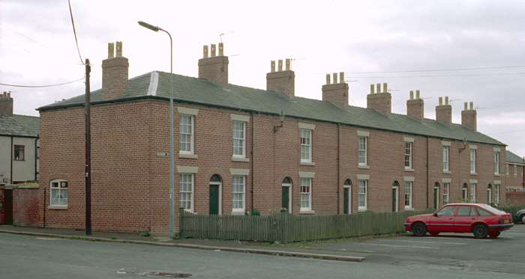
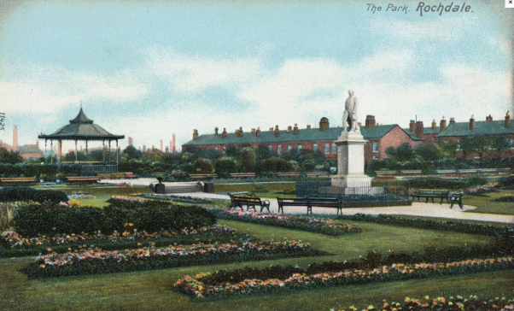
Activity
What is the architecture where I live like today?
Here are some suggestions to get you started:
What do you like/dislike about your school building?
What do you like/dislike about the building you live in?
What do you like/dislike about your local park?
Discuss your views, explaining what in particular you do or don’t like about their architecture/design.
What other buildings or public spaces do you feel strongly about?
Notes:
A good opportunity to ask the students what the architecture is like where they live.
You could think about examples of old and new buildings and discuss what they like and dislike in relation to particular buildings or sites.
Include your school and nearby homes and houses, as well as public buildings.
Remember you can also think about parks, gardens and pedestrianized areas for example.
The town of Rochdale is distinct; the structure of the landscape means that key buildings are clustered into the compact town centre, focussing upon the river. The magnificently Gothic Town Hall, the mediaeval parish church St Chads, the Riverside Offices, bus station and shopping centre are situated within the valley, while the skyline is dominated by a line of great tower blocks called the Seven Sisters.
Image: Photograph taken 15 July 2000 © Mr Simon Barker. Source Historic England Archive ref: IOE01/00226/27
Image: Photograph taken 16 April 2001 © Mr Peter Sargeant. Source Historic England Archive ref: IOE01/03284/16
Image: Photograph 1900-1920 © Source Historic England Archive ref: PC10926

Slide 13
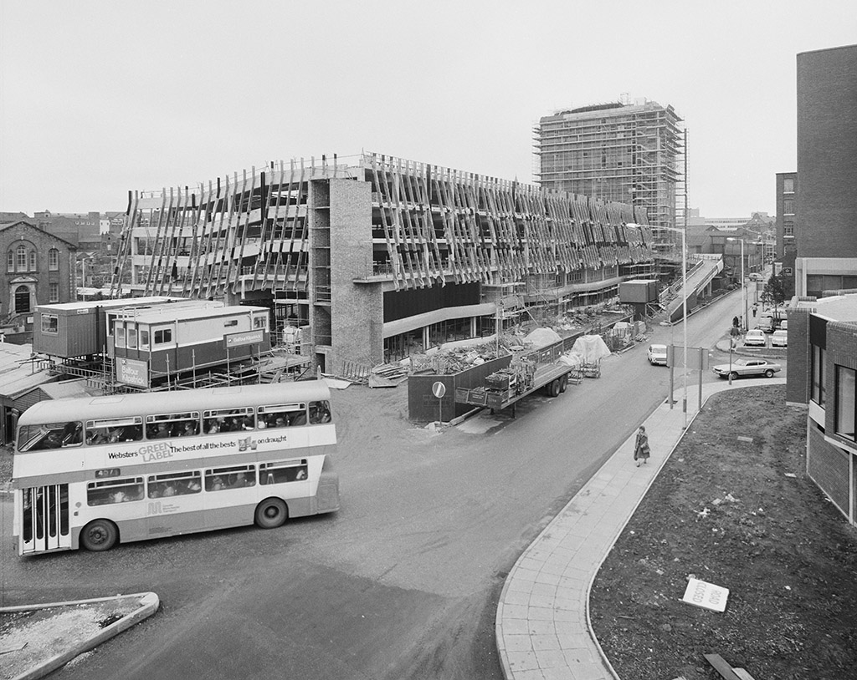
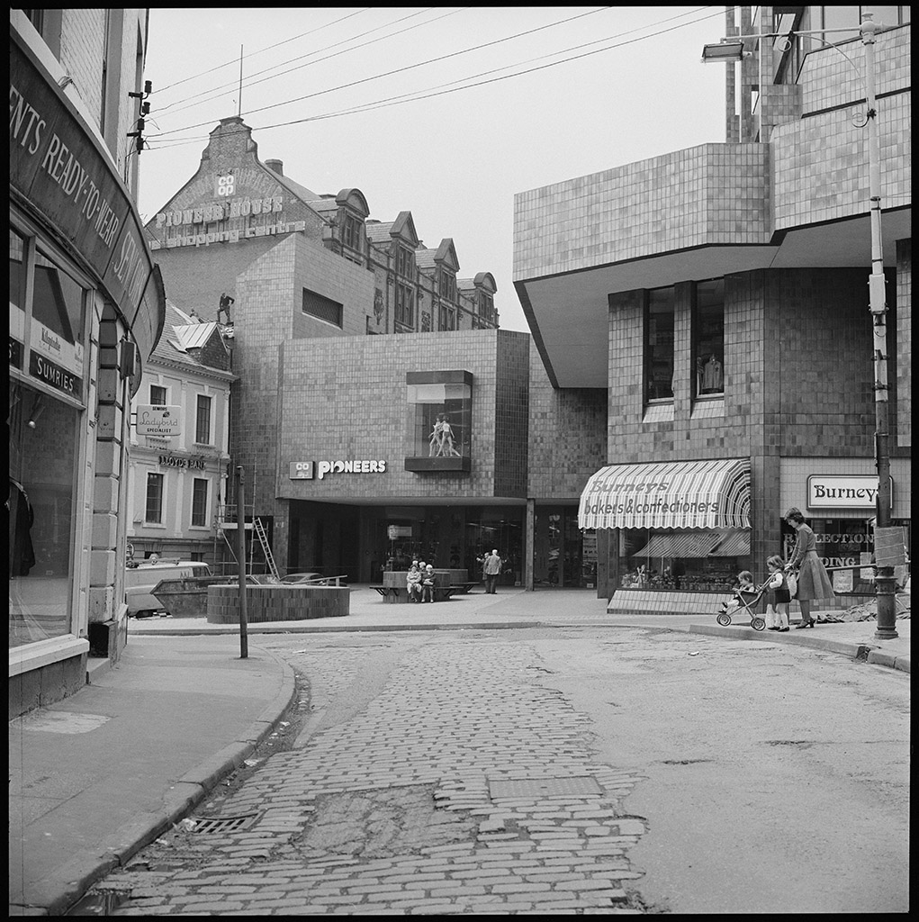
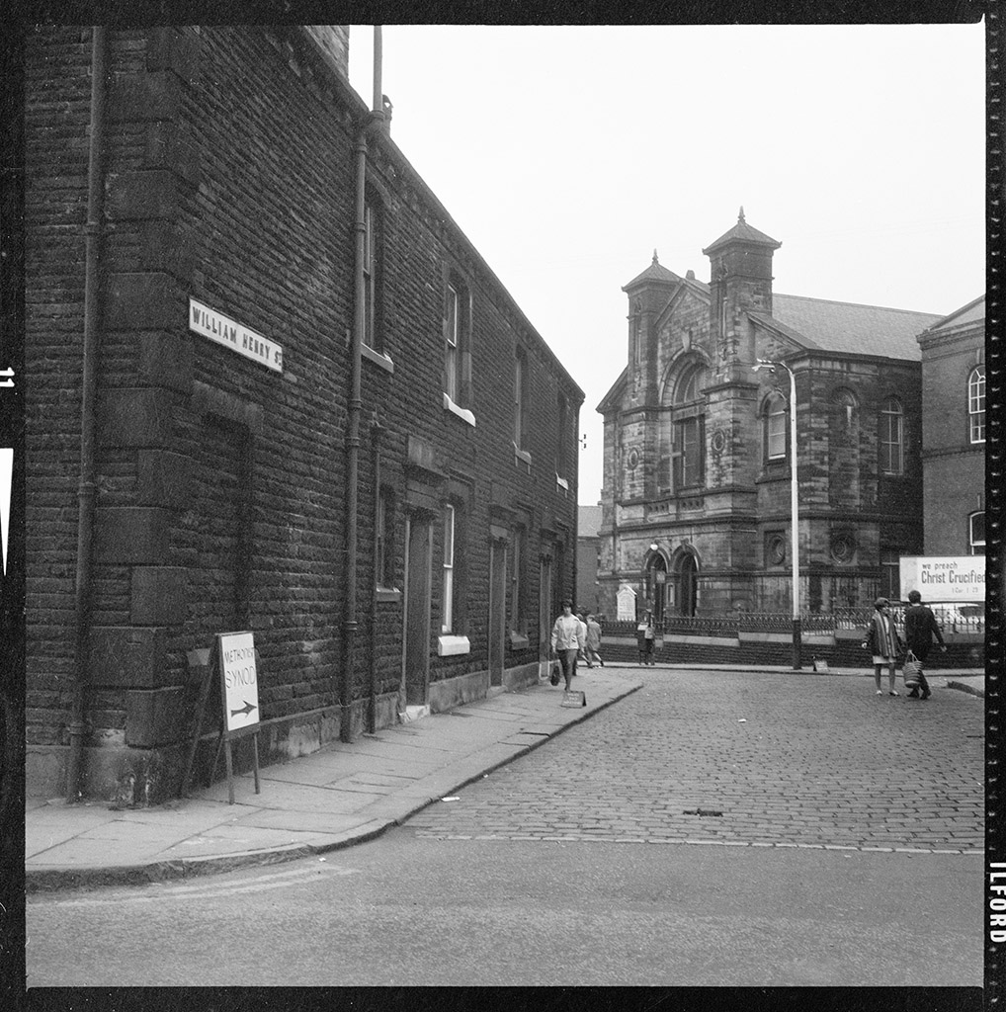
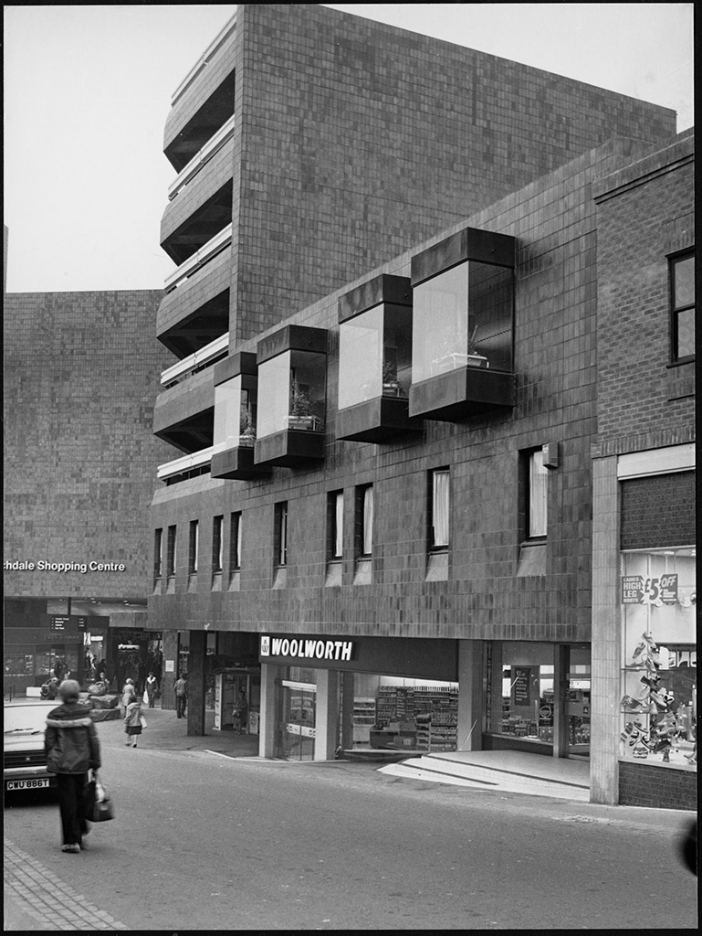
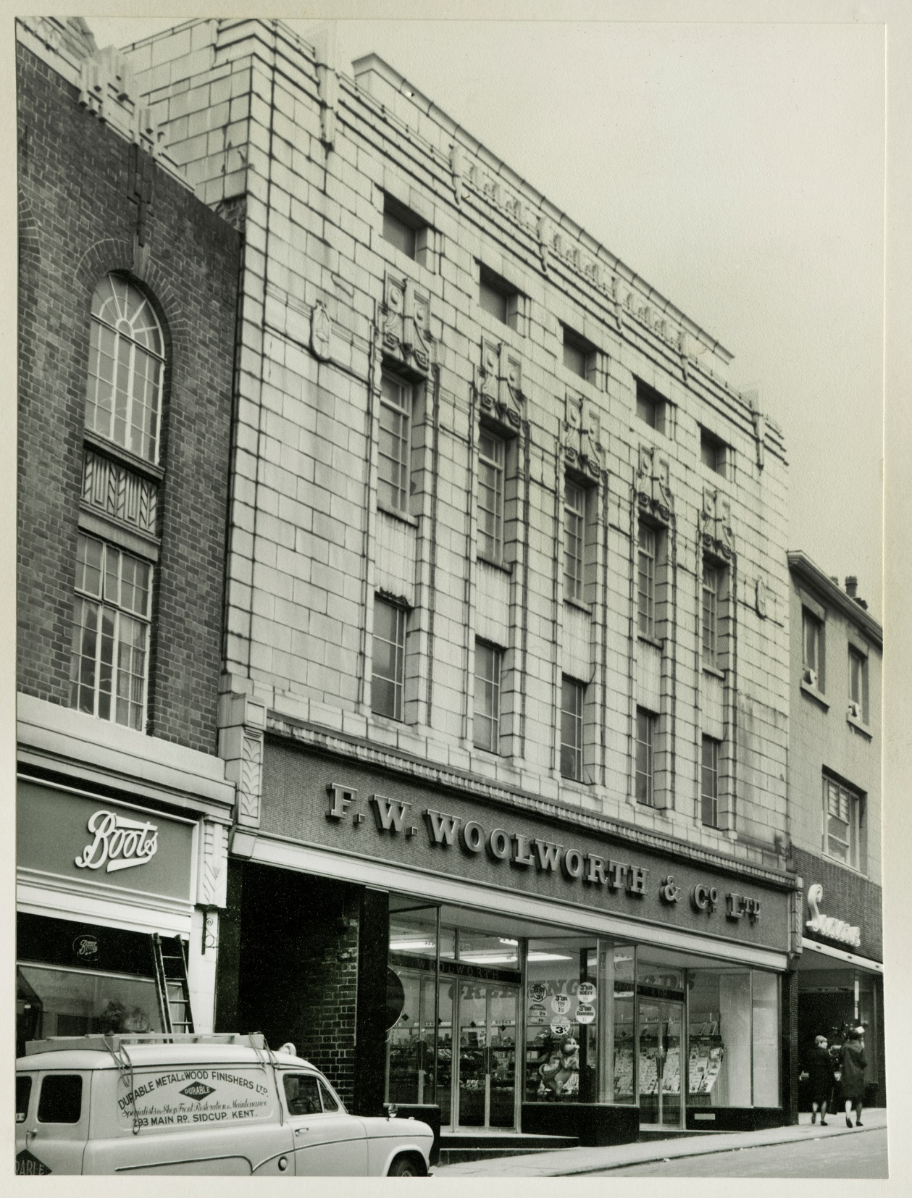
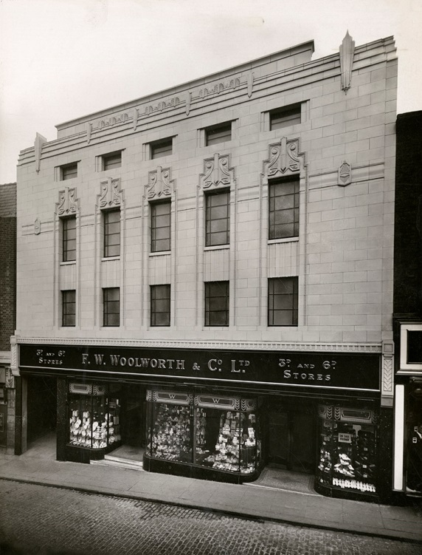
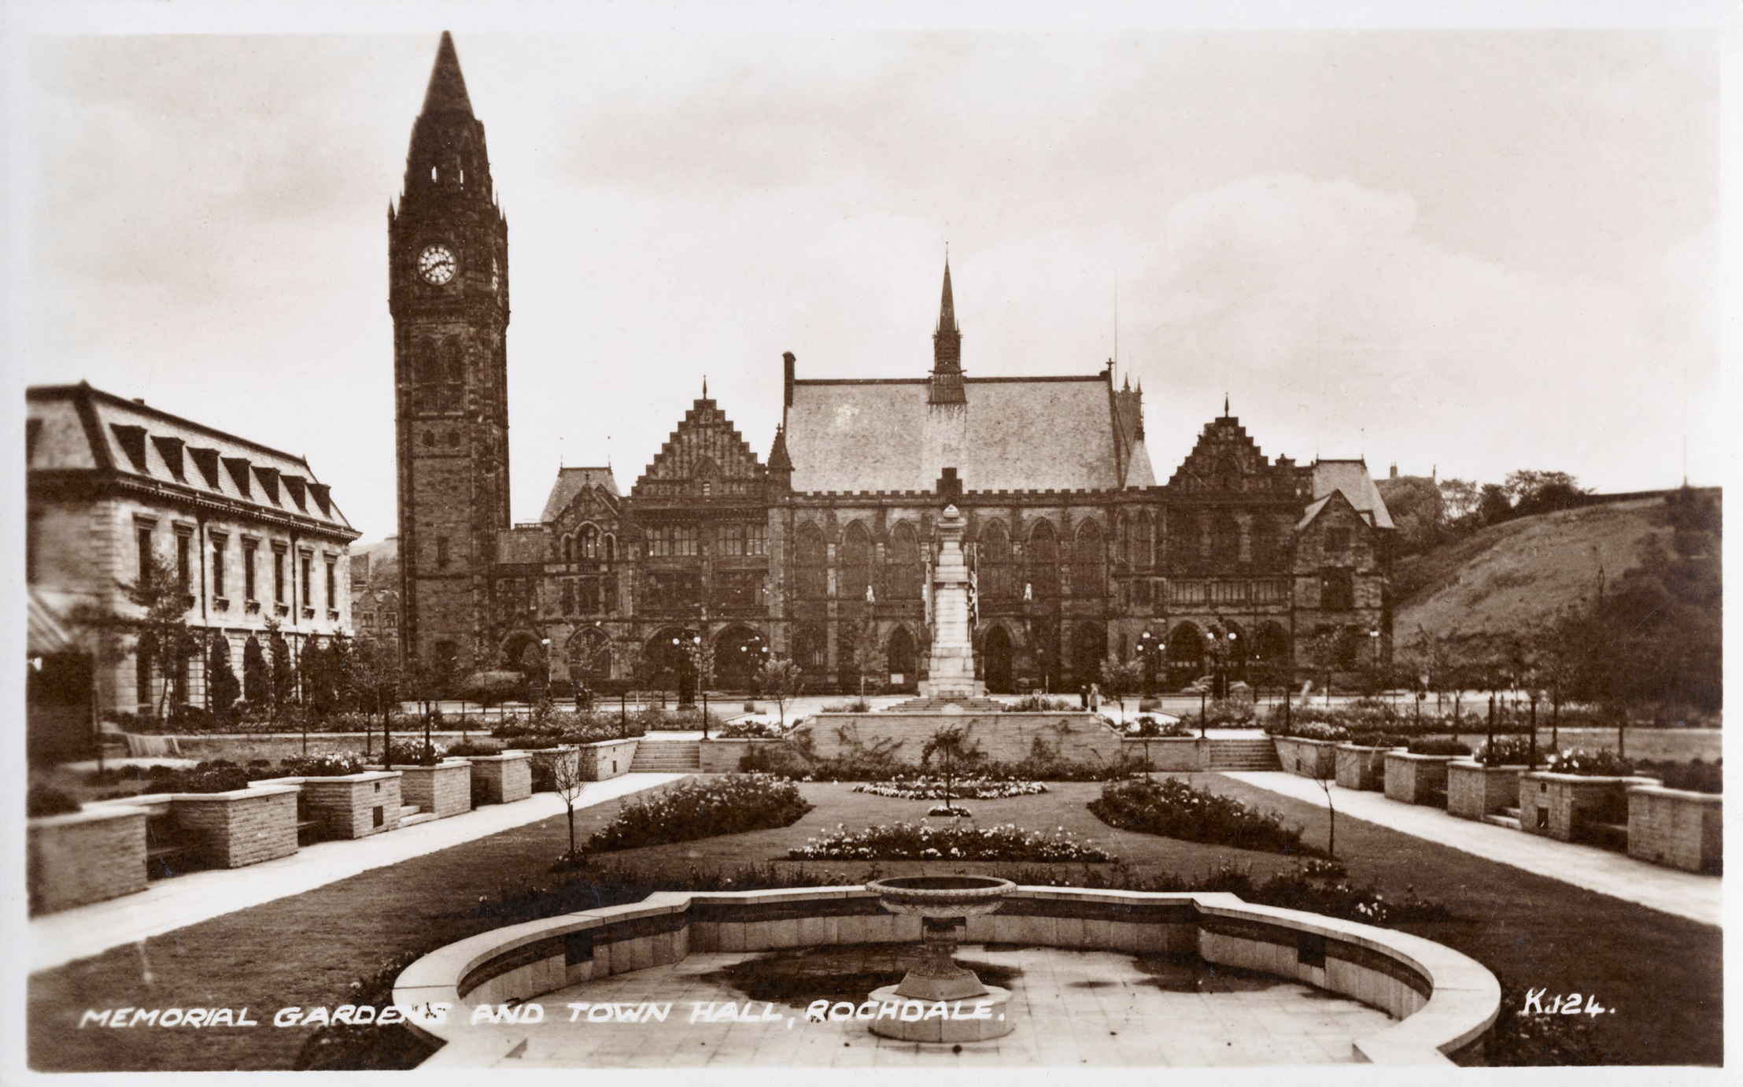
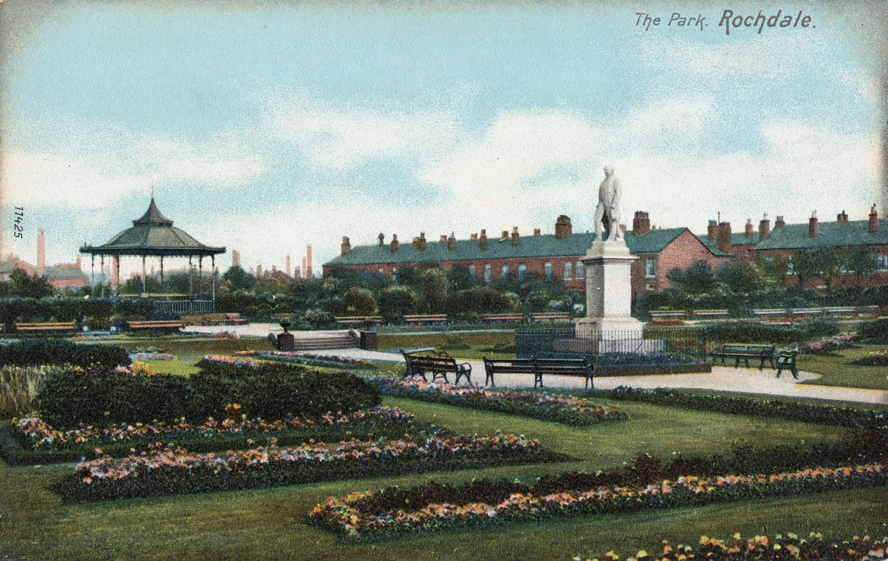
Activity
Has the area I live in always looked the same?
Notes:
Use old photos to look at your area in the past – these all come from the Historic England Archive (https://historicengland.org.uk/images-books/photos/), but you could use any you can find online, subject to their copyright.
Image: General View Looking Across The Memorial Gardens Towards The Town Hall, 1900-1920 © Source: Historic England Archive ref: PC10928
https://historicengland.org.uk/images-books/photos/item/PC10928
Image: View Showing View Across The Park Showing Statue And Bandstand, 1900-1930 © Source: Historic England Archive ref: PC10926
https://historicengland.org.uk/images-books/photos/item/PC10926
Image: A view from the junction of Oldham Road looking west along William Henry Street, 1966-74 © Historic England Archive ref: DES01/01/0143
https://historicengland.org.uk/images-books/photos/item/DES01/01/0143
Image: An elevated view looking south-west towards Rochdale Bus Station, 22 July 1977 © Historic England Archive. John Laing Photographic Collection ref: JLP01/09/771579B
https://historicengland.org.uk/images-books/photos/item/JLP01/09/771579B
Image: A view of the Co-op Pioneer Shopping Centre, 16 May 1978 © Historic England Archive. John Laing Photographic Collection ref: JLP01/09/781250
https://historicengland.org.uk/images-books/photos/item/JLP01/09/781250
Image: F W Woolworth and Company Limited, Yorkshire Street, 1938-40 © Source: Historic England Archive ref: FWW01/01/0274/001
https://historicengland.org.uk/images-books/photos/item/FWW01/01/0274/001
Image: F W Woolworth and Company Limited, showing the newly renovated shop front, 16 November 1966 © Source: Historic England Archive ref: FWW01/01/0274/002
https://historicengland.org.uk/images-books/photos/item/FWW01/01/0274/002
Image: F W Woolworth and Company Limited, part of the newly constructed Rochdale Shopping Centre, 1978-80 © Source: Historic England Archive ref: FWW01/01/0274/004
https://historicengland.org.uk/images-books/photos/item/FWW01/01/0274/004

Slide 14
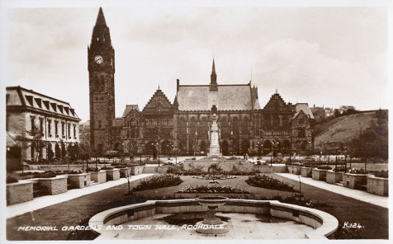
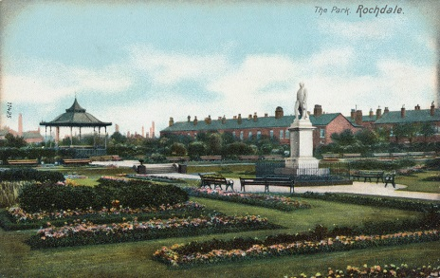
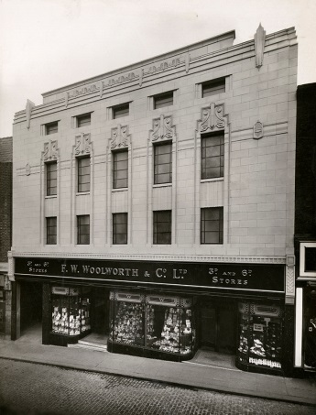
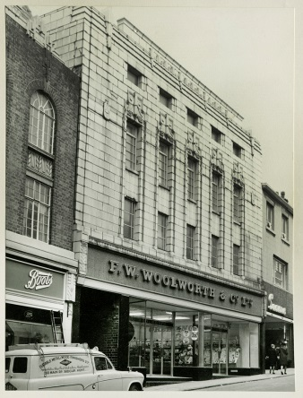
Activity
Has the area I live in always looked the same?
Notes:
Follow the links below/on each image to find out more about each one.
https://historicengland.org.uk/images-books/photos/item/PC10928
https://historicengland.org.uk/images-books/photos/item/PC10926
https://historicengland.org.uk/images-books/photos/item/DES01/01/0143
https://historicengland.org.uk/images-books/photos/item/JLP01/09/771579B
https://historicengland.org.uk/images-books/photos/item/JLP01/09/781250
https://historicengland.org.uk/images-books/photos/item/FWW01/01/0274/001
https://historicengland.org.uk/images-books/photos/item/FWW01/01/0274/002
https://historicengland.org.uk/images-books/photos/item/FWW01/01/0274/004

Slide 15
Activity
Has the area I live in always looked the same?
Use the Historic England Archive or other online archives to find old photos of what your area looked like in the past. Having look at those on the previous slides and any others you have found:
Choose 3 words to describe the kind of architecture you see in the old photos.
Can you work out where any of the old photos were taken?
Use Google satellite view to find out what the building/area looks like today?
Answer the question: ‘Has the area I live in always looked the same?’ Say which specific photos or other research you would use to back up your answer.

Slide 16
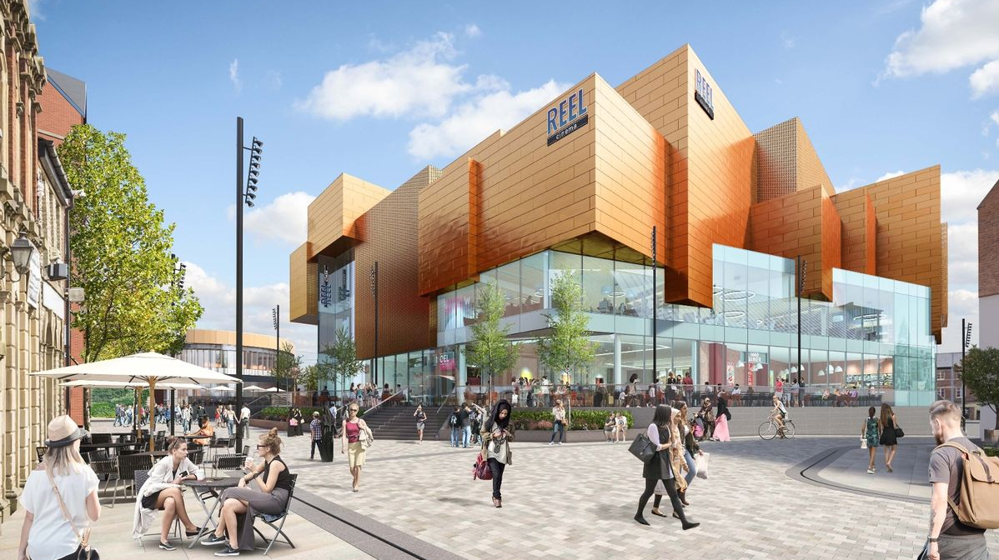
Activity
Will the area I live in always look the same?
Notes:
It is now time to focus on the future. Students will now have seen how places can change over time and that places do not remain ‘static’ but are always changing – so what might the future look like?
Explain that Rochdale town centre has been undergoing impressive regeneration in recent years with the opening of the new council offices, new transport infrastructure including the Metrolink trams arriving in the town centre, while investment into public spaces including re-opening the river and historic bridges has brought new life to the town. A new market opened recently and more and more independent businesses choose Rochdale for their home base. The regeneration programme is continuing with the impressive Riverside Centre to be opened in 2020. Despite these significant changes there are parts of the town centre that have continued to decline or face challenges; these include Rochdale’s historic high street and one of the main gateways to the town centre, Drake Street.
Image: https://www.rochdaletowncentre.co.uk/news/three-new-tenants-announced-for-rochdale-riverside/

Slide 17
What could be better about where I live?
Notes:
A good opportunity to ask the students what could be better about where they live.
Ask them to think about other parts of the area, not just the ones you have been looking at in the previous slides.
Are there any particularly run down sites / areas?
What would they do if they were in charge?

Slide 18
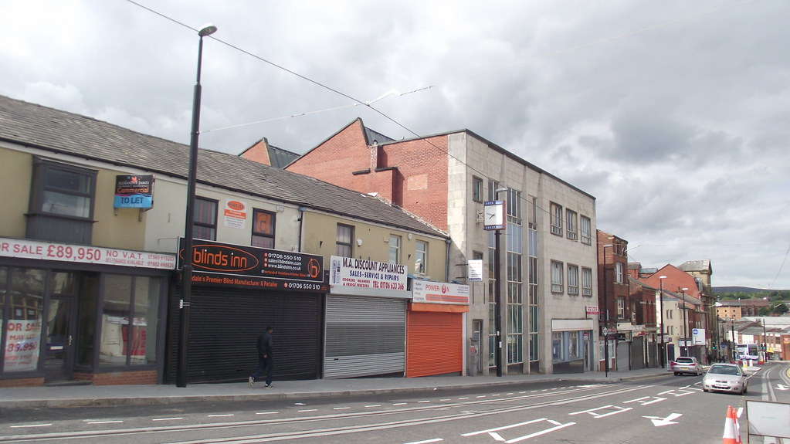
Drake Street
Notes:
This is the historic high street – Drake Street – many of the shops are empty. It is an example of a part of Rochdale in which the architecture could do with some care and attention.

Slide 19
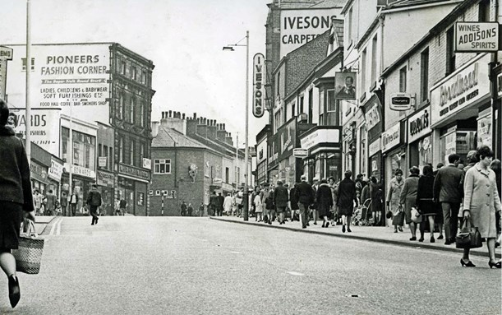
Drake Street
Notes:
Drake Street was once a bustling high street.
Image: © Burnley Evening Post

Slide 20
Historic England have made part of Rochdale, including Drake Street, a Heritage Action Zone
‘Historic buildings which have deteriorated through decades of neglect will be restored and put back into use, and unsung places will be recognised and celebrated for their unique character and heritage, helping to instil a sense of local pride.’
Rochdale Heritage Action Zone Project Officer

Slide 21
What is a Heritage Action Zone?
Heritage Action Zones are areas that are rich in heritage and history but which, over time have become run down
An organisation called Historic England, which champions and protects England's historic places, is providing support to these places to help breathe new life into them
The Rochdale HAZ is centred on Drake Street - the historic route from the railway station down to the Town Hall
The area was awarded “Heritage Action Zone” status in 2017
Notes:
You can find out more about HAZ on the HE website at https://historicengland.org.uk/services-skills/heritage-action-zones/
You can find out more about Rochdale HAZ at https://historicengland.org.uk/whats-new/in-your-area/north-west/rochdale-heritage-action-zone/

Slide 22
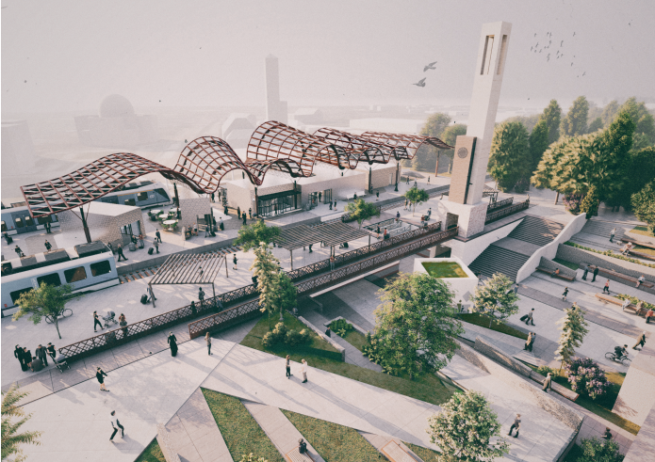
Rochdale Reimagined – Your task
In 2019 University Students from Manchester School of Architecture (MSA) created architectural designs and models reimagining the use of five site of old buildings and unused spaces in Rochdale.
Today, you are going to become “honorary architects”, reimagining and redesigning the same spaces that the MSA students looked at.
One of the designs for Rochdale station created by MSA students

Slide 23
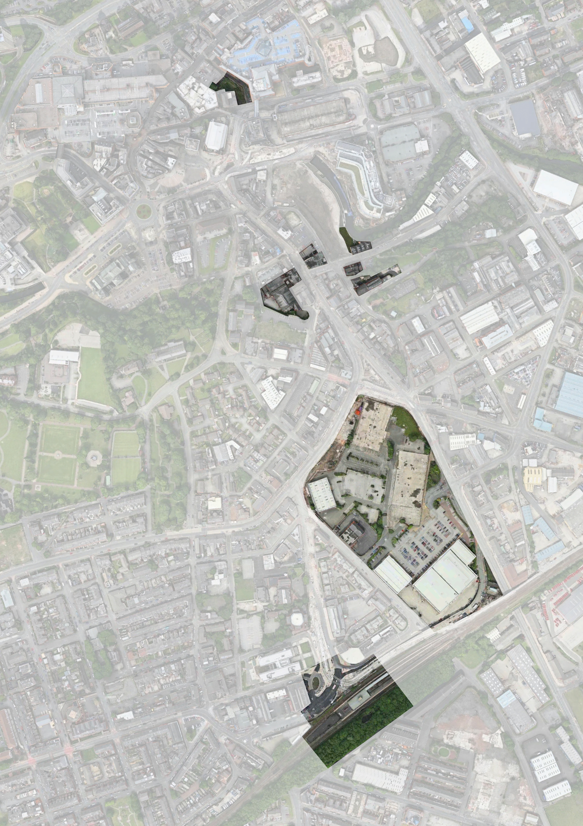
Rochdale Reimagined – The 5 sites:
The Railway Station
The Old Retail Park
Drake Street and Champness Hall
Riverside and Fashion Corner
The Wheatsheaf and Bell Street
In groups, you will each be given one site to focus on.
Notes:
Divide the class into five groups, with each group focusing on one site. (If possible ensure there are even numbers of children in each group). Distribute relevant project booklets one between two. As a class read the first sections of the project booklet, up to and including the section called “Heritage Action Zones” (Note. These sections are the same in every booklet) – discuss unfamiliar and key words.

Slide 24
Rochdale Reimagined – The 5 sites:
Find your site on the map on page 3 of your booklet
What do you know about your site already?
What would you like to know?
Site 05
Bell Street
Site 03
Drake St. + Champness Hall
Site 01
The Railway Station
Site 04
Fashion Corner + Waterside
Site 02
The Retail Park
Notes:
In pairs, ask the students to find their site on the map on page 3 of their booklet (as download from previous slide). If possible, you could take a walk to see the sites or find them on Google street map and use street view to have a closer look. What do the students like / dislike about the look of the site?
In architects teams, or pairs within their teams, students explore their booklets to find out more about their sites. Students could make a mind map of important information or select a number of interesting facts to share with the class. Class feedback to share learning.
There is more scope for geography here – the students could plan the route from your school to the site for example.

Slide 25
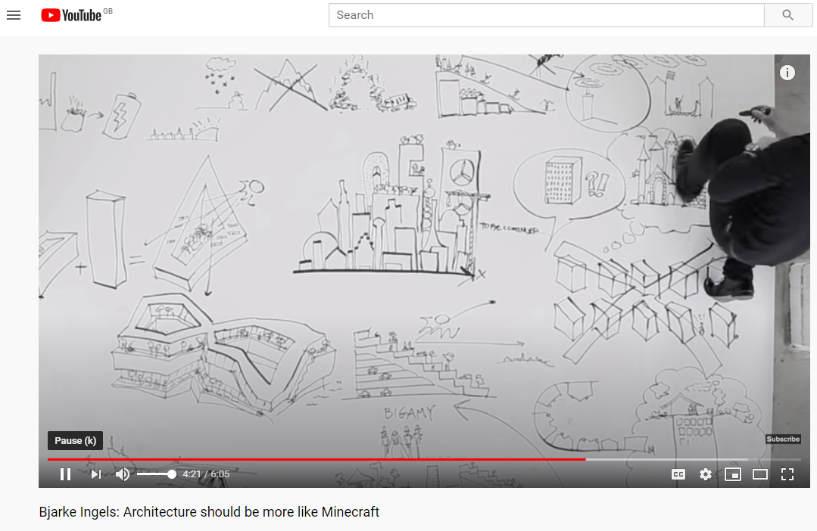
Where does an ‘Honorary Architect’ start?
Notes:
This is a good point to ask what they think an architect might do on a project like this.
Then as a class watch this inspiring film about Architecture (Note. some of the words will be new to students, so you may wish to stop and discuss the different ideas)

Slide 26
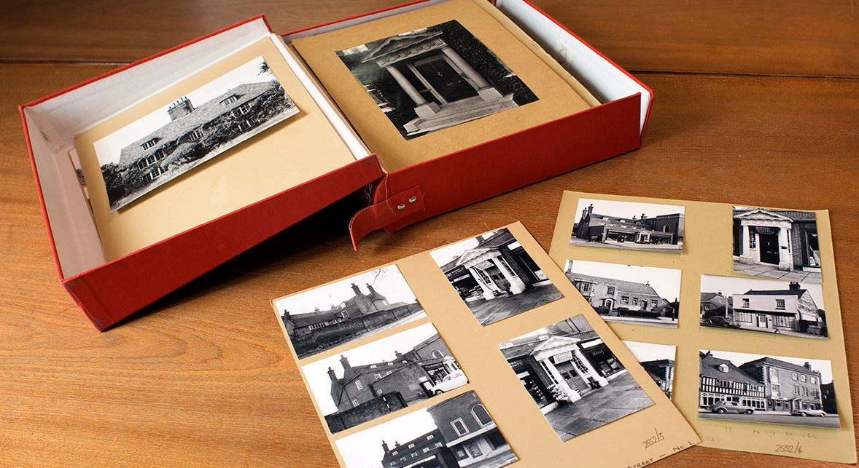
Step 1: Investigate
Notes:
Use the information in the workbooks and any additional online resources you find to investigate each site.
Image: Historic England

Slide 27
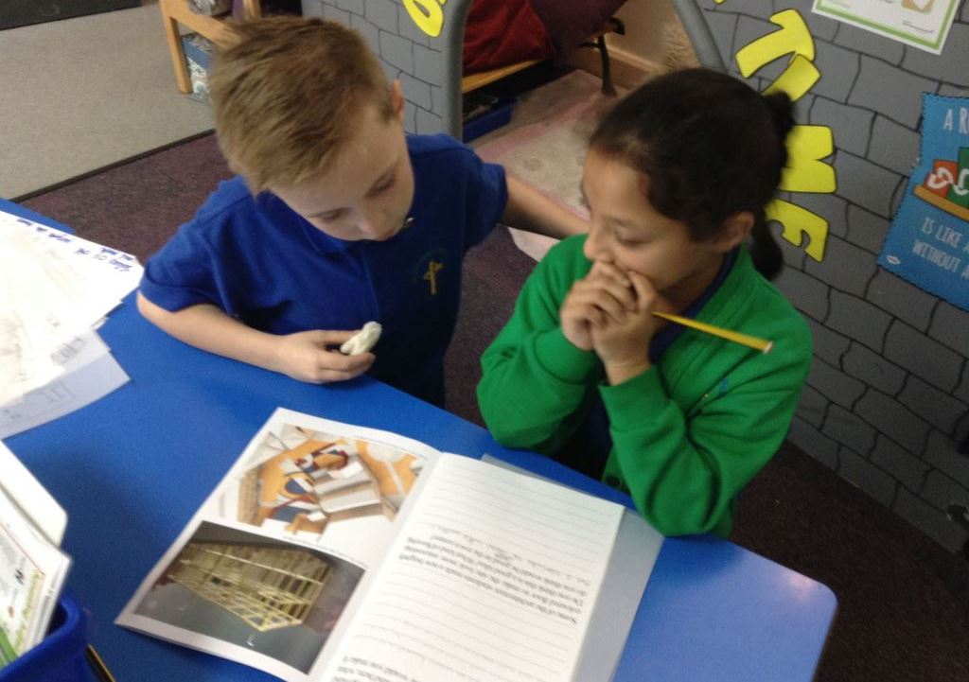
Step 1: Investigate your site in the past and the present.
  With your partner read in your booklets to find out about
    the history of the site
    what it is used for today
    Use local history libraries / online website to find out more
  Have a discussion with your partner about:
    why it is important
    whether it has been well looked after
    what you like and don’t like about it.

Slide 28
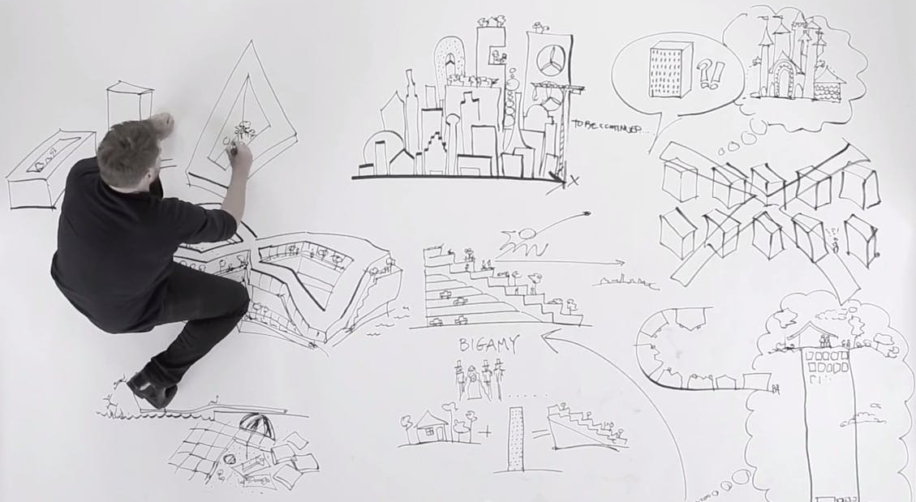
Step 2: Think
Notes:
Image: From inspiring film about Architecture

Slide 29
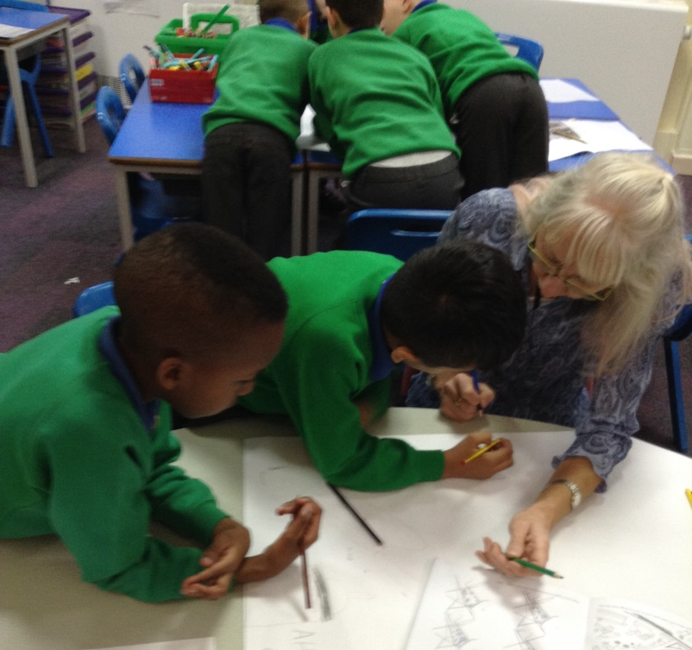
Step 2: Think about your ideas for reimagining the site
In pairs develop your ideas for reimaging and redesigning the site you are working on. You could create a “mood board” including
  mind maps of your ideas,
  sketches and drawings,
  cut out ideas from magazines
Answer the questions in your project booklet to help you to start thinking more deeply about your ideas for redesign.
Notes:
You may want to re-watch the inspiring film about Architecture

Slide 30
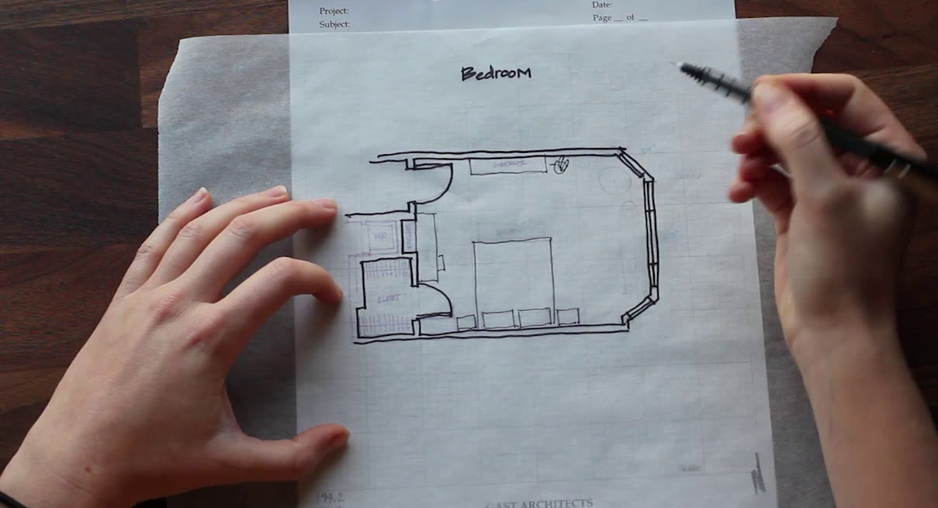
Step 3: Trace
Notes:
Next they should use the booklet and the tracing paper to draw over the old building and add anything new they are proposing. They can go over and over this to make lots of itertaions.
Image: http://www.nauni.id/

Slide 31
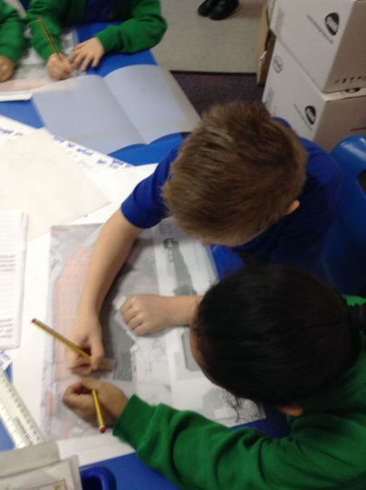
Step 3: Trace the outline of your site and add the changes you have made
Once you have decided on your redesign, use tracing paper to trace the outline of your site from your project booklet.
Now add the changes you plan to make.
Notes:
You could ask students to add labels to explain their design or to colour code it and produce a key.

Slide 32

Step 4: Model
Notes:
Anything can be used to model and imagine the spaces. You can often model things that you cannot draw. These crisps are made to look like a model by adding scale model people. https://archinect.com/news/article/138592709/cutting-across-the-chicago-architecture-biennial-sou-fujimoto-s-potato-chips-and-other-found-architectures
Image Credit: Tom Harris / Chicago Architecture Biennial

Slide 33
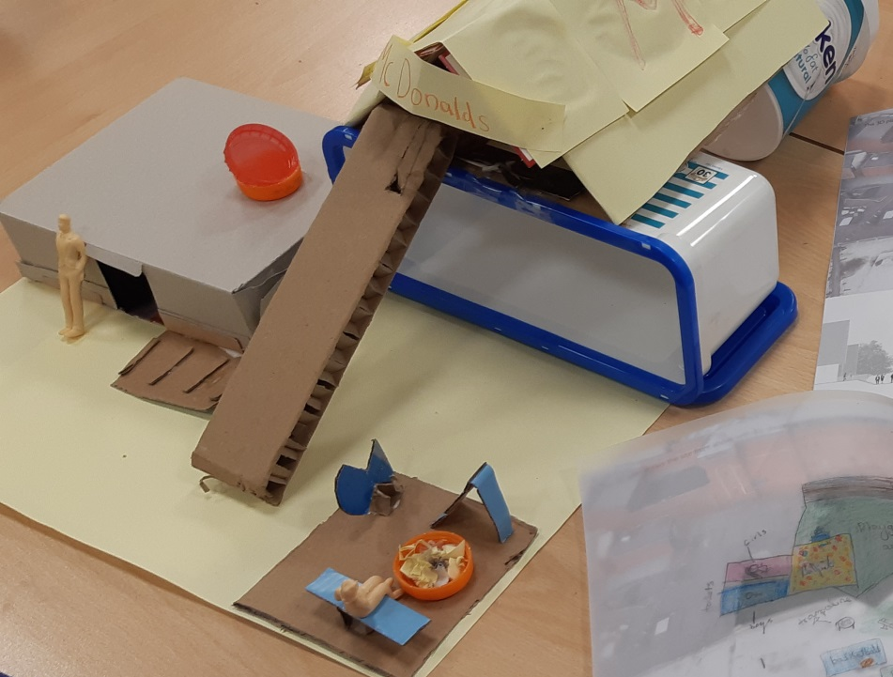
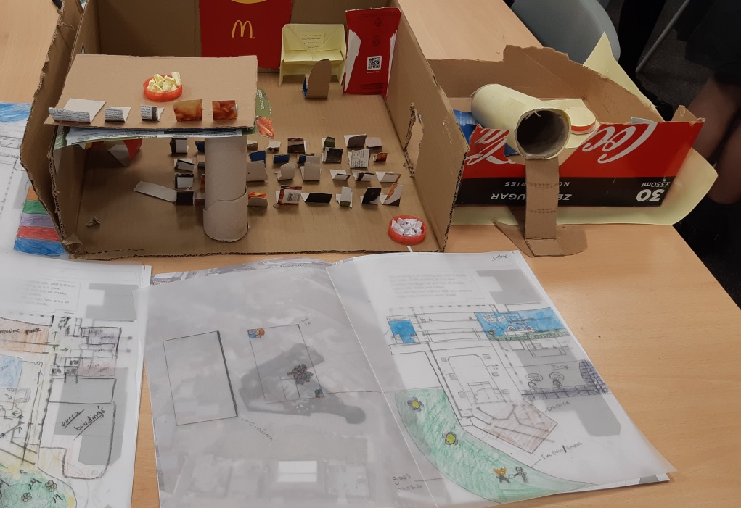
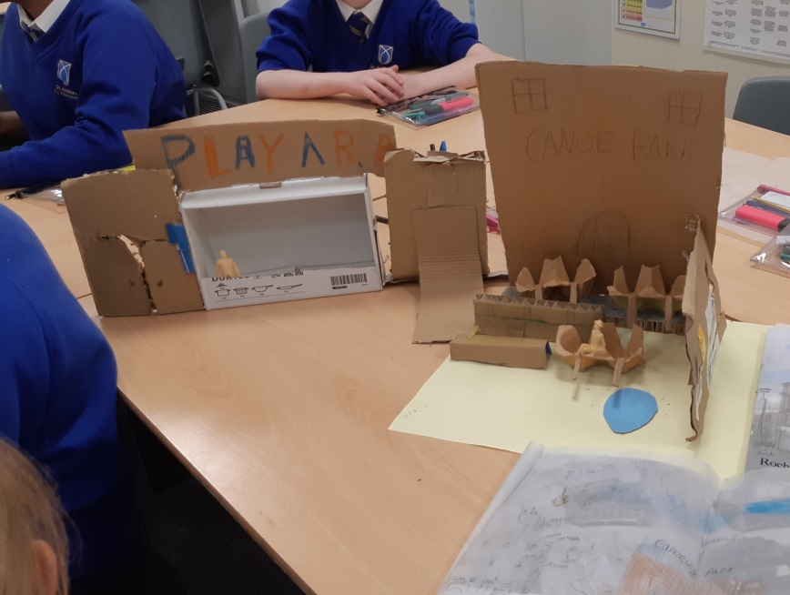
Step 4: Model your design
Notes:
Use a range of materials such as cardboard boxes, plastic bottles etc (see list in scheme of work for other ideas). You could also ask students to label them or write a description of their design once it is completed.
Take photos of your models. You might like to use small plastic models of people which can be purchased online (see scheme of work for details)

Slide 34
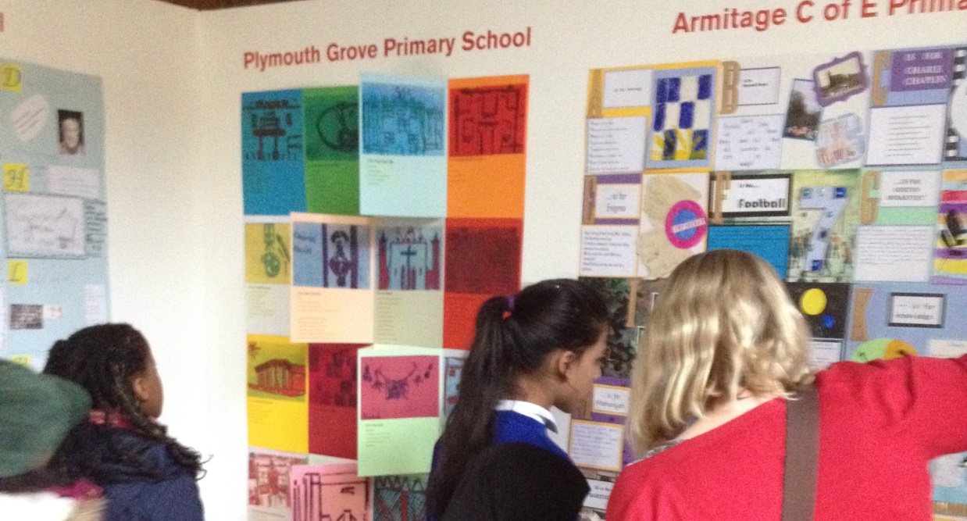
Step 5: Share

Slide 35
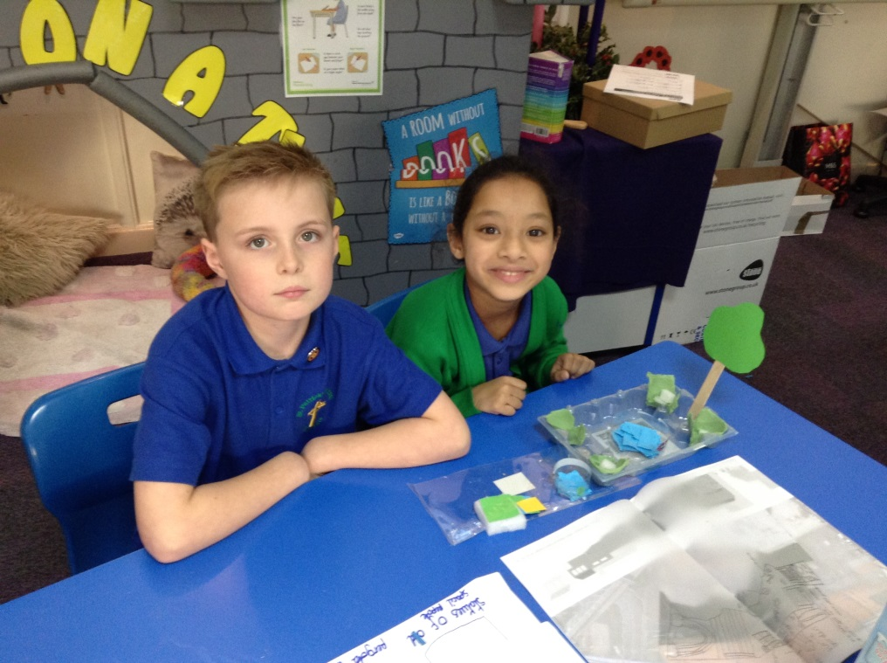
Step 5: Share your designs and ideas with others
Describe your designs to the rest of the class.
You could even vote on your preferred design for each site.
Why not have a class exhibition and invite other students, staff and parents to see your work!

Slide 36
Find more teaching resources at:
HistoricEngland.org.uk/Education

