Slide 1
Teaching activity about coronations
Coronations
Can photographs tell us more about past coronations than paintings?
Notes:
Follow this link to see the route and archive images of Queen Elizabeth II’s Coronation Procession: https://storymaps.arcgis.com/stories/af1e1b457b9040bb8a8c8131bc577dda
Image: Queen Elizabeth II Procession - Source: Historic England Archive Ref: P/C00425/003 Date: 2 Jun 1953

Slide 2
How to use this PPT
Contents
Timeline of British coronations since 1821
Images and information on coronations and public celebrations of coronations through time since 1821
Suggested activities on how to use photographs and paintings to find out about the past
Our coronation resources are designed for teachers to use with Key Stage 1 and 2 pupils. Please see the slide notes for more information and activity suggestions.
By using archive photographs and paintings of coronation ceremonies and celebrations as historical sources, pupils will develop a range of skills.
They will be able to identify similarities, differences and changes through time between coronations, helping them to develop a sense of chronology.
They will learn how to interpret images and to question the accuracy of archive images as sources of evidence of past events.
Notes:
Some prior knowledge and understanding about the coronation of King Charles III and why this is a significant national and global event. This resource can be used as a stand-alone activity or part of a wider study on the monarchy or historical sources and interpretations.

Slide 3
Can photographs tell us more about past coronations than paintings?
History
To learn about British coronations and their significance in British history since 1821​
To develop skills in chronology using timelines and historical images
To learn the different ways images of events from the past were recorded
To learn about and question photographs and paintings as reliable sources of evidence and interpretations of the past
This PPT is part of the Teaching Activity: Can photographs tell us more about past coronations than paintings?

Slide 4
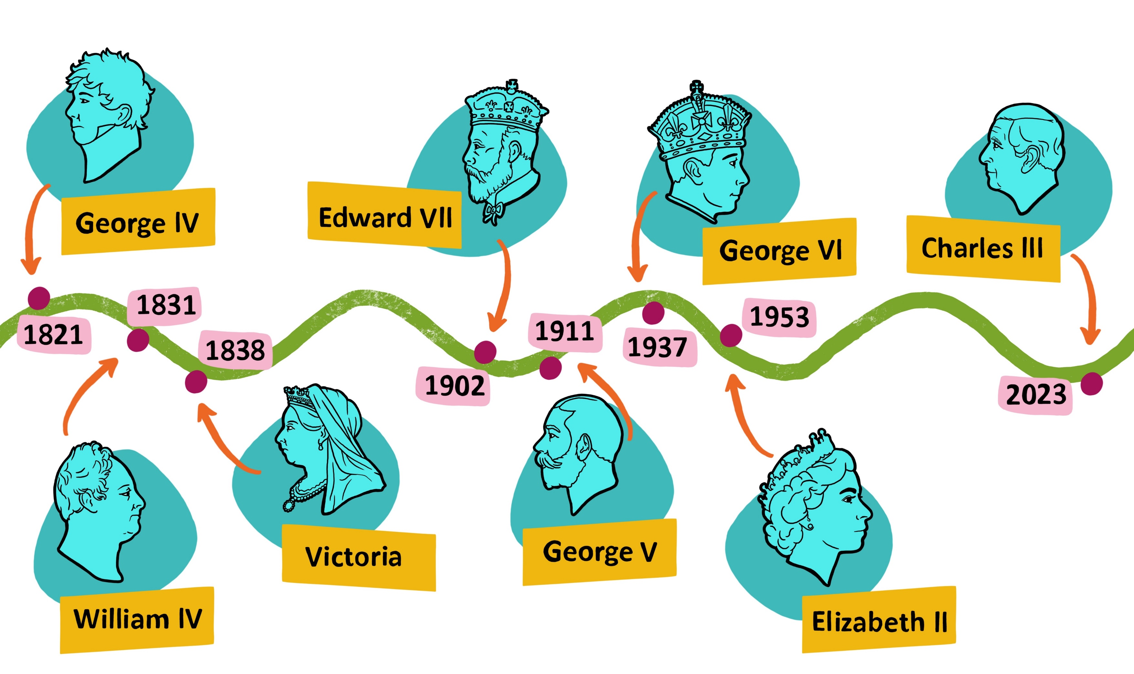
200 years of British Coronations
200 years of British Coronations
Notes:
Timeline of coronations from the past 200 years. There are different versions of this slide at the end of the PowerPoint that can be printed out for chronology activities. These include versions where pupils can complete the names of the monarchs, the dates and draw their own images. Black and white versions are also included.
Image ©Sean Curran Historic England

Slide 5
How will the 2023 Coronation be watched and recorded?
Class discussion
Millions of people all over the world will be able to watch the coronation of King Charles III and Camilla, Queen Consort.
What are the different ways people will be able to do this?
What are the different ways people will be able to record the coronation, so people can see images of it in the future?
Make a list
Notes:
Class discussion on how the coronation can be viewed - Some people will be invited to West Minster Abbey and be part of the ceremony. People could line the streets of London to watch the procession as it passes by. The people watching from the streets can take their own photos and film it with their phones and cameras. Official photographers will take photos in West Minster Abbey and on the route of the procession. Television cameras will film the coronation and people can watch at home on the TV. The event will be streamed and people can watch it online. People will be able to listen to the commentary on the radio. People will be able to sketch and paint the coronation, while it is happening or from their own, or other people’s, films and photographs - or from memory. People can write about it in notebooks, diaries and blogs. Journalists will write about it for newspapers, websites and other media. People will be able to share images and information in emails, text and WhatsApp messages, Instagram, TikTok and other social media. Books will be written before and after the event.

Slide 6
King Charles III and the Queen Consort, Camilla 2023
On May 6 2023 King Charles III and the Queen Consort, Camilla, will be crowned.
Their coronation will take place at Westminster Abbey.
The coronation will be part of a Christian service and the King will make promises to God and the people he serves.
King Charles and Camilla lighting a candle January 2023
Notes:
For more information about the Coronation of King Charles III, A Guide to Coronations, Information on The Crown Jewels and the Coronation Big Lunch follow this link https://www.royal.uk/coronation
Image: King Charles III and Camilla, the Queen Consort light a candle at Buckingham Palace, London, to mark Holocaust Memorial Day, in Britain January 27, 2023. ©Alamy Ref: 2MHW6PJ Date: January 27, 2023
NOTE: Larger versions of all the images of coronations and coronation celebrations are included at the end of this PPT.

Slide 7
Coronation of Queen Elizabeth II 1953
Queen Elizabeth was the last British monarch to be crowned (in 1953).
How many years ago was this?
Her coronation was the first one in the world to be filmed and watched on television.
Why was this?
Many photographs were taken, but many ordinary people didn’t own a camera. Can you think why?
Why do you think most of the photos of Queen Elizabeth II’s coronation are black and white?
Watch a 4 year old Charles watching his mother being crowned in 1953.
The Coronation of Queen Elizabeth II 1953
Notes:
This YouTube link below will take you straight to the point of crowning and 4 year old Charles watching ( 3mins).
YouTube BBC footage of Coronation of Queen Elizabeth II 1953 https://youtu.be/52NTjasbmgw?t=5415
Colour photography was still relatively new in the early 1950’s, so there are lots of black and white photos of Queen Elizabeth II’s coronation. A lot of people didn’t have their own camera and there was a cost for a roll of film and having the films processed, so may people would not have a camera of their own, and couldn’t afford one.
Image: Queen Elizabeth II during her coronation.. ©Alamy Ref: RJRP3M Date: 2 June 1953

Slide 8
Colour Photographs
Compare the black and white photograph of the coronation of Queen Elizabeth II with this colour photograph.
What details can you see in the colour photograph that you can’t see in the black and white photo?
Try comparing the colour photograph to a painting of a coronation of a monarch – before cameras were invented.
Are there any similarities?
Compare the colours of the robes.
The Coronation of Queen Elizabeth II 1953
Notes:
Comparing this colour photograph with black and white images of photos helps to work out what the colours are likely to have been at past coronations. Comparing it to paintings (pre-photography) also suggests that the artists’ interpretations of the coronations, robes, regalia, ceremony etc. were quite accurate as the coronations follow a tradition throughout history.
Image: Queen Elizabeth II during her coronation. ©Alamy Ref: RJRP56 Date: 2 June 1953

Slide 9
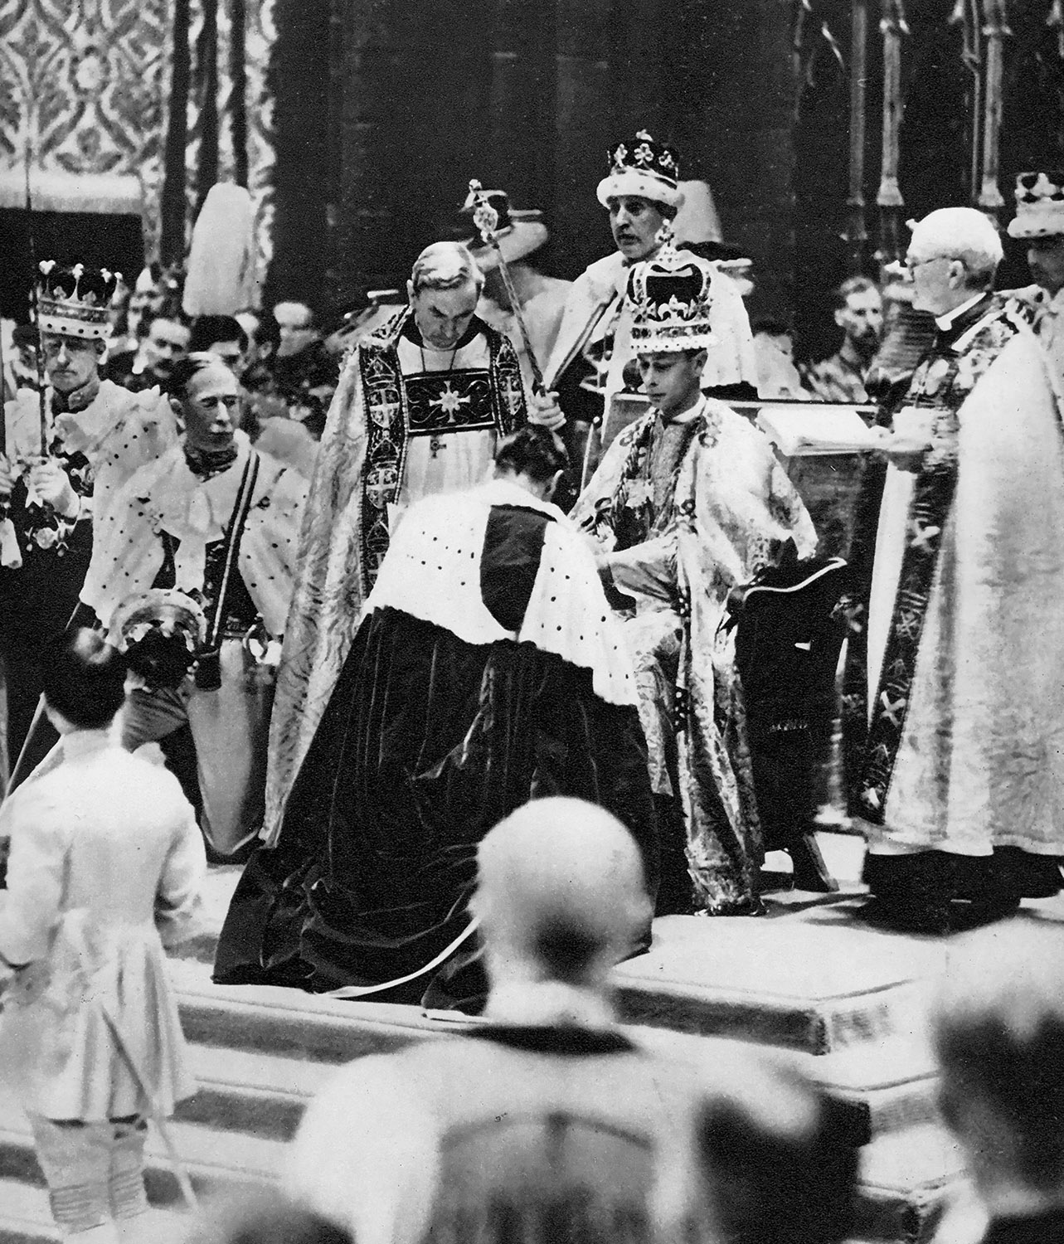
The Coronation of George VI and Queen Elizabeth 1937
Think about the colours in the colour photo of the 1952 coronation
Compare the colour photograph of Queen Elizabeth II’s coronation to these photos.
Use it to try to work out what colours the clothes King Georg VI and Queen Elizabeth are wearing are likely to have been.
If a monarch of England is male, and he is married, his wife can be made Queen Consort. She is crowned at the coronation after her husband, the King.
However, traditionally, the husband of a Queen cannot be made King Consort.
Do you think this is fair?
Class discussion
Notes:
Class discussion on why a Queen’s husband could not be made King Consort? Do the class think this tradition is fair and will/should it change in the future? Are there any other examples of men and women being treated differently in the past? E.g. women being able to vote.
Upper Image: EDITORIAL George VI, 1895 – 1952. King of the United Kingdom and the Dominions of the British Commonwealth. Queen Elizabeth, The Queen Mother. Elizabeth Angela Marguerite Bowes-Lyon, 1900 – 2002. Wife of King George VI and mother of Queen Elizabeth II. Seen here at their coronation in 1937. From The Coronation in Pictures, published 1937. ©Alamy Ref: RJRP56 Date: 12 May 1937
Lower Image: His Majesty King George VI (1895-1952), receives homage at his coronation, 1937. George VI's coronation took place on 12th May 1937 at Westminster Abbey, the date previously intended for his brother Edward VIII's coronation. ©Alamy Ref: 2M3PC13 Date: 12 May 1937

Slide 10
The Coronation of King George V and Queen Mary 1911
The coronation of King George V and Queen Mary took place in 1911.
How many years ago was this?
How many years are there between this coronation and the coronation of George VI and Queen Elizabeth in 1937?
1937
- 1911
The Coronation of King George V and Queen Mary 1911
Notes:
Here we can see that Queen Elizabeth II’s mother was made Queen Consort when her father was made King (Elizabeth’s husband, Prince Phillip, was not made King Consort). Working out the number of years between the coronations emphasises how long Queen Victoria and Queen Elizabeth II (the only 2 Queens in the past 200 years) were monarchs.
Image: King George V and Queen Mary of England after their coronation in 1911 ©Alamy Ref: 2A603M2 Date: 22 June 1911

Slide 11
The Coronation of King Edward VII and Queen Alexandra 1902
This coronation photograph looks very similar to the one of King George V and Queen Mary in 1911.
Why do you think this might be?
Edward had an older sister, called Princess Victoria. She was the eldest child of Queen Victoria and Prince Albert. Until recently, the sons of monarchs were always before daughters in the line to the throne.
Was this fair?
Think about the dates
Group discussion
King Edward VII and Queen Alexandra 1902
Notes:
This coronation was only 9 years before the last one, so the technology and style of photography wouldn’t have changed very much.
Group/Class Discussion on the male heirs being higher up in line to the thrown than their sisters, if they had any, and how fair this was. This changed in 2011. So when Prince William and Kate were expecting their first child in 2013, had the child been a girl, she would have been next in line to the throne after her father Prince William. They had a boy, Prince George, and as the eldest child, he is next in line, after his father. However, his younger sister Princess Charlotte, is 3rd in line, before her younger brother Prince Louis who is 4th.
Image: KING EDWARD VII AND QUEEN ALEXANDRA in their Coronation robes ©Alamy Ref: BRT92Y Date: 9 August 1902

Slide 12
The Coronation of Queen Victoria 1837
Queen Victoria was crowned in 1837. How many years were there between her coronation and the coronation of her son, Edward VII, in 1902?
Are there any photographs of Queen Victoria’s coronation?
Investigate
The Coronation of Queen Victoria 1837
Notes:
The earliest photographs of Queen Victoria are in the 1940s before her coronation. Photography was very new and it was several years later before photographs of her would be shown to the public. Therefore, there are only paintings and drawings of her coronation. Comparing this painting to the colour image of Queen Elizabeth indicates how accurate the artist's interpretation of the event is (compare also to other photographs/paintings where more of West Minster Abbey can be seen).
Image: Queen Victoria's coronation, 1837 (1887). The Archbishop of Canterbury placing the crown on Victoria's (1819-1901) head in Westminster Abbey, 28 June 1837. ©Alamy Ref: W7CN32 Date: 1887

Slide 13
The Coronation of William IV and Queen Adelaide 1831
The only way we can learn about what things looked like in the past, before photography was invented, is through drawings, painting and sculptures.
Compare the paintings of coronations with the photographs of coronations.
Do you think the paintings are accurate images of what happened at the coronations and what the people and clothes looked like?
Find out more about decoding art.
Look
The Coronation of King William IV and Queen Adelaide 1831
Notes:
Follow this link to the Royal Collections Trust website and explore the interactive activities on decoding art https://www.rct.uk/discover/school-resources/decoding-art
Pupils need to consider how artists and sculptors would have an individual style and that their artwork is influenced by this and how they interpret the events. Sometimes artists would have been asked to make sure their work flattered their subjects, especially if they were being paid by them to do the work. Other artists might want to express a personal opinion through their work e.g. make their subject look happier/sadder, or events look more elaborate etc.
Image: Coronation of William IV and Queen Adelaide's in Westminster Abbey, London, 1831. ©Alamy Ref: DDTK61 Date: 1831

Slide 14
The Coronation of George IV 1821
Compare this coronation painting of George IV with the ones of Queen Victoria and William IV.
What are the similarities in the 3 paintings?
Today, photographs can be taken in less than a second. How long do you think it might take to paint a picture like this?
How do you think the artists remembered all the details from the coronations?
Think, pair, share
The Coronation of George IV 1821
Notes:
Ask pupils to compare the 3 paintings and make note of the colours of the robes, the people participating in the ceremonies, the details of West Minster Abbey (notice the arches and the carpet).
Ask the children how they would try to remember a scene they had to paint in so much detail if they couldn’t take a photograph – sketches, notes on numbers of people and descriptions etc?
Image: George IV's coronation, 19 July 1821 by James Stephanoff. George IV, King George IV, (George Augustus Frederick, 1762 – 1830) ©Alamy Ref: 2ATFR9W Date: 19 July 1821

Slide 15
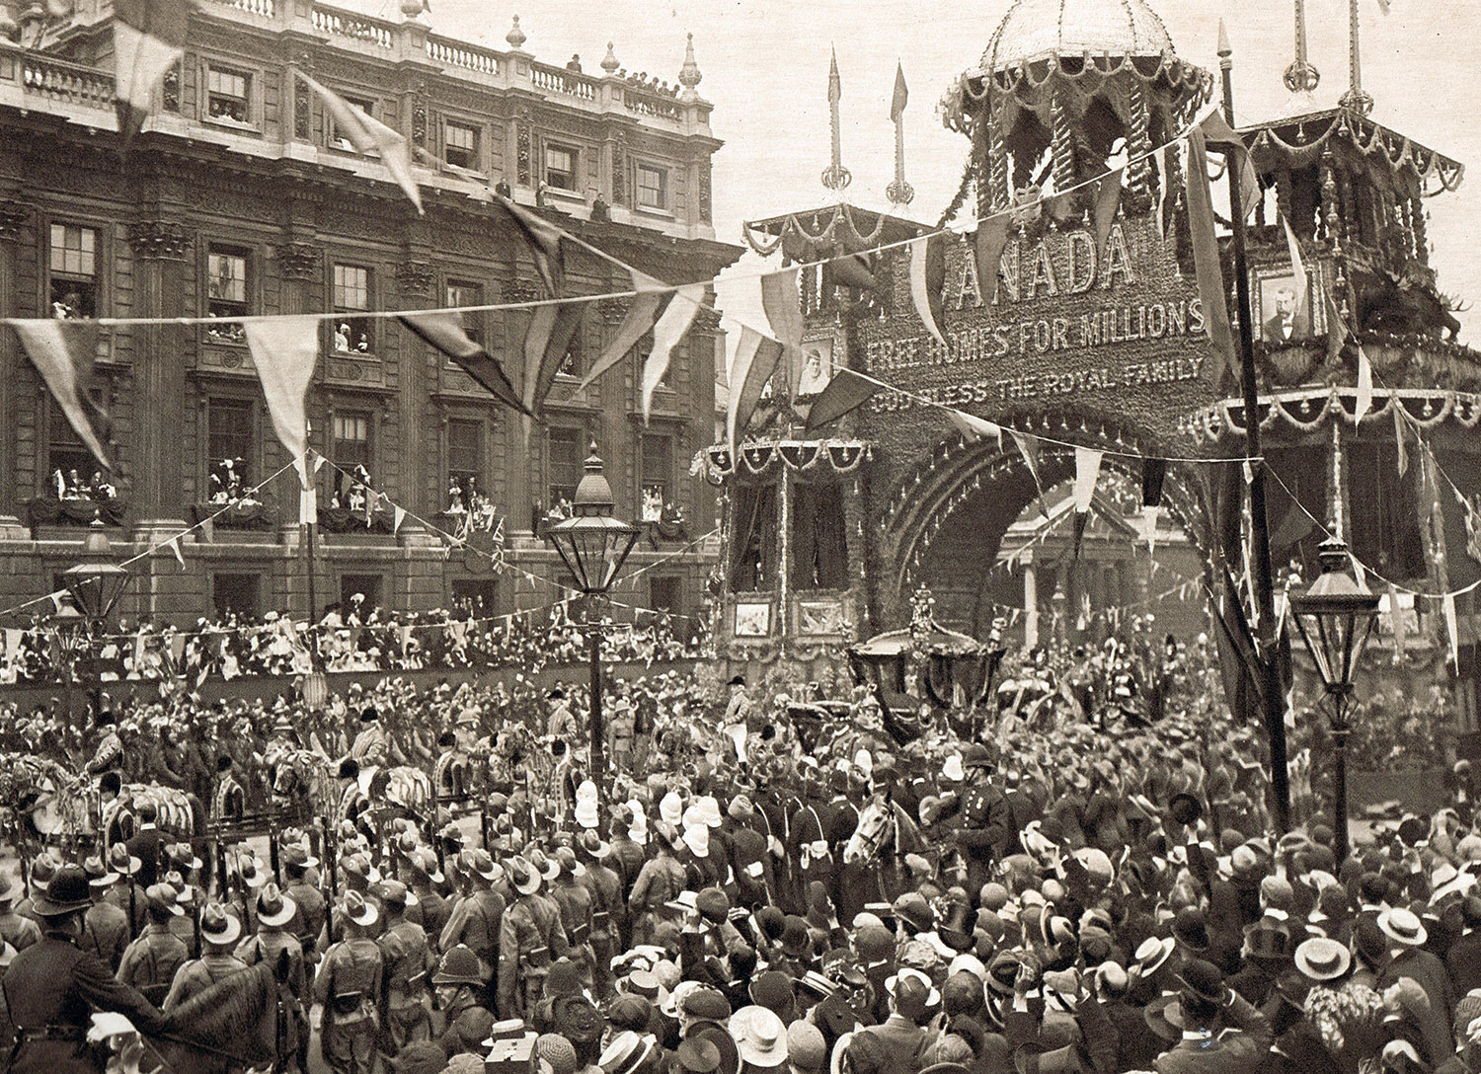
Coronation Celebrations
Coronation Celebration 1902
In May 2023 millions of people, from all over the world, will watch the coronation of King Charles III and the Camilla, the Queen Consort, on the television. Thousands of people will line the streets of London to watch the procession go past.
Many people will hold their own celebrations and street parties.
What do archive images of previous coronation celebrations tell us about the past and changes though time?
Coronation Celebration 1838
Notes:
Use the images of public celebrations of coronations from the past 200 years to study how life has changed and how the events have been recorded.
Upper Image : Coronation of Edward VII ©Alamy Ref: K1JBC1 Date: 9 August 1902
Lower Image : Large Street Party for 5000 people in the Market Place, Wisbech, Isle of Ely, Cambridgeshire, England on the 28th June 1838 to celebrate the Coronation of Queen Victoria, print by George Johann Scharf after JP Hunter, 1838 ©Alamy Ref: 2DC2H9W Date: 28 June 1838

Slide 16
Queen Elizabeth II Children’s Coronation Party 1953
What does this photograph infer about how children celebrated the coronation of Queen Elizabeth II in 1953?
How many years ago was this coronation?
What clues tell you this is a coronation party?
Why do you think this photograph isn’t in colour?
Can you guess what the colours of the bunting might be?
What do you notice about the clothes the children are wearing?
Where do you think this party might have been held?
Queen Elizabeth II Children’s Coronation Party 1953
Notes:
Once the pupils have worked out how long ago this coronation party was, ask them to think about how old they think the children are in the photograph and how old they would be now – in their 70’s. Could they be a similar age their grandparents or great-grandparents?
Ask them to think about what the children are wearing? Would they like to make coronation crowns? The bunting is likely to have been red, white and blue - the colours of the Union Jack flag. They may have seen bunting like this before - ask them when (possibly for the Queen’s Platinum Jubilee last year?).
The archive information for this photograph doesn’t tell us where it was taken and the exact date of the party. June 2nd 1953 was a public holiday, so it could have been taken in a church hall or it could have been taken in a school, if the party was held before or after the coronation day. It looks like the children have dressed in their best clothes for the occasion and notice that some of the boys are wearing jackets shirts and ties, but they don’t look like they are wearing school uniform.
Image : Queen Elizabeth II Coronation Children's Party 1953 ©Alamy Ref: DD0R5G Date: 1953

Slide 17
Queen Elizabeth II Coronation Children's Party 1953
Compare this photograph of a children’s party to celebrate the coronation of Queen Elizabeth II with the previous photo.
What are the similarities and differences? Can you tell this is a coronation party?
What do you notice about the children on the left and right side of the photo?
What does this infer about how children were treated in 1953?
Group discussion
Elizabeth II Children’s Coronation Party 1953
Notes:
It’s not as obvious that this is a coronation party. The children are all wearing party hats, but they’re not crowns. You would need to zoom in to this image to see what is on the hats and on the bottles on the tables. There isn’t any bunting in this photograph either. We don’t know where it was taken, so again, this party could be in a school or church or community hall.
The boys and girls are all on separate tables/sides of the room. This could have just been for the photograph, but girls and boys were often in separate groups in the 1950s. Some schools had different girls and boys entrances.
Image : Queen Elizabeth II Coronation Children's Party 1953 ©Alamy Ref: DD0REJ Date: 1953

Slide 18
Elizabeth II Coronation Street Party 1953
Look carefully at this photograph of a street party to celebrate the coronation of Queen Elizabeth in 1953.
What do you notice about the people who are standing and the people who are sitting?
What kind of food and decorations are on the table?
This photograph was taken in Blackpool on 2 June 1953. What does it tell you about the tell you about the weather on that day?
Elizabeth II Coronation Street Party 1953
Notes:
It’s hard to tell this is a street party to celebrate the coronation of Queen Elizabeth II. We only know this from the information recorded with the image. People often share food at street parties, and it looks like there is a lot of food on the table. Some foods were still being rationed in 1953, due to the impact of WWII, so people may have saved their rations for the party. Everyone involved would have had to plan the party together, so this infers this community were quite organised. Notice that it’s mainly children who are seated at the table and the adults are standing. People look like they have dressed smartly for the occasion. Most people are wearing a jacket or coats, so although it’s June, it looks like it might have been a little chilly that day!
Image : Street Party, Coronation Day 2nd June 1953. Saville Road, Blackpool ©Alamy Ref: EPFE8G Date: 2 June 1953

Slide 19
King George VI Coronation School Tea 1937
Can you tell the children in this photograph are celebrating the coronation of King George VI?
They are drinking out of special coronation mugs they were given as souvenirs. Have you ever received a royal souvenir?
What can the photograph help us infer about schools in 1937?
Compare the photographs of children’s coronation parties. Which party would you like to have attended and why?
King George VI Coronation School Tea 1937
Notes:
The children are all drinking from coronation mugs they have been given as souvenirs - do the children remember the book they were given to commemorate Queen Elizabeth II’s Platinum Jubilee in 2022?
There are no hats or bunting in at this party – ask the pupils if it looks as much fun as the other parties.
We can see that the desks are arranged in rows – ask pupils how they prefer to be seated in the classroom.
Image : Coronation school tea at a school in Crayford , Kent , to celebrate the coronation of King George VI . Children are drinking out of the coronation mugs that they have just received ©Alamy Ref: 2BJ038E Date: 10 May 1937

Slide 20
George V Coronation Street Party 1911
This photograph of a street party, to celebrate the coronation of George V, was taken over 100 years ago, in 1911.
How has the street been decorated?
What is on the table?
There are lots of people in this photograph. How have they been organised to make sure their faces can be seen?
What does this photograph tell us about
what life was like for families living on streets like this in 1911?
George V Coronation Street Party 1911
Notes:
This photograph was taken over a 100 years ago. Not many people had their own camera, so it might have been taken by a professional photographer for a newspaper. The people have all been carefully arranged, so the taller people are at the back and shorter people are at the front and everyone can be seen. Notice the children at the front and how young they look. It looks like the little girl at the front is in a wheelchair of some kind. It looks very different to modern wheelchairs. The table in the middle has an urn on it, suggesting they may be having cups of tea and the street has been decorated with Union Jack flags (ask the children what colour they are). There are lots of children and we know that people often had large families in the 1900’s. All the people in this picture will now have passed away, but they would be thrilled to think children are learning from this photo over a 100 years later! Children might learn from photographs of coronation parties in 2023 in 2123!
Image : STREET PARTY in Acland Street, Limehouse,east London, (now Acland Road), on 23 June 1911 to celebrate the Coronation of George V ©Alamy Ref: 2CTCNGY Date: 23 June 1911

Slide 21
Crowds Celebrating the Coronation of Edward VII 1902
When King Edward the VII was crowned in 1902, it was the first time photography had been used to record a coronation.
Why was that?
What do you think the crowd is waiting to see?
What does this photograph infer about how people felt about the coronation in 1902?
Crowds gather to celebrate the Coronation of Edward VII 1902
Notes:
This photograph of the coronation procession shows that thousands of people were keen to catch a glimpse of the King in the royal carriage. Notice the people watching from the window. They will have a fabulous view, but the people on the street would have struggled to see over the crowds. Notice the bunting and how the people are dressed. Look closely at the street lamps. They are very different from street lights today.
Image : Coronation of Edward VII ©Alamy Ref: K1JBC1 Date: 9 August 1902

Slide 22
Coronation Celebration of Queen Victoria 1838
Look carefully at this painting of a large street party to celebrate the coronation of Queen Victoria in 1838.
Do you think it would have been easy to organise this party?
Can you spot anything flying in the air?
How long do you think it took to paint this picture?
How do you think the artist managed to remember all the details?
Do you think this an accurate picture of the party?
Could this be the artist’s interpretation of what happened?
Would a photograph be more accurate?
Large Street Party for the Coronation of Queen Victoria 1838
Notes:
This is a painting of huge street party! The archive information says it is for 5000 people! It shows people sitting at very long tables and we can see some men are wearing top-hats. It would have needed to be a very wide street, so it might have been in another public area e.g. in market place. The artist, JP Hunter, would have had to make sketches and take notes to capture all the details. He might have added some details or missed some out. Notice the flags and the hot air balloons in the sky.
Image : Large Street Party for 5000 people in the Market Place, Wisbech, Isle of Ely, Cambridgeshire, England on the 28th June 1838 to celebrate the Coronation of Queen Victoria, print by George Johann Scharf after JP Hunter, 1838 ©Alamy Ref: 2DC2H9W Date: 28 June 1838

Slide 23
Coronation Procession of King William IV 1834
In this painting, what can you see that
infers it is a royal procession?
Compare it to the photograph of the coronation procession of Edward VII in 1902 and the 1st slide (image of Elizabeth II’s coronation procession).
Can you identify the building in the background?
Coronation Procession of King William IV 1834
Notes:
We know that this is a royal procession, because we can see the royal carriage. We can also see that lots of people have gathered to watch and we can see soldiers on horseback. The building in the background is West Minster Abbey, where the coronation would have been held. It looks as if the procession is heading towards the abbey, because of the position of the carriage driver. It looks like the weather might have been quite gloomy as the clouds look very dark.
Image : Coronation Processing of King William IV 1834©Alamy Ref: MKP7AB Date: 1834

Slide 24
Coronation Procession of George IV 1821
Can you spot which person is King George IV?
How can you tell?
What is different about this image of a coronation procession?
Can you see any similarities with the painting of Queen Victoria’s coronation celebration?
Is a painting always an accurate account of events? Could it be an interpretation? What might an artist decide to change to make the picture look more attractive?
Coronation Procession of George IV 1821
Notes:
In this painting of a coronation procession, King George IV is not in the royal carriage, he is walking with soldiers on a covered platform. We can tell he is the King by the clothes he is wearing.
Some of the crowd are in a covered seating area. Others are standing, waving and raising their hats. It looks like there is a similar seating/viewing area in the distance suggesting this is quite a long procession. Notice the sky is blue, indicating that the weather is good, and the hot air balloon in the sky – there was a hot air balloon in the painting of the street party celebrating Queen Victoria’s coronation. This suggests that they were very popular in the 1800s. Maybe people wanted to get a good view of the coronation procession, or maybe a balloon ride was another way of celebrating.
Image : Street procession with King George IV at his coronation festivities on July 19, 1821, in St. James' Park, London. Balloon flying at upper right represents balloonist Charles Green's first ascension and the first successful use of coal gas which was cheaper than hydrogen and more readily available ©Alamy Ref: BG6Y0Y Date: 19 July 1821

Slide 25
Will you celebrate the 2023 Coronation of King Charles and Camilla, Queen Consort?
Millions of people will watch the coronation of King Charles II and Camilla, the Queen Consort, on Saturday May 6th 2023 on the television or online.
Many people will celebrate with family, friends and neighbours. Some communities will have street parties.
Monday 8th of May is a national holiday and people are being encouraged to take part in a volunteering activity.
The Coronation Weekend
Saturday May 6th the Coronation
Sunday May 7th The Big Lunch
Monday May 8th The Big Help Out
Find out more
Notes:
Link to the Royal Website for more information about the coronation plans https://www.royal.uk/coronation-weekend-plans-announced
Link The Big Lunch to order a Coronation pack and Big Lunch pack https://www.edenprojectcommunities.com/the-big-lunch?gclid=Cj0KCQjwn9CgBhDjARIsAD15h0BYoRI4dbRAfkjufQ-864pqI7BmGMRQhEmXACqAAKCQQEeWYZuOpbkaAiVEEALw_wcB
Link to The Big Help Out to register events https://thebighelpout.org.uk/

Slide 26
Additional Activity Suggestions
Use the blank timeline slide and draw your own images and complete the dates, using the coronation slides for reference
Cut out the monarch cameos and stick them on a blank timeline
Use the photographs and paintings of coronations to create a timeline
Use the photographs and paintings of coronation celebrations to create a timeline
Match the coronation images with the celebration images
Make party hats and bunting for a coronation celebration party
Notes:
See the slides below for timeline/chronology activity sheets and larger versions of archive images used

Slide 27
200 years of British Coronations
200 years of British Coronations
Notes:
Image: ©Sean Curran Historic England

Slide 28
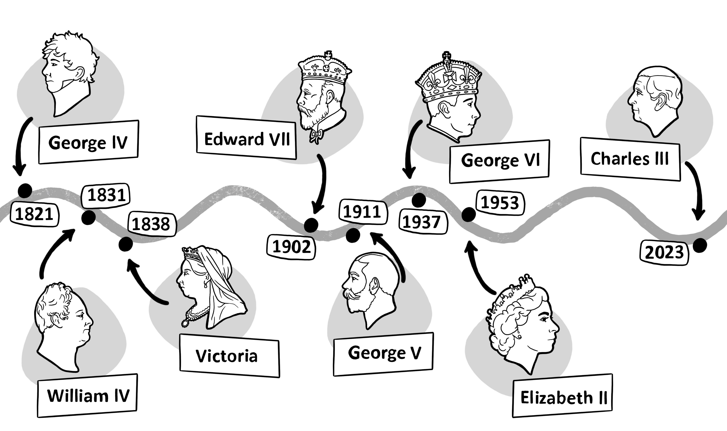
200 years of British Coronations
200 years of British Coronations
Notes:
Printer version. Pupils could colour in the cameos of the monarchs.
Image: ©Sean Curran Historic England

Slide 29
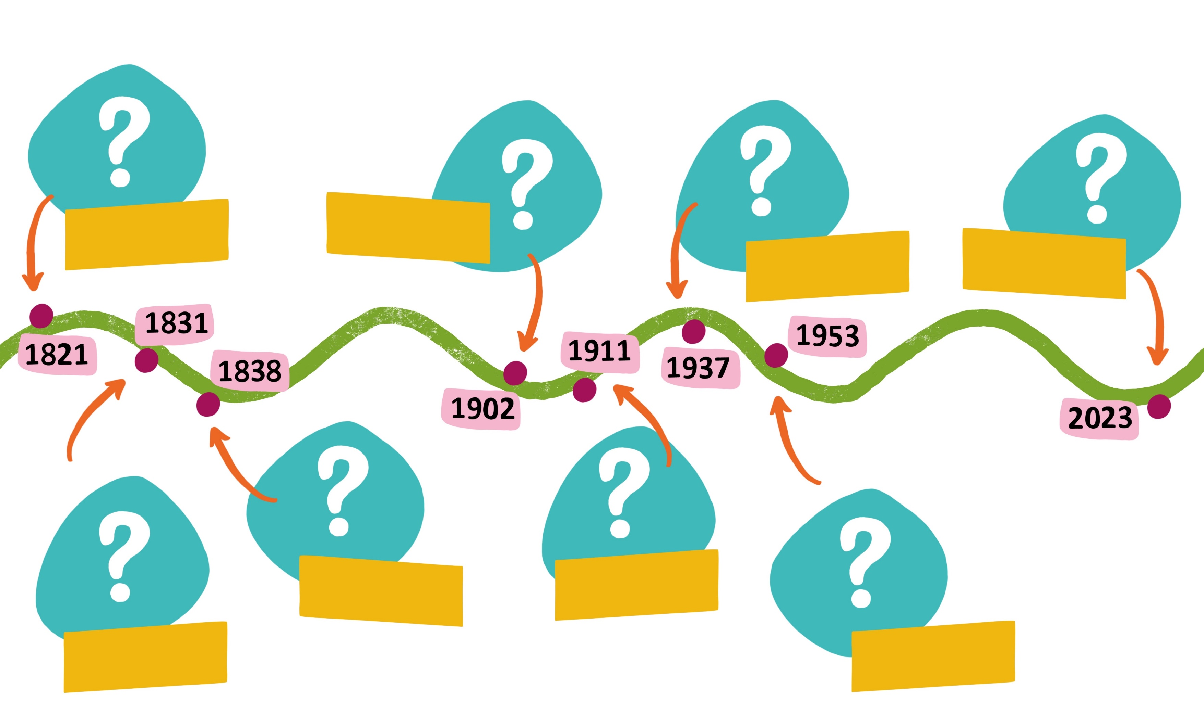
200 years of British Coronations
200 years of British Coronations
Notes:
Image: ©Sean Curran Historic England

Slide 30
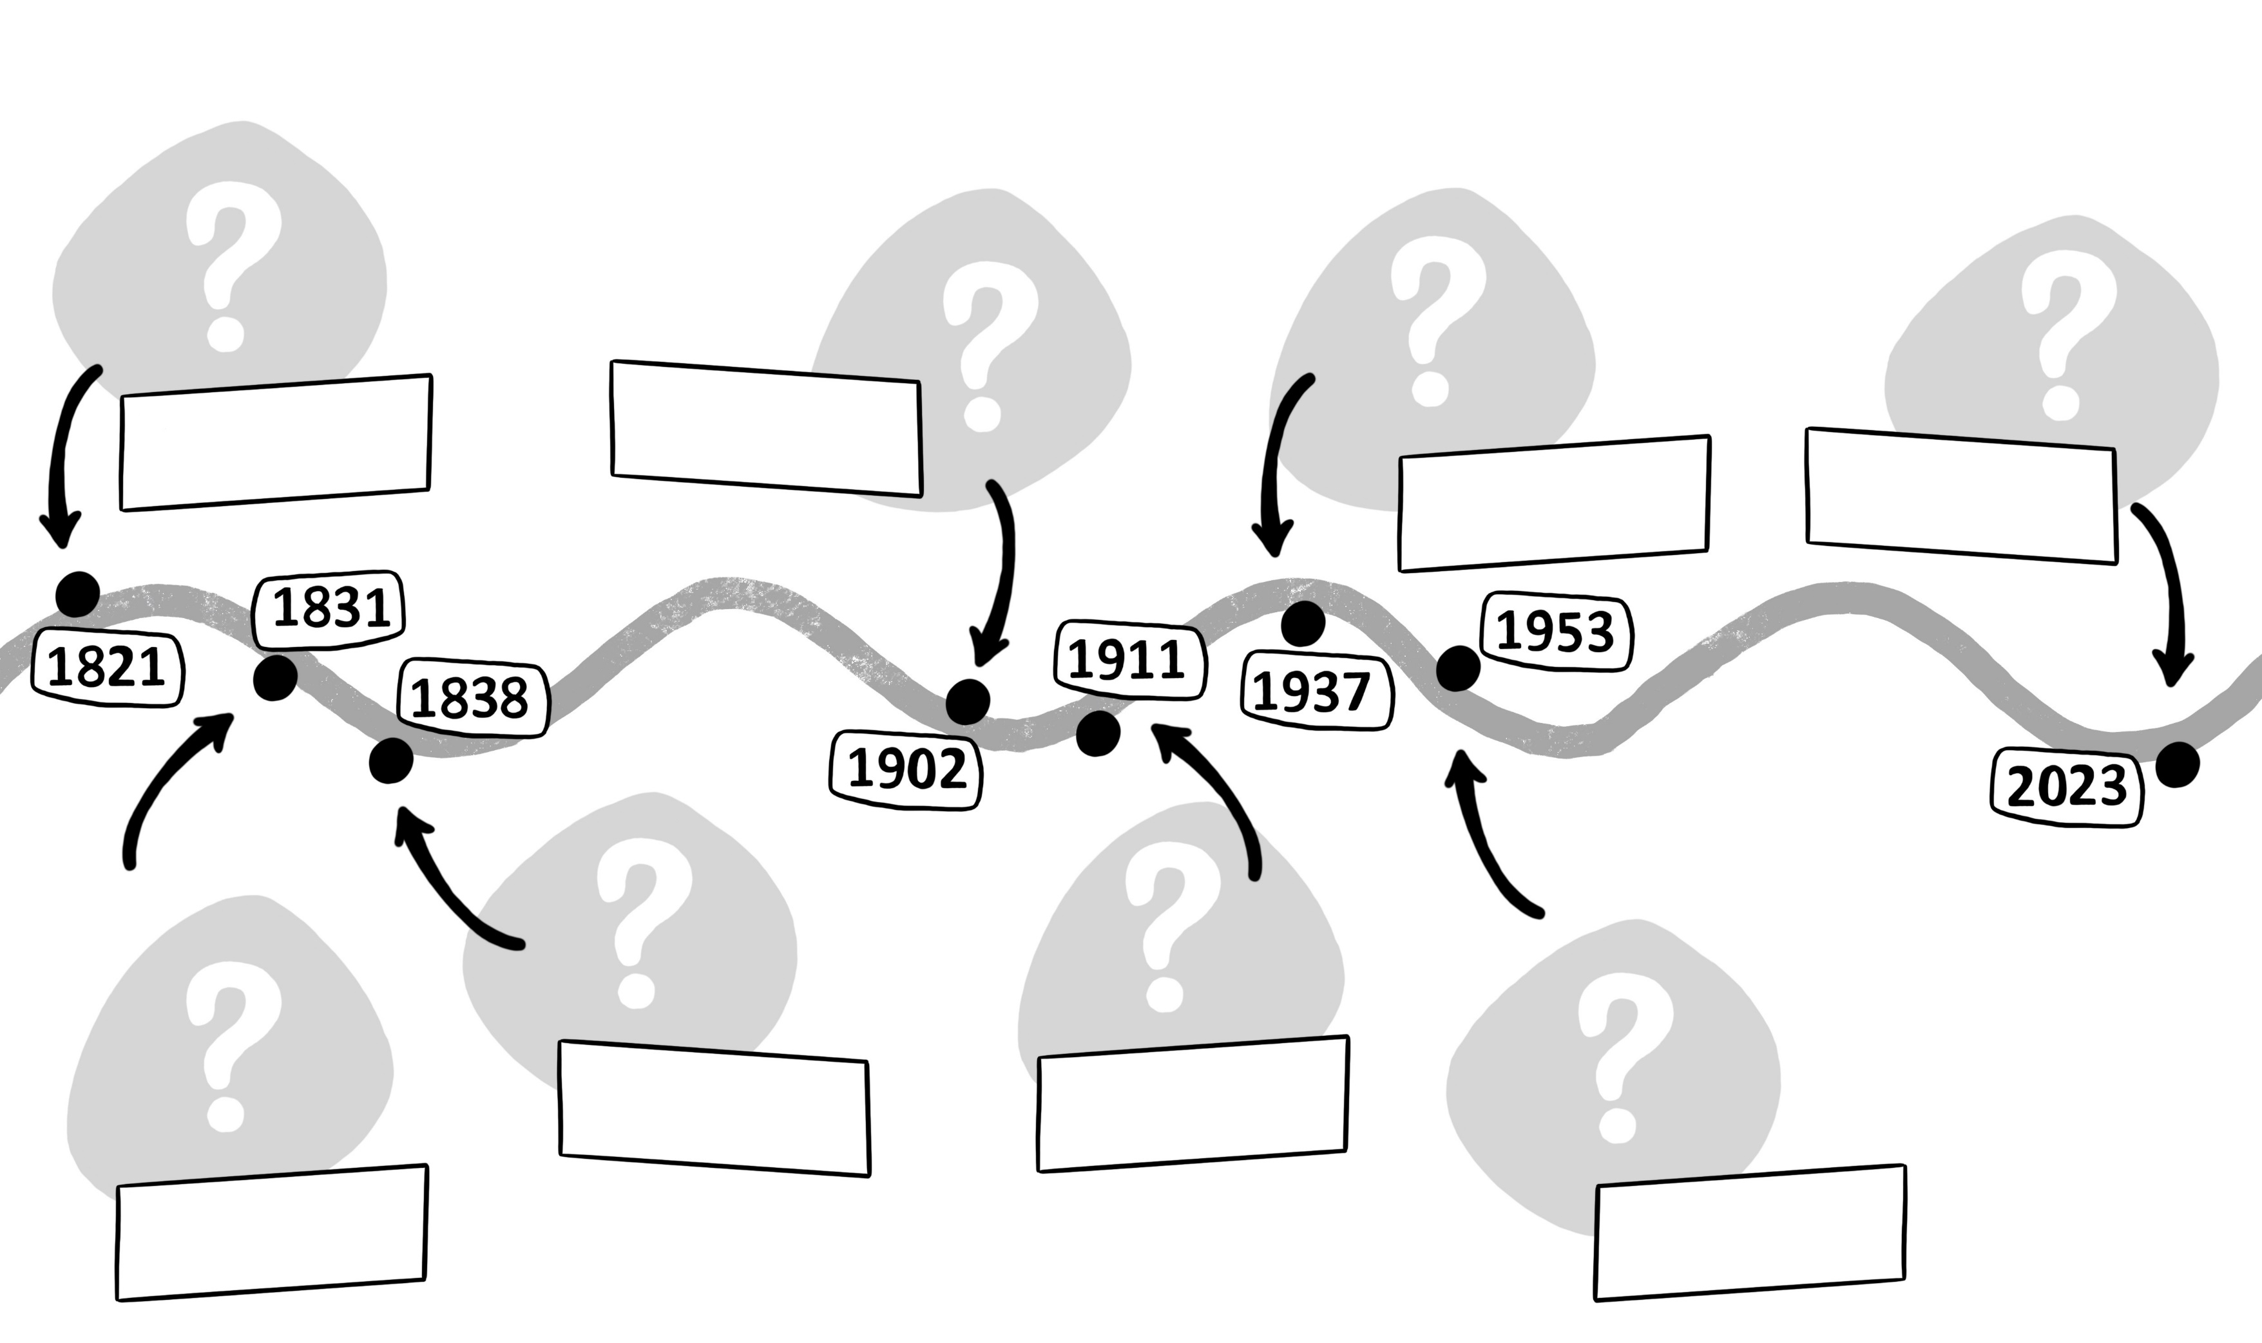
Blank timeline
Notes:
Pupils could cut out the monarch cameos on the last slide and stick them to the this timeline and write in their names.
Image: ©Sean Curran Historic England

Slide 31
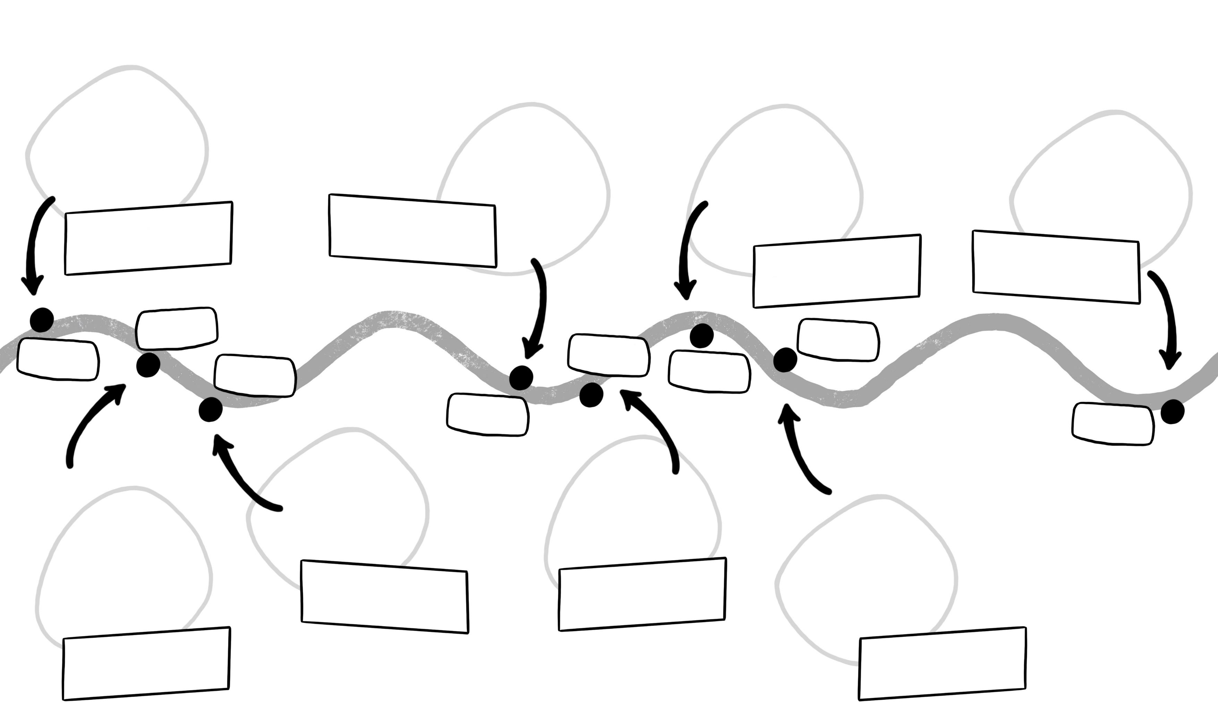
200 years of British Coronations
Notes:
Pupils could use the complete timeline for reference and draw their own monarchs, name them and add the dates of their coronations.
Image: ©Sean Curran Historic England

Slide 32
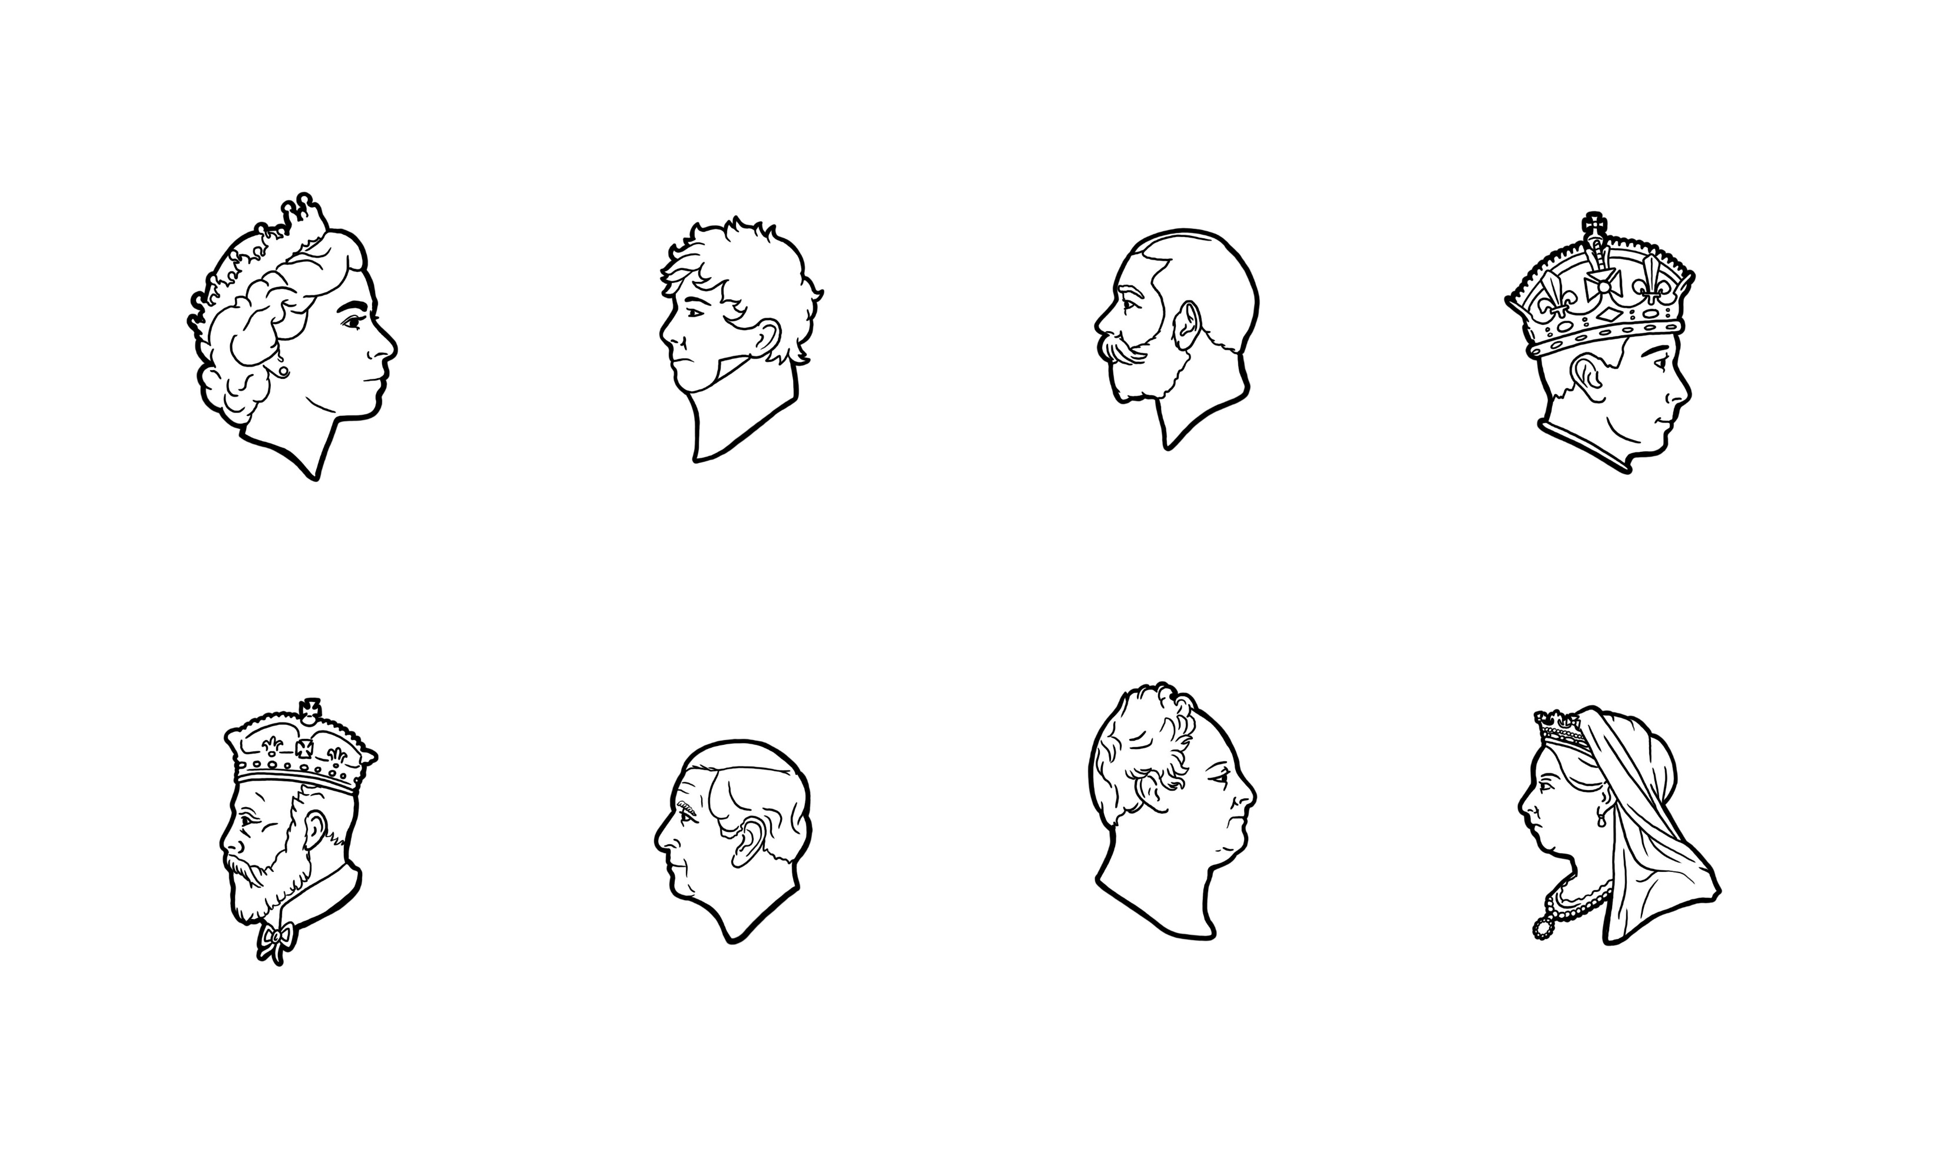
200 years of British Monarchs
Notes:
Cameos of the monarchs – can be coloured in, cut out and stuck on a copy of slide 29.
Image: ©Sean Curran Historic England

Slide 33
Image of King Charles III and Camilla, the Queen Consort
Notes:
Image: King Charles III and Camilla, the Queen Consort light a candle at Buckingham Palace, London, to mark Holocaust Memorial Day, in Britain January 27, 2023. ©Alamy Ref: 2MHW6PJ Date: January 27, 2023

Slide 34
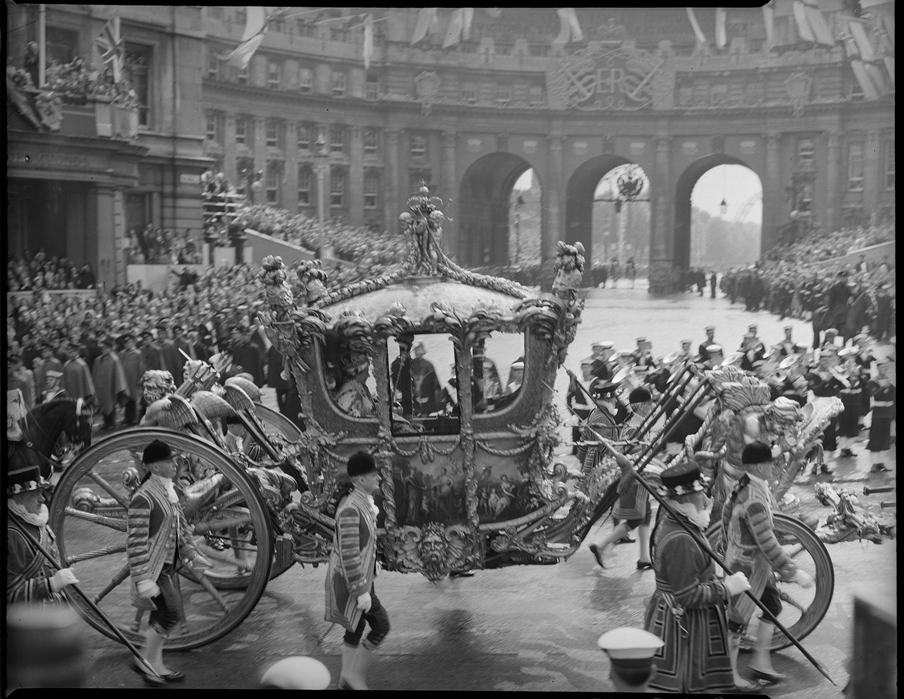
Image of Queen Elizabeth II Procession
Notes:
Image: Queen Elizabeth II Procession - Source: Historic England Archive Ref: P/C00425/003 Date: 2 Jun 1953

Slide 35
Image of Queen Elizabeth II during her coronation
Notes:
Image: Queen Elizabeth II during her coronation.. ©Alamy Ref: RJRP3M Date: 2 June 1953

Slide 36
Colour image of Queen Elizabeth II during her coronation
Notes:
Image: Queen Elizabeth II during her coronation.. ©Alamy Ref: RJRP56 Date: 2 June 1953

Slide 37
Image of King George VI and Queen Elizabeth
Notes:
Image: EDITORIAL George VI, 1895 – 1952. King of the United Kingdom and the Dominions of the British Commonwealth. Queen Elizabeth, The Queen Mother. Elizabeth Angela Marguerite Bowes-Lyon, 1900 – 2002. Wife of King George VI and mother of Queen Elizabeth II. Seen here at their coronation in 1937. From The Coronation in Pictures, published 1937. ©Alamy Ref: RJRP56 Date: 12 May 1937

Slide 38
Image of King George VI during his coronation
Notes:
Image: His Majesty King George VI (1895-1952), receives homage at his coronation, 1937. George VI's coronation took place on 12th May 1937 at Westminster Abbey, the date previously intended for his brother Edward VIII's coronation. ©Alamy Ref: 2M3PC13 Date: 12 May 1937

Slide 39
Image of King George V and Queen Mary
Notes:
Image: King George V and Queen Mary of England after their coronation in 1911 ©Alamy Ref: 2A603M2 Date: 22 June 1911

Slide 40
Image of King Edward VII & Queen Alexandra
Notes:
Image: KING EDWARD VII AND QUEEN ALEXANDRA in their Coronation robes ©Alamy Ref: BRT92Y Date: 9 August 1902

Slide 41
Image of Queen Victoria's coronation
Notes:
Image: Queen Victoria's coronation, 1837 (1887). The Archbishop of Canterbury placing the crown on Victoria's (1819-1901) head in Westminster Abbey, 28 June 1837. ©Alamy Ref: W7CN32 Date: 1887

Slide 42
Image of King William IV’s coronation
Notes:
Image: Coronation of William IV and Queen Adelaide's in Westminster Abbey, London, 1831. ©Alamy Ref: DDTK61 Date: 1831

Slide 43
Image of King George IV’s coronation
Notes:
Image: George IV's coronation, 19 July 1821 by James Stephanoff. George IV, King George IV, (George Augustus Frederick, 1762 – 1830) ©Alamy Ref: 2ATFR9W Date: 19 July 1821

Slide 44
Image of Queen Elizabeth II Coronation Children's Party
Notes:
Image : Queen Elizabeth II Coronation Children's Party 1953 ©Alamy Ref: DD0R5G Date: 1953

Slide 45
Image of Queen Elizabeth II Coronation Children's Party
Notes:
Image : Queen Elizabeth II Coronation Children's Party 1953 ©Alamy Ref: DD0REJ Date: 1953

Slide 46
Image of a coronation Street Party - 1953
Notes:
Image : Street Party, Coronation Day 2nd June 1953. Saville Road, Blackpool ©Alamy Ref: EPFE8G Date: 2 June 1953

Slide 47
Image of Coronation school tea
Notes:
Image : Coronation school tea at a school in Crayford , Kent , to celebrate the coronation of King George VI . Children are drinking out of the coronation mugs that they have just received ©Alamy Ref: 2BJ038E Date: 10 May 1937

Slide 48
Image of a coronation Street Party - 1911
Notes:
Image : STREET PARTY in Acland Street, Limehouse, east London, (now Acland Road), on 23 June 1911 to celebrate the Coronation of George V ©Alamy Ref: 2CTCNGY Date: 23 June 1911

Slide 49
Image of Coronation procession of Edward VII
Notes:
Image : Coronation of Edward VII ©Alamy Ref: K1JBC1 Date: 9 August 1902

Slide 50
Image of large Street Party for 5000 people
Notes:
Image : Large Street Party for 5000 people in the Market Place, Wisbech, Isle of Ely, Cambridgeshire, England on the 28th June 1838 to celebrate the Coronation of Queen Victoria, print by George Johann Scharf after JP Hunter, 1838 ©Alamy Ref: 2DC2H9W Date: 28 June 1838

Slide 51
Image of Coronation Procession of King William IV 1831
Notes:
Image : Coronation Procession of King William IV 1831 ©Alamy Ref: MKP7AB Date: 1834

Slide 52
Image of Street procession with King George IV at his coronation
Notes:
Image : Street procession with King George IV at his coronation festivities on July 19, 1821, in St. James' Park, London. Balloon flying at upper right represents balloonist Charles Green's first ascension and the first successful use of coal gas which was cheaper than hydrogen and more readily available ©Alamy Ref: BG6Y0Y Date: 19 July 1821

