Slide 1
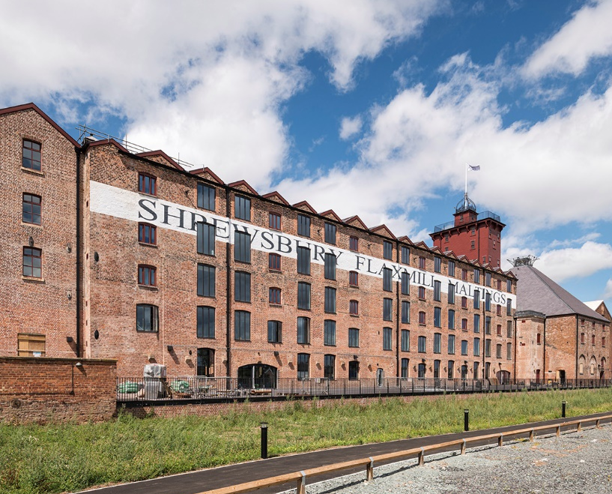

EDUCATION
Families of the Flax Mill

Slide 2

What can the census tell us about the lives of families who worked at the Shrewsbury flax mill in 1851?
Key Stage 2: History & Geography
Learning Aims and Outcomes
  To develop our local history skills by using historical evidence to find out about our area and the people who lived here in the past
  To develop our geography skills by using maps and aerial photographs to find out about our area in the past
  To investigate why key historical sites in our local area are important
  To find out why we can care about historic sites in our local area and how we can continue to use them in the future
This PowerPoint relates to this Teaching Activity – Families of the Flax Mill:
https://historicengland.org.uk/services-skills/education/teaching-activities/families-of-the-flax-mill
Education Resources
More resources at HistoricEngland.org.uk/Education

Slide 3
Families of the flax mill
Shrewsbury Flaxmill Maltings was in use as a flax mill from 1797-1887, before being converted in to a maltings. During its use as a flax mill hundreds of men, women and children worked there.
This PPT is designed to be used with the Families of the flax mill StoryMap. It looks at some of the places in Shrewsbury where these people lived and uses the 1851 census to help us discover more about some of the families that lived here.
You can find out more about the history of the Shrewsbury Flaxmill Maltings here:
https://www.shrewsburyflaxmillmaltings.org.uk/story/history/
Having been derelict for many years, Historic England, the Friends of the Flaxmill Maltings and Shropshire Council worked together in partnership to save this remarkable piece of the industrial revolution and make it a place that everyone can be proud of and be part of. Find out more about the project here:
https://www.shrewsburyflaxmillmaltings.org.uk/story/the-partners/
The work that has been done to save, conserve and give new life to Shrewsbury Flaxmill Maltings shows how historic buildings can be repurposed and cared for, and aims to be an inspiration to all. If you are local to Shrewsbury the new exhibition within Shrewsbury Flaxmill Maltings is now open for visitors: https://www.shrewsburyflaxmillmaltings.org.uk/visit/
Education Resources
More resources at HistoricEngland.org.uk/Education

Slide 4
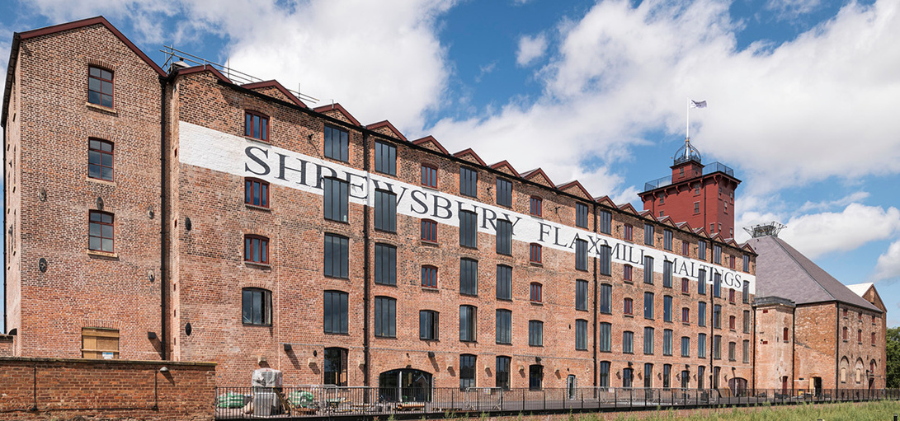
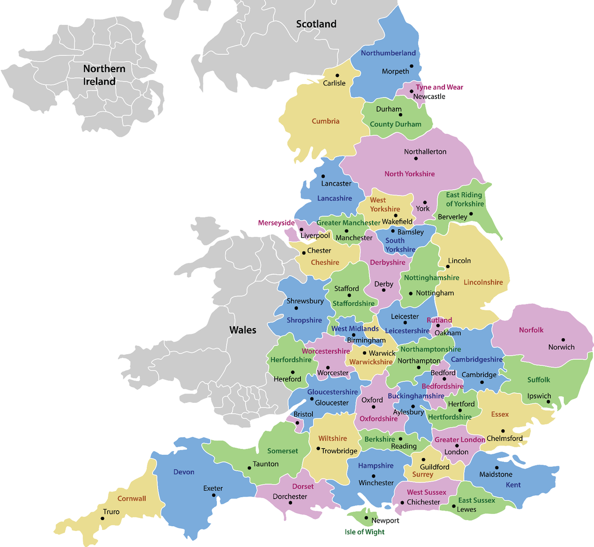
Shrewsbury Flaxmill Maltings was built between 1796 and 1797 and was the world’s first completely iron-framed building.
It paved the way for future all iron-framed and steel-framed structures, including modern skyscrapers.
The people who built the mill, John Marshall and brothers Thomas and Benjamin Benyon wanted to create a factory to spin flax which could then be woven into linen thread.

Slide 5


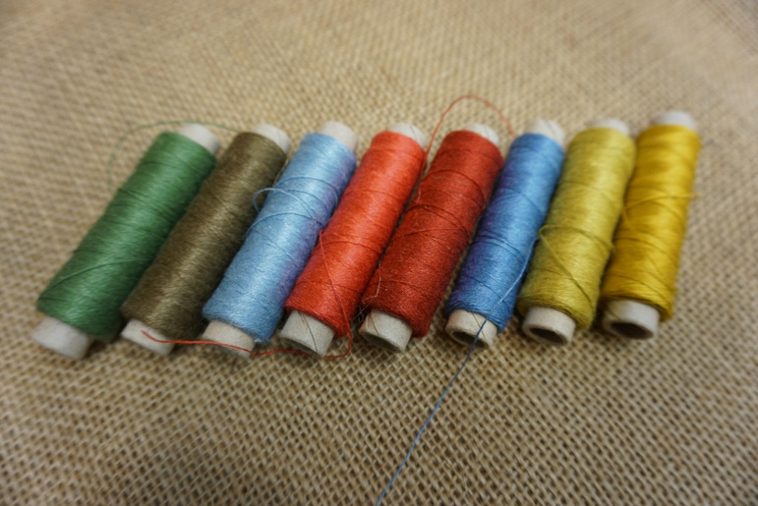
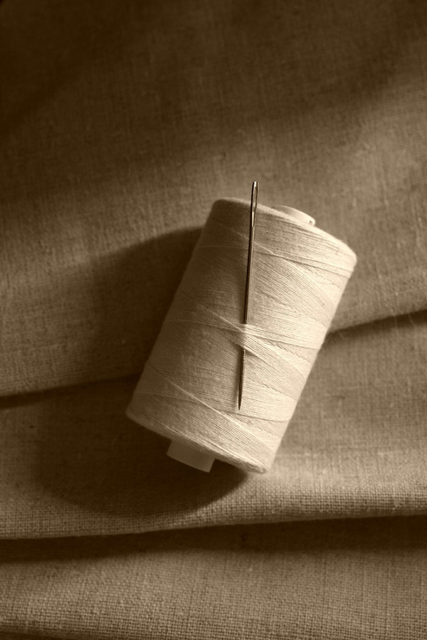
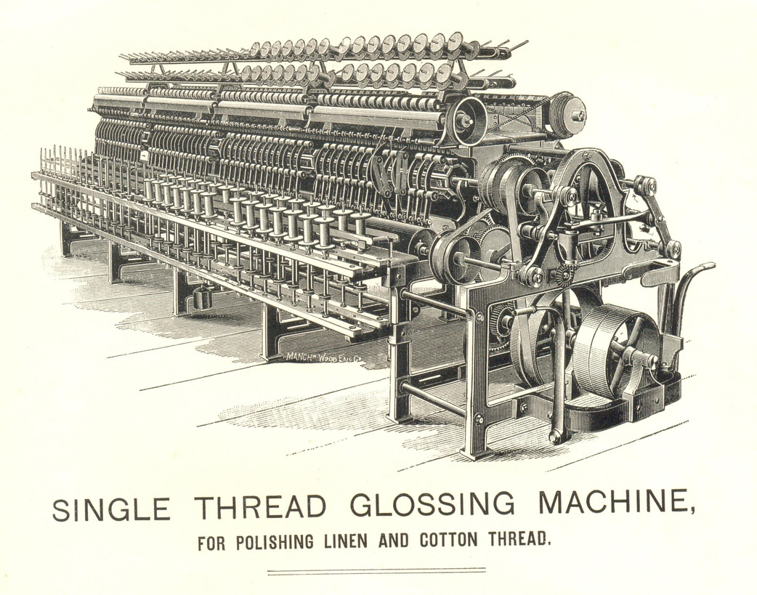
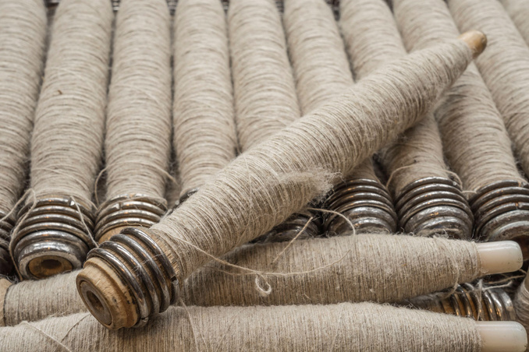
Shrewsbury Flaxmill Maltings was in use as a flax mill from 1797-1887, before being converted in to a maltings in 1897. The flax mill made linen thread.
The flax was spun using a process called wet spinning which would have made the air damp and unhealthy to breathe.​
Education Resources
The thread was dyed different colours in the mill’s own dye house.
Notes:
Image: Linen cloth and thread reel © mauritius images GmbH / Alamy Stock Photo, Ref: H45BRB, Date: 1 March 2006
Image: Thread spools for weaving © Martin Rottler / Alamy Stock Photo, Ref: 2C6XDKR, Date: 3 July 2020
Image: Single Thread Glossing Machine for polishing linen and cotton thread © Amoret Tanner Collection / Alamy Stock Photo, Ref: FJE825, Date: 1865
Image: Dyed linen thread © Daegrad Photography / Alamy Stock Photo, Ref: T5PB4E, Date: 26 April 2019

Slide 6

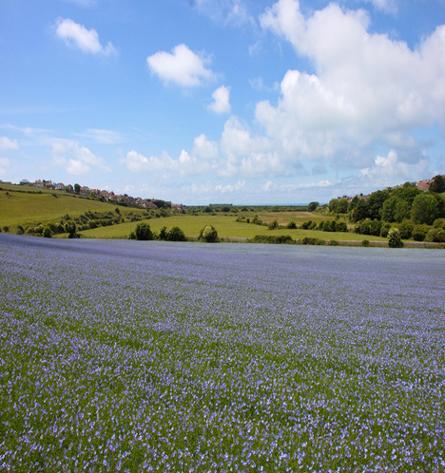
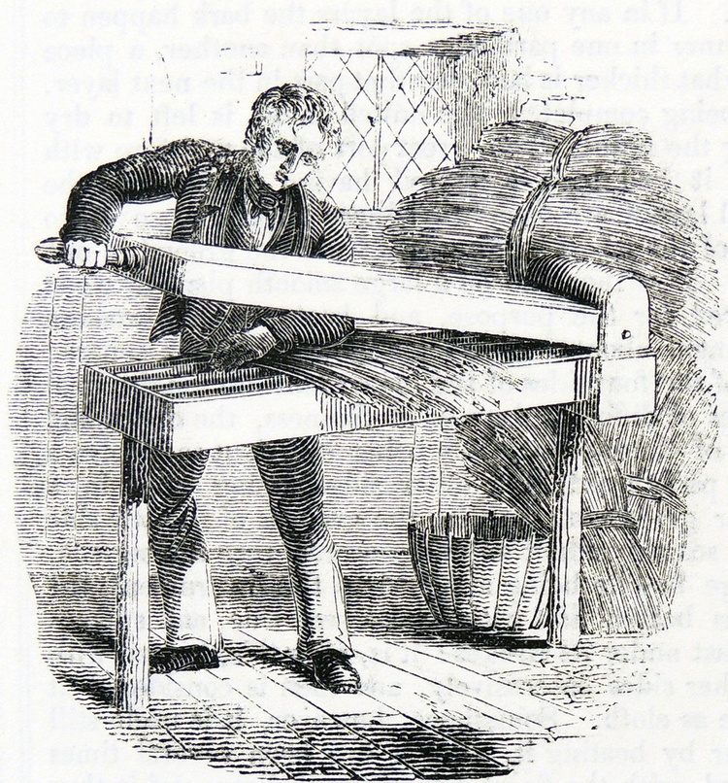
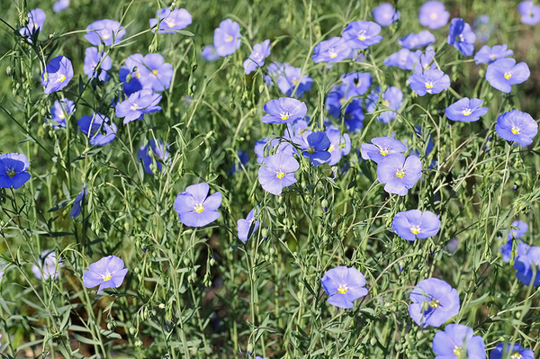
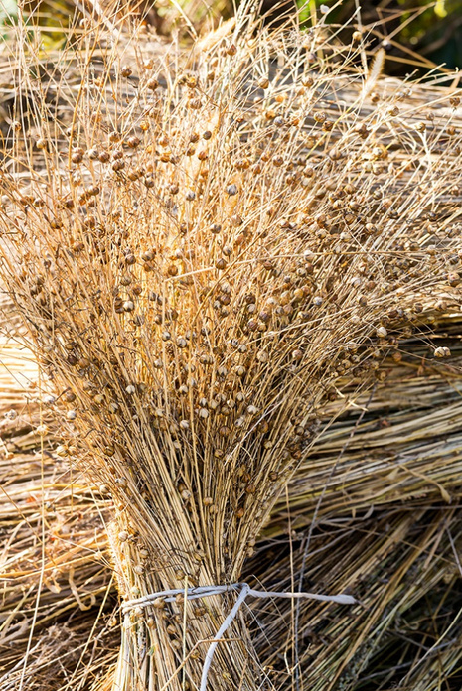
Flax is plant that can be grown by farmers as a crop. It is the stalks from the plant that are used to make linen.
After it was harvested it was soaked and dried. It was then taken to the mill by canal boats and later by trains.
A machine was then used to break down the hard outer casing of the flax plant to get to the fibres inside.
Education Resources
Notes:
Image: Linen (flax) flowers © LianeM / Alamy Stock Photo, Ref: HGKEFM, Date: 15 May 2016
Image: Blooming flax field © Ivan M / Alamy Stock Photo, Ref: TD35FN, Date: 11 June 2019
Image: Bunch of slender stems of flax or linseed with seed capsules © mrtwister / Alamy Stock Photo, Ref: GXN1D0, 13 October 2013
Image: Bruising flax stalks in preparation for retting (soaking), one of the processes in the production of linen. Engraving, London, 1851 © World History Archive / Alamy Stock Photo, Ref: DYEHK7, Date: 24 January 1905

Slide 7

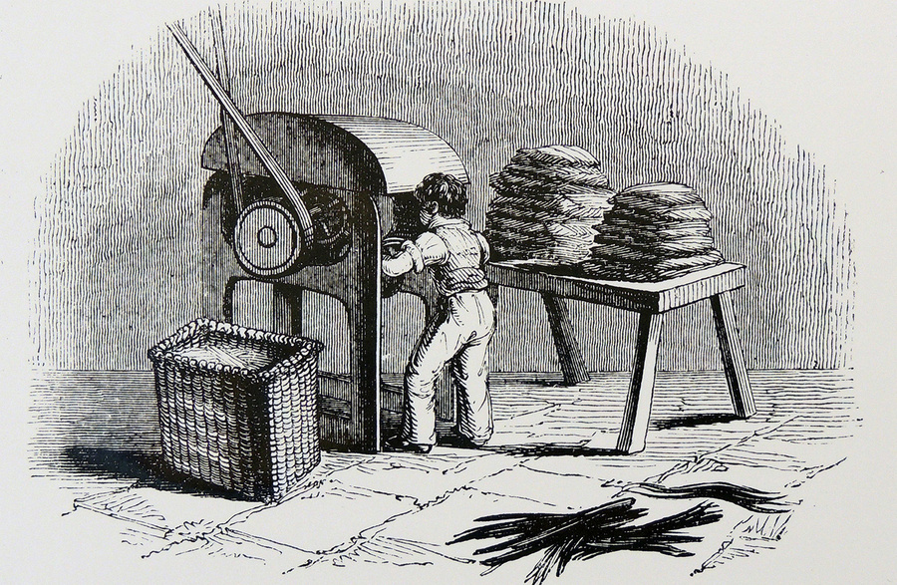
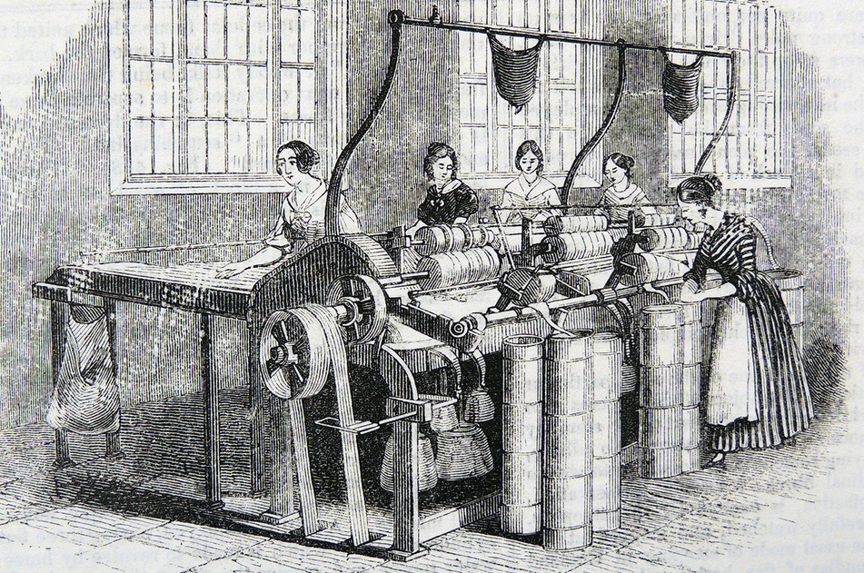
The process of sorting was called ‘heckling’. It was often young boys who had to cut the fibres to length.
The fibres then had to be sorted into the right type and length for the machines. After that they were separated, straightened and cleaned.
Education Resources
The people who worked this machine were sometimes called ‘Spreaders’.
Next, they were passed through a series of small rollers to draw the fibres into a band or sliver until they were thick and long.
Notes:
Image: Small boy using a machine to cut flax stalks into uniform lengths for heckling, one of the processes in the production of linen. Engraving, London, 1846 © World History Archive / Alamy Stock Photo, Ref: DYEHK6, Date: 16 January 1905
Image: Women drawing flax, Marshall's Flax Mill, Leeds, Yorkshire. Engraving, London, 1843© World History Archive / Alamy Stock Photo, Ref: DYEHNC, Date: 16 January 1905

Slide 8
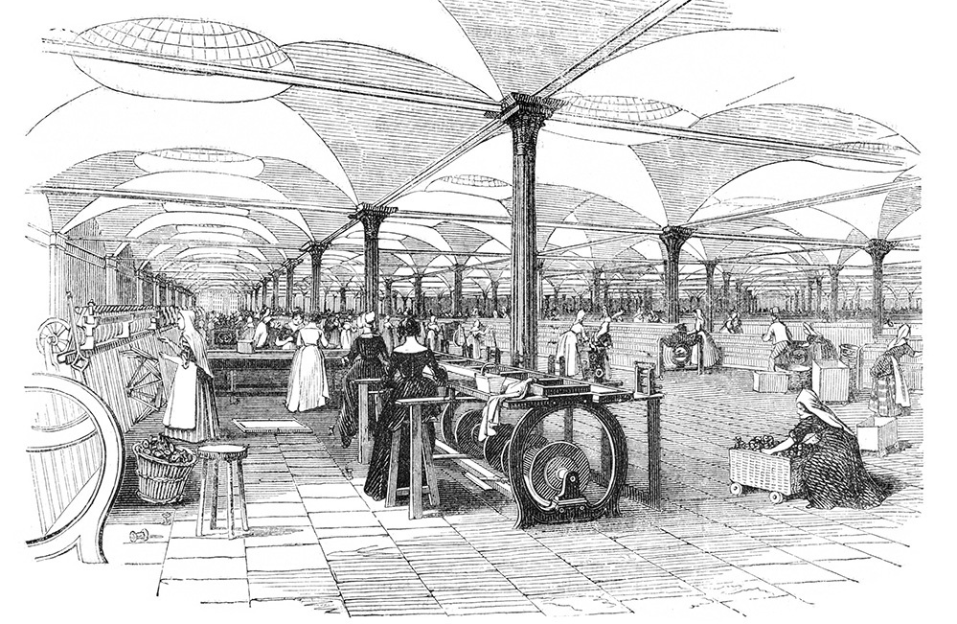
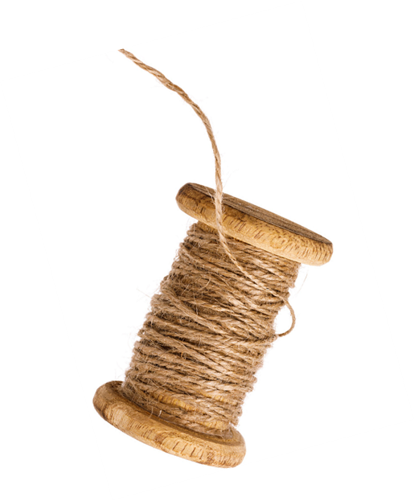
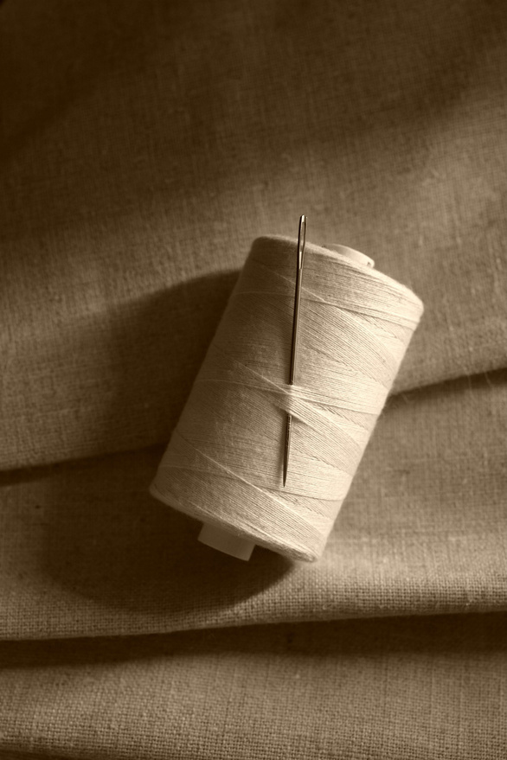
The slivers were then spun into different types of linen thread. The tow (coarse or rough fibres) would be used to make heavier threads.
Education Resources
The line, or best fibres would be spun into fine threads for sewing delicate garments.
Thread was dyed different colours in the flax mill’s own dye house.
Notes:
Image: Interior Marshall's flax mill Leeds mills spinning yarn linen in 1843 © SOTK2011 / Alamy Stock Photo, Ref: C8F35K, Date: 2011
Image: Coil with (tow) threads from linen fibre isolated on white background © SERGEI CHAIKO / Alamy Stock Photo, Ref: PWK2YF, Date: 9 October 2018
Image: Linen cloth and thread reel © mauritius images GmbH / Alamy Stock Photo, Ref: H45BRB, Date: 1 March 2006

Slide 9
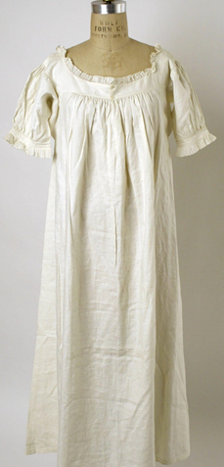


The finished thread was then sold for weaving and sewing into a range of products.
These included clothing, rope, sails, maps, playing cards.
and even, much later on, wings for early aeroplanes!
Education Resources
Notes:
Image: Linen Nightgown 1830s American or European © MET/BOT / Alamy Stock Photo, Ref: 2HJ212P, Date: 22 January 2022
Image: Large (linen) sails © Panther Media GmbH / Alamy Stock Photo, Ref: J62PTY, Date: Not stated
Image: Bristol Boxkite Replica G-ASPP (with linen wings), at Old Warden, Biggleswade, Bedfordshire © Peter Lane / Alamy Stock Photo, Ref: MPEEF9, Date: 6 May 2018

Slide 10
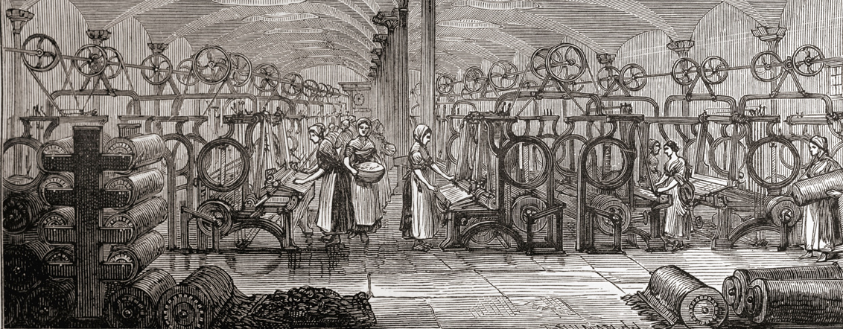




During its 90 years as a flax mill hundreds of men, women and children worked there. The 1833 Factory Act made it against the law to employ children under the age of 9.
8 hours work
2 hours school
1 hour lunch
=
11 hour day
Did you know...
Education Resources
Between the ages of 9 and 13 children were allowed to work only 8 hours with an hour lunch break and had 2 hours of education each day.
How many hours a day are you busy?
The 1851 census shows that 55% of the people who worked in Shrewsbury Flax Mill were under 20 years old and 35% were under 16.
Notes:
Image: Interior of Marshall's Mill, Marshall Street, Holbeck, Leeds, West Yorkshire, England in the late 19th century. © Classic Image / Alamy Stock Photo, Ref: C4GXT3
We don’t have any images for Shrewsbury, but this image shows people working at John Marshall’s Mill in Leeds at a similar time.
Highlight to pupils that the Factory Act still meant 9-13 year olds we doing 11 hour days at work and school! Ask pupils to think about how many hours a day they spend doing different things and then compare it to a child in 1833.

Slide 11
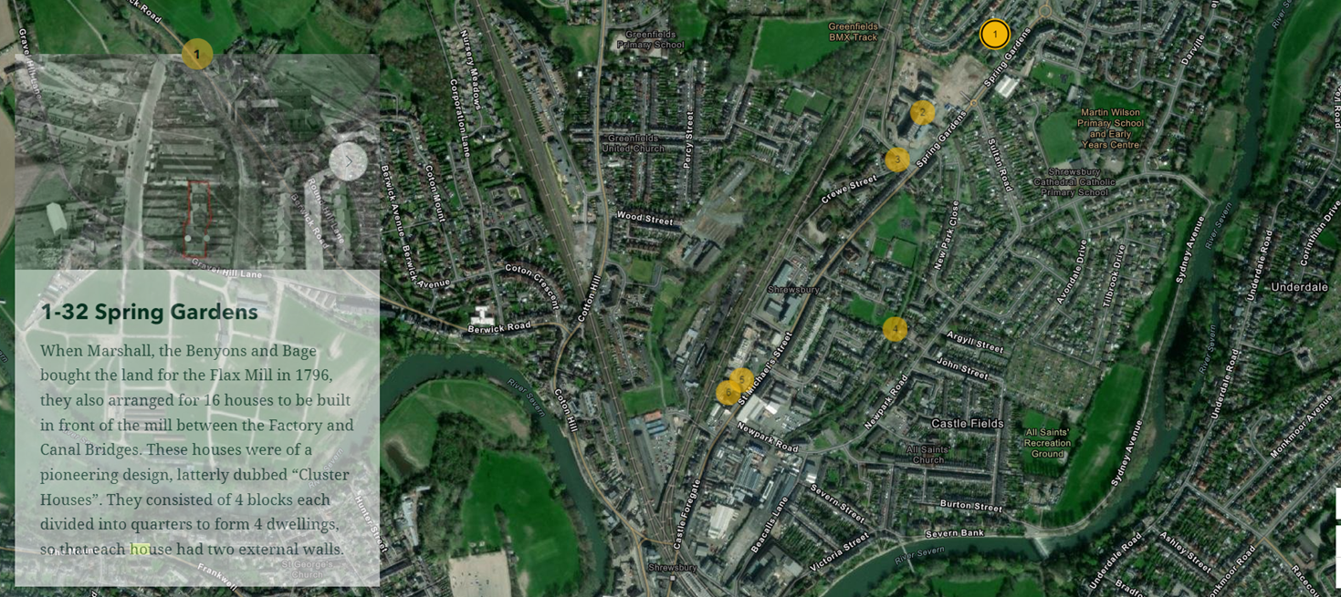
Where did the people live?
Because the census is arranged by streets, it helps to know what areas to look in.
Use the Families of the flax mill Story Map to find out where some of these streets were in Shrewsbury.
Education Resources
Notes:
https://storymaps.arcgis.com/stories/d43388b725074196a8b1317a5a912f84 As a class look through each of the locations on the map – then stop before scrolling down to find the census descriptions.

Slide 12
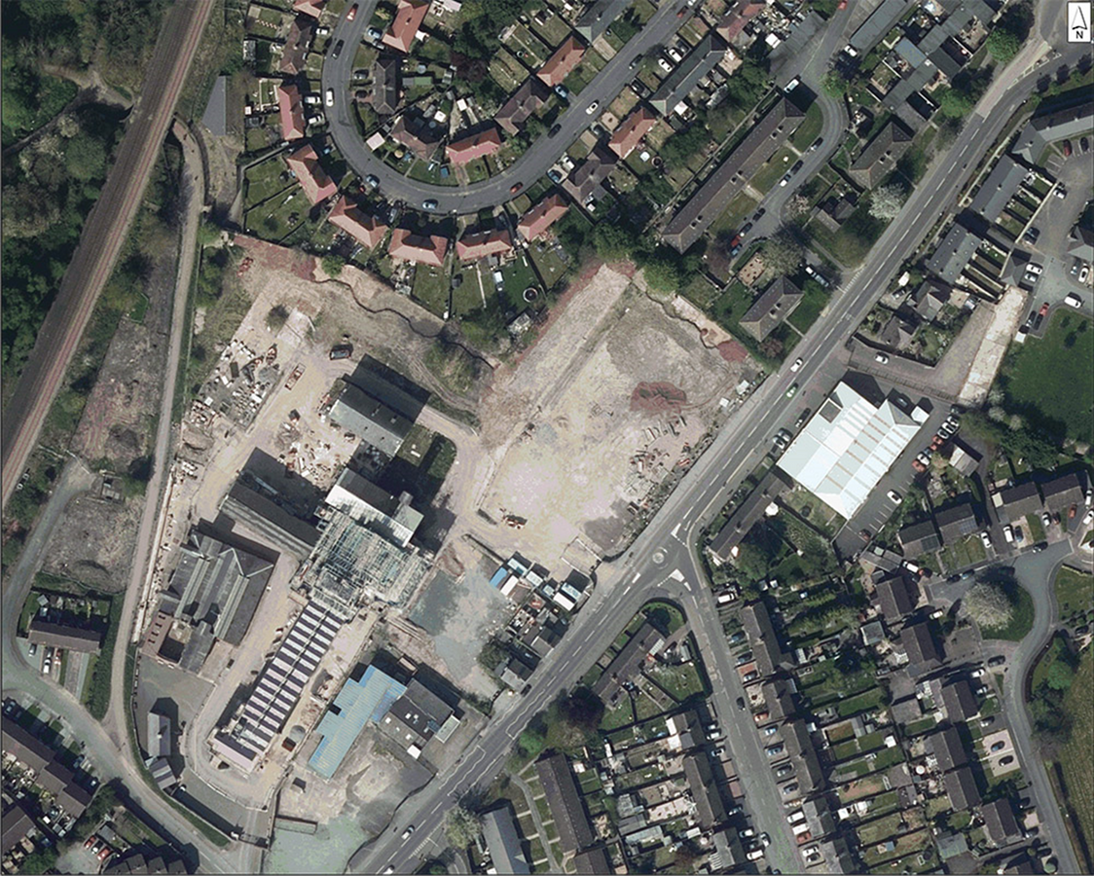
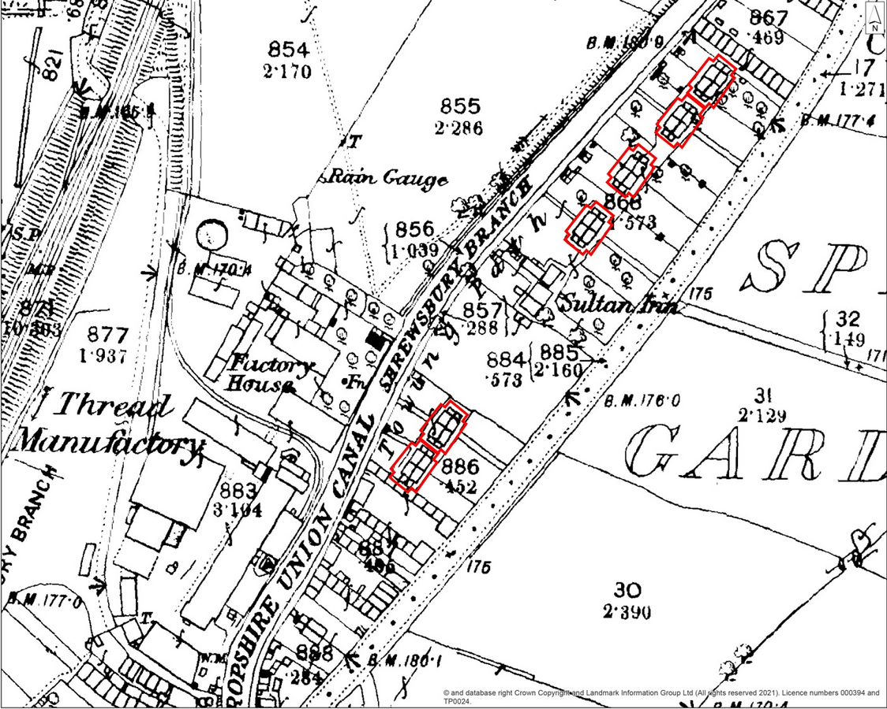




Compare the 1882 map of Spring Gardens with the modern aerial photo
Education Resources
Can you find one thing that has changed?
Can you find one thing that has stayed the same?
Use the StoryMap and these slides to look in more detail at the places in which some of the flax mill workers lived
Notes:
Use the StoryMap and these slides to look in more detail at the places in which some of the flax mill workers lived.
Aerial photo: © Historic England. Contains public sector information licensed under the Open Government Licence v3.0.
Historic Map: © & database right Crown Copyright and Landmark Information Group Ltd (All rights reserved) License numbers 000394 and TP0024

Slide 13
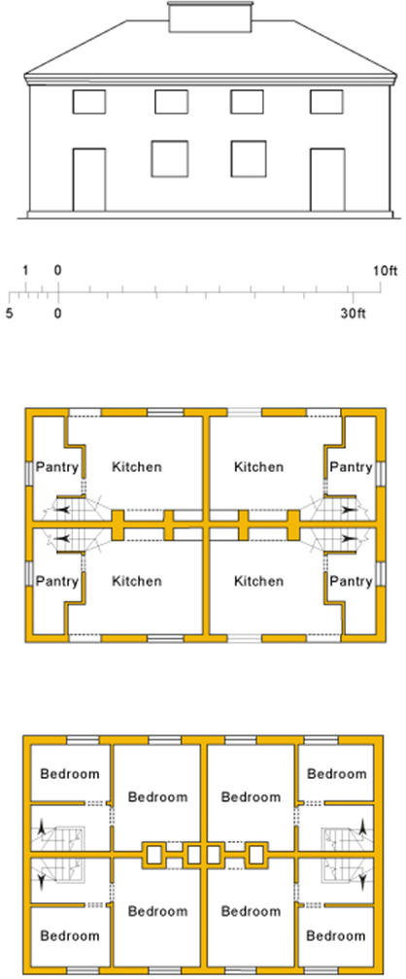
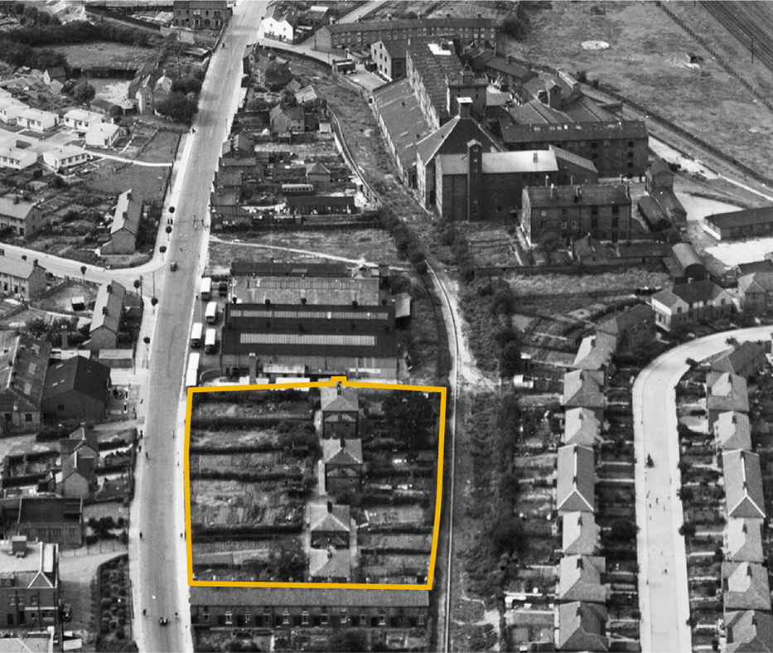
Spring Gardens
What do you think it would have been like to live here?
Education Resources
How might it be different or the same to how we live today?
Notes:
Use the aerial photo and plan to discuss what it might have been like to live there and how it might, or might not, be different to how live today. NB: You may want to use the scale on the diagram to highlight to size of the bedrooms – we can then come back to this after you’ve looked at the Census to see how many people were likely to be sharing each bedroom. The large one is roughly 2.5 x 3.5m and the small one 2 x 1.5m – you may want to measure these out on the classroom floor to help children understand how big they are.
Image: Historic England (RAF Photography) Ref:raf_540_84_pffo_0011 - 29th August 1948

Slide 14
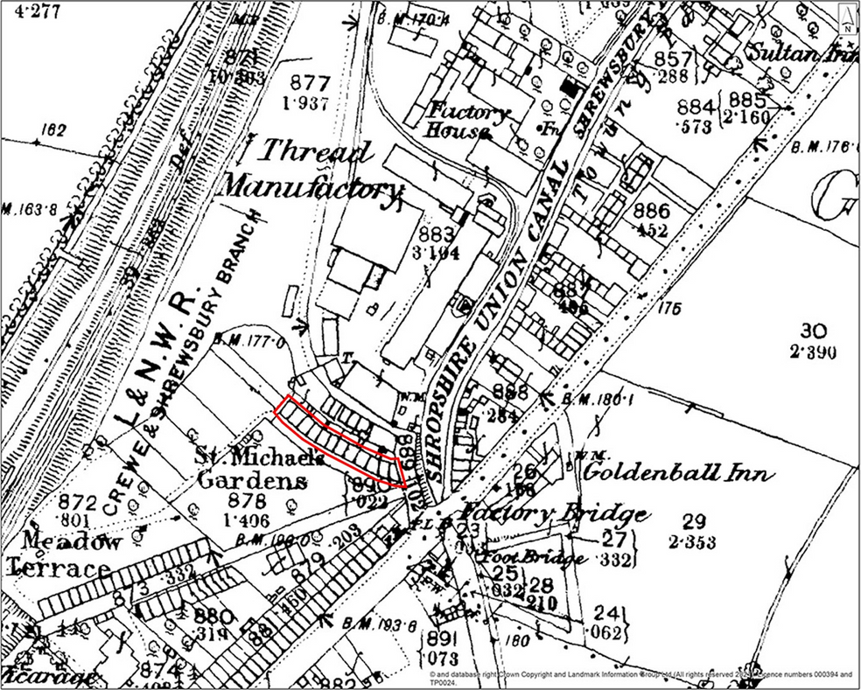
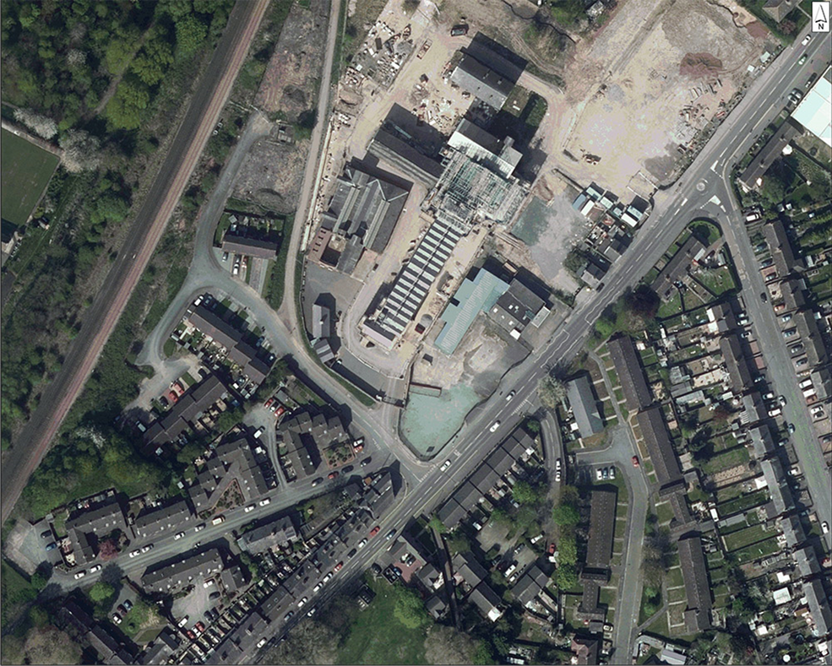
Compare the 1882 map of St Michael’s Gardens with the modern aerial photo
Education Resources
Can you find one thing that has changed?
Can you find one thing that has stayed the same?
Use the StoryMap and these slides to look in more detail at the places in which some of the flax mill workers lived
Notes:
Use the StoryMap and these slides to look in more detail at the places in which some of the flax mill workers lived.
Aerial photo: © Historic England. Contains public sector information licensed under the Open Government Licence v3.0.
Historic Map: © & database right Crown Copyright and Landmark Information Group Ltd (All rights reserved) License numbers 000394 and TP0024

Slide 15
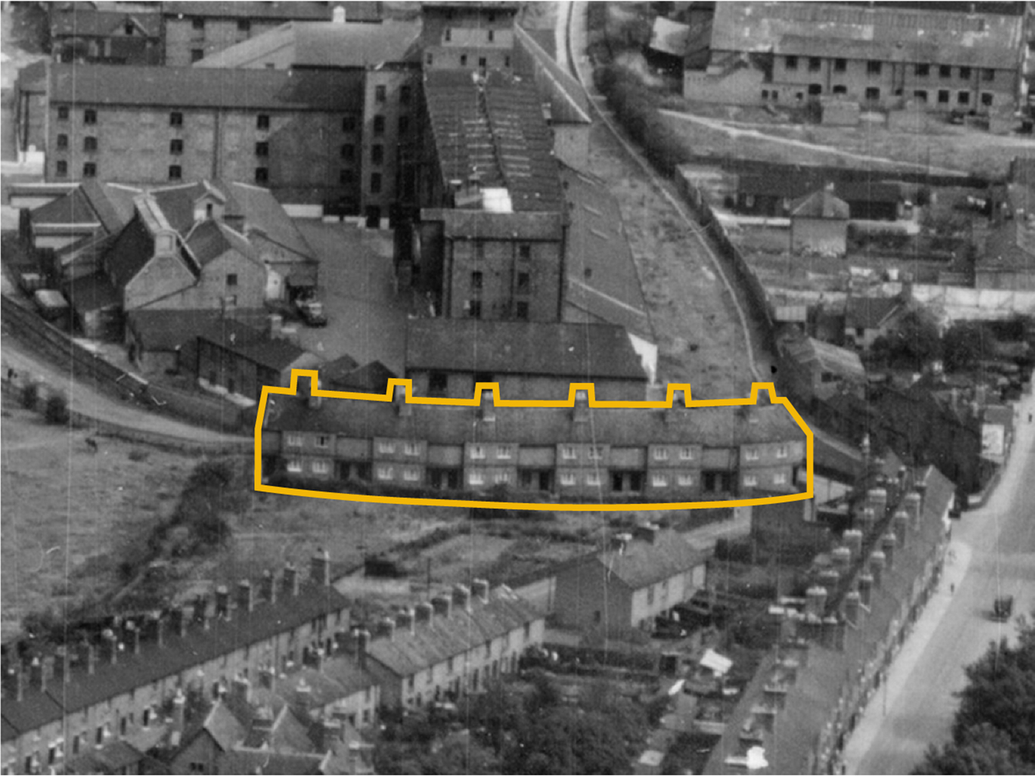
St Michael’s Gardens
What do you think it would have been like to live here?
Did you know...
Education Resources
Although there are 6 chimney stacks, it is actually a curving terrace of 12 houses
How might it be different or the same to how we live today?
Notes:
Image: Historic England (RAF Photography) Ref:raf_540_84_pffo_0032 - 29th August 1948

Slide 16
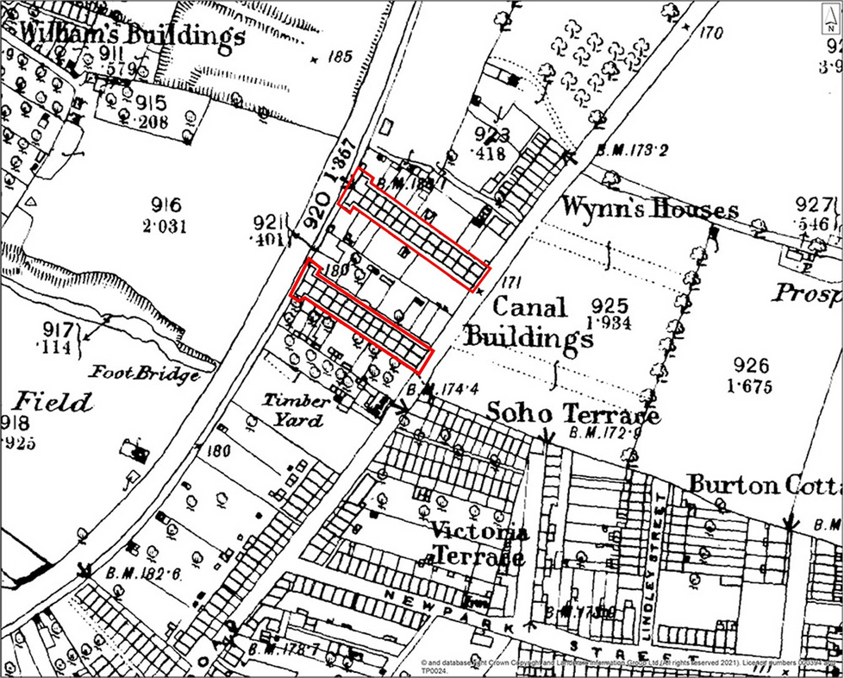
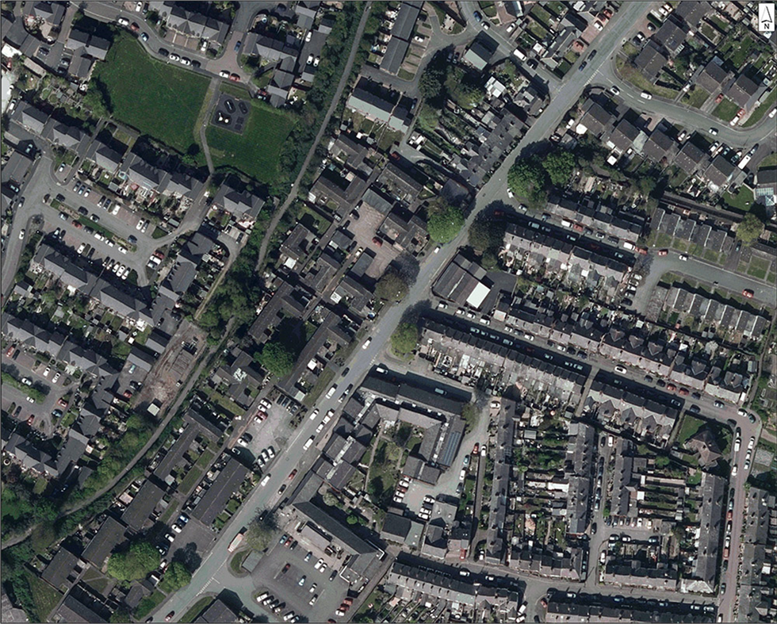
Compare the 1882 map of Canal Buildings with the modern aerial photo
Education Resources
Can you find one thing that has changed?
Can you find one thing that has stayed the same?
Use the StoryMap and these slides to look in more detail at the places in which some of the flax mill workers lived
Notes:
Use the StoryMap and these slides to look in more detail at the places in which some of the flax mill workers lived.
Aerial photo: © Historic England. Contains public sector information licensed under the Open Government Licence v3.0.
Historic Map: © & database right Crown Copyright and Landmark Information Group Ltd (All rights reserved) License numbers 000394 and TP0024

Slide 17
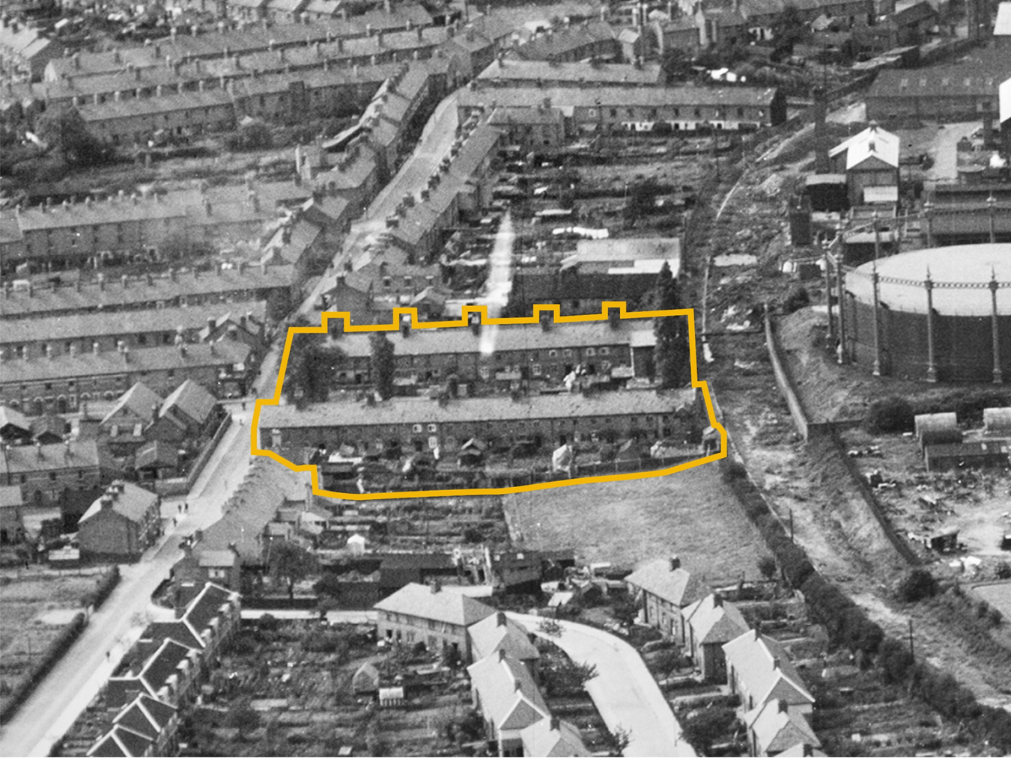
Canal Buildings
Did you know...
Education Resources
Although there are 12 chimney stacks it is actually 2 terraces making up 24 houses
Notes:
Use the aerial photo to discuss what it might have been like to live here and how it might, or might not, be different to how live today.
Image: Historic England (RAF Photography) Ref:raf_540_84_pffo_0011 - 29th August 1948

Slide 18
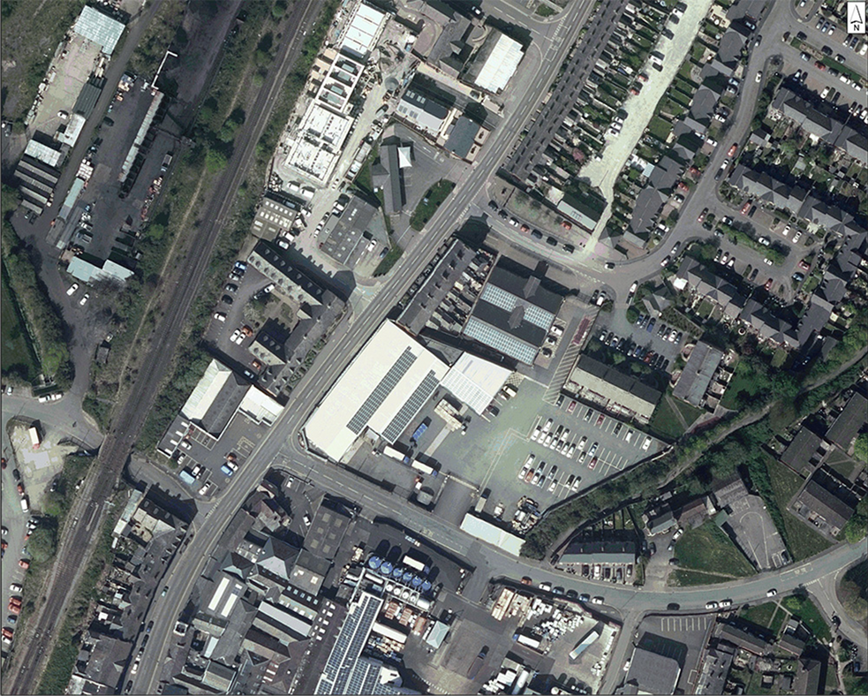
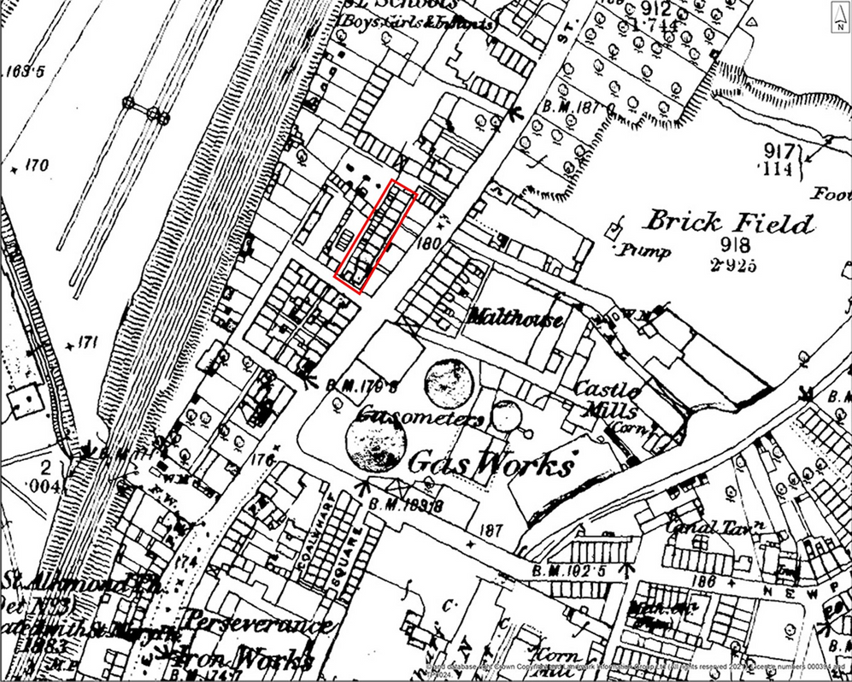
Compare the 1882 map of John’s Row with the modern aerial photo
Education Resources
Can you find one thing that has changed?
Can you find one thing that has stayed the same?
Use the StoryMap and these slides to look in more detail at the places in which some of the flax mill workers lived
Notes:
Use the StoryMap and these slides to look in more detail at the places in which some of the flax mill workers lived.
Aerial photo: © Historic England. Contains public sector information licensed under the Open Government Licence v3.0.
Historic Map: © & database right Crown Copyright and Landmark Information Group Ltd (All rights reserved) License numbers 000394 and TP0024

Slide 19
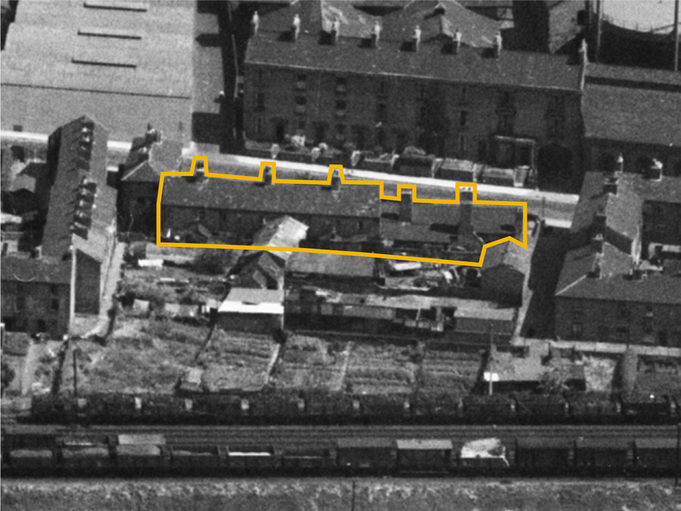

John’s Row
Did you know...
Education Resources
This row of houses was built by John Simpson (the builder who probably built the masonry walls of the flax mill). He named it John’s Row after his son, also John, who died aged 14 in 1814.
There were originally more houses, but by the time of this 1948 photo these were the only ones left.
Notes:
Image: Historic England Archive (Aerofilms Collection), Ref: eaw001633, Date: 12th July 1946

Slide 20
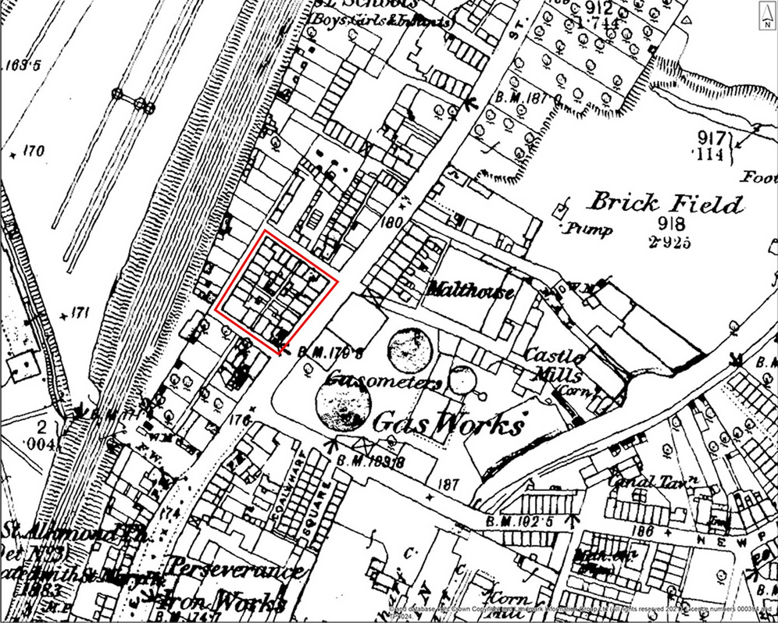
Compare the 1882 map of Simpson’s Square with the modern aerial photo
Education Resources
Can you find one thing that has changed?
Can you find one thing that has stayed the same?
Use the StoryMap and these slides to look in more detail at the places in which some of the flax mill workers lived
Notes:
Use the StoryMap and these slides to look in more detail at the places in which some of the flax mill workers lived.
Aerial photo: © Historic England. Contains public sector information licensed under the Open Government Licence v3.0.
Historic Map: © & database right Crown Copyright and Landmark Information Group Ltd (All rights reserved) License numbers 000394 and TP0024

Slide 21
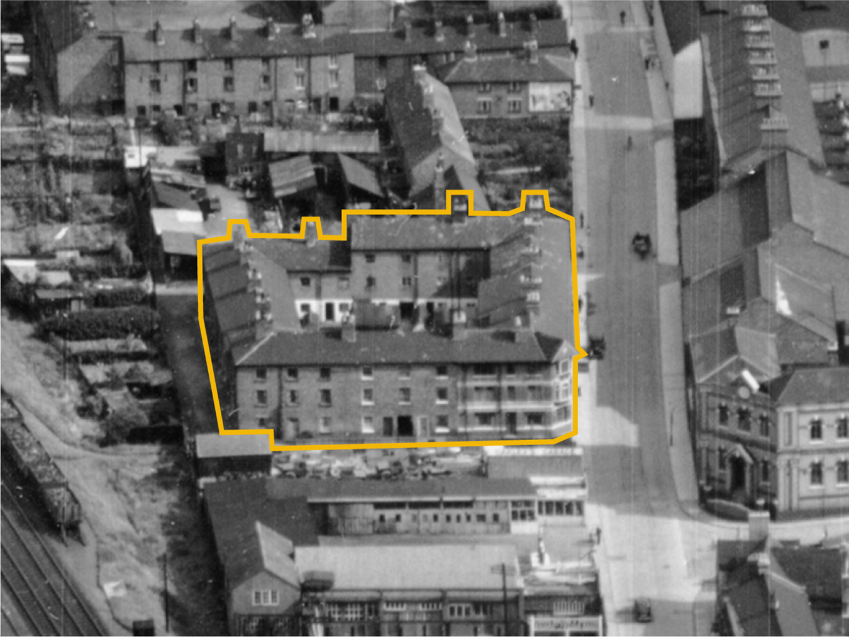
Simpson’s Square
Did you know...
Education Resources
In 1814 John Simpson (the builder who probably built the masonry walls of the flax mill) took out insurance for a “connected range of twenty-four Dwelling Houses” in Castle Foregate. These became known as Simpson’s Square.
Notes:
Image: Historic England (RAF Photography) Ref:raf_540_84_pffo_0031 - 29th August 1948

Slide 22


Education Resources
What can the census tell us about the lives of families who worked at the Shrewsbury flax mill in 1851?

Slide 23
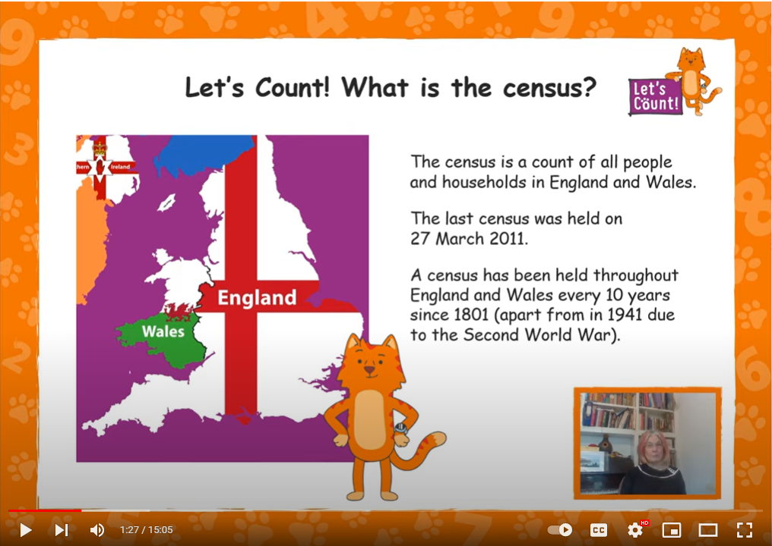
What is a census?
Education Resources
Notes:
Briefly explain to pupils what a census is – the first few minutes of the video does this really clearly: https://www.youtube.com/watch?v=dlg5CRSskL4
If you want to go into the census in more detail there are some great resources here: https://letscount.org.uk/en/resources-for-teachers/english-curriculum-resources/

Slide 24
What jobs were done in the flax mill?
Job title | What they did in the mill
Dyer | Dyed/coloured the thread
Finisher | Turned the thread into usable material - improving the look, performance, or "hand" (feel) of the finished product
Fireman | Looked after the boilers that powered the machinery
Maker Up | Made up the thread into a finished product
Overlooker | A superintendent or overseer who made sure everyone was doing their job properly
Paperer | Involved in packaging up thread
Parter | Parted or separated the flax fibres from each other
Piecer | Pieced together (mended) any threads which broke on the machines
Polisher | Used the polishing machine to make the thread smooth and glossy
Job title | What they did in the mill
Reeler | Worked on the machine that wound the thread onto the bobbin
Sorter | Made sure all the pieces of flax placed together in a bunch were of the same colour and were capable of being spun together
Spinner | Worked on spinning machines, each with many spindles, to make thread
Spooler | Changed the spools of yarn on the spinning machine to keep it running
Spreader | Worked on the machine used for turning pieces of flax fibre into a continuous sliver or ribbon that could then be spun
Stacker | Pulled bundles of flax over metal pins (heckles) to level the flax fibres before they could be used on the machines
Twister | Worked the machine used for twisting threads together
Weigher (Flax) | Weighed the flax that was to be made into linen thread
Writing Clerk | A skilled clerk who worked in the office
Education Resources
Notes:
Before we start to look at the 1851 we need to know what type of jobs to look out for…

Slide 25

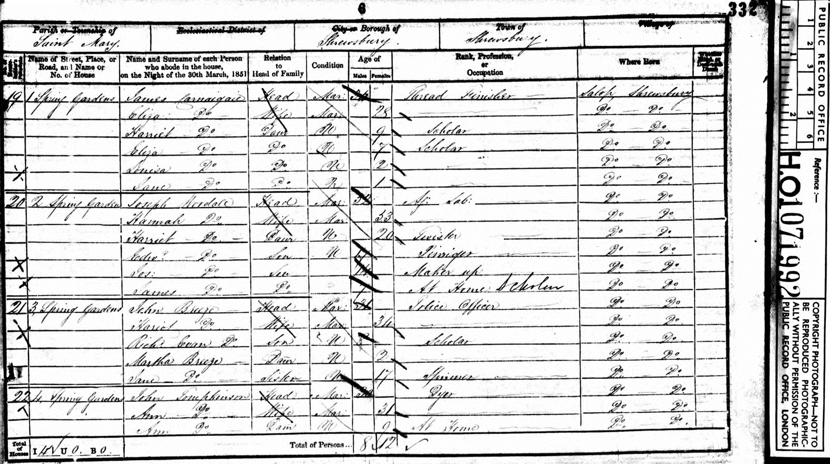
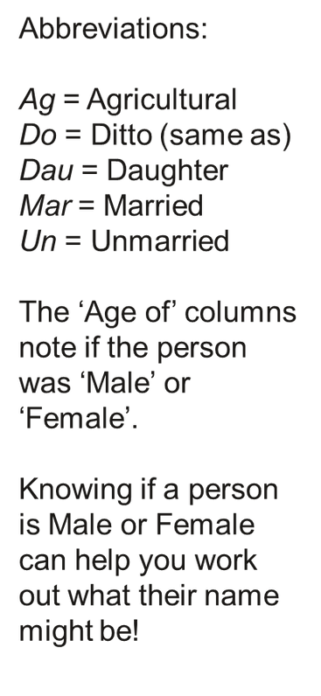
How to ‘read’ the census
Address
Name
Age
Job
Education Resources
Notes:
Explain about the information on a census sheet – the StoryMap shows the original census, but also has transcriptions for every family and the jobs from the flax mill have been highlighted in orange to make them easier to spot.
Image: Page from 1851 census for 1-4 Spring Gardens, Ref: PRO HO/107/1992/332/6

Slide 26

Use the Story Map to find a family!
Work in pairs to search the Story Map and find out about one of the families – use your Record Sheet to keep notes
Evans
Goodby
Marris
Thomas
Education Resources
Evans
Hinley
Morris
Thornburn
Farmer
Humphreys
Roberts
Tomkinson
Fazey
Jones
Robinson
Whittingham
France
King
Rowson
Williams
Gardener
Martin
Taylor
Woodall
Notes:
Assign pairs, groups or individuals to a name (or names) for them to research – make sure all the families are covered.

Slide 27
Record Sheet
The _________________________________ Family lived at ______________________________
Name | Age - Male | Age - Female | Job
PRINT OUT
More resources at HistoricEngland.org.uk/Education
Notes:
PRINT OUT this slide for pupils to record their family research – they can use the back of the sheet of paper to note down any other information they find or thoughts they have. NB: All the flax mill jobs are highlighted in ORANGE on the StoryMap (https://storymaps.arcgis.com/stories/d43388b725074196a8b1317a5a912f84) - suggest to pupils they also use a DIFFERENT COLOUR for flax fill jobs when they fill in their Record Sheet.

Slide 28

EXAMPLE Record Sheet
The Williams___________________ Family lived at 10 St Michael’s Gardens__________________
Name | Age - Male | Age - Female | Job
William Williams | 45 |  | Cabinet Maker
Mary Williams |  | 42
William Williams | 23 |  | Thread Finisher at Factory
Thomas Williams | 20 |  | Thread Finisher at Factory
Mary Ann Williams |  | 15 | Thread Finisher at Factory
Edward Williams | 13 |  | Errand Boy
Henry Williams | 10 |  | Scholar
Emma Williams |  | 7 | Scholar
Use the back of the sheet to record anything else you find interesting about the family
PRINT OUT
Use a different colour for flax mill jobs on your Record Sheet
All the flax mill jobs are highlighted in orange on StoryMap
More resources at HistoricEngland.org.uk/Education
Notes:
PRINT OUT this slide for pupils to record their family research – they can use the back of the sheet of paper to note down any other information they find or thoughts they have. NB: All the flax mill jobs are highlighted in ORANGE on the StoryMap (https://storymaps.arcgis.com/stories/d43388b725074196a8b1317a5a912f84) - suggest to pupils they also use a DIFFERENT COLOUR for flax fill jobs when they fill in their Record Sheet.

Slide 29

What was the most interesting thing you found?
Education Resources
Notes:
Ask pupils to share what they’ve found out. Click on the speech bubbles to add text

Slide 30
Who did the 8 most common jobs?
Share your information from your Record Sheets. If someone did one of these jobs in the mill add a tally mark into the correct column.
Use different colour tally marks for males and females, to help see if they did different types of job.
Job title | Boy (9-19) | Man (20 +) | Girl (9-19) | Woman (20 +) | TOTAL
Dyer
Finisher
Maker Up
Reeler
Sorter
Spinner
Parter
Piecer
Polisher
Education Resources
Notes:
Ask everyone to share the information from their Record Sheet. If they did one of the 8 jobs listed above add tally marks to each column to record what they’ve found about people working in the mill. We suggest that you use different colours for males and females to help highlight the differences.
You can do this on the whiteboard as a whole class or print out copies of this slide and ask pairs/groups to keep their own record/tally as others are sharing their findings.

Slide 31



ANSWERS Who did the 8 most common jobs?
Share your information from your Record Sheets. If someone did one of these jobs in the mill add a tally mark into the correct column.
Use different colour tally marks for males and females, to help see if they did different types of job.
Job title | Boy (9-19) | Man (20 +) | Girl (9-19) | Woman (20 +) | TOTAL
Dyer |  |  |  |  | 2
Finisher |  |  |  |  | 8
Maker Up |  |  |  |  | 4
Reeler |  |  |  |  | 17
Sorter |  |  |  |  | 2
Spinner |  |  |  |  | 13
Spreader |  |  |  |  | 5
Twister |  |  |  |  | 3
Total | 11 | 9 | 18 | 16 | 54
Education Resources
Notes:
Discuss the results with your pupils, noting that many of the jobs employed mainly people of the same sex.

Slide 32
EXTENDED VERSION
What jobs were done in the flax mill?
Job title | Boy 9-15 | Girl 9-15 | Boy 16-19 | 16-19 | Man 20-29 | Woman 20-29 | Man 30-39 | Woman 30-39 | Man 40+ | Woman 40+ | Total
Dyer
Finisher
Fireman
Maker Up
Overlooker
Paperer
Parter
Piecer
Polisher
Reeler
Sorter
Spinner
Spooler
Spreader
Stacker
Twister
Weigher
Writing Clerk
Non-specific
TOTAL
Education Resources
Share your information from your Record Sheets, these are all the jobs from people working in the mill, add a tally to it, use different colours for male and female to see the difference.
Notes:
EXTENDED VERSION – For more able pupils looking at ALL the jobs gives an even more detailed picture of what was happening in the mill.
Ask everyone to share the information from their Record Sheet and then add tally marks to each column to record what they’ve found about people working in the mill. We suggest that you use different colours for males and females to help highlight the differences.
You can do this on the whiteboard as a whole class or print out copies of this slide and ask pairs/groups to keep their own record/tally as others are sharing their findings.

Slide 33
ANSWERS EXTENDED VERSION
What jobs were done in the flax mill?
Job title | Boy 9-15 | Girl 9-15 | Boy 16-19 | 16-19 | Man 20-29 | Woman 20-29 | Man 30-39 | Woman 30-39 | Man 40+ | Woman 40+ | Total
Dyer |  |  |  |  | I |  |  |  | I |  | 2
Finisher | I |  | III |  | IIII |  |  |  |  |  | 8
Fireman |  |  |  |  |  |  |  |  | I |  | 1
Maker Up |  |  | II |  | II |  |  |  | I |  | 5
Overlooker |  |  |  |  | I |  |  |  |  |  | 1
Paperer | I |  |  |  |  |  |  |  |  |  | 1
Parter |  |  |  | I |  |  |  |  |  |  | 1
Piecer | I |  |  |  |  |  |  |  |  |  | 1
Polisher |  |  |  | I |  |  |  |  |  |  | 1
Reeler | II | IIIII |  | IIIII |  | IIIII |  |  |  |  | 17
Sorter | II |  |  |  |  |  |  |  |  |  | 2
Spinner |  | III | I | III | I | IIIII |  |  |  |  | 13
Spooler |  |  |  | I |  |  |  |  |  |  | 1
Spreader |  | I |  | I |  | I |  |  |  |  | 3
Stacker | I |  |  |  |  |  |  |  |  |  | 1
Twister |  |  |  |  |  | IIIII |  |  |  |  | 5
Weigher | I |  |  |  |  |  |  |  |  |  | 1
Writing Clerk |  |  |  |  |  |  | I |  |  |  | 1
Non-specific | II | I | I | III | I |  |  |  | II |  | 10
TOTAL | 11 | 10 | 7 | 15 | 10 | 16 | 1 | 0 | 5 | 0 | 75
Education Resources
Share your information from your Record Sheets, these are all the jobs from people working in the mill, add a tally to it, use different colours for male and female to see the difference.
Notes:
EXTENDED VERSION – For more able pupils looking at ALL the jobs gives an even more detailed picture of what was happening in the mill.
Ask everyone to share the information from their Record Sheet and then add tally marks to each column to record what they’ve found about people working in the mill. We suggest that you use different colours for males and females to help highlight the differences.
You can do this on the whiteboard as a whole class or print out copies of this slide and ask pairs/groups to keep their own record/tally as others are sharing their findings.

Slide 34
Questions to discuss: flax mill jobs
1. Looking at the information about the families are there jobs only done by men or boys?
2. Which jobs are mostly done by women or girls?
Education Resources
3. Are any jobs only done by children?
4. What is the age of the youngest working child you found in this information?
5. No women over 30 work at the flax mill. Why do you think this is?
Notes:
Answers:
1.Dyer, Finisher, Fireman, Maker-Up, Overlooker, Paperer, Piecer, Sorter, Stacker, Weigher
2.Reeler, Spinner, Spooler, Stacker
3.Paperer, Piecer, Sorter, Spooler, Stacker, Weigher
4.Women aged 30+ - once women had children it was very difficult for them to be able to work in factory jobs as they had to be at home to look after their children
5.7! Did you spot Ann Taylor – who according to the census is only 7 but working as a Thread Reeler – this would have been illegal as she’s under 9!

Slide 35
Questions to discuss: other jobs
Looking back at all the Record Sheets:
2. What do you notice about the families where the ‘Head of Household’ is also a Widow?
Education Resources
1. Which jobs can you identify, that did not involve working in the flax mill?
3. Who is the oldest person still working and what is their job?
4. Can you find any children who are neither working nor at school, but should be at school if they were alive today?
Notes:
Answers:
1.Carpenter, Washer woman, House keeper, Filer & Turner, Tailor journeyman, Agricultural Labourer, Carter, Dressmaker, Cabinet maker, Errand boy, Plate layer on railway, Labourer, Moulder (+ apprentice), Servant, Steam Boiler maker, Laundress, Blacksmith’s apprentice
2.They’re more likely to have all the children working and also to have lodgers staying in the house. Widows didn’t get any ‘benefits’ – so if your husband died it was hard to earn the extra money to make up for his loss of wages
3.William Fazey – 78 – Agricultural Labourer. Today we wouldn’t expect a 78 year old to still be working, especially not in a very physical job like Ag. Lab!
4. No – All the children of school age who aren’t working are described as ‘Scholar’ or ‘School’. This is really positive – it was not until 1880 that school attendance was compulsory for children aged between 5 and 10 years of age. So the fact that in 1851 so many children are listed as being at school is a credit to Shrewsbury! Use this as a link to the Extension Activity - Schools and Child Workers

Slide 36
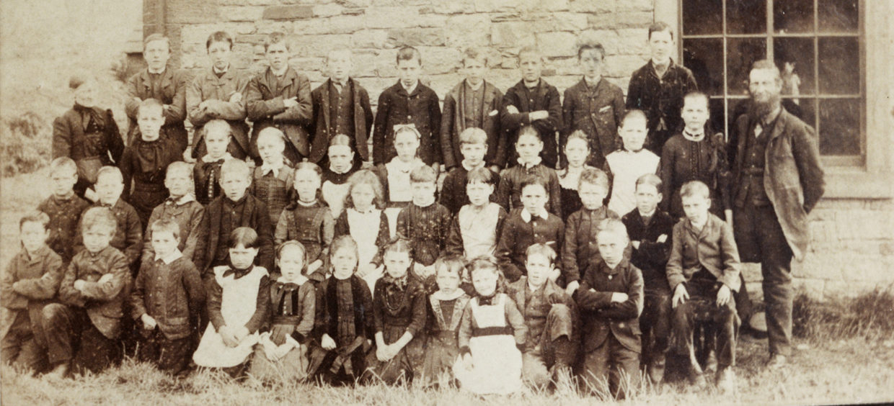

Extension Activity: School and Child Workers
It was not until 1880 that school attendance was compulsory for children aged between 5 and 10 years of age. It was not until 1899 that this was extended to the age of 12 – after the flax mill had closed.
Education Resources
All the children of school age who aren’t working are described as ‘Scholar’ or ‘School’. This is really positive – it was not until 1880 that school attendance was compulsory for children aged between 5 and 10 years of age. So the fact that in 1851 so many children are listed as being at school is a credit to Shrewsbury!
Notes:
Image: A group of school children and teachers, posing outside of Craggs Endowed School, Rosley, Cumbria © Source: Historic England Archive, Ref: JLP01/20/012/02/001, Date: 1880 - 1890
All the children of school age who aren’t working are described as ‘Scholar’ or ‘School’. This is really positive – it was not until 1880 that school attendance was compulsory for children aged between 5 and 10 years of age. So the fact that in 1851 so many children are listed as being at school is a credit to Shrewsbury!

Slide 37
School and Child Workers: Questions to discuss
  Why did many factory owners, such as John Marshall, employ children?
  Why did parents allow their children to work at the factory with them?
  Why did the factory owners provide an education for the children at their factory?
  How did the children benefit from gaining an education?
Thinking about the children you've found in the 1851 census;
Consider and describe:
Education Resources

Slide 38


School and Child Workers: Extended Responses
How might factory children feel about having to go to school? Would they see this more as an opportunity or a punishment?
(There is no right answer)
Education Resources
You could write this in the first person. It could be in the form of a diary entry, a letter, or a monologue, in the role of one of the children featured on the Story Map resource.
If you want to look at 2 different points of view, write a playscript of a conversation between 2 or more children, who may have different feelings about the idea of going to school for an education.

Slide 39
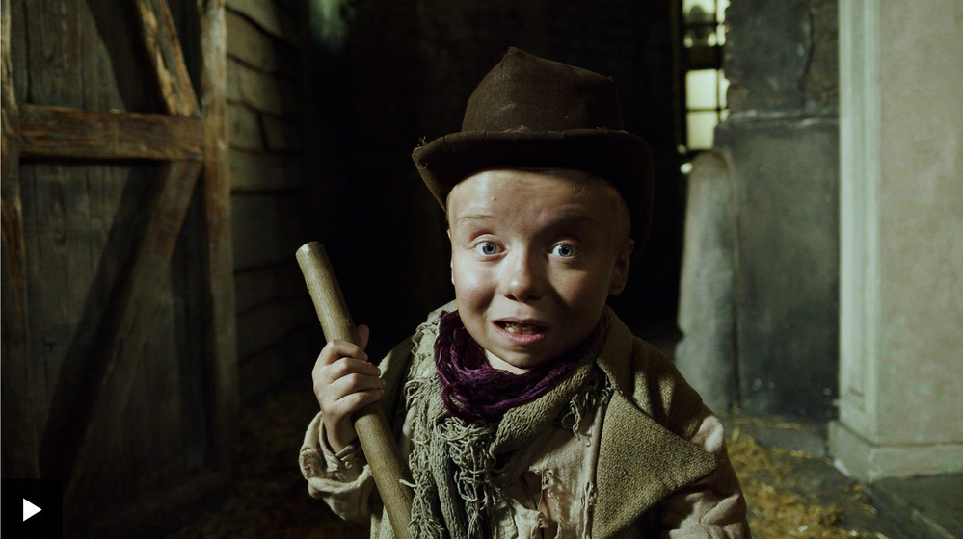
School and Child Workers: Compare to elsewhere
In Shrewsbury, many children worked in the Flax Mill.
In other parts of the country, what jobs did children do?
Here’s one example.
Can you find other examples?
Education Resources
https://www.bbc.co.uk/teach/class-clips-video/history-ks2-dodgers-guide-to-being-a-victorian-kid/ztb2m39
More resources at HistoricEngland.org.uk/Education

