Slide 1
What can primary evidence tell us about the significance of carnival to the Manchester community in the 1970s?
Lesson 3: How can music add to our understanding of the significance of carnival to the Manchester Community in the 1970’s?
The following PPT was produced by Michelle O’Neill, Head of History at Wellacre Academy in Trafford, Manchester and Jessica White, former PhD student at Manchester University and now lecturer in Black British History at the University of Liverpool. It focuses on the use of newspapers as evidence to explore the significance of carnival to the Manchester community in the 1970s. For more information, see Overview and Scheme of Work.

Slide 2

Which were more useful for telling us about the significance of carnival to the Manchester community the 1970s? Why?
Newspaper articles
Photographs
Notes:
Image: Pixaby

Slide 3
Key Question:
How far can music add to our understanding of the significance of carnival to the Manchester Community in the 1970’s?

Slide 4
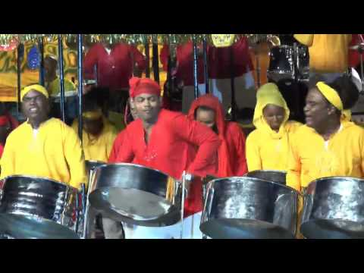
Watch 1 or 2 minutes of this video of The Trinidad Allstars. It is an example of the type of music you might hear at carnival in Manchester
Write down 5 or more words to describe the musicians
Write down 2 or more sentences to describe how the music makes you feel
https://www.youtube.com/watch?v=uYqAX9vCUrk
The clip is several minutes long. You only need to watch 1-2 minutes!

Slide 5
Carnival Music - A History
During the Second World War – Carnival was banned in Trinidad, but the Trinidadian carnivalists began using anything they could find – rubbish can lids, scrap metal, etc – to form drums. Steel pan replaced traditional drumming in the Trinidadian Carnival, and Windrush migrants brought the steel pan tradition with them to Britain.
In the early years of the Notting Hill Carnival (then named the Notting Hill Festival) it had a steel band march. The steel band players, through moving through the streets and extending the march, turned the Festival into a Carnival.
1975 - Carnival Development Committee made a change - Jamaican DJs were asked to play music at Notting Hill (it is important to remember that the biggest single group of Caribbean immigrants to Britain were from Jamaica, which didn’t not share Trinidad Carnival traditions).
Over time, reggae music replaced steel bands as the main source of music at the event. Recorded music replaced performed music. A lot of the reggae was ‘resistant’ – spoke of violence and police oppression.

Slide 6
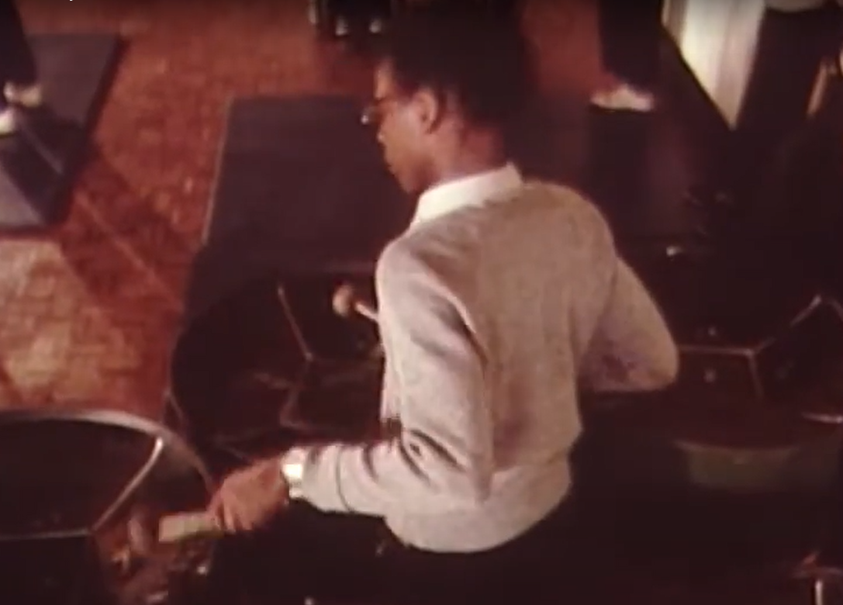
https://www.youtube.com/watch?v=L8zp7WF-03U
Watch the video from the link above from 1 minute 30 seconds to 8 minutes. It is from a 1977 documentary about carnival, showing Manchester school children prepare to perform at the Leeds Caribbean Carnival.
Now watch a few more minutes from 21 minutes onwards - you can see what a Caribbean carnival in the 1970s looked like.
Write down five things you found interesting from the clips.
Write down two questions you have.
Notes:
Image: Still from https://www.youtube.com/watch?v=L8zp7WF-03U

Slide 7
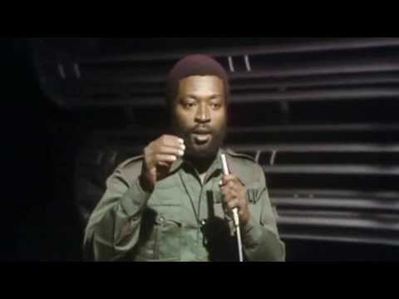
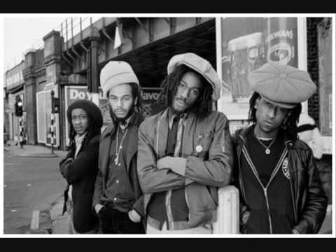
Click on the images to listen to two examples of popular reggae music from the late 1970s - early 1980s. Can you recognise any similar sounds in any music that is popular today?
(The clips are quite long – you could just watch a couple of minutes of each one)
Police and Thieves, recorded by
Junior Murvin in 1976
Three Babylon, recorded by Aswad in 1976
Notes:
Clip 1 - https://www.youtube.com/watch?app=desktop&v=XlP3J3J3Upw Clip 2 - https://www.youtube.com/watch?app=desktop&v=0Q7SCTOSmt4
Find out more about the history and influence of Reggae at https://www.bbc.co.uk/teach/bring-the-noise/the-rise-of-reggae/zdkxqp3

Slide 8
Police and thieves in the street (Oh Yeah)
Scaring the nation with their guns and ammunition
Police and thieves in the street (Oh Yeah)
Fighting the nation with their guns and ammunition
From Genesis to Revelation
The next generation will be, hear me
From Genesis to Revelation
The next generation will be, hear me
And all the crimes come in, day by day
And no one stops it in any way
All the peace maker turn war officers
Hear what I say
Read the lyrics to ‘Police and Thieves’ recorded by Junior Murvin in 1976 (one of the examples you have just listened to). What do these lyrics reveal to us about some of the issues in the late 1970s/1980s?
Notes:
Find out more here: https://www.historyworkshop.org.uk/notting-hill-carnival-disturbances/

Slide 9
Reflection
How far can music add to our understanding of the significance of carnival to the Manchester Community in the 1970’s?
How does the music associated with carnival support what you have already found out about carnival in previous lessons? | Does the music associated with carnival add anything extra to your understanding of carnival?

Slide 10
What can primary evidence tell us about the significance of carnival to the Manchester community the 1970s?
Drawing Conclusions
Complete this sentence:
“Having examined a range of primary evidence about carnival, I believe that carnival was significant to the Manchester Community in the 1970s because……”
Can you explain at least 3 reasons why carnival was significant to the Manchester Community in the 1970s?

