Slide 1

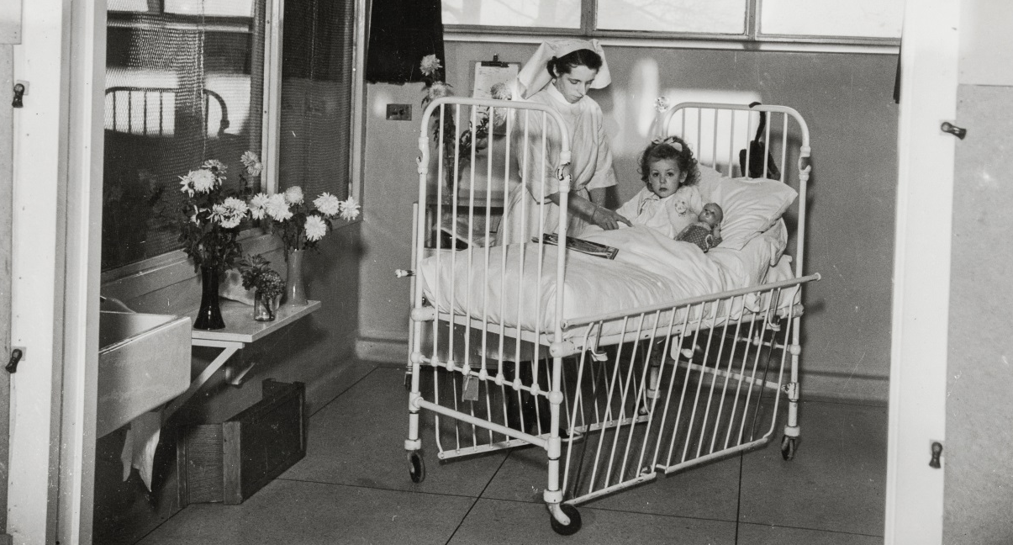
Caring for people in the past:
Isolation hospitals
A history of isolation – we are not alone!
A timeline of places that tell the story of England’s isolation history
This PowerPoint relates to this Teaching Activity: https://historicengland.org.uk/services-skills/education/teaching-activities/caring-for-people-isolation-hospitals

Slide 2
How and why have we cared for people in the past? Focus: Isolation hospitals
Key Stage 3: History
Learning Aims and Outcomes
To develop historical enquiry skills by using photographs as primary source evidence to build knowledge, draw conclusions and stimulate new questions
To understand how and why people cared for each other in the past, focusing on those with infectious diseases
To use buildings as a source of evidence for interpreting the past
To look at examples of change and continuity in health care and the development of treatments for the sick, over time
This PowerPoint relates to this Teaching Activity: https://historicengland.org.uk/services-skills/education/teaching-activities/caring-for-people-isolation-hospitals
Notes:
Although this PPT is written as a teacher-led classroom presentation, it is designed so that all the activities and research tasks within it could be done by students as part of their home learning.

Slide 3
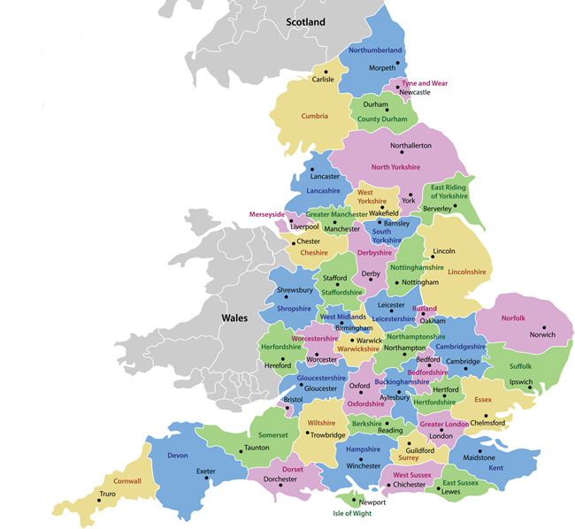
North East
The year 2020 marks 200 years since the birth of Florence Nightingale – a pioneering nurse whose actions helped save the lives of many.
It is with due respect for her work that the new Covid-19 hospitals should all be named in her honour.
This map shows the locations of the new ‘Nightingale’ hospitals being built in 2020.
Yorkshire & the Humber
North West
Birmingham
Bristol
London
Exeter
Notes:
Ask pupils to look at the map and work out which is their local Nightingale Hospital. Ask if they’ve heard about it in the news before. Discuss with pupils why the new hospitals are necessary. Go online to find an image of it and see what the building looks like and/or use Google to look at the site from the air to get a sense of the size and scale of the building.

Slide 4
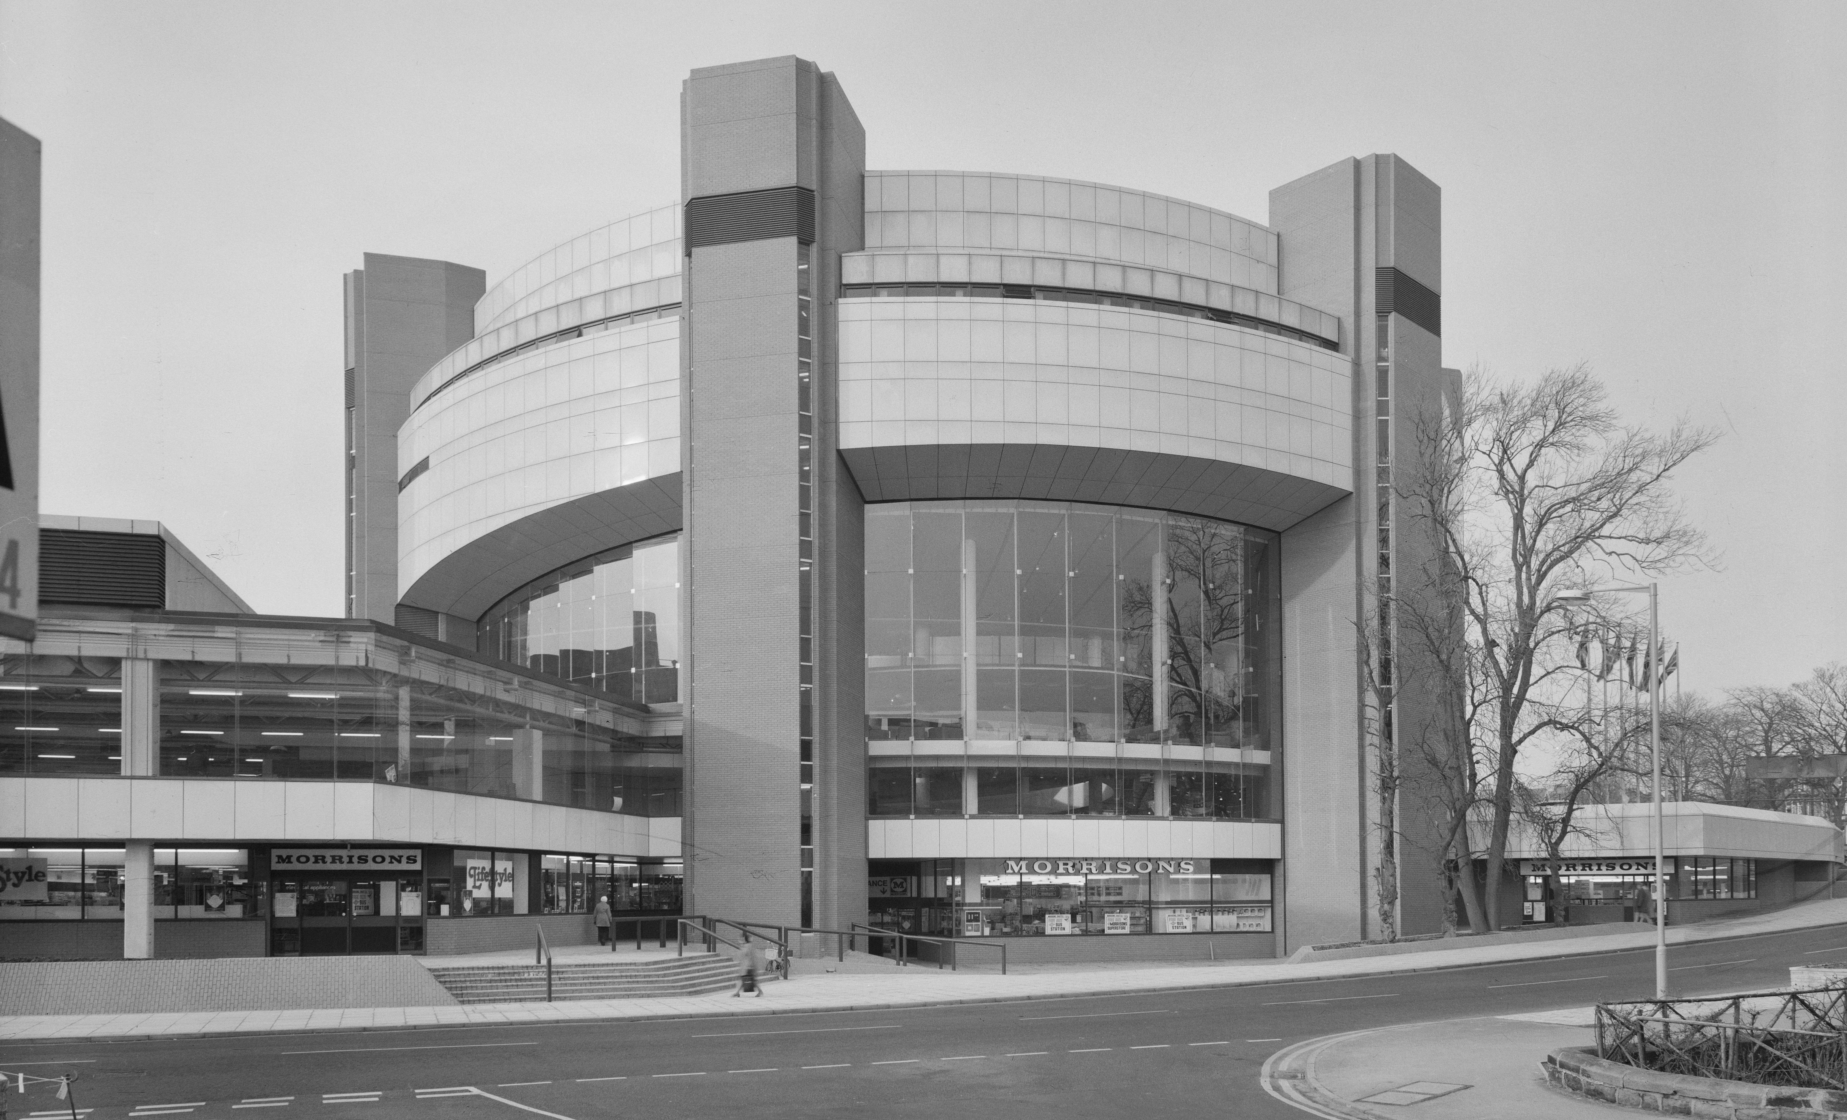
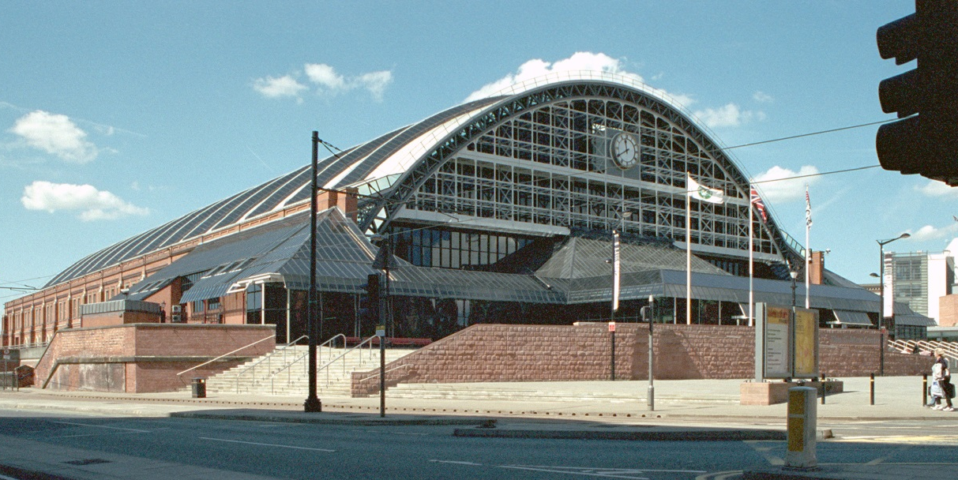
Many of the Nightingale Hospitals are brand new.
Others are reusing existing buildings, in more of a ‘make do and mend’ ethos.
These include:
The Harrogate Convention Centre – Yorkshire & the Humber, opened in 1982 as Harrogate Conference Centre
Manchester Central Convention Complex – North West, opened in 1880 as Manchester Central Railway Station
Notes:
Image: © Historic England Archive. John Laing Photographic Collection. An exterior view of the Harrogate Conference Centre, seen from the junction of King's Road and Strawberry Dale Avenue, Harrogate – 2nd February 1982 Ref: JLP01/09/820189
© Mr Peter Sargeant. Source Historic England Archive. G Mex / Former Central Station, Windmill Street, Manchester – 12th May 2002 Ref: IOE01/06536/21

Slide 5
The Nightingale Hospitals are just the latest in our history of buildings used to care for those with infectious diseases.
In history this type of building is called an ‘isolation hospital’. This is because those inside them needed to be kept isolated – away from other people.
This often included doctors and nurses, or those caring for the sick, as well the people who were sick themselves.
Notes:
Image: © Historic England Archive (Aerofilms Collection). Claverton Down Isolation Hospital, Claverton Down, Bath - 4th July 1934 Ref: epr000134

Slide 6
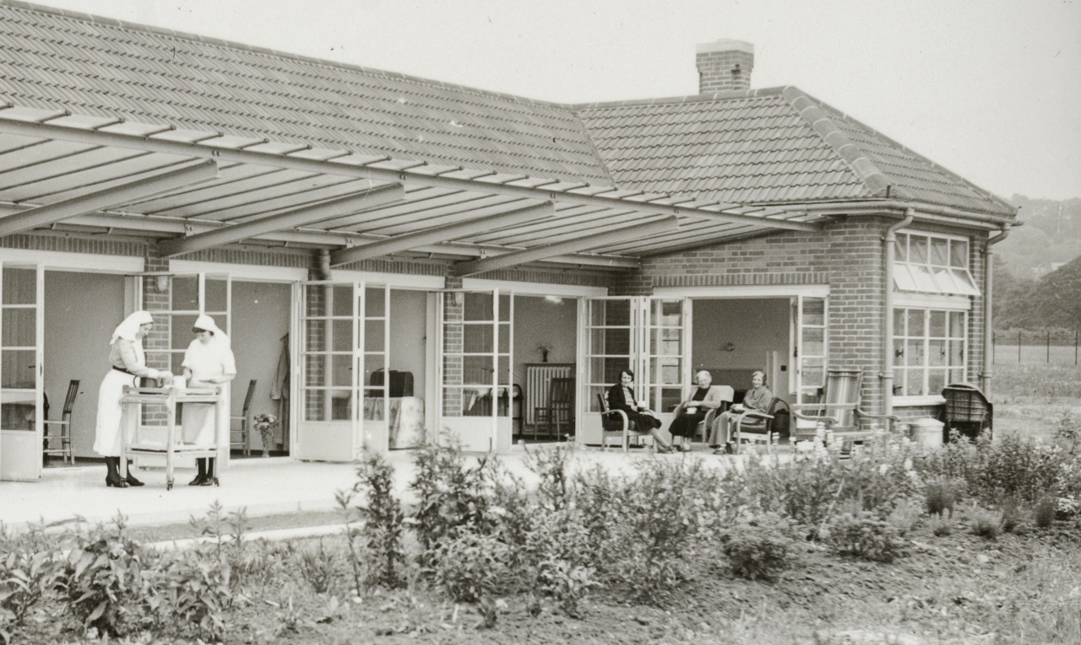
Covid-19 is the first major infectious disease to affect our daily lives in the 21st century.
In the early 20th century, there were other infectious diseases that affected many people’s daily lives.
The three main ones that required treatment in isolation hospitals were Tuberculosis (TB), Scarlet Fever & Polio.
Notes:
Image: © Source: Historic England Archive. The exterior of the open-air women's ward and veranda at Cold Arbour Hospital, Oxford - 24th June 1939 Ref:med01_01_0428

Slide 7
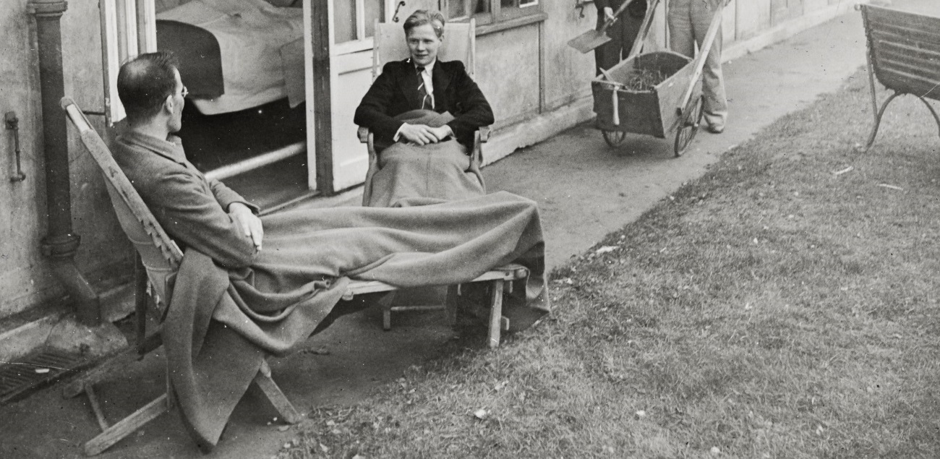
Tuberculosis (TB)
This was an infectious bacterial disease transmitted through the air, that mainly affected people’s lungs. It was often called TB and in the 19th century the same disease was known as Consumption.
Before vaccines and antibiotics were developed it was treated by sending patients to a hospital in a place with clean air for ‘bed-rest’, often outside.
Outbreaks of TB declined majorly after a vaccine was introduce in 1953.
Notes:
Image: © Source: Historic England Archive. The exterior of the open-air women's ward and veranda at Cold Arbour Hospital, Oxford - 24th June 1939 Ref:med01_01_0428

Slide 8
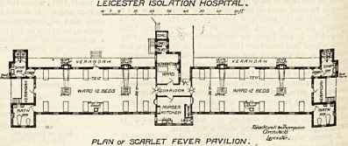
Scarlet Fever
This is a bacterial illness that mainly affects children. It causes a distinctive pink-red rash, hence the name ‘scarlet’ fever. It is easily spread to other people, not all of whom get symptoms or seem sick.
In the first decades of the 20th century in England and Wales it was a leading cause of child death. There is no vaccine, but from 1945 onwards antibiotic treatments became available and this led to a large decline in cases.
Notes:
Image: © The hospital, ‘The new isolation hospital for Leicester.’ v. 30, 14 Sep 1901, pp. 402-403

Slide 9
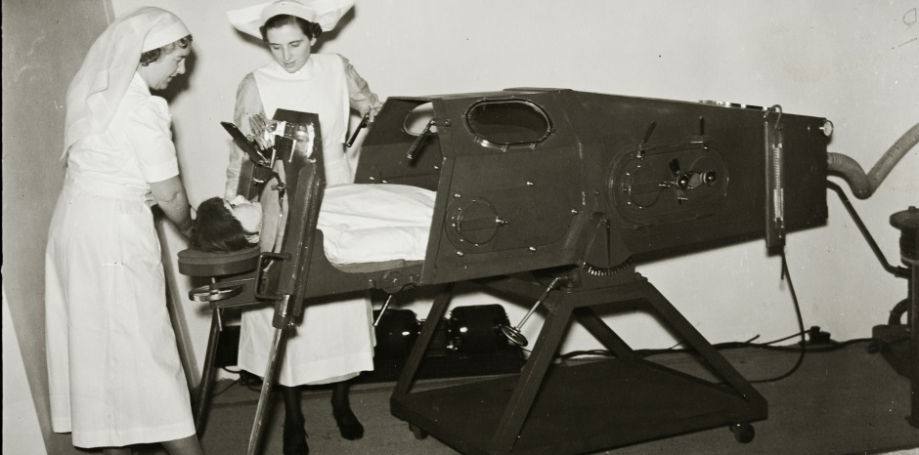
Poliomyelitis (Polio)
This is caused by the poliovirus, a highly contagious virus specific to humans. It can invade the central nervous system, destroying or damaging the nerve cells that control muscles, resulting in weakness, then paralysis.
It mainly affects children aged under five years of age. One in 200 infections leads to irreversible paralysis and, among those paralysed, 5 to 10 % die when their breathing muscles become immobilized.
There is no cure for polio once a person becomes infected; it can only be prevented by immunization. A vaccine was developed in the 1950s and there have been no cases in the UK since the mid 1980’s.
Notes:
Image: © Source: Historic England Archive. Two nurses operating an iron lung at an exhibition in Charing Cross underground station, London – 8th May 1939 Ref:med01_01_0377

Slide 10
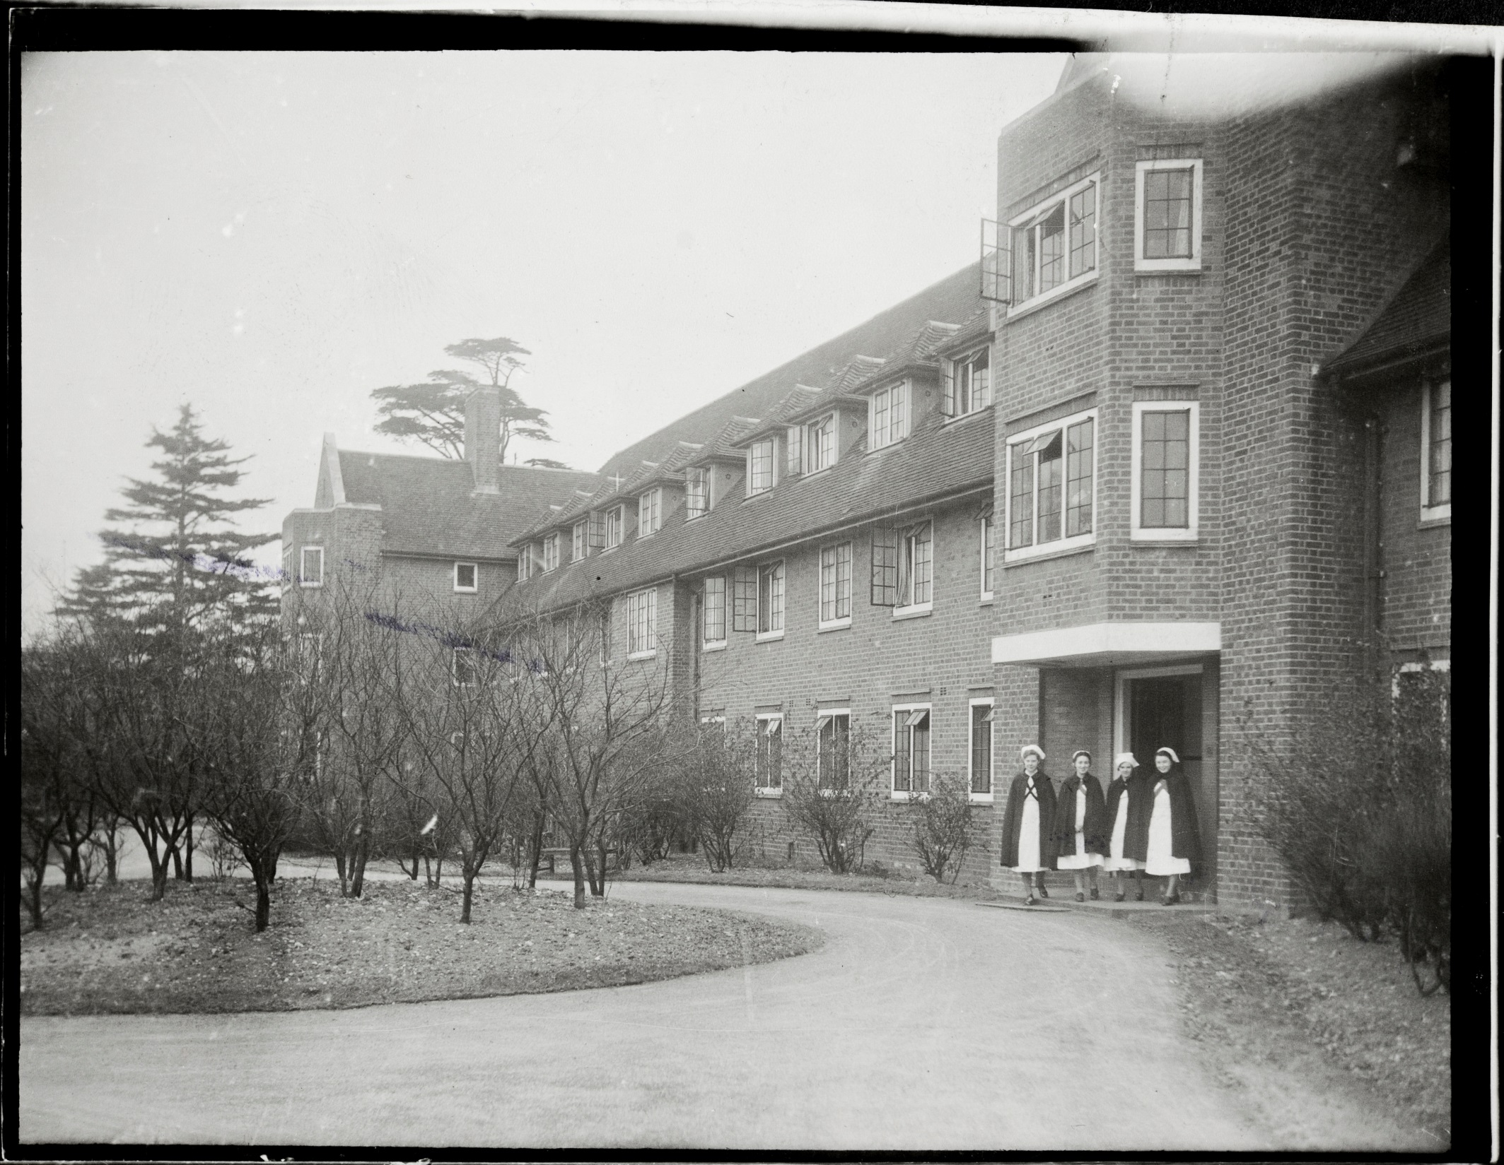
Activity
The following archive photos show places designed to treat patients with these diseases. They were all taken in specialist hospitals, just like the Nightingale ones today.
Look closely at the photos. Think about the different ways you could categorise the photos, to help you examine them as primary evidence.
Here are some suggestions to get you started:
Photos taken inside/outside
Photos with/without patients
Photos with adults/children
Photos with/without specialist equipment
What other categories could you come up with?
Notes:
Image: © Source: Historic England Archive. An exterior view of the nurses' home at Harefield (TB) Sanatorium, Harefield Sanitorium, Harefield, Greater London – 8th March 1942 Ref:med01_01_2717

Slide 11
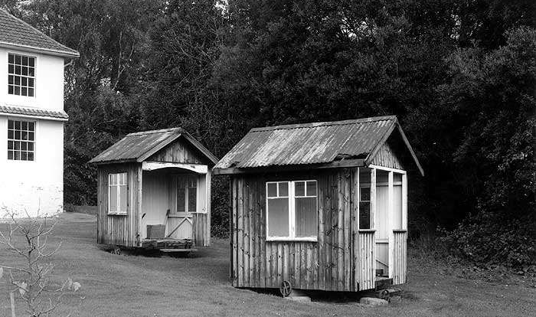
Revolving sleeping chalets for TB patients, Mundesley Hospital, Mundesley
Notes:
Image: © Crown copyright.NMR Historic England Archive. Shelters at Mundesley Hospital, Norfolk - September 1992 Ref:bb92/07249
Fresh air formed an important part of the treatment for tuberculosis, with many hospitals using open windows and balconies. These revolving sleeping chalets were a feature of the treatment at Mundesley Hospital from around 1900. Note how the huts are on wheels so that they can moved to face into the sun or wind to provide the best ‘fresh air’ for the patients. Mundesley Hospital was established by F W Burton-Fanning - as a TB sanatorium for rich patients. It was one of the first private TB sanatoria and the first large one to be built in England. It was modelled on TB sanatoria in Germany and Switzerland where open-air treatment had been pioneered.

Slide 12
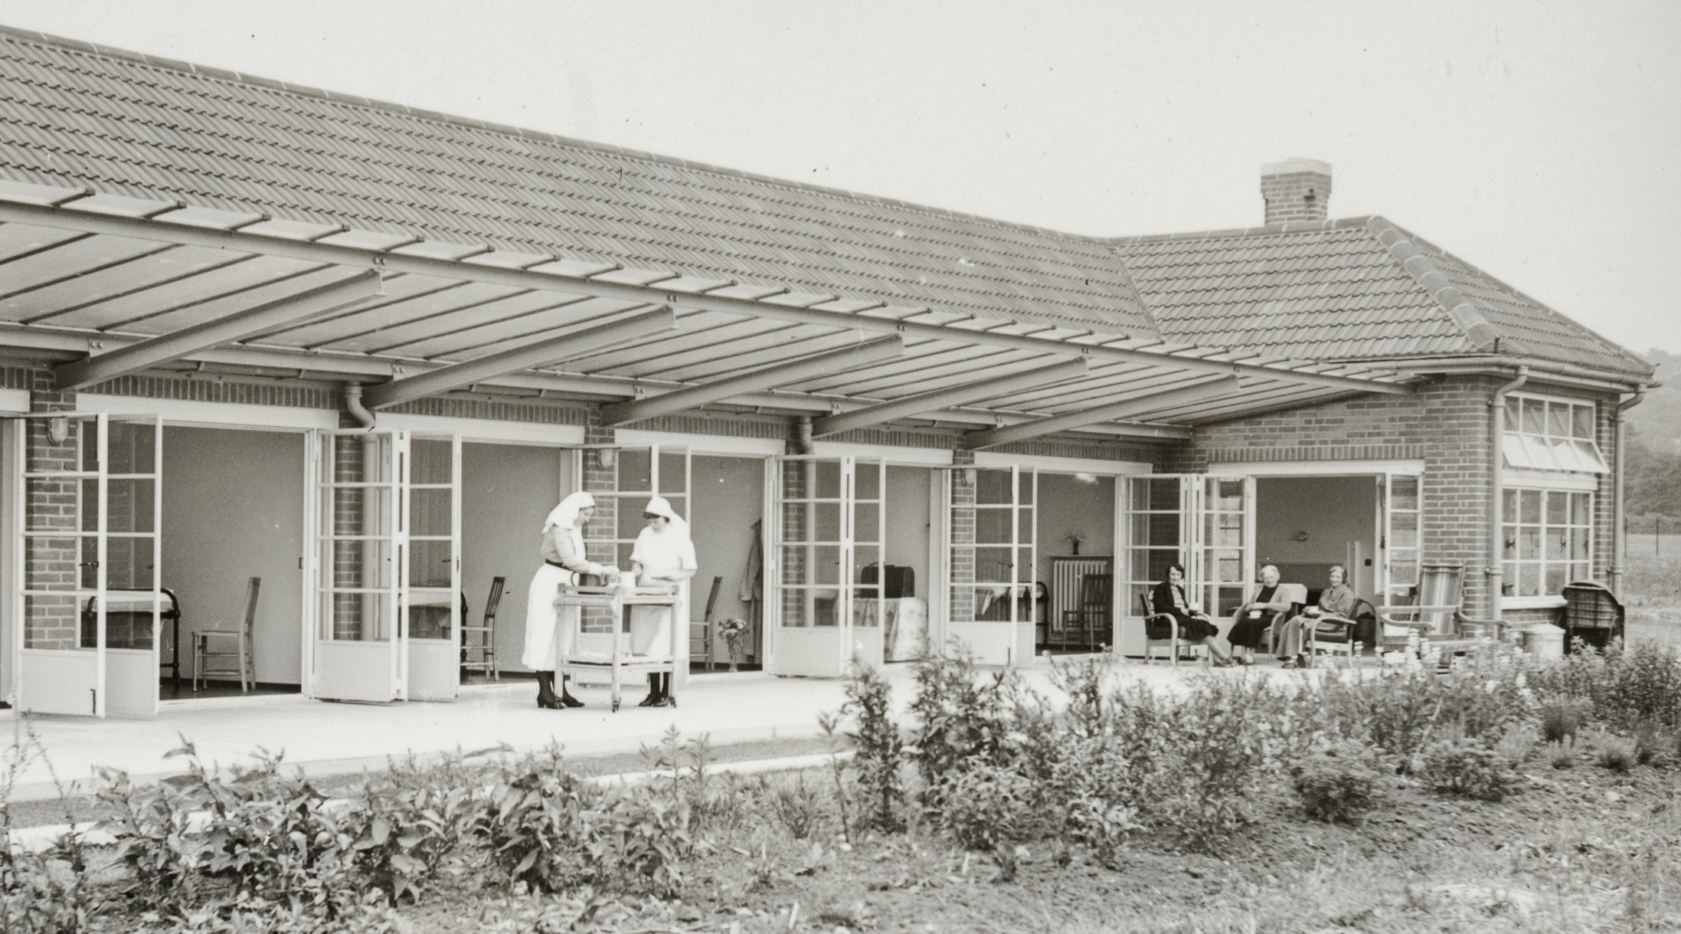
The open-air women's ward and veranda at Cold Arbour Hospital, Oxford
Notes:
Image: © Source: Historic England Archive. The exterior of the open-air women's ward and veranda at Cold Arbour Hospital, Oxford - 24th June 1939 Ref:med01_01_0428
The caption on the reverse of the photograph reads: “Oxford City isolation hospital, Oxford. Part of the women’s section of the open-air T.B. wards at the Oxford City Isolation Hospital, Oxford.”

Slide 13
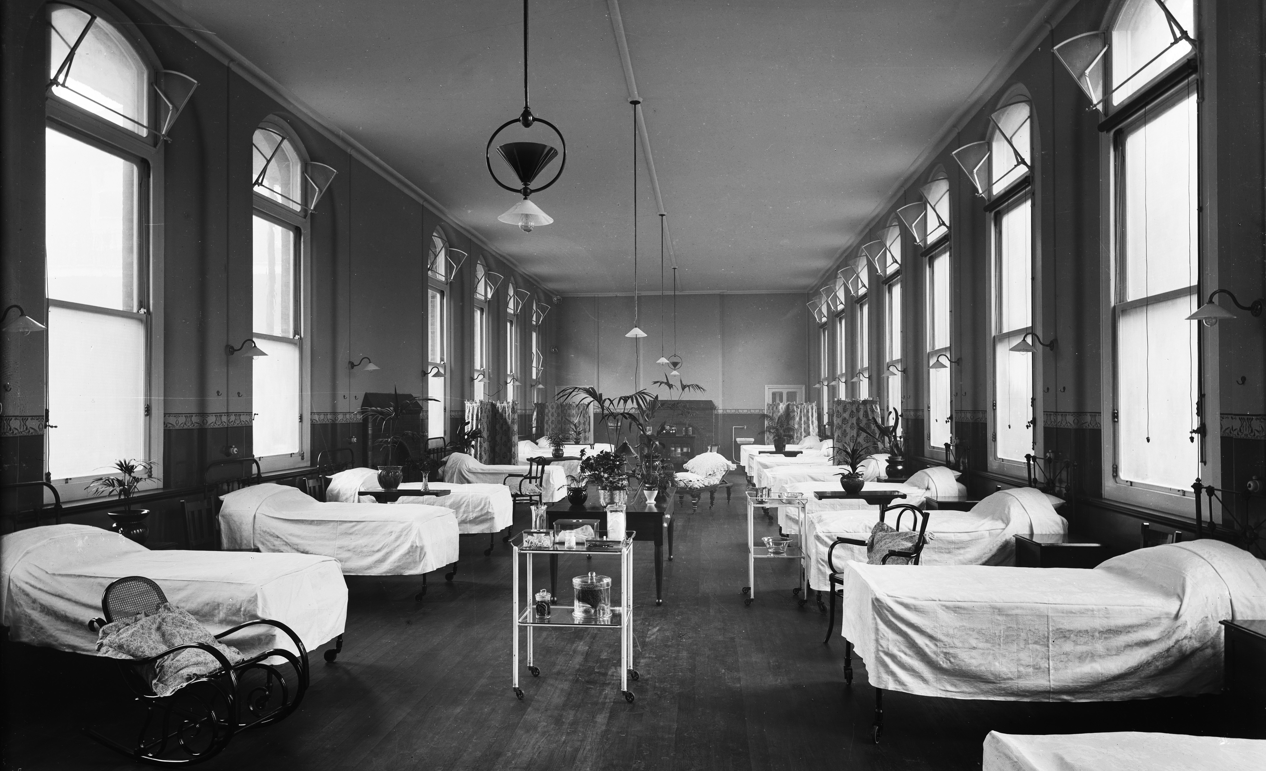
The Female Scarlet Fever Ward, London Fever Hospital, London
Notes:
Image: © Source: Historic England Archive. The Female Scarlet Ward at the London Fever Hospital, Liverpool Road, Islington, London – Jan-Feb 1908 Ref: bl20157
The London Fever Hospital was a voluntary run infectious diseases hospital founded in 1802, moving to Liverpool Road in 1848. This photograph shows a ward designed in the early 20th century by Keith Downes Young, architect to the London Fever Hospital for over 40 years.

Slide 14
Nurses outside the nurses' home, Harefield Sanatorium, Harefield
Notes:
Image: © Source: Historic England Archive. An exterior view of the nurses' home at Harefield (TB) Sanatorium, Harefield Sanitorium, Harefield, Greater London – 8th March 1942 Ref:med01_01_2717
The caption on the reverse of the photograph reads: “Training in a T.B. hospital (Pictures taken at Harefields Hospital, (Middlesex County Council) Middlesex) Picture shows part of the exterior of the fine Nurses’ Home at Harefields Hospital, Middlesex.”
Nurses caring for patients with TB also lived alongside them at the hospital. Whilst not in full isolation, keeping all the nurses saying ‘on-site’ was designed to increase efficiency and help reduce the risk of spreading infection to the wider population.

Slide 15
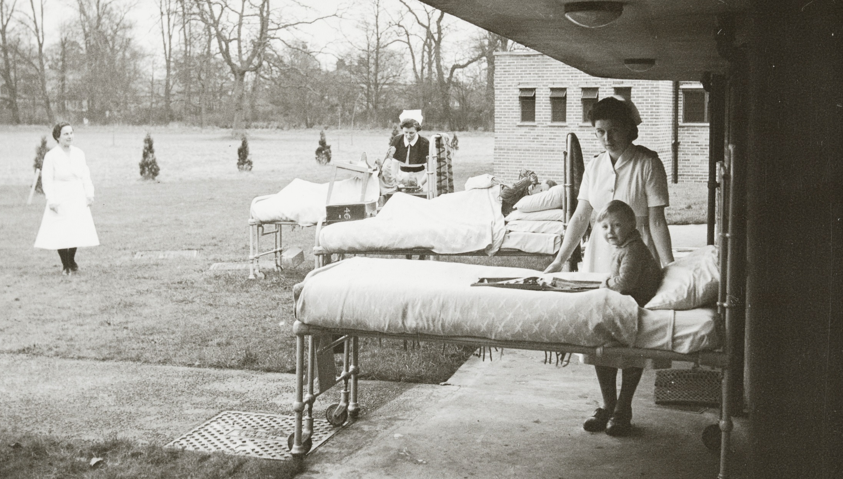
Treatment of TB children outside in their beds, Harefield Santorium, Harefield
Notes:
Image: © Source: Historic England Archive. Treatment of T.B. children, patients in their beds under the verandah alongside the wards, Harefield Sanitorium, Harefield, Greater London - 8th March 1942 Ref: med01_01_2726
Harefield Sanatorium opened in 1921, on the site of a the First World War auxiliary hospital, for the treatment of tuberculosis patients. Children may have stayed at the sanatorium for up to a few years whilst undergoing treatment. Fresh air was advocated as a key factor in the treatment of tuberculosis. Patients were exposed to fresh air in ‘open air wards’ or taken out onto verandas or into gardens. The hospital became world-renown for the treatment of lung and respiratory conditions.

Slide 16
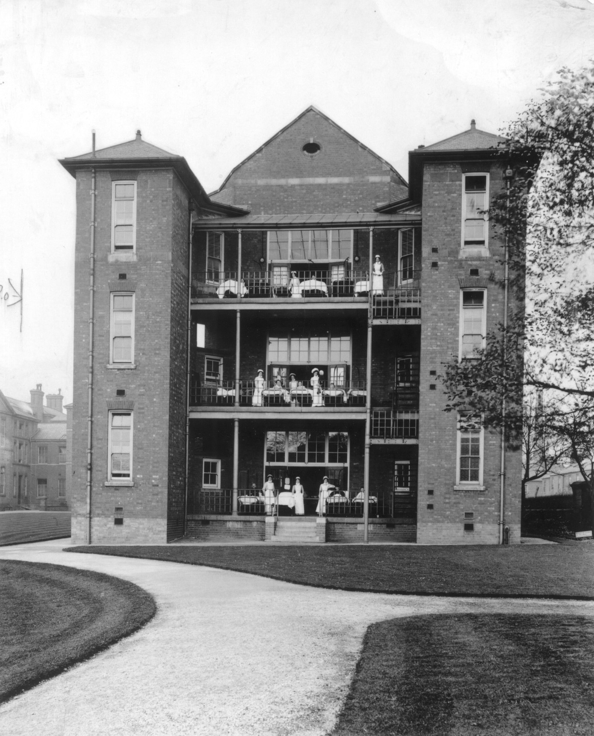
Beds on balconies at Leicester Royal Infirmary, Leicester
Notes:
Image: © Crown copyright.NMR Historic England Archive. Beds on balconies at Leicester Royal Infirmary – date unknown Ref: bb92/04314
Leicester Royal Infirmary was built on the pavilion plan in 1771, and the ward blocks are typical of those built throughout the country in the late 19th century. Towers containing the sanitary facilities flank sun balconies where patients' beds have been wheeled.

Slide 17
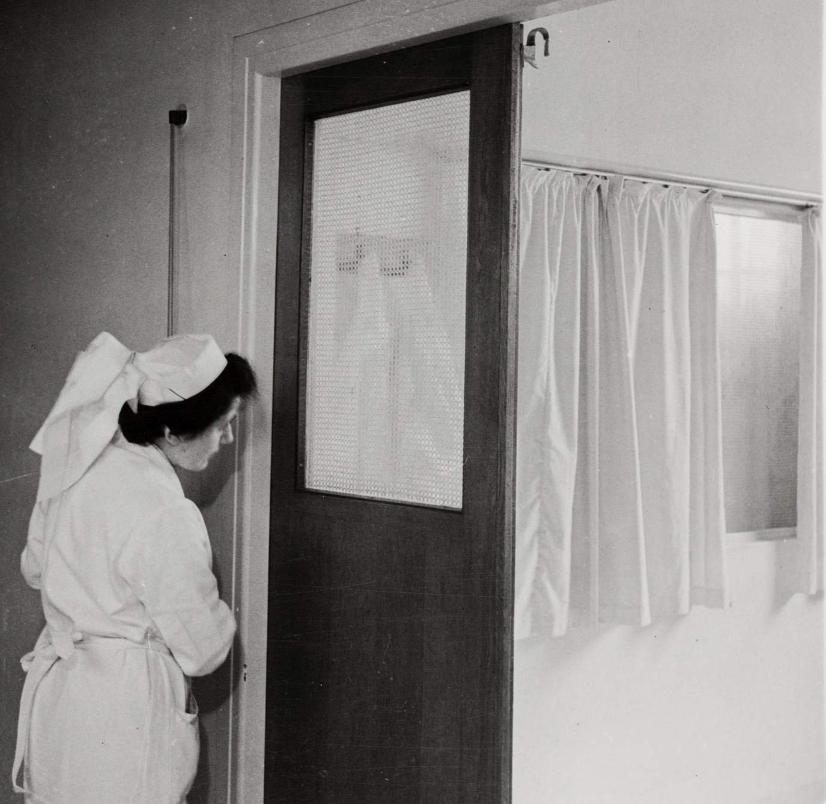
Nurse using a pulley in the corridor to draw the curtains on a ward in an isolation block, St Helier Hospital, Sutton.
Notes:
Image: © Source: Historic England Archive. A nurse using a pulley in the corridor to draw the curtains in a ward of the isolation block at St Helier Hospital, Sutton, Greater London Authority - 27th April 1943Ref:med01_01_3757
The caption on the reverse of the photograph reads: “St. Helier’s Hospital Surrey. Pic shows how the nurse can from the corridor in the isolation block draw the curtains inside an infectious ward.”
The hospital was commissioned in 1934, as part of the St Helier council estate. Queen Mary laid the foundation stone for the new hospital in March 1938 and it received its first patients in February 1941.Find out more about the St Helier Hospital and housing estate: https://ezitis.myzen.co.uk/sthelier.html

Slide 18

Child's room in the isolation block at Lodge Moor Hospital, Sheffield
Notes:
Image: © Source: Historic England Archive. A view into a young child's room in the isolation block at Lodge Moor Hospital, Sheffield – 12th December 1941 Ref:med01_01_2352

Slide 19
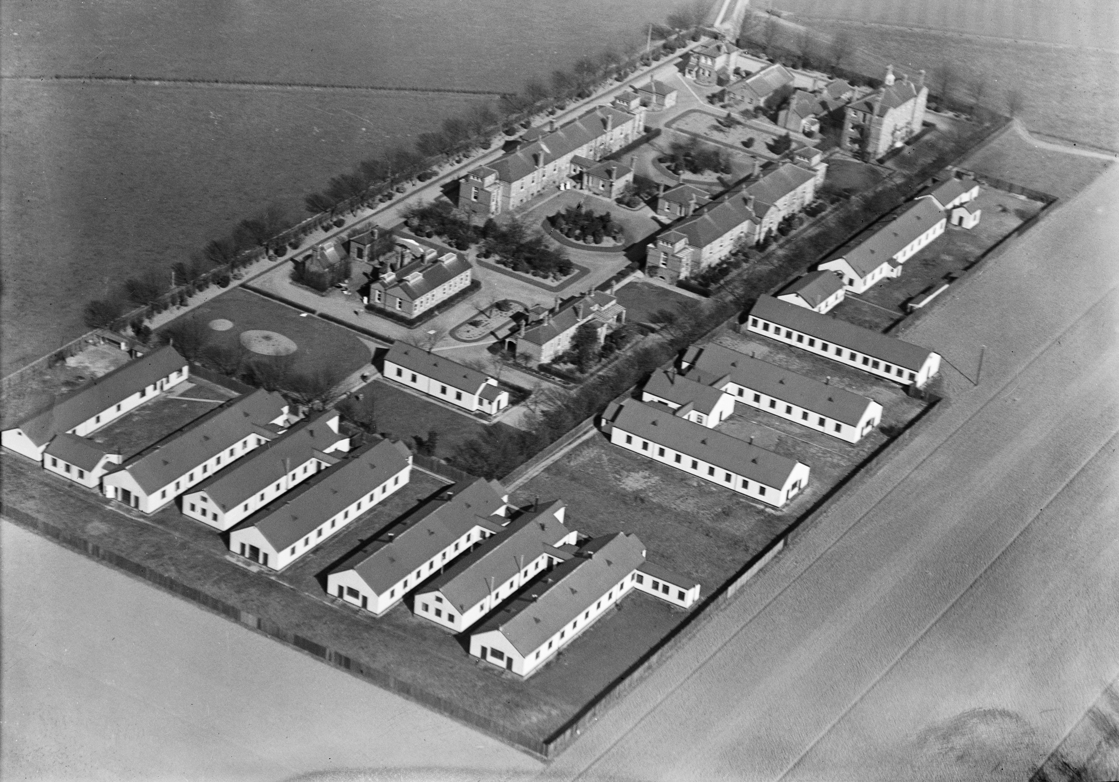
The Isolation Hospital, Dagenham, Greater London
Notes:
Image: © Historic England Archive (Aerofilms Collection). The Isolation Hospital, Dagenham, Greater London – January 1921 Ref: epw005337
This aerial photo of an isolation hospital shows how they were built on the edge of urban areas, surrounded only by fields where possible. The Dagenham Sanatorium, Rainham Road South, was opened in 1899 as a smallpox hospital for the county borough of West Ham, and later became a tuberculosis sanatorium. (fn. 286). https://www.british-history.ac.uk/vch/essex/vol5/pp281-294 Find more information here: https://ezitis.myzen.co.uk/dagenham.html

Slide 20
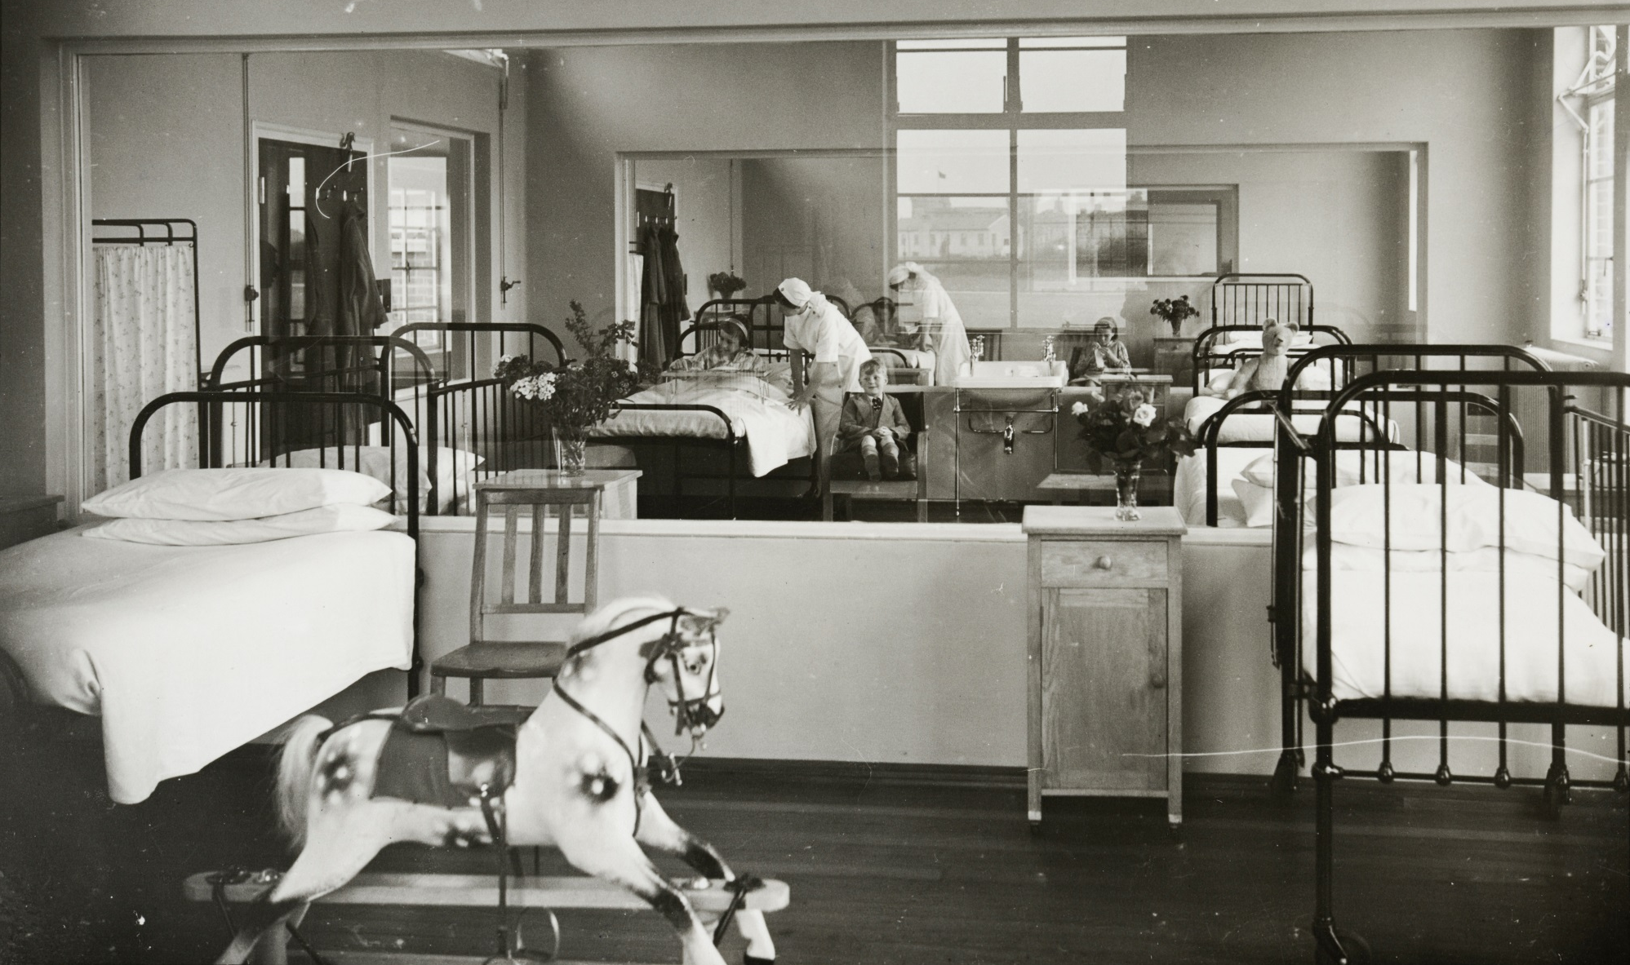
Three children’s wards, each isolated from the others by large internal windows, so children and nurses could still see each other, Cold Arbour Hospital, Oxford
Notes:
Image: © Source: Historic England Archive. A view of three wards, each separated from the others by large internal windows, at Cold Arbour Hospital, Oxford – 10th May 1943 Ref:med01_01_0429
The caption on the reverse of the photograph reads: “Oxford City isolation hospital, Oxford. Three wards in one. This picture, taken in the scarlet fever block of the Oxford City Isolation Hospital, shows three separate wards in one each being separated from the other by a large sheet of glass. Each section has four beds in it.”

Slide 21
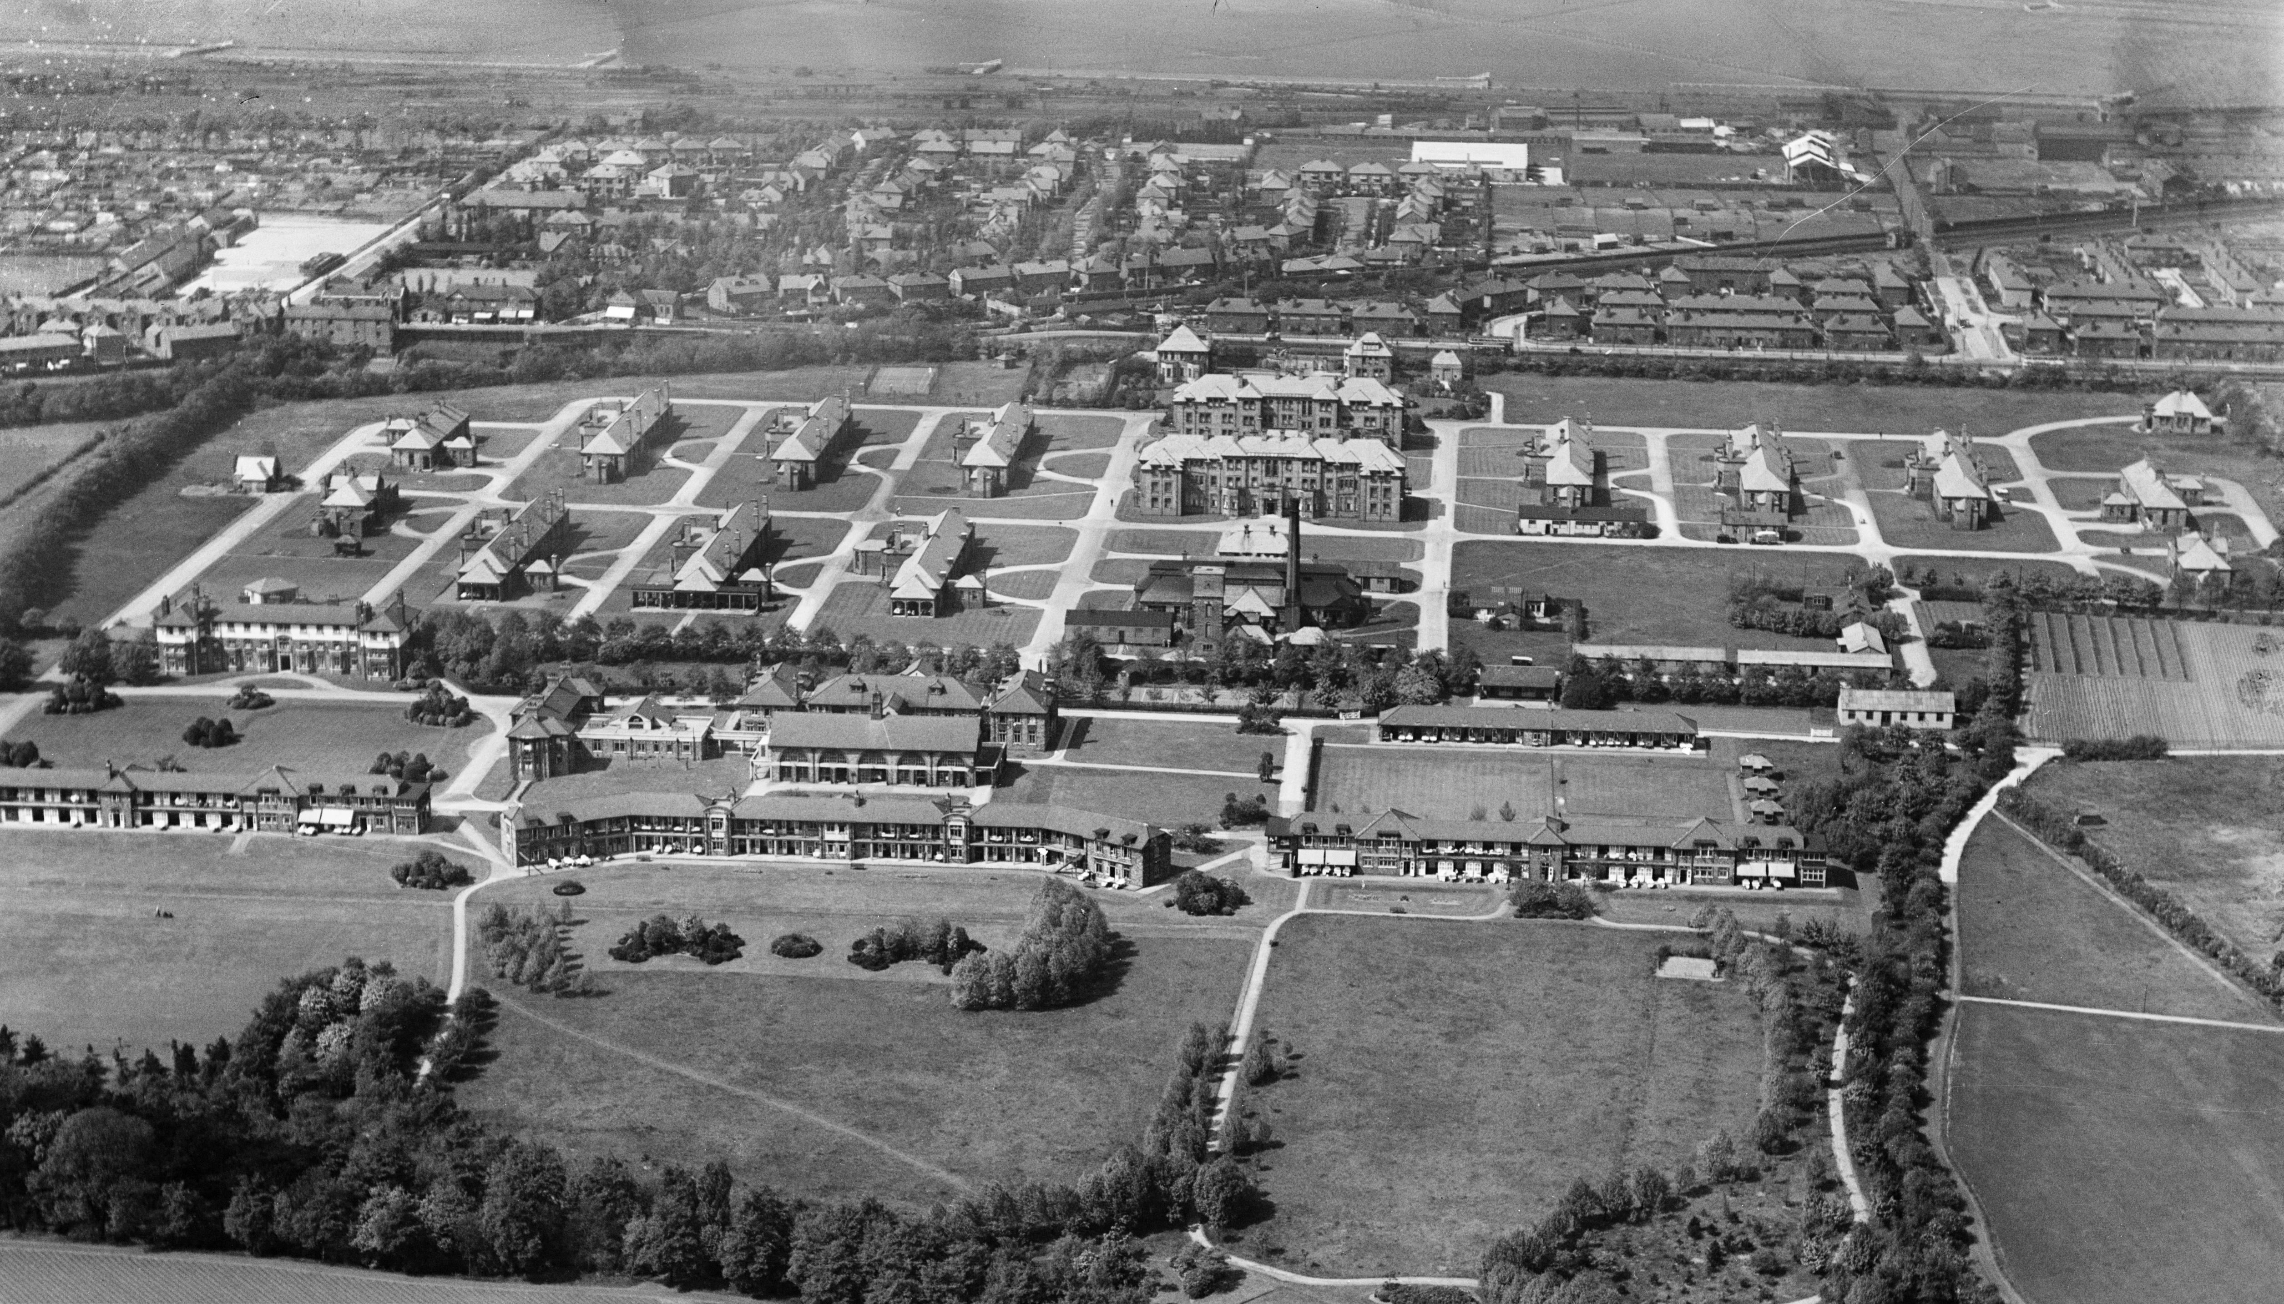
Fazakerley Sanatorium and Isolation Hospital, Lower Lane, Fazakerley, Liverpool
Notes:
Image: © Historic England Archive (Aerofilms Collection). Fazakerley Sanatorium and Isolation Hospital – May 1935 Ref: epr000615
Fazakerley Sanatorium was opened on the 8th October 1920 by Dr John Utting JP. It was built to house 245 pulmonary TB patients - http://lostliverpool.blogspot.com/2008/02/history-of-university-hospital-aintree.html “…if children with tuberculosis were admitted, they would often have their brother or sister admitted with them to keep them company.” Find out more from people who worked there: https://www.liverpoolecho.co.uk/news/health/a-history-of-healthcare-3492855

Slide 22
Research Task
The following archive photos show equipment designed to treat patients with these diseases. They were all taken in specialist hospitals, just like the Nightingale ones today.
Divide into groups, each group should look at a specific photo.
Think about what each piece of equipment was designed to do. Assign each one of the following functions: diagnosis, treatment, prevention.
Then research your piece of equipment online and produce a short summary to share with the class – so that everyone then understands the function and importance of each piece of equipment in the treatment of infectious diseases.
Notes:
This task could also be done remotely be assigning each student a particular photo to focus on and then asking them to write their summary and email it to the teacher.

Slide 23
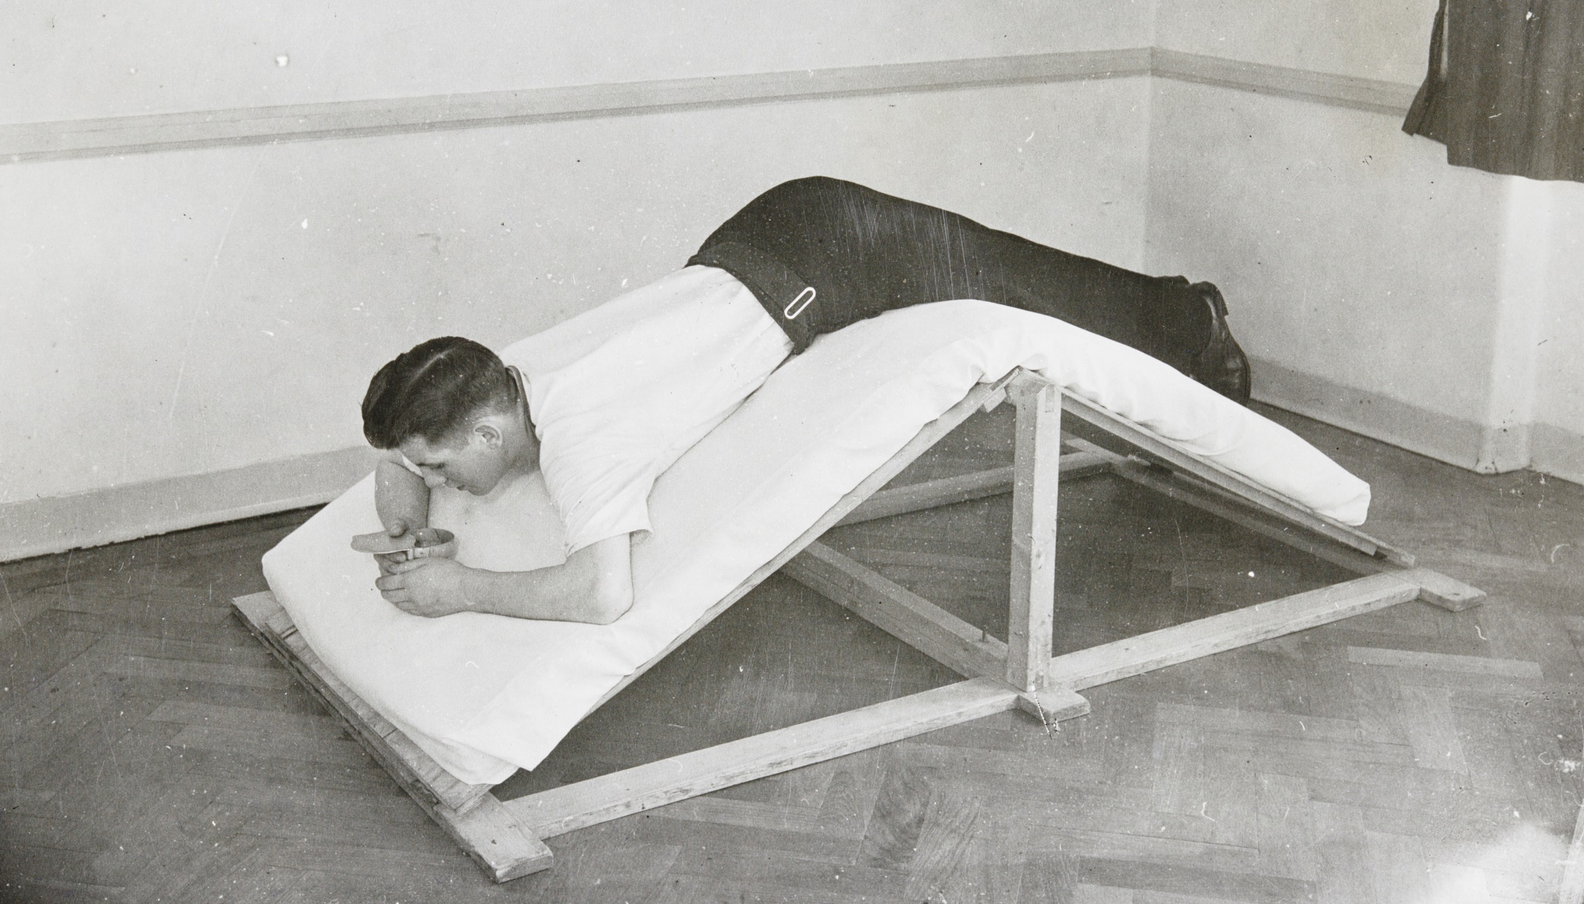
A TB patient on a postural drainage frame, Harefield Sanatorium, Harefield
Notes:
Image: © Source: Historic England Archive. A patient positioned on a postural drainage frame, at Harefield Sanatorium, Harefield, Greater London- 9th October 1942 Ref:med01_01_3318
“Tuberculosis treatment. Picture shows a postural drainage frame in use.” The hospital became world-renown for the treatment of lung and respiratory conditions. Postural drainage refers to the clearing of mucus from the lungs using gravity. This was to help patients to breath more easily.

Slide 24
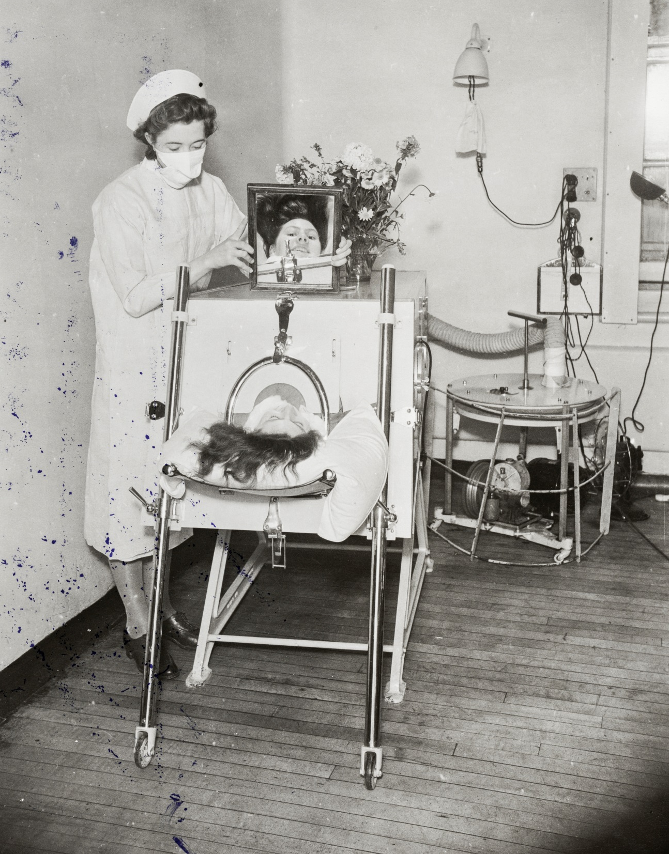
A nurse attending to a patient in an iron lung, Central Middlesex County Hospital, Brent
Notes:
Image: © Source: Historic England Archive. A nurse attending to a patient in an iron lung at Central Middlesex County Hospital, Brent, London – 18th July 1941 Ref:med01_01_1912
The caption on the reverse of the photograph reads: “Infantile paralysis in an iron lung. Picture shows Jean Mary Ashworth, aged 15, who suffering from anterior polioencephalitis was placed in a Both respirator cabinet.”
Polioencephalitis, a viral infection of the brain resulting in inflammation of the brain’s grey matter, is caused by the poliomyelitis virus. In the 1930s it was believed that poliomyelitis and polioencephalitis were “the same disease”. The Both respirator, a negative pressure ventilator, was invented by Edward Both in 1937. It was cheaper than alternative models of the iron lung, and could be constructed and transported with more ease. Iron lungs enabled patients to breathe when muscle control had been lost or when breathing exceeded their ability, but are now largely obsolete.

Slide 25
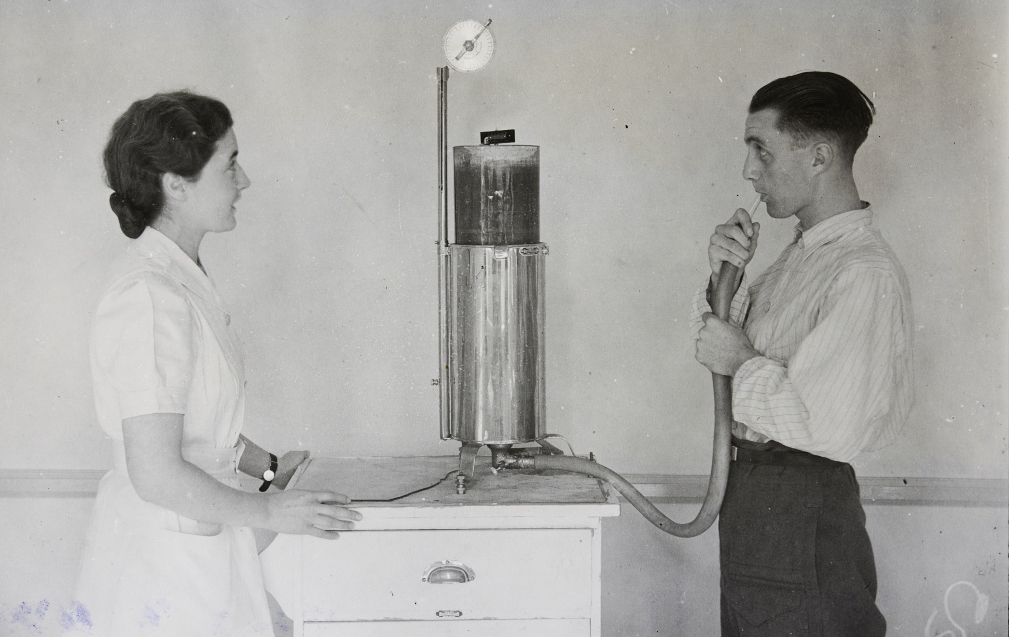
A TB patient using a spirometer to test his lungs, Harefield Sanatorium, Harefield
Notes:
Image: © Source: Historic England Archive. A nurse observing a patient whilst using a spirometer to test his lung function, Harefield Sanatorium, Harefield, Greater London - 9th October 1942 Ref:med01_01_3319
“Tuberculosis treatment. Picture shows the measurement of vital capacity with a spirometer.” A spirometer tests the function of a patient’s lungs and is used to assess the progress of disease or treatment. It records a patient’s total vital capacity – the total volume of air breathed out.

Slide 26
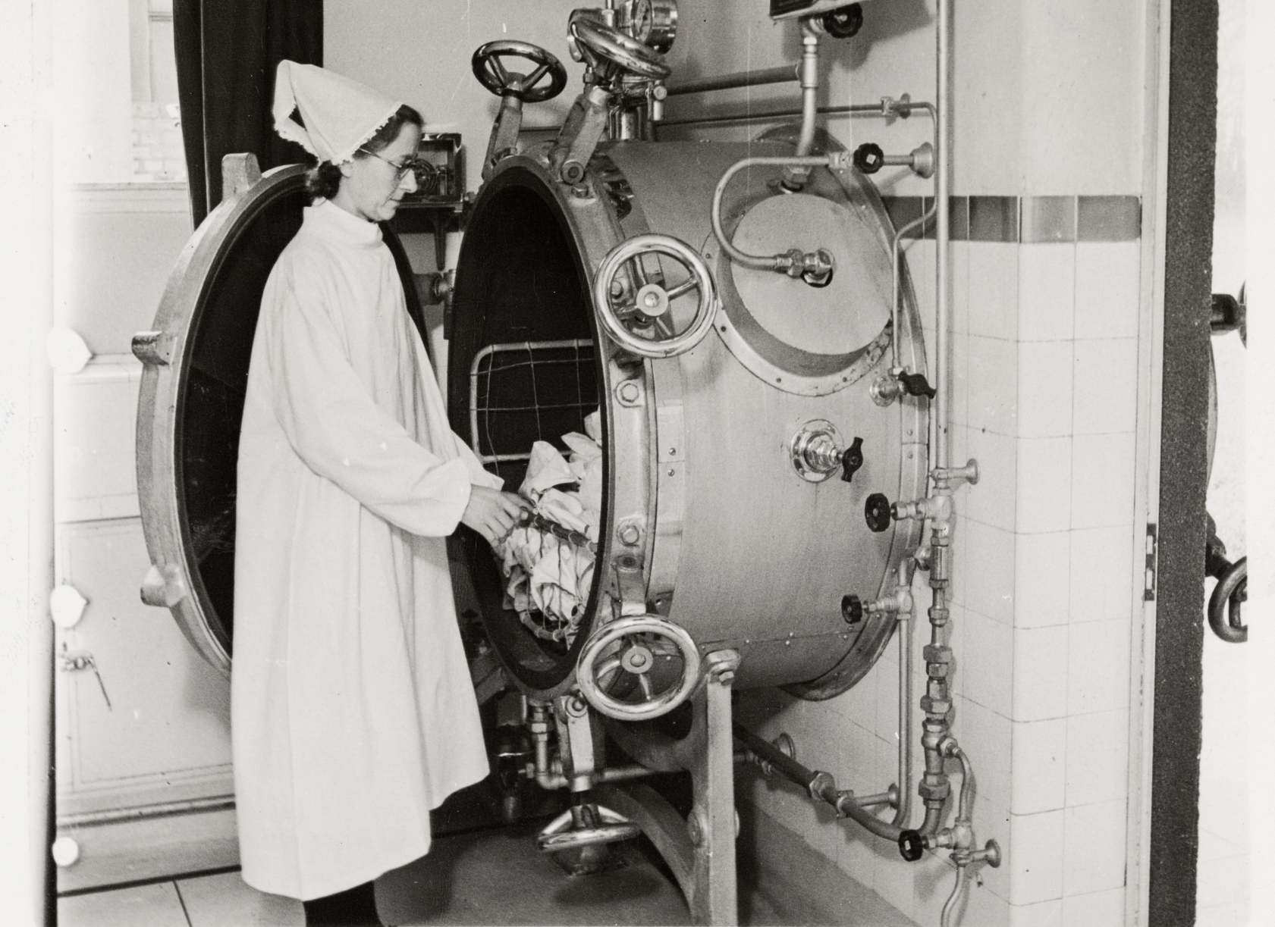
Nurse placing linen into a steriliser on an isolation block, St Helier Hospital, Sutton
Notes:
Image: © Source: Historic England Archive. A nurse placing linen into a steriliser, in the isolation block at St Helier Hospital, Sutton, Greater London Authority - 27th April 1943 Ref:med01_01_3758
The caption on the reverse of the photograph reads: “St. Helier’s Hospital Surrey. Pic shows the linen steriliser in the isolation block. Soiled linen is seen being placed in the steriliser, and after autoclaving it will be removed from the other end outside the isolation block.”
The hospital was commissioned in 1934, as part of the St Helier council estate. Queen Mary laid the foundation stone for the new hospital in March 1938 and it received its first patients in February 1941. Find out more about the St Helier Hospital and housing estate: https://ezitis.myzen.co.uk/sthelier.html

Slide 27
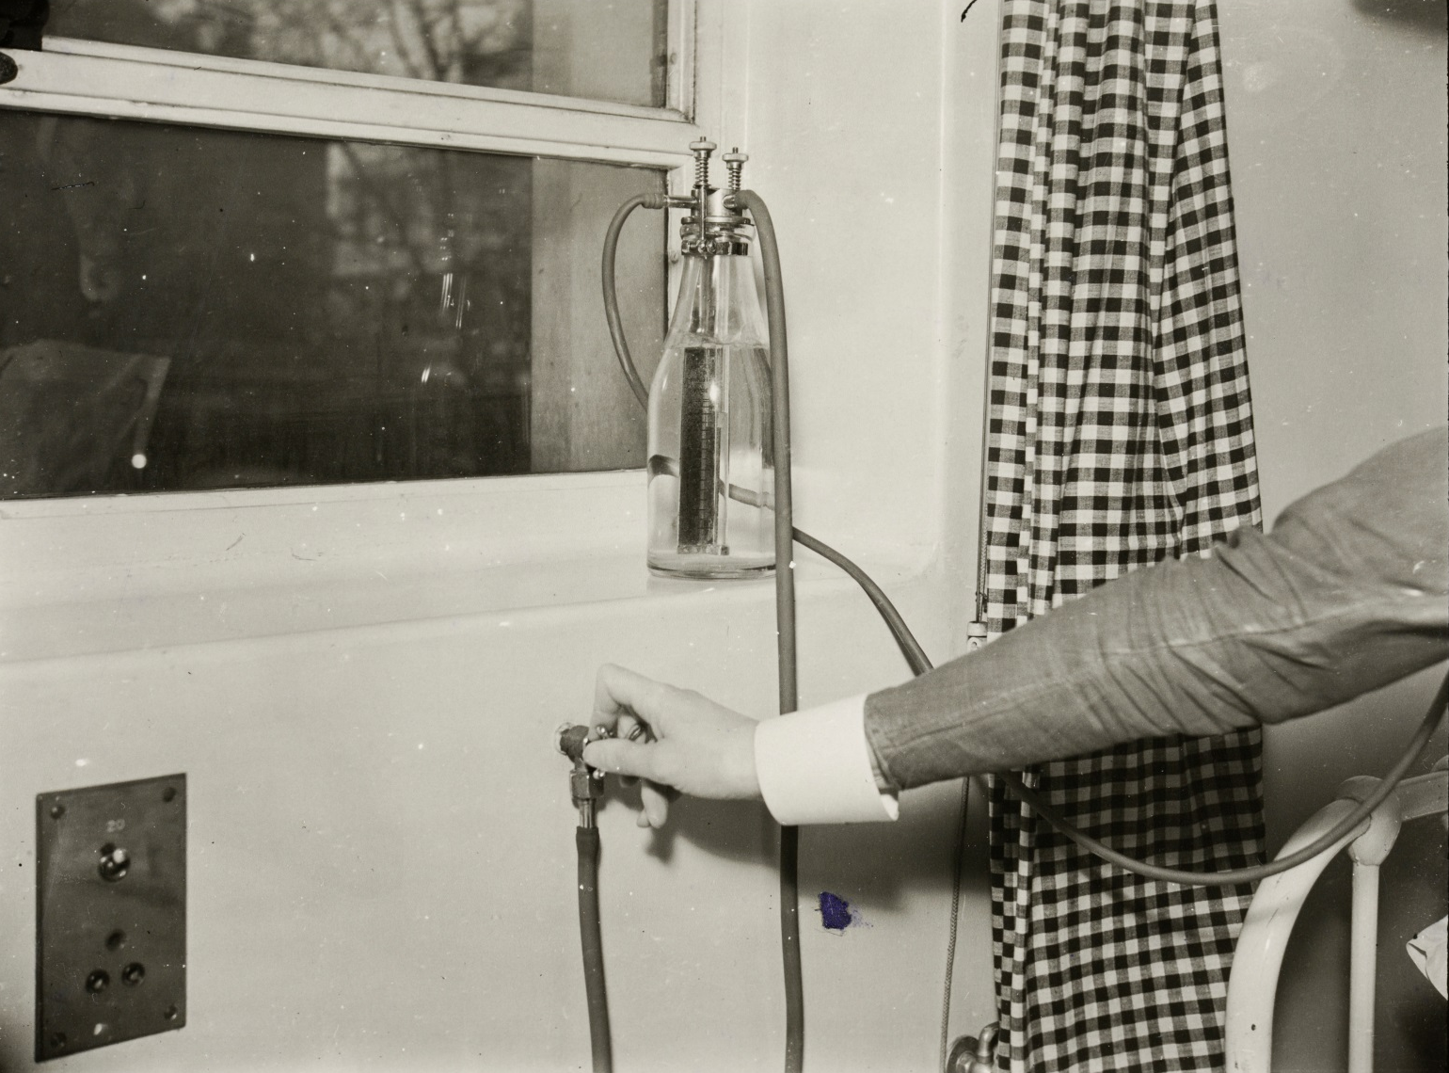
Administering oxygen beside a patient's bed, St Bartholomew's Hospital, London
Notes:
Image: © Source: Historic England Archive. A stop-cock and flow-meter for administering oxygen beside a patient's bed at St Bartholomew's Hospital – 3rd February 1939 Ref:med01_01_0179.
The image was originally titled ‘These gases give life’. Here the oxygen coming via the pipeline from the left-hand group of cylinders issues besides the patient’s bed, and under the control of the nurse at the stop-cock passes through the flow-meter, which indicates in litres per minute the amount of oxygen the patient is receiving. The piped provision of oxygen to patient’s in bed was an important invention – which led the way to the creation of other assisted breathing equipment, such as ventilators

Slide 28
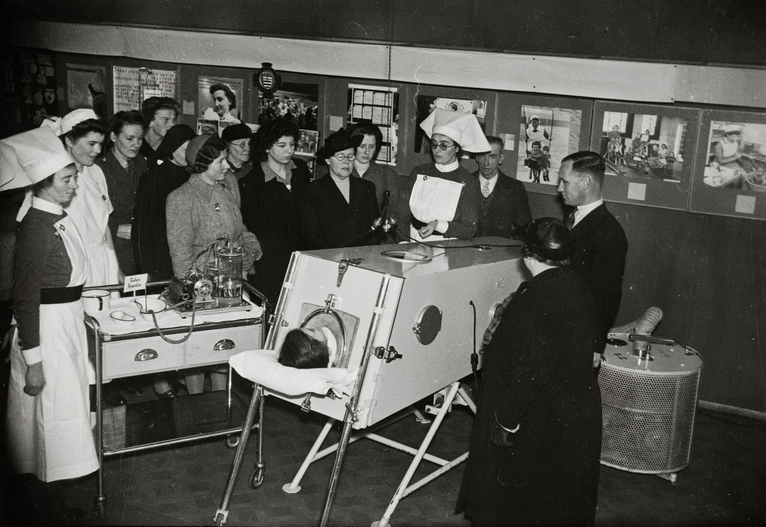
Nurses demonstrating the use of an iron lung, London
Notes:
Image: © Source: Historic England Archive. Nurses demonstrating the use of an iron lung to group of women, at an exhibition of nursing, Oxford Street, London – 12th December 1941 Ref:med01_01_3855
The caption on the reverse of the photograph reads: “L.C.C. Nurses Demonstrate the Iron Lung to Intending Nurses. Pic shows Sister Pike, of Grove (L.C.C.) Hospital, demonstrating the iron lung to intending nurses at the nursing exhibition in Oxford Street, London. Mile End Hospital nurses also assisted.” Iron lungs, or negative pressure ventilators, enabled patients to breathe when muscle control had been lost or when breathing exceeded their ability. Often used to treat patients with poliomyelitis, the machine is now largely obsolete.

Slide 29
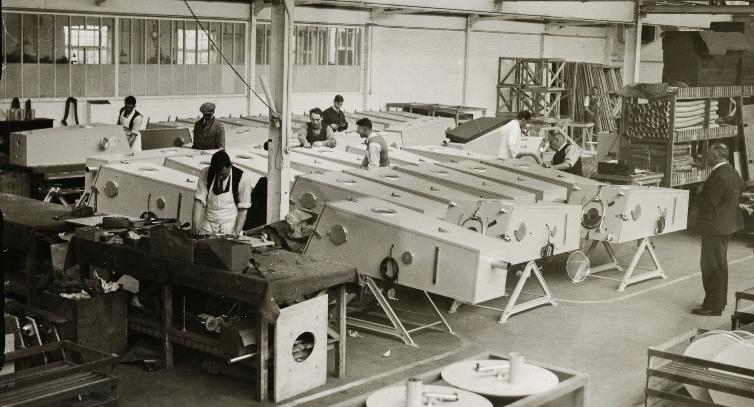
Making iron lungs, Morris Motor Works, Cowley, Oxford
Notes:
Image: © Source: Historic England Archive. A scene in a factory producing iron lungs at the Morris Motor Works, Cowley, Oxfordshire - 28th March 1939 Ref:med01_01_0323
The caption on the reverse of the photograph reads: “Iron lungs for Australia. Photo shows:- Work on the production of a consignment of 167 “iron lungs” for Australia proceeding apace at the Morris Motor Works at Cowley, Oxford. It will be remembered that Lord Nuffield, the car magnate, recently undertook to supply every hospital in the British Empire with an “iron lung”.”
The first iron lung in the UK was designed in 1933. In 1937, Australia was facing an epidemic of poliomyelitis, with iron lungs being one of the main methods of treating the illness’s complications. Lord Nuffield, having seen the iron lung in operation, offered part of his factory in Oxford to be taken over for the production of Both respirators, an affordable version of the iron lung. Over 1,700 of these respirators were distributed to hospitals following his offer to provide free iron lungs to any hospital in the Commonwealth that requested one. High-resolution copies of this image are available for free for non-commercial use. Please Enquire to place an order.

Slide 30
The caption on the reverse of the photograph reads: “Iron lungs for Australia.”
Photo shows:- Work on the production of a consignment of 167 “iron lungs” for Australia proceeding apace at the Morris Motor Works at Cowley, Oxford. It will be remembered that Lord Nuffield, the car magnate, recently undertook to supply every hospital in the British Empire with an “iron lung”.”
The first iron lung in the UK was designed in 1933. In 1937, Australia was facing an epidemic of poliomyelitis, with iron lungs being one of the main methods of treating the illness’s complications. Lord Nuffield, having seen the iron lung in operation, offered part of his factory in Oxford to be taken over for the production of respirators, an affordable version of the iron lung. Over 1,700 of these respirators were distributed to hospitals following his offer to provide free iron lungs to any hospital in the Commonwealth that requested one.
The same response, of an offer to help build respirators, was offered by many British companies at the start of the Covid-19 outbreak in early 2020.
Notes:
Image: © Source: Historic England Archive. A scene in a factory producing iron lungs at the Morris Motor Works, Cowley, Oxfordshire - 28th March 1939 Ref:med01_01_0323
The caption on the reverse of the photograph reads: “Iron lungs for Australia. Photo shows:- Work on the production of a consignment of 167 “iron lungs” for Australia proceeding apace at the Morris Motor Works at Cowley, Oxford. It will be remembered that Lord Nuffield, the car magnate, recently undertook to supply every hospital in the British Empire with an “iron lung”.”
The first iron lung in the UK was designed in 1933. In 1937, Australia was facing an epidemic of poliomyelitis, with iron lungs being one of the main methods of treating the illness’s complications. Lord Nuffield, having seen the iron lung in operation, offered part of his factory in Oxford to be taken over for the production of Both respirators, an affordable version of the iron lung. Over 1,700 of these respirators were distributed to hospitals following his offer to provide free iron lungs to any hospital in the Commonwealth that requested one. High-resolution copies of this image are available for free for non-commercial use. Please Enquire to place an order.

Slide 31
Activity
Having looked at a range of evidence discuss the following questions, making sure you can back up your points with specific examples.
How are people being treated?
Who is being treated – young, old, everyone?
What do the hospitals have in common?
Where you can clearly see the faces of people in the photos, what words would you use to describe their emotions?
From looking at the photos how do you think it felt to be in isolation?
Do you think it was the same experience for everyone?
Listen to the audio clips on the next slide – does this affect your thoughts?

Slide 32
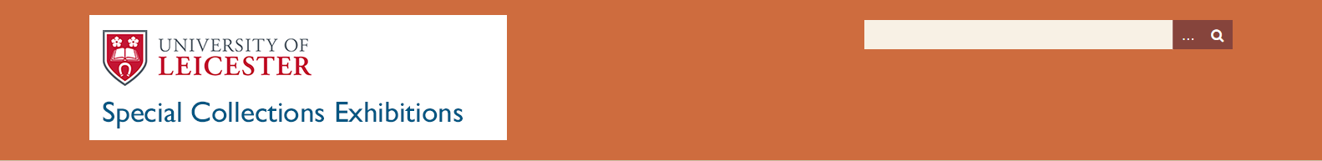
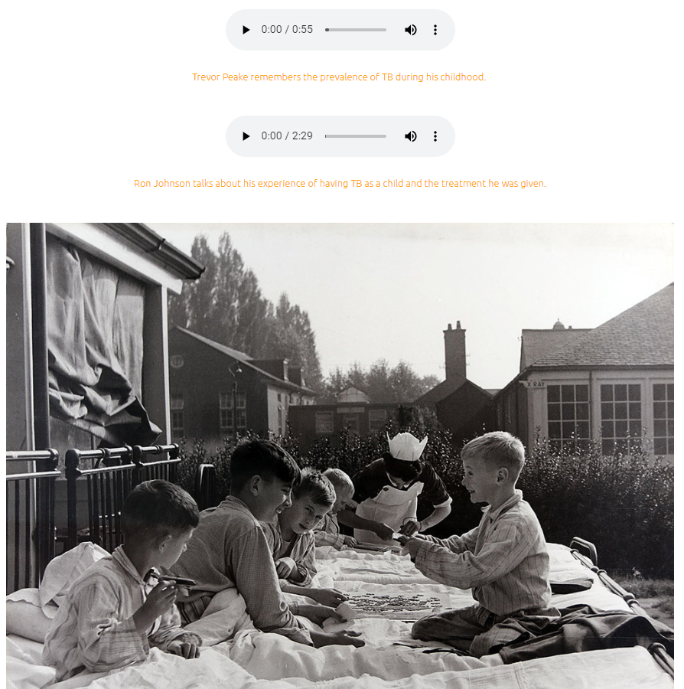
University of Leicester, Special Collections Exhibition on ‘The Post War History of Leicester 1945-1962 – Case Study TB’ has additional information on TB, including audio files.
They talk about with life with TB at the Groby Road Isolation Hospital, shown on the previous slide
Notes:
University of Leicester, Special Collections Exhibition on The Post War History of Leicester 1945-1962 – Case Study TB https://leicester.omeka.net/exhibits/show/postwar/health/tb
Excellent additional information on TB with audio and video files

Slide 33
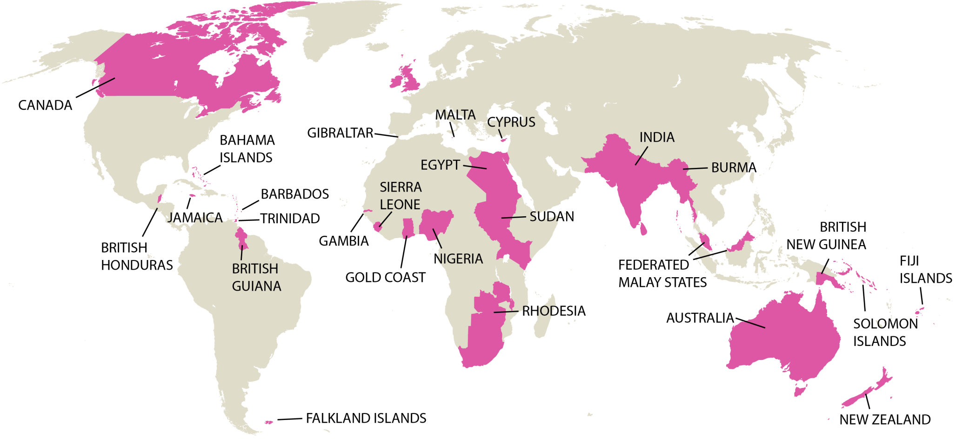
At the start of the 20th century, England was part of the British Empire.
This had an impact on our response to infectious diseases too! Quarantining ships arriving into ports was an important step in isolating infectious diseases. As was providing hospitals across the Empire.
Notes:
Image: © Historic England

Slide 34
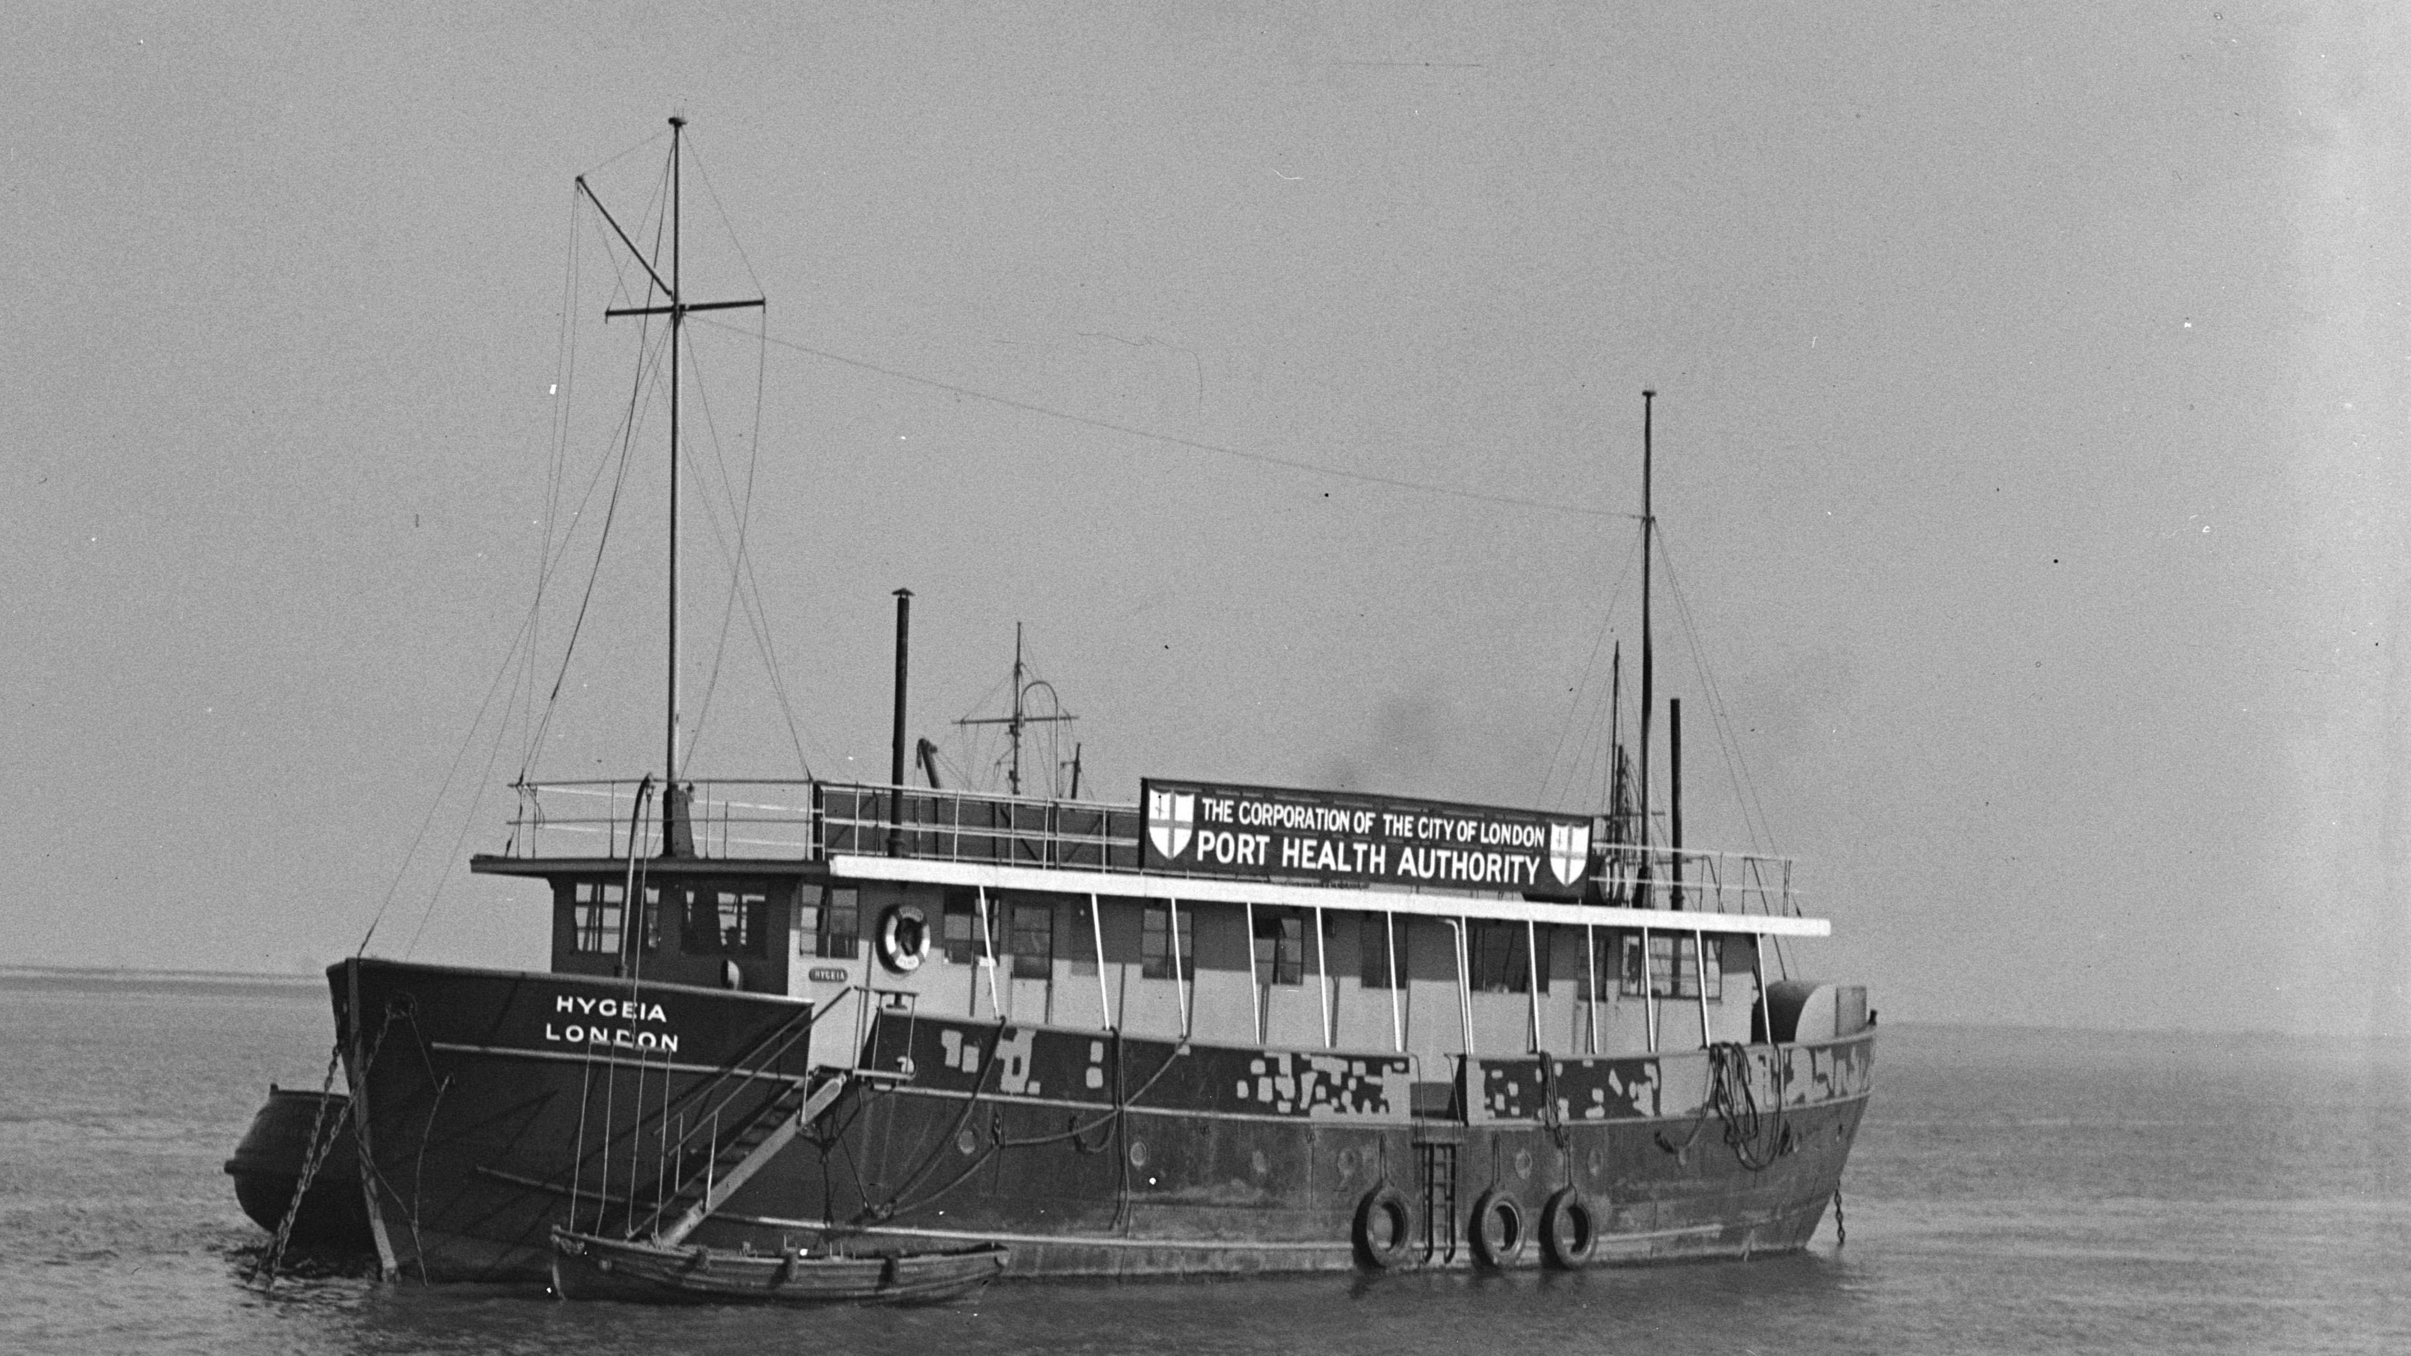
The Port Health Authority vessel, the 'Hygeia', moored on the water, Gravesend.
The Corporation of the City of London became responsible for preventing the spread of infectious diseases through the port in 1872.
Notes:
Image: © Historic England Archive. The Port Health Authority vessel, the 'Hygeia', moored on the water, Gravesend, Greater London. The Corporation of the City of London became responsible for preventing the spread of infectious diseases through the port in 1872. – Date: circa 1945 – circa1965Ref: AA001810
The Port of London Sanitary Authority, now the London Port Health Authority, based its operations at Gravesend where a hulk, the “Hygeia” was maintained as a quarantine station where accommodation was provided for the boarding medical officers who provided a service twenty four hours a day. Various quarantine launches were at the medical officers’ disposal, including, for example, the Humphrey Morris which was acquired in 1962 and had a consultation room, a small hospital with accommodation for two stretcher cases and three sitting patients. Up until 1978 the Port Health Authority’s team of doctors screened all vessels entering the Port of London and decided which ones should be boarded. In fact, all ships coming from areas known to have certain endemic diseases, such as Africa, Asia, Central and South America were boarded. In order to carry out these health checks, the Port Health Authority had to have accurate information on shipping. Therefore, all ships masters were required to radio ahead, giving the Authority at least four hours notice of their arrival, so that the authority had time to check where they had been and to make any necessary preparations. There are many accounts of different infectious diseases in the annual reports produced by the Medical Officer of Health for the Port Health Authority. These range from Malaria to Smallpox, and interestingly the 1957 report refers extensively to Asian Influenza and the arrangements being made to deal with the potential introduction of the disease via the port. One report refers to the SS Arcadia, a cruise ship, that had 176 out of its crew of 725 affected. Complete disinfection of all the accommodation had to be carried out and control measures were introduced to prevent further spread amongst other crew. From: https://www.gresham.ac.uk/lecture/transcript/download/front-line-infectious-disease-control-at-britains-borders/

Slide 35
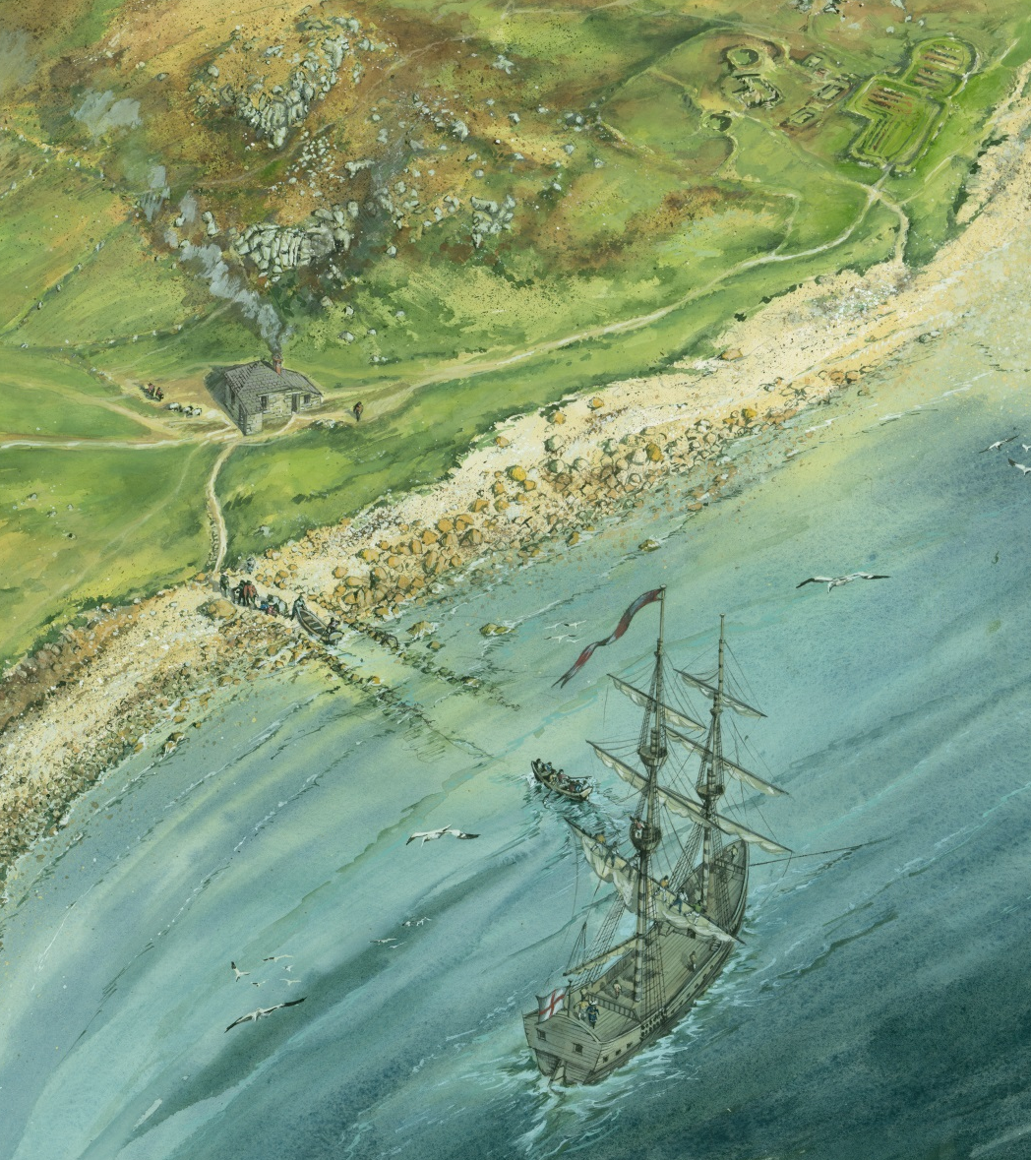
Plague ship and Quarantine Station (Pest House), St Helen’s, Isles of Scilly
A Quarantine Station was built on St Helens in 1764.
Any plague-ridden ship to the north of Cape Finisterre and heading for England was required to anchor in St Helen's Pool.
The quarantine station had a national role, as an attempt to safeguard the country from ship-borne infectious diseases arriving via the Western Approaches.
St Helen’s was chosen as it was uninhabited. The facility remained open in 1850, but was officially closed under the Public Health Act, 1896.
Notes:
Image: © Historic England Archive. Reconstruction illustration depicting an aerial view of a plague-ridden ship anchored in St Helen's Pool near the Pest House, a Quarantine Station on St Helen's in the Isles of Scilly, as it may have looked in the late-eighteenth century – Date: circa 1995 - circa 2005 Ref: IC171/004

Slide 36
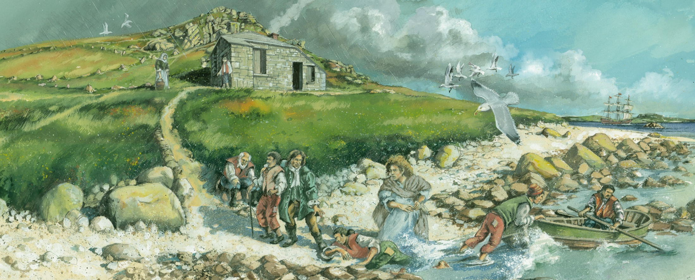
This illustration shows passengers from a plague-ridden ship being brought ashore to stay in the ‘Pest House’.
Unfortunately survival rates were low, even if you arrived with a minor ailment. There was no segregation of diseases, and bedding etc. was re-used and shared. So you were likely to catch/die from something worse after your arrival!
Notes:
Image: © Historic England Archive. Reconstruction illustration showing passengers from a plague-ridden ship being brought ashore near St Helen's Quarantine Station, known as the Pest House, in the Isles of Scilly in the late-eighteenth century – Date: circa 1995 - circa 2005 Ref: IC171/005

Slide 37
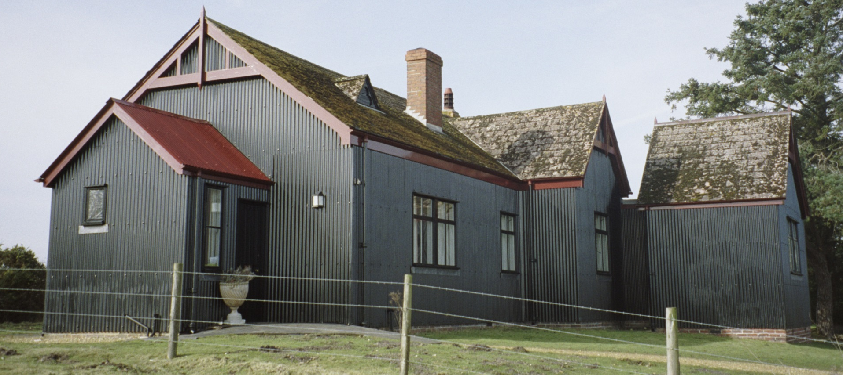
Former Isolation Hospital, Arne, Dorset
This isolation hospital dates from the early 1900s. It was built to a pre-fabricated system by Humphrey's of Knightsbridge. It was recommended as a model pre-fabricated isolation hospital. Hospitals like this were once important in the treatment of infectious diseases in Britain and the Empire.
Notes:
Image: © Rev Andrew Salmon. Source Historic England Archive. Former Isolation Hospital, Arne, Dorset – 27th February 2006 Ref: IOE01/15293/08
This isolation hospital dates from the early 1900s. It was built to a pre-fabricated system by Humphrey's of Knightsbridge. It was type 3 of their range as published in their 1900 catalogue. It is a single storey building with two wards reached via external porches, one on each side of the kitchen, bathroom, store, washroom. There are three asymmetrically placed bedrooms all reached via a lobby placed off-centre. It was recommended as a model pre-fabricated isolation hospital. Hospitals like this were once important in the treatment of infectious diseases in Britain and the Empire. This is now the best preserved example left.

Slide 38
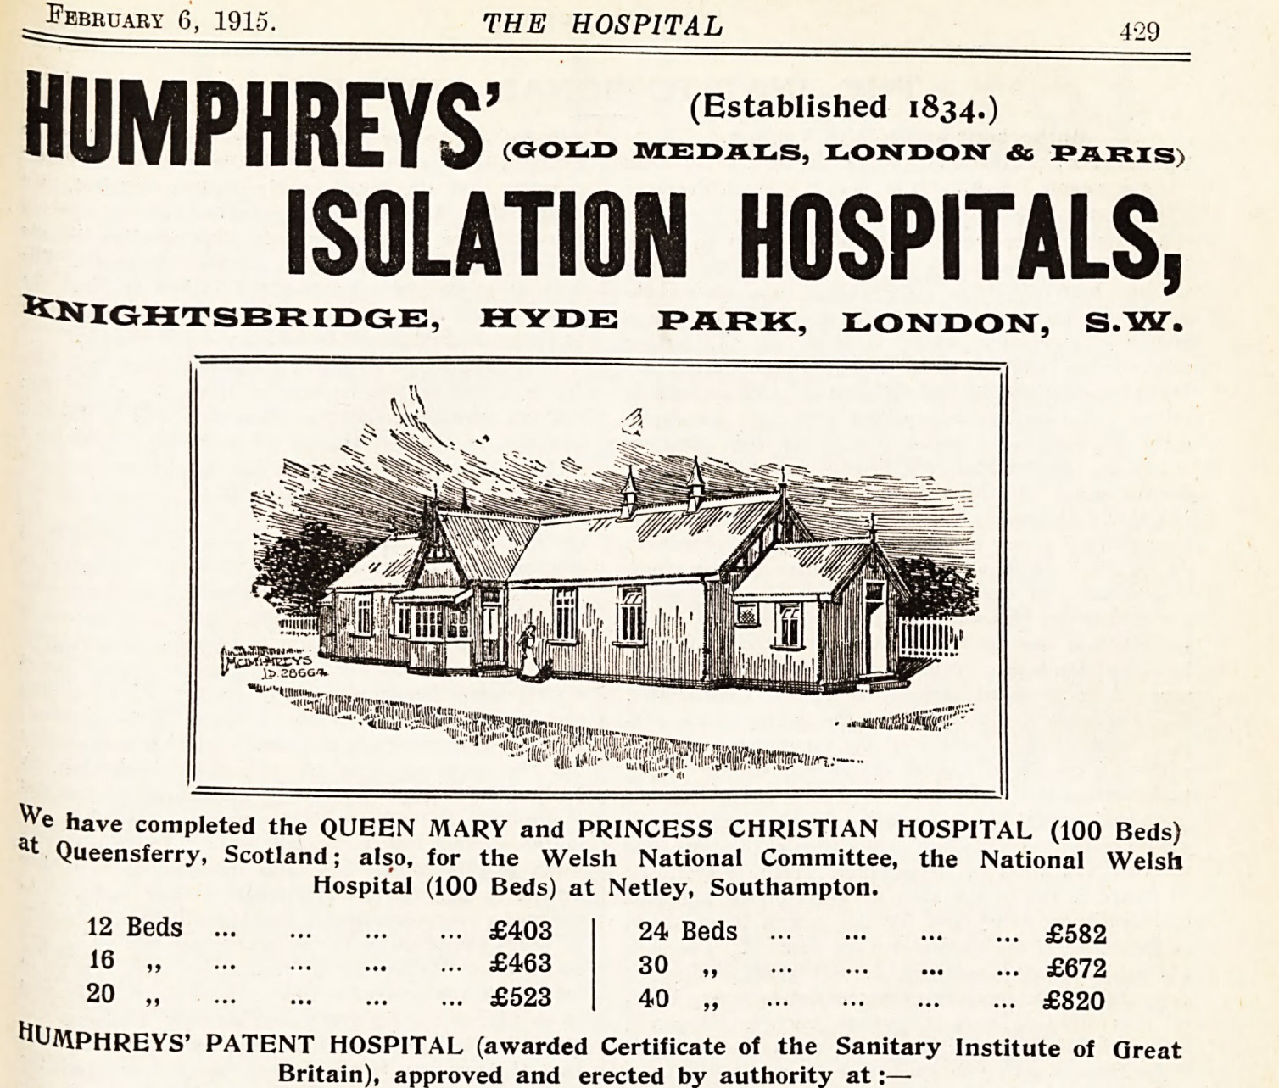
This advert from 1915 shows an illustration of one of ‘Humphreys’ Isolation Hospitals’.
It also has the costs for each, depending on how many ‘beds’ they are designed for.
‘Flat-pack’ hospitals like this could be easily shipped and assembled anywhere they were needed across The Empire.
© The hospital, V. 57, 6 Feb 1915, p. 429
Notes:
Image: © The hospital, (advert for Humphrey’s Isolation Hospitals) v. 57, 6 Feb 1915, p. 429
Find out more about Humphrey’s Hospital: https://historic-hospitals.com/2015/08/30/humphreys-hospitals/

Slide 39
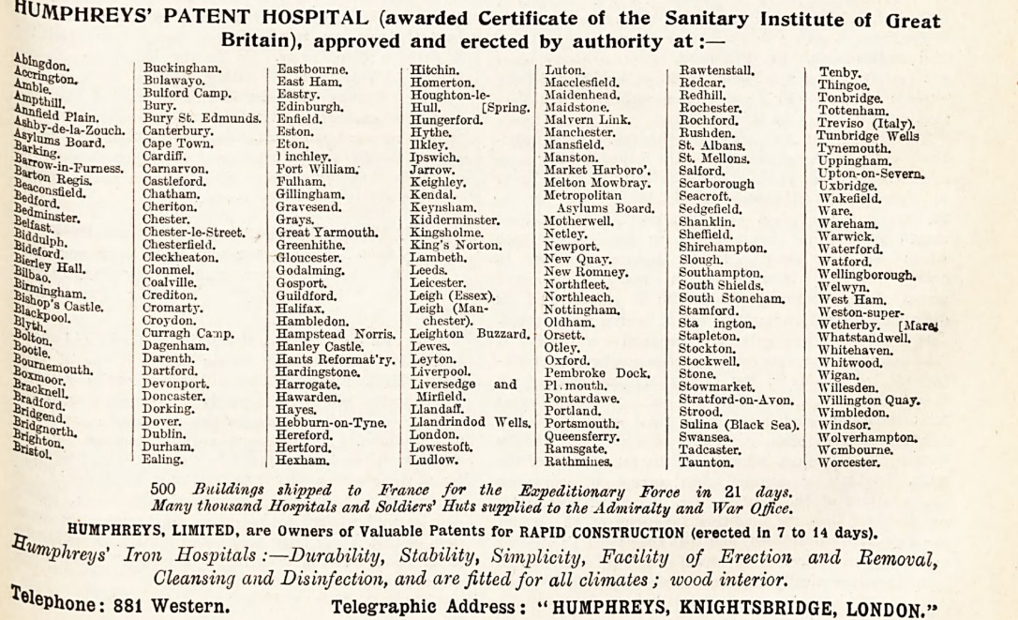
Given the date of 1915, as well as giving a list of locations, the advert also promotes their use by the military.
© The hospital, V. 57, 6 Feb 1915, p. 429
Notes:
Image: © The hospital, (advert for Humphrey’s Isolation Hospitals) v. 57, 6 Feb 1915, p. 429
Find out more about Humphrey’s Hospital: https://historic-hospitals.com/2015/08/30/humphreys-hospitals/

Slide 40
Research Task
Use the links below, and any other information you can find, to look more closely at the actual design of the ‘flat pack’ hospital and how long it took to build. Then compare it to the design and build of the new Nightingale Hospitals.
https://historicengland.org.uk/listing/the-list/list-entry/1140120
https://historic-hospitals.com/2015/08/30/humphreys-hospitals/
https://www.bbc.co.uk/news/av/uk-52112652/coronavirus-transforming-london-s-excel-centre-into-nightingale-hospital
https://www.bbc.co.uk/news/health-52125059
Having looked at all these different types of isolation hospital:
‘If you were advising on the design of an isolation hospital what are the 3 most important features that it must include?

Slide 41
Research Task
As you discovered earlier, England sent medical equipment to Australia to help them during the 1937 Polio epidemic.
Can you now try to find:
Examples of British companies helping Empire countries deal with infectious diseases.
Did they help for free?
Did they ever refuse to help?
In terms of hospitals and medical developments was it an advantage to be in the British Empire?

Slide 42
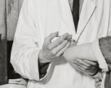
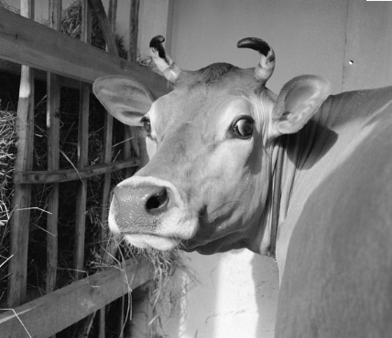
Vaccination
Today scientists across the world are currently working on a vaccine for Covid-19. The process of vaccinating people is called immunisation. It means people either can’t catch a disease, or if they do, the symptoms will be very mild and they won’t be very ill.
Immunisation is one of the most successful and cost-effective health treatments ever invented. Every year 2-3 million deaths are prevented from a wide variety of diseases across the world by immunisation programmes.
In England it has completely stopped anyone from getting a disease called smallpox. Smallpox was a very serious disease in 18th century Europe.
It killed more than 400,000 people each year and was known as the ‘speckled monster’ in England.
But one man (& a cow called Blossom!) set out to change all that!
Notes:
Image: © Source: Historic England Archive. A doctor injecting a nurse with diphtheria vaccine at Lodge Moor Hospital, Sheffield – 12th December 1941 Ref:med01_01_2356
© Historic England Archive. Portrait of a horned cow in a cowshed, Wood Farm, Dereham, Norfolk – 1956 Ref:aa081139

Slide 43
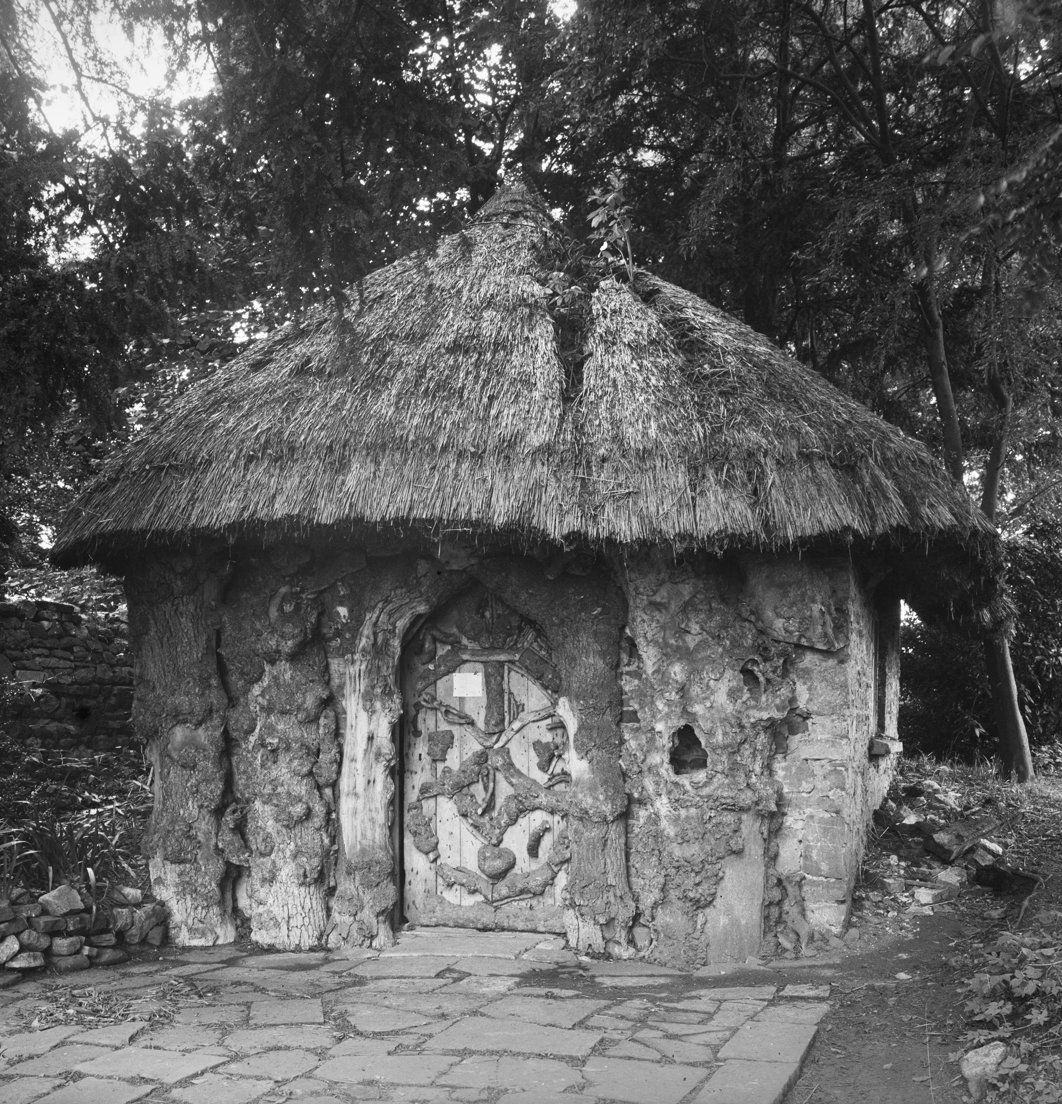
This hut belonged to Dr Edward Jenner (1749-1823) .
It is where he did his first vaccination against smallpox in 1796.
Edward was working as a country doctor in Gloucestershire.
He was able to see a link between cowpox, a relatively mild disease, and the deadly smallpox.
It was widely known that getting cowpox would stop you from getting smallpox, but Edward was the first to carry out controlled experiments.
Notes:
Image: © Source: Historic England Archive. Exterior view of the Jenner Hut in the grounds of The Chantry, Berkeley, Gloucestershire – 1920-1940 Ref: aa44_12384

Slide 44
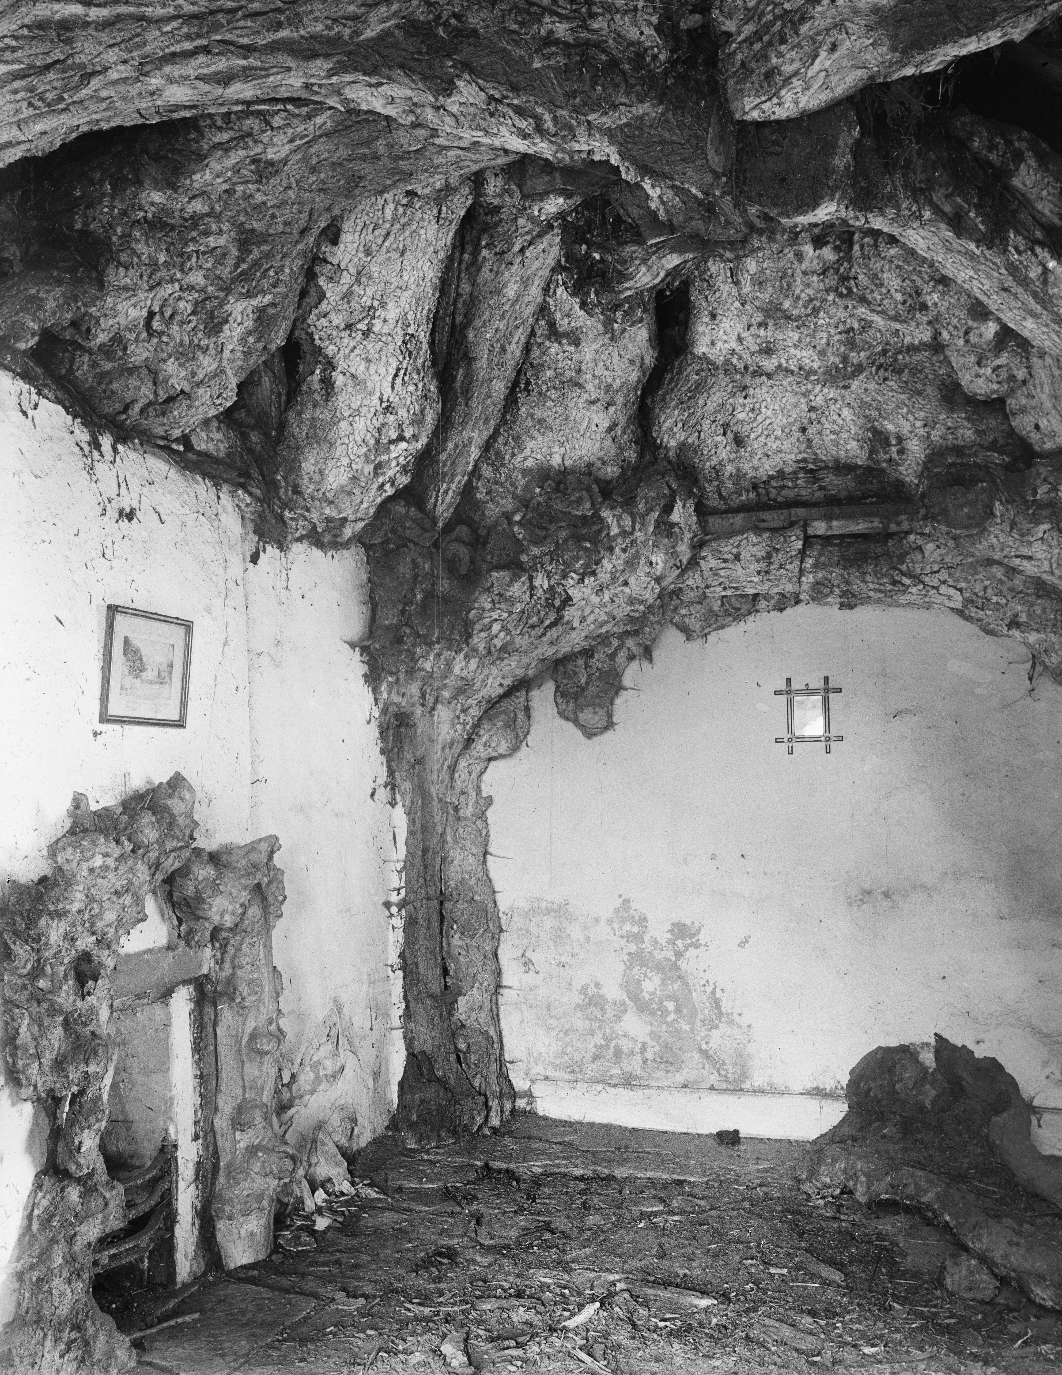
On 14 May 1796, in this very hut, Edward scraped pus from cowpox blisters on the hands of Sarah Nelmes, a milkmaid who had caught the virus from a cow called Blossom.
He then used the pus to inoculate James Phipps, his gardener's 8-year-old son, by inserting it into a cut.
James had a fever and had some uneasiness, but no full-blown infection, and a few days later was fully recovered!
Edward repeated the experiment on James two more times, using smallpox ‘material’, but James never got smallpox – he was immune!
Notes:
Image: © Source: Historic England Archive. Interior view of the Jenner Hut in the grounds of The Chantry, Berkeley, Gloucestershire – 1920-1940 Ref: aa44_12385

Slide 45
Activity
New medical treatments often create what we call ethical dilemmas. Think about the situation between Edward and James.
Was Edward right to experiment on an 8 year old boy?
What were the risks?
What were the benefits?
On balance was this the right thing to do?
Do you think this would happen today?
Did you know that vacca = cow in Latin!
At the present time there is no vaccination against Covid 19.
Can you find out about any examples of people taking part in
trials for a new vaccine?
Notes:
© Historic England Archive. Portrait of a horned cow in a cowshed, Wood Farm, Dereham, Norfolk – 1956 Ref:aa081139

Slide 46
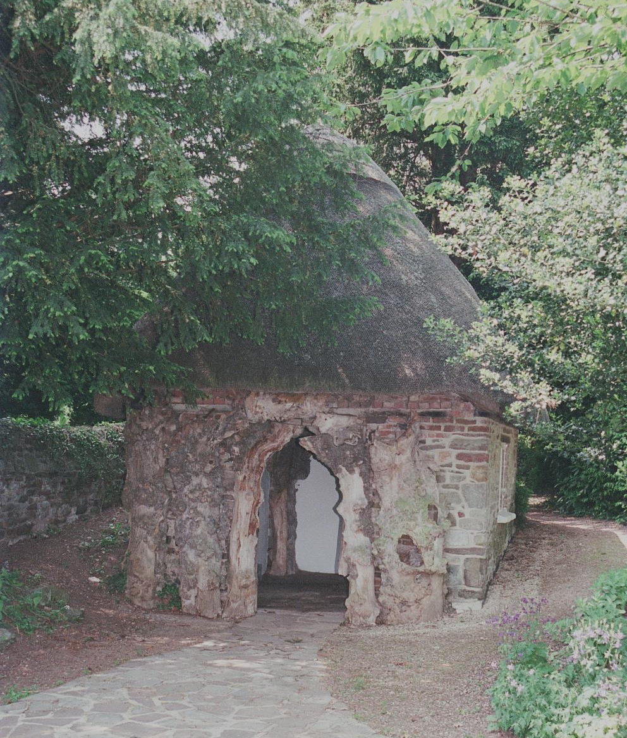
In all, Edward tested his method on 23 people: all recovered fully and were completely immune to smallpox.
He ‘christened’ his hut the 'Temple of Vaccinia', and continued to use it to provide vaccinations to the poor of the district free of charge.
After he published his findings, there was an almost instantaneous response as his theory of vaccination was taken up globally, in the Americas, South-East Asia and China.
As a pioneer of vaccination, Edward is acknowledged as having saved more lives than any other human!
'Temple of Vaccinia'
Notes:
Image: © IoE Mr Peter Yardley. Source Historic England Archive. Jenner Hut in the grounds of The Chantry, Berkeley, Gloucestershire – 30th June 2001 Ref: IOE01/05871/13
Find out more here: https://historicengland.org.uk/listing/what-is-designation/heritage-highlights/jenners-hut-birthplace-public-health/ This webpage also has more details and an audio piece discussing Edward and his hut: https://historicengland.org.uk/get-involved/100-places/science-discovery/cholera-smallpox-immunology/

Slide 47
So important to our heritage is Edward’s hut that in 1952, it was listed as Grade II*. That means it’s protected, so future generations can learn from it.
Before Edward’s brilliant work – and even for quite a while after it, there was still a great need for places dedicated to helping those infected with smallpox.
It was not until ‘The Vaccination Act’ of 1853 that all babies up to 3 month months old HAD to have a smallpox vaccination in England and Wales.
So let’s look at some other heritage related to smallpox here in England.
'Temple of Vaccinia'
Notes:
Image: © IoE Mr Peter Yardley. Source Historic England Archive. Jenner Hut in the grounds of The Chantry, Berkeley, Gloucestershire – 30th June 2001 Ref: IOE01/05871/13
Find out more about Listed Buildings with our Enriching the List project: https://historicengland.org.uk/services-skills/education/teaching-activities/how-you-can-enrich-the-list/

Slide 48
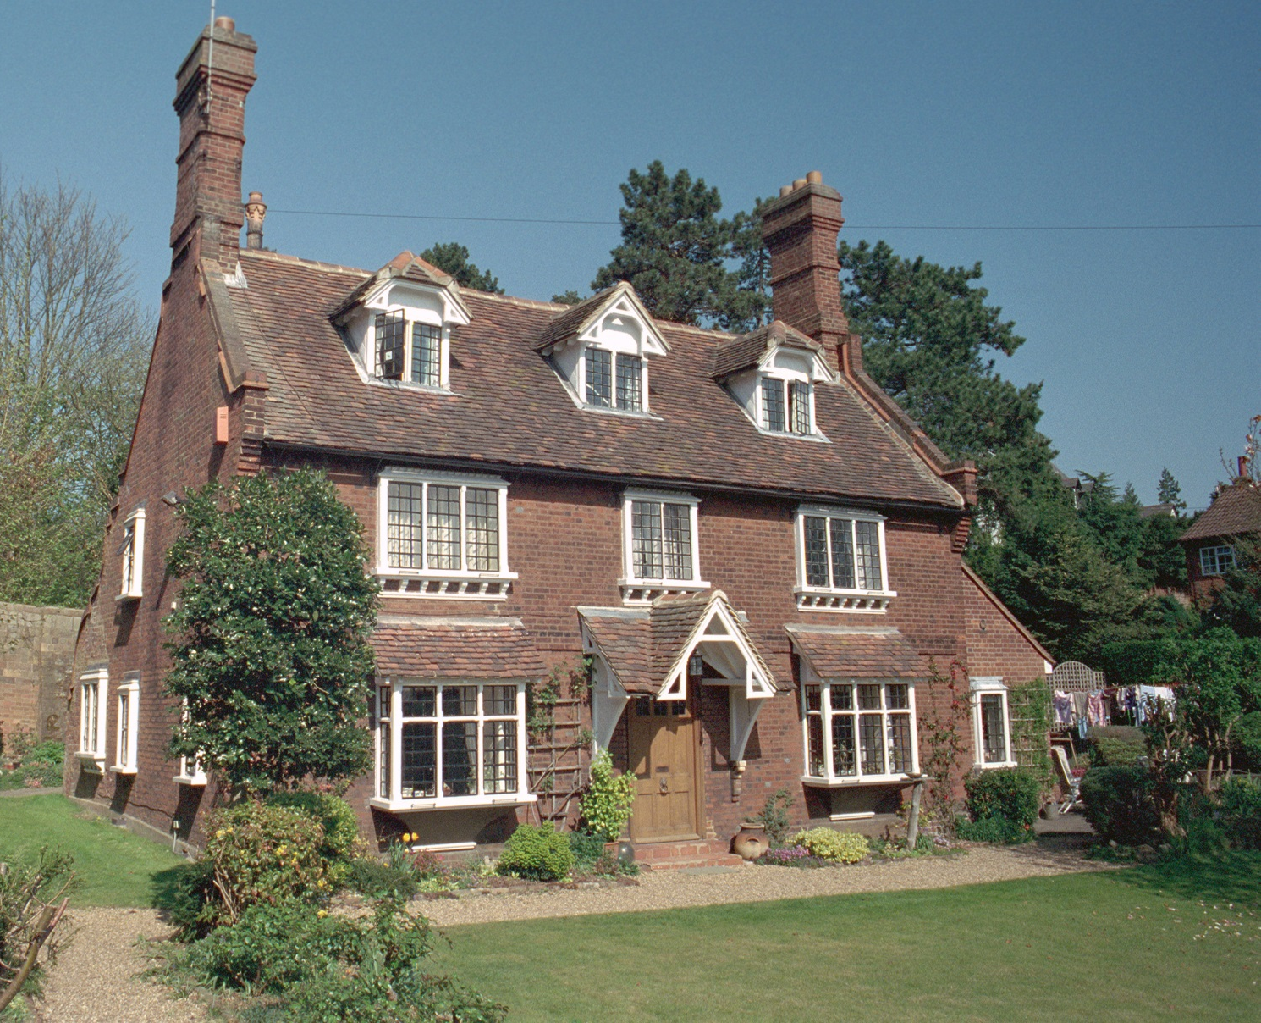
The Old Pest House, Byde Street, Hertford, Hertfordshire.
This house was built in 1763 as an isolation hospital against smallpox by Thomas Dimsdale (1712-1800).
Thomas was also a doctor and pioneer of smallpox inoculation.
He lived next door and his house was known as 'The Inoculation House‘
Notes:
Image: © Mr A, Gude. Source Historic England Archive. The Old Pest House, Byde Street, Hertford, Hertfordshire – 17th April 2003 Ref: IOE01/10388/34
Unlike Jenner, Dimsdale inoculated people with actual smallpox, not cowpox. Whilst this worked for many people, giving them a mild case of smallpox, from which they recovered and developed immunity – it didn’t work for everyone. Some people who were given it got full-blown smallpox and died!
He wrote many scientific papers on smallpox and innoculation. HE even went to Russia and inoculated Catherine the Great, her son and many people at the Russian court. Find his papers here: https://wellcomecollection.org/works?query=%22Dimsdale,%20Thomas,%201712-1800.%22 Find out more:
https://en.wikipedia.org/wiki/Thomas_Dimsdale

Slide 49
Inoculation Vs Vaccination
Before Edward Jenner’s vaccine, Thomas Dimsdale inoculated people. This meant deliberately infecting them with actual smallpox, not cowpox.
This worked for many people, giving them a mild case of smallpox, from which they recovered and developed immunity.
But it didn’t work for everyone, some people who were given it got full-blown smallpox and died!
However, it was the work of earlier doctors like Thomas, who helped Edward find a better solution.
Both however, should be thankful to Lady Mary Wortley Montague, who was influential in introducing the practice of inoculation into England.
Notes:
Unlike Jenner, Dimsdale inoculated people with actual smallpox, not cowpox. Whilst this worked for many people, giving them a mild case of smallpox, from which they recovered and developed immunity – it didn’t work for everyone. Some people who were given it got full-blown smallpox and died!
He wrote many scientific papers on smallpox and innoculation. HE even went to Russia and innocuated Catherine the Great, her son and many people at the Russian court. Find his papers here: https://wellcomecollection.org/works?query=%22Dimsdale,%20Thomas,%201712-1800.%22

Slide 50
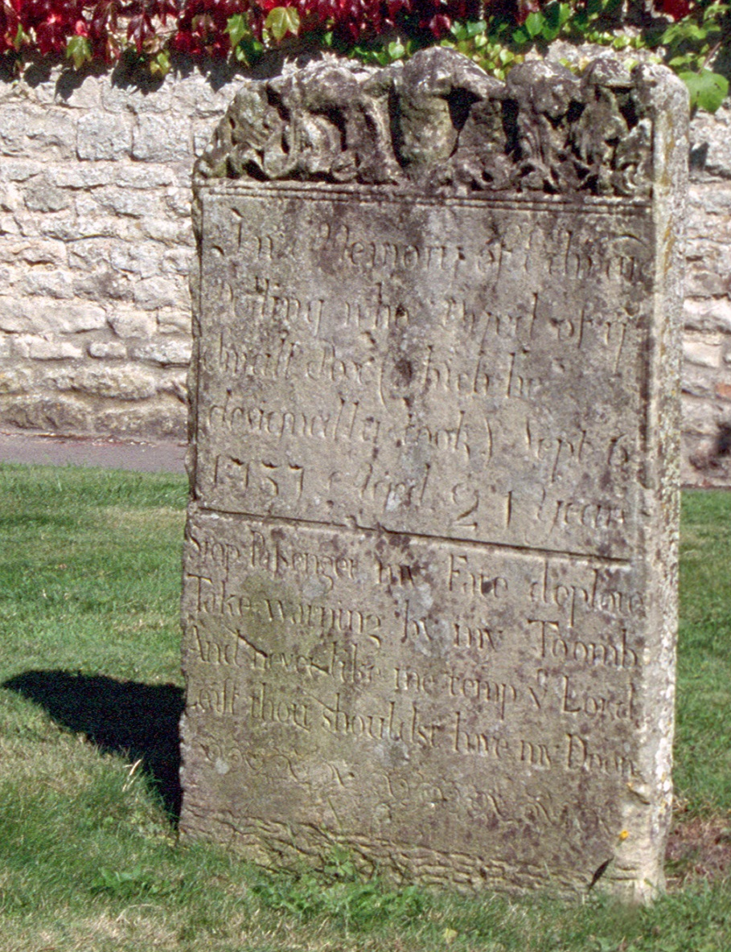
Grave of Edmund Dolling, Church Street, Mere, Wiltshire.
This is the grave of Edmund Dolling, its inscription reads:
In Memory of Edmund Dolling who Died of ye Small Pox which he designedly took Sept 6 1737 Aged 21 years.
Stop Passenger my Fate deplore, Take warning by my Toomb ,
And not like me tempt ye Lord ,
Lest thou shouldst have my Doom.’
It is an example of an early and unsuccessful attempt at inoculation.
Notes:
Image: © Ms Geraldine Bunn. Source Historic England Archive. Edmund Dolling monument, c.10 m east of north east corner of Church of St Michael, Mere, Somerset – 13th September 2002 Ref: IOE01/04615/11 There is more information on inoculation in this document here (including more about Lady Mary Wortley Montague): https://www.wiltshire-opc.org.uk/Items/Mere/Mere%20-%20History%20of%20St.%20Michaels.pdf

Slide 51
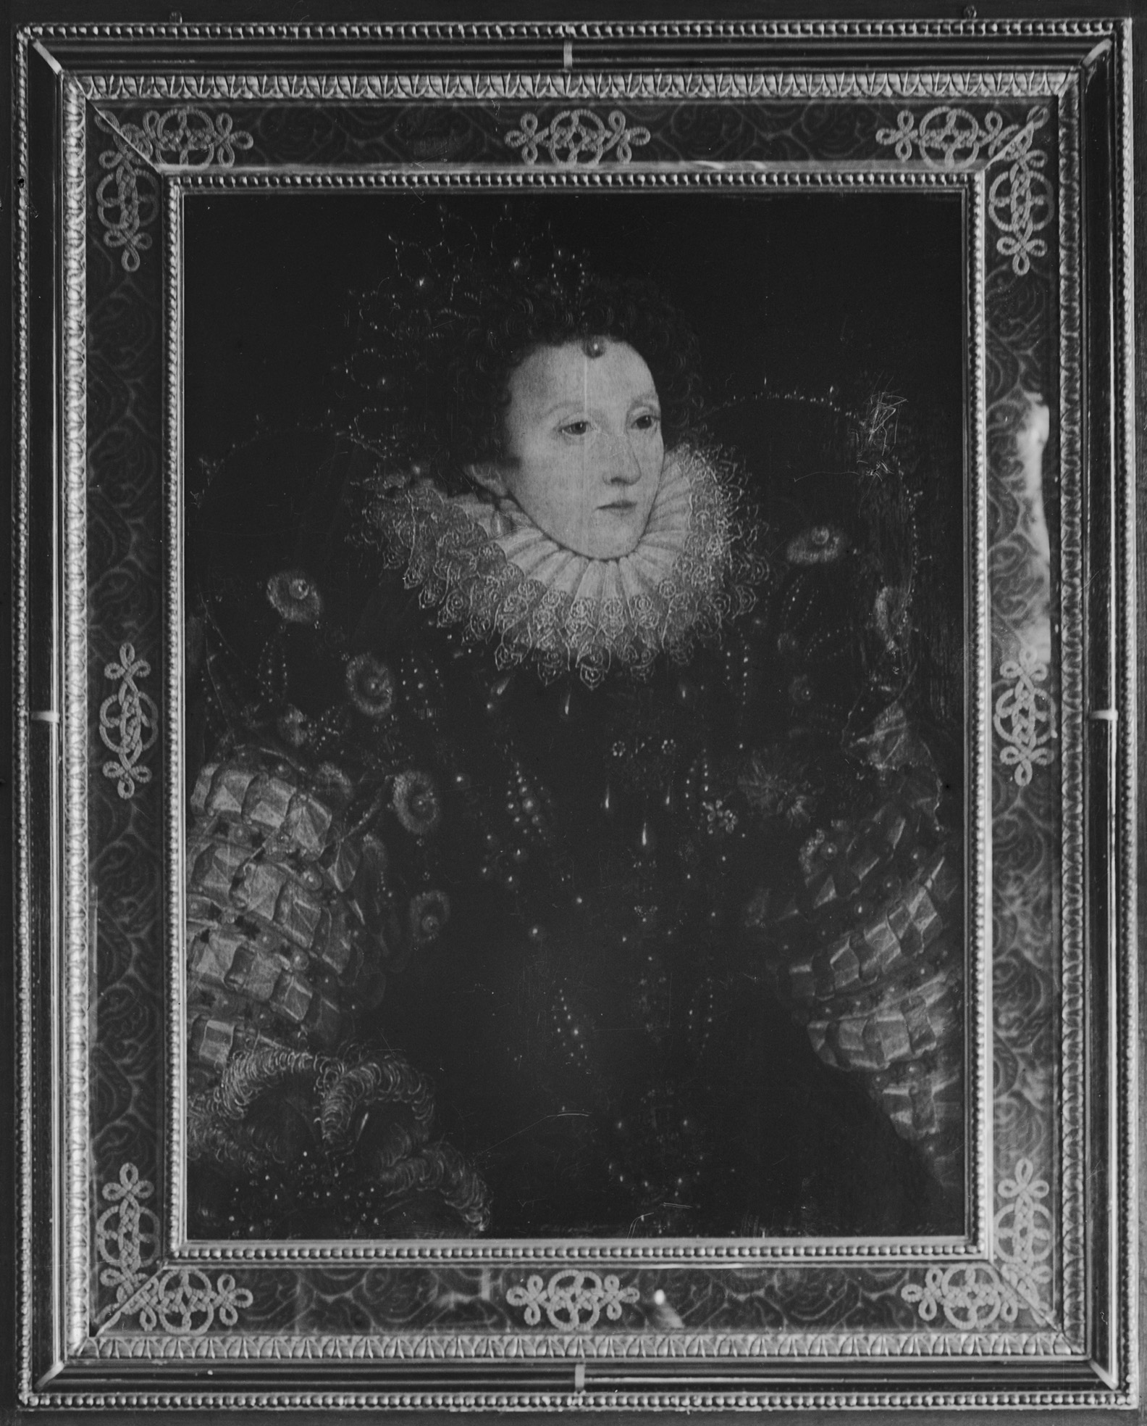
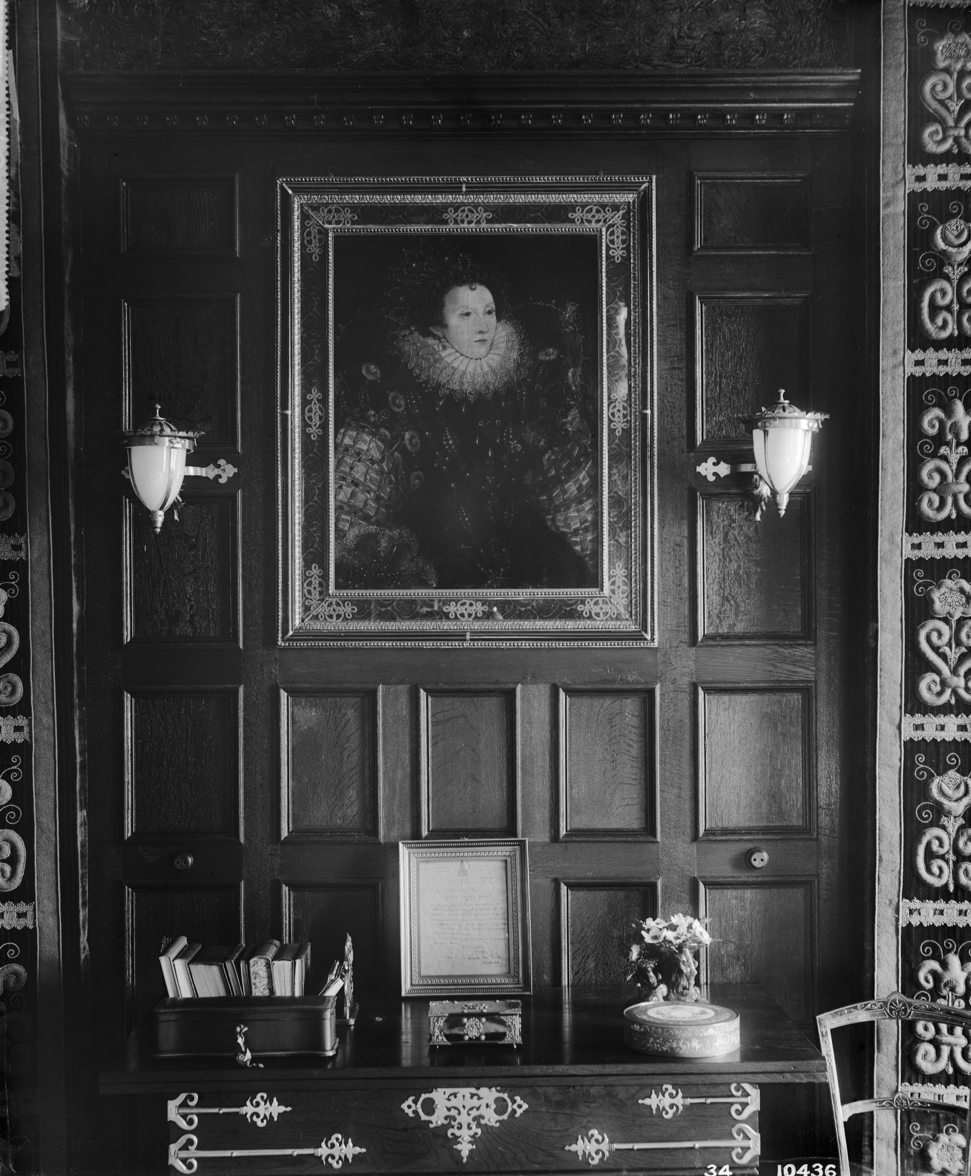
Fascinating Fact:
Did you know Elizabeth I survived smallpox.
The disease left her with terrible scars.
Not that you’d ever know it from her official portraits!
Notes:
Image: © Source Historic England Archive. Interior in Lord Rothschild's room at Tring Park showing a portrait of Queen Elizabeth I, Tring, Hertfordhire –September 1890 Ref: bl10436 There is more information on inoculation in this document here: https://www.wiltshire-opc.org.uk/Items/Mere/Mere%20-%20History%20of%20St.%20Michaels.pdf

Slide 52
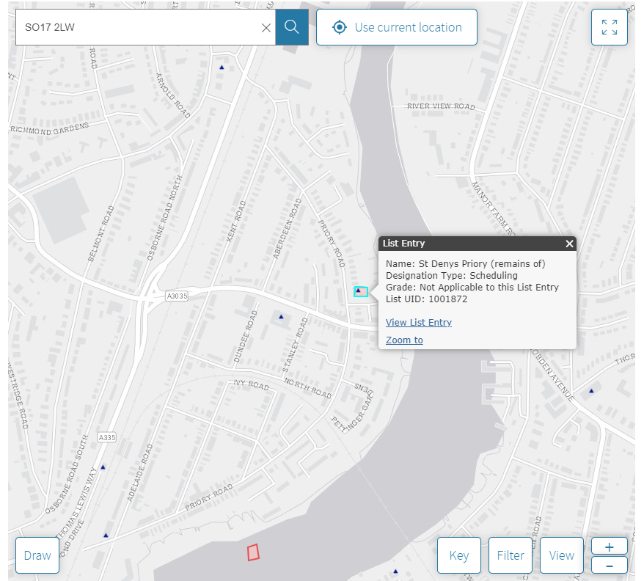
Research Task
Search the National Heritage List for England
All of this evidence for smallpox comes from ‘listed’ heritage.
Listing highlights what is significant about a building or site, and helps to protect it for the future.
Why not search the National Heritage List for England to see what nationally important ‘listed’ heritage is near your school?
Go to the Map Search, put in the school’s postcode and see what evidence from the past you uncover!

Slide 53
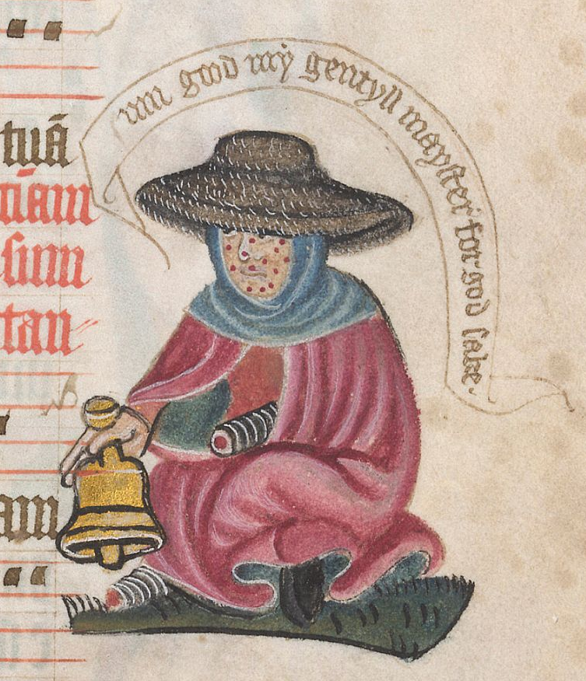
So how did people treat infectious diseases in medieval times?
Leprosy, known today as Hansen's disease, entered England in the 4th century AD and had spread across the country by 1050. The disease was already known about from ancient societies in China, Egypt and India.
It is caused by bacteria and leads to skin defects and deformities. In its extreme form it could cause the loss of fingers and toes and other terrible conditions.
People knew it was contagious and so people with the disease were shunned from ‘normal’ society and had to live separately.
A leper begging for alms © The British Library
Notes:
A leper begging for alms from the margins of an English Pontifical (manuscript relating to or for the Pope). Date: c 1425. From: MS Lansdowne 451, fo 127r © British Library

Slide 54
Look carefully at the drawing, what do you notice about the person?
He has spots on his face, showing the marks on the skin caused by leprosy
He has bandages on one hand and one foot. Showing he had a very severe case of leprosy, causing him to lose fingers and toes
He’s holding a bell, to ring to get people’s attention and ask for help. He’s too poorly to work and needs to rely on charity or ‘alms’ from other people to help him
‘Alms’ is a medieval word used to describe anything – money, food, clothes etc. – given freely to the poor to help them.
A leper begging for alms © The British Library
Notes:
A leper begging for alms from the margins of an English Pontifical (manuscript relating to or for the Pope). Date: c 1425. From: MS Lansdowne 451, fo 127r © British Library

Slide 55
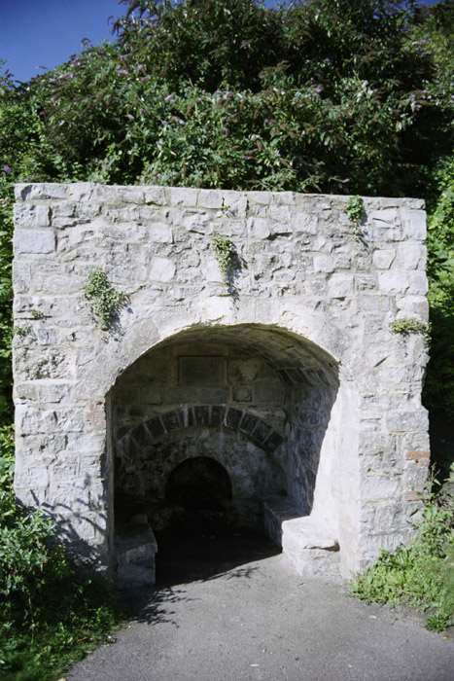
From the time of the Norman Conquest to about 1350, at least 350 religious houses and hospitals for the care of lepers - known as 'lazar' (leper) houses - were built in England.
At this time in England monks and ‘the church’ were the only way most ordinary people could access any kind of health care.
Parts of some of these religious buildings still remain today, like this well, the only part left from a leper hospital in Lyme Regis, Dorset.
The rise in cases of leprosy – and the associated increase in number of places to care for them – may have been linked to a rise in the number of people travelling across the world on religious pilgrimages, then bringing the disease back with them.
Notes:
Image: © Mr Duncan Miller. Source Historic England Archive. The Lepers' Well, Broad Street, Lyme Regis, Dorset – 21st August 2004 Ref: IOE01/12749/19

Slide 56
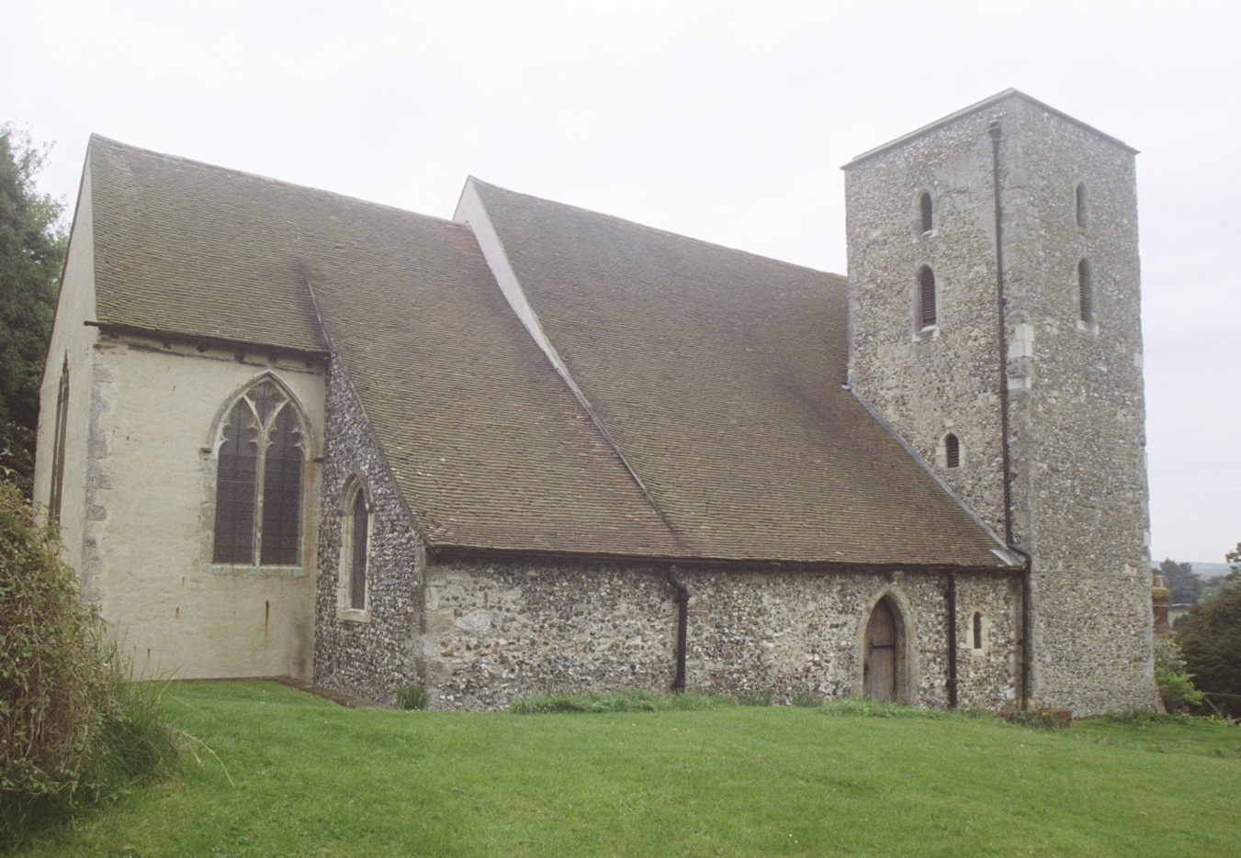
The Old Leper Church Of St Nicholas, Harbledown, Canterbury, Kent
This church was built as part of a leper hospital.
It was founded by Lanfranc, archbishop of Canterbury (1070-89), in about 1085.
It is the oldest surviving building from a leper hospital in England.
Harbledown was the last step for pilgrims on their way to Canterbury.
Notes:
Image: © Ms Eve Wilson. Source Historic England Archive. Hospital Of The Forest Of Blean / The Old Leper Church Of St Nicholas – 5th May 2006 Ref: IOE01/14608/32

Slide 57
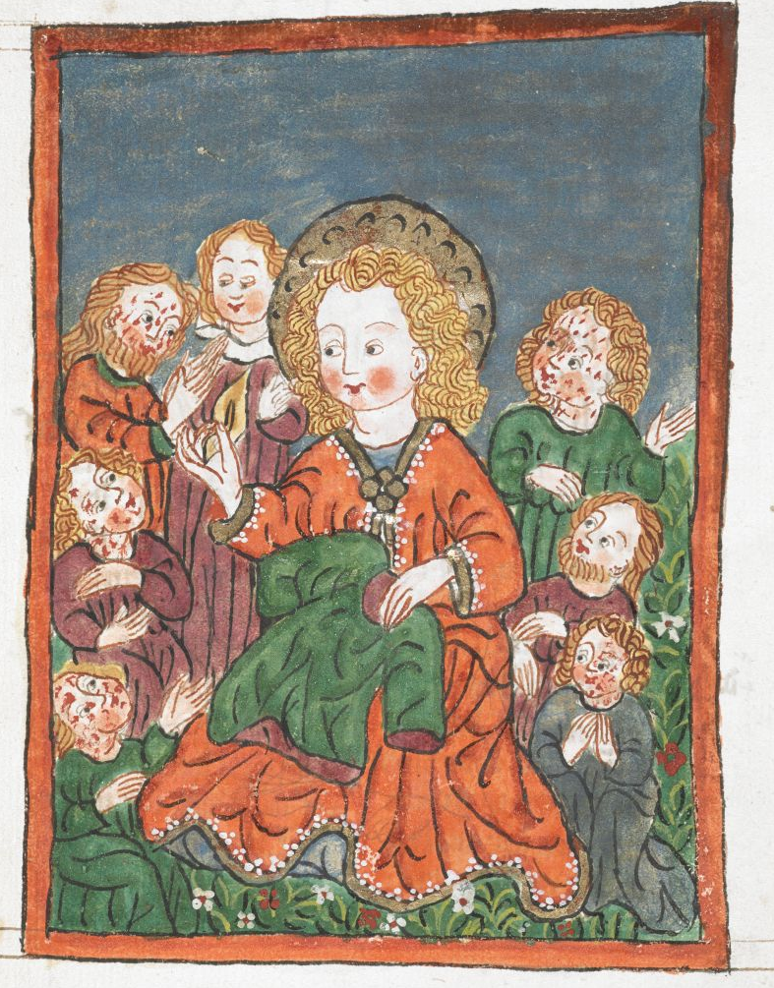
People reacted to leprosy in different ways.
Some people believed getting it was a punishment for sin.
Others saw the suffering of lepers as similar to the suffering of Jesus Christ. So, because lepers were suffering on earth they would go directly to heaven when they died. Therefore they were seen as being closer to God than other people. This made them special.
Many of those who cared for them, or made charitable donations, believed that such good works would make their own journey to heaven quicker when they died.
Francis seated among the lepers, giving alms.
© The British Library
Notes:
St Francis and the lepers http://www.bl.uk/catalogues/illuminatedmanuscripts/ILLUMIN.ASP?Size=mid&IllID=61638
If you teach in a Christian school you may wish to view this weblink: https://www.littlewaychapel.com/blog/simple-childrens-lesson-for-st-francis-day

Slide 58
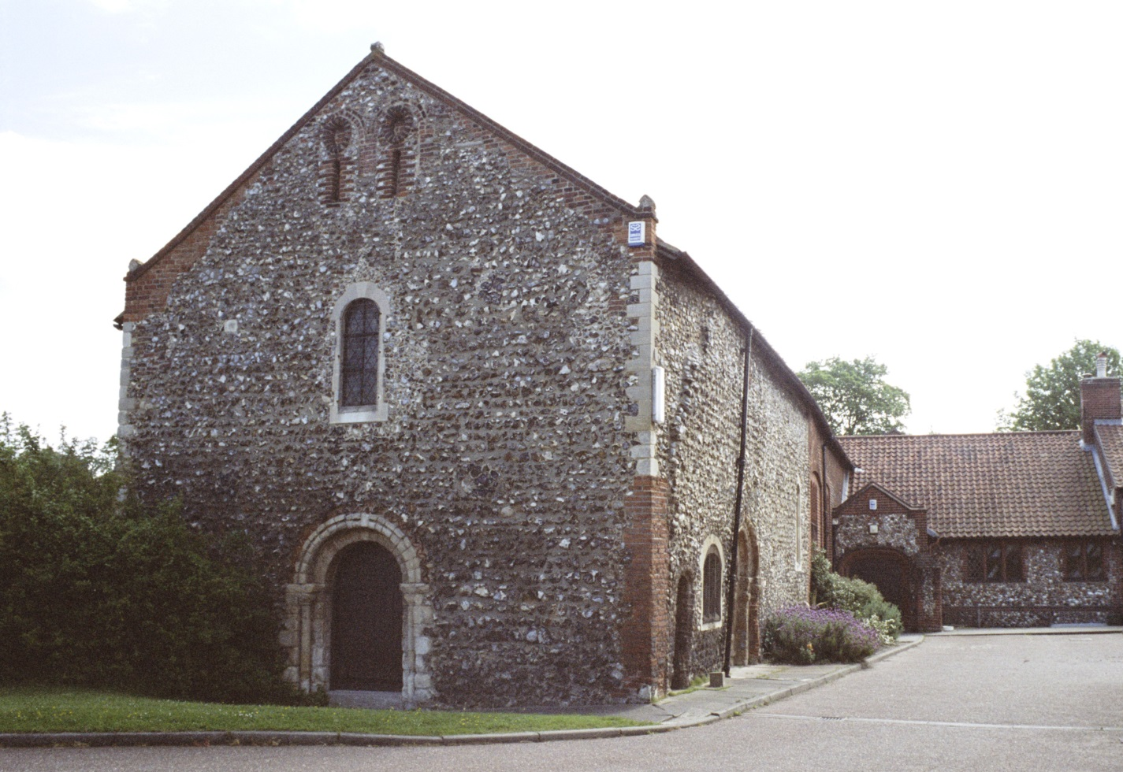
Lazar (Leper) House, Sprowston Road, Norwich, Norfolk
This house is all that remains of the Leper Hospital of St Mary Magdalen.
It was founded before 1119 by Bishop Herbert de Losigna, the first Bishop of Norwich.
Such houses were built on the edge of towns and cities, as lepers needed to stay in contact with society to beg alms, trade items, and offer services such as praying for the souls of benefactors.
Notes:
Image: © Mr Russell Sparkes. Source Historic England Archive. Lazar House, Sprowston Road, Norwich, Norfolk – 29th May 2006 Ref: IOE01/13348/31
More information about Lazar House: https://www.eveningnews24.co.uk/news/lazar-house-sprowston-leper-hospital-norwich-heritage-open-days-1-6278849

Slide 59
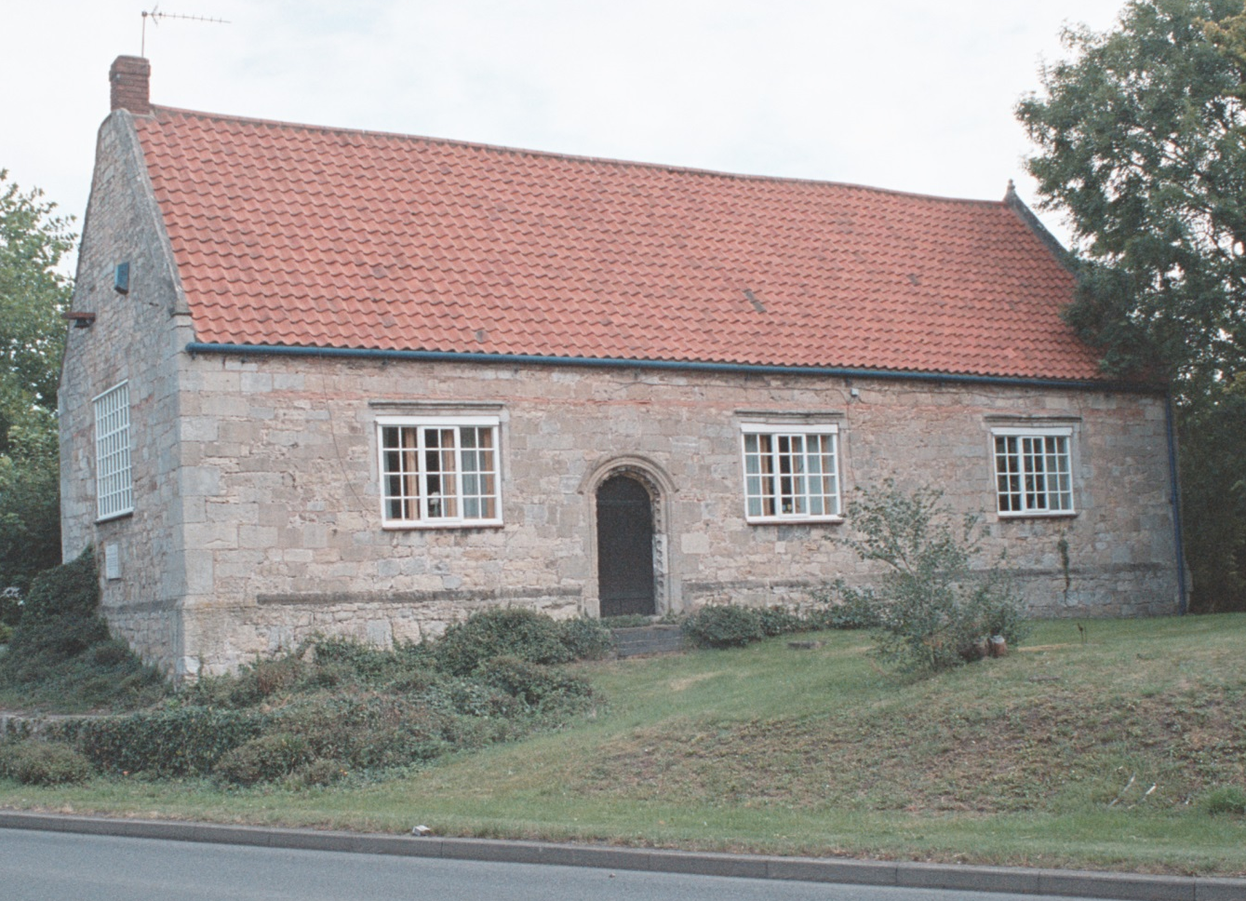
The Old School (former Hospital of St John the Evangelist), Blyth, Nottinghamshire
This building was originally part of the Hospital of Saint John the Evangelist.
The hospital was founded in the reign of King John (1199-1216). It was rebuilt on this site in 1446.
It was originally for lepers.
The building was later used as a school.
Notes:
Image: © Mr James Brown. Source Historic England Archive. The Old School (former Hospital of St John the Evangelist), Blyth, Nottinghamshire – 17th August 2007 Ref: IOE01/16726/07
More information about Lazar House: https://www.eveningnews24.co.uk/news/lazar-house-sprowston-leper-hospital-norwich-heritage-open-days-1-6278849

Slide 60
Care in religious leper houses centred as much on a person's spiritual needs as on their physical problems.
Most had a detached chapel where praying and singing continued throughout the day. Like the example from Harbledown, where according to a source from 1344
‘inmates wore a distinct habit, heard daily mass and said the Lord’s Prayer and Hail Mary and the canonical hours.’
The canonical hours in the Middle Ages were 9 sets of prayers said every day:
Vigil (eighth hour of night: 2 a.m.)
Matins (a later portion of Vigil, from 3 a.m. to dawn)
Lauds (dawn; approximately 5 a.m., but varies seasonally)
Prime (early morning, the first hour of daylight, approximately 6 a.m.)
Terce (third hour, 9 a.m.)
Sext (sixth hour, noon)
Nones (ninth hour, 3 p.m.)
Vespers (sunset, approximately 6 p.m.)
Compline (end of the day before retiring, approximately 7 p.m.)

Slide 61

The emphasis was on cleanliness and wholesome food - clothes were washed twice a week and a varied diet was supplied if possible, often from the house's own fields and livestock.
The therapeutic effect of gardening work and the beauty of nature were recognised.
Like the monasteries of the time, many leper houses had their own fragrant gardens of flowers and healing herbs, and residents took part in their upkeep.
Many lepers stayed in touch with their family and friends and were allowed to make visits home and receive visitors.
Monks in the herb garden at Rievaulx Abbey
Notes:
Image: Historic England Archive. Reconstruction illustration showing Cistercian monks working in the Infirmary Cloister at Rievaulx Abbey, as it may have appeared in the mid-thirteenth century. Medicinal herbs for the treatment of the sick were grown in the cloister garden. Date: circa 1993 - circa 2005 Ref: IC086/013

Slide 62
Activity
Having now considered a range of evidence, discuss the following questions, making sure to back up your points with specific examples.
How was the treatment of those with leprosy in medieval times different to the later treatment of people with smallpox and TB?
Can you identify which treatments were ‘spiritual’ and which were ‘physical’?
Today we rely on ‘physical’ treatments, such as vaccines and drugs, to cure illnesses. Does that mean the people no longer need ‘spiritual’ treatments or do they still provide important ‘mental health’ benefits?
Notes:
All of these tasks could be done remotely as part of students home learning. Any slides or information produced could be uploaded and shared via the school’s learning platform.

Slide 63
Activity
Having now looked at a range of responses to the isolation of patients with infectious diseases, can you attempt to:
Identify the similarities and differences in our responses to isolation over time?
Highlight some significant developments and create a graph showing progress v time.
Reflection:
What is the most interesting/surprising fact you’ve discovered
about isolation and infectious diseases?
Progress
Time
Notes:
All of these tasks could be done remotely as part of students home learning. Any slides or information produced could be uploaded and shared via the school’s learning platform.

Slide 64
Activity
Summary
‘Hospitals are now better at treating disease than at any other time in history’
How far would you agree with this view?
Use the evidence in these slides, and your own research, to support your answer.
Notes:
All of these tasks could be done remotely as part of students home learning. Any slides or information produced could be uploaded and shared via the school’s learning platform.

Slide 65
Extension Research
Having looked at the how the treatment of disease has developed over a long period of time:
What new questions have you generated after looking through all the photos?
Is there anything else you’d now like to research further?
Challenge:
The new Covid-19 hospitals are all called ‘Nightingale’ – whilst at least one should retain this name, could you suggest 6 other names of past medical professionals that the others could be named after instead?
Notes:
All of these tasks could be done remotely as part of students home learning. Any slides or information produced could be uploaded and shared via the school’s learning platform.

