Slide 1
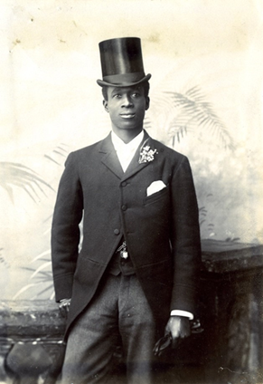
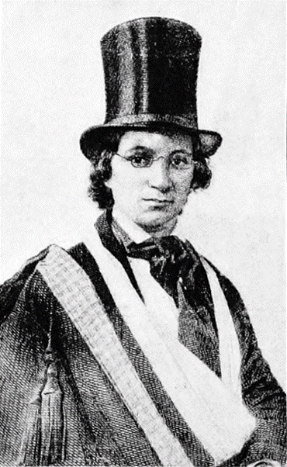
African Lives in Northern England
African Lives in
Northern England
This resource tells the stories of the many men and women of African descent who have visited and lived in villages and towns across the North East of England and Cumbria.
Celestine Edwards
Ellen Craft
Notes:
Images:
Celestine Edwards portrait, reproduced courtesy of National Archives
Ellen Craft, image from The Underground Railroad from Slavery to Freedom by Wilbur Henry Siebert, Albert Bushnell Hart, Edition: 2. London: Macmillan, 1898. Public domain, retrieved from https://commons.wikimedia.org/wiki/File:Ellen_Craft_escaped_slave.jpg

Slide 2
African Lives in Northern England
Key Stage 2 / 3: History
Learning Aims and Outcomes
To learn about the contribution people of African descent have made to the North East and Cumbria and begin to build appreciation of the diversity of the region.
To understand the interconnections between the North East and Cumbria, the rest of England, the rest of Europe, Africa, the Caribbean and North America because of the movement of people throughout history
To raise awareness of some of the stories of individuals who came from Africa and the Caribbean and the impact they had on the North East and Cumbria and our heritage
To highlight the way in which people from African descent have influenced significant historical events and are linked to our local buildings in the North East and Cumbria.
To gain an improved understanding of enslavement, discrimination and racism, whilst exploring the ways they can, and have, been challenged throughout history.

Slide 3
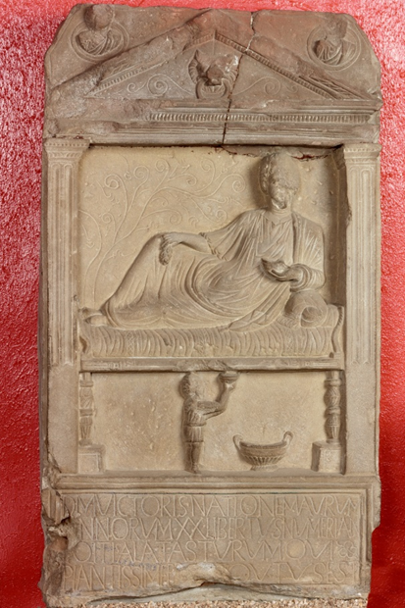
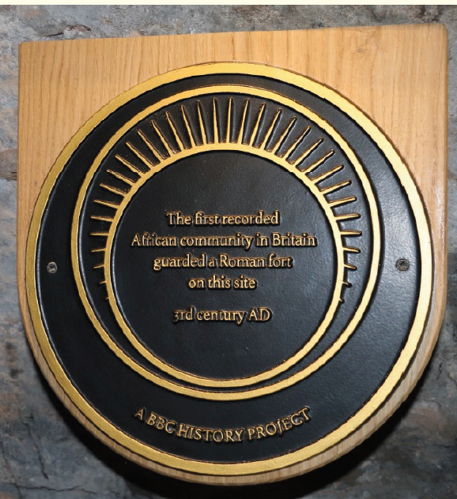
Romans
African Lives in Northern England
Plaque commemorating first African Community, reproduced courtesy of Beverley Prevatt Goldstein
The Victor Tombstone reproduced courtesy of TWAM
Coin with Septimus Severus, dated 201AD, reproduced courtesy of TWAM
Notes:
Image: Plaque commemorating first African Community, reproduced courtesy of Beverley Prevatt Goldstein
The Victor Tombstone reproduced courtesy of Tyne and Wear Archives & Museum (TWAM)
Severus Coin, reproduced courtesy of Tyne and Wear Archives & Museum (TWAM)

Slide 4
The First African Community
African Lives in Northern England
There were people born in Africa living in Northern England 2,000 years ago, when it was part of the Roman Empire. Evidence shows that the first African community was in Cumbria.
Hadrian’s Wall was protected by troops from across the Roman Empire. One unit from Mauretania (Tunisia/Libya/Algeria) in North West Africa lived at Aballava Roman Fort at Burgh by Sands in Cumbria in the third and fourth centuries AD. Some of the soldiers would have had families living outside the fort and may have told their children songs and stories from Africa.
This plaque placed outside St Michael’s Church, Burgh by Sands in 2016, recognises this first African community.
Plaque commemorating first African Community, reproduced courtesy of Beverley Prevatt Goldstein
Notes:
Image: Plaque commemorating first African Community, reproduced courtesy of Beverley Prevatt Goldstein

Slide 5
The African Emperor
African Lives in Northern England
Septimus Severus
Septimus Severus, the Emperor of Rome, AD 193-211, was born in Lepcis (Libya) and was of mixed African and Roman heritage.
He came to Britain in the early third century AD and rebuilt much of Hadrian’s Wall, including the fort at South Shields.
He had problems with his two quarrelling sons and ill-health and died in York in 211AD.
Coin with Septimus Severus, dated 201AD, reproduced courtesy of TWAM
Notes:
Image: Coin with Septimus Severus, dated 201AD.
Severus Coin, reproduced courtesy of Tyne and Wear Archives & Museum (TWAM)

Slide 6
Victor, the Freedman
African Lives in Northern England
Victor, a Moor from Mauretania in North West Africa, is remembered on this tombstone at Arbeia in South Shields.
He was servant to a cavalryman, Numerianus, who was devoted to him and provided him with this beautiful tombstone, carved by a Syrian stonemason.
The Victor Tombstone reproduced courtesy of TWAM
Notes:
Image: The Victor Tombstone reproduced courtesy of Tyne and Wear Archives & Museum (TWAM)

Slide 7
Task
African Lives in Northern England
How many Roman forts are between Aballava, the site of the first African community in England, and Arbeia where Victor is buried?
The map below of Hadrian’s wall will help you!
Map reproduced courtesy of Don O’Meara, Historic England
Notes:
Image: Maps reproduced courtesy of Don O’Meara, Historic England

Slide 8
Research Tasks
African Lives in Northern England
Use these weblinks to find out more and to complete the following tasks:
https://www.history.org.uk/primary/resource/7010/the-world-on-the-wall-exploring-diversity-on-hadr
https://www.blackpast.org/global-african-history/africans-hadrians-wall/
https://www.bbc.co.uk/programmes/p0113mp1
https://www.english-heritage.org.uk/visit/places/hadrians-wall/hadrians-wall-history-and-stories/
Between Aballava and Arbeia we find the modern towns of Carlisle, Corbridge, Newcastle and Wallsend. Can you find the name of the Roman fort on which any one of these towns were built?
Can you draw a picture of a Roman soldier from North Africa?
Enquiry Question
What did these diverse Romans contribute to Britain?
Notes:
https://www.blackpast.org/global-african-history/africans-hadrians-wall/
https://www.bbc.co.uk/programmes/p0113mp1
https://blog.historicenvironment.scot/2018/10/africans-antonine-wall/
https://www.english-heritage.org.uk/visit/places/hadrians-wall/hadrians-wall-history-and-stories/
https://www.history.org.uk/primary/resource/7010/the-world-on-the-wall-exploring-diversity-on-hadr

Slide 9
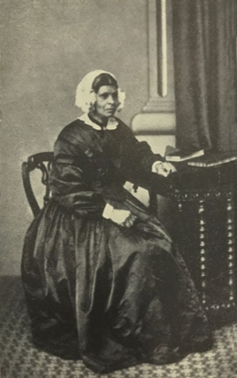
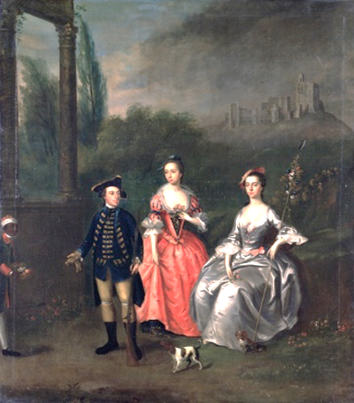
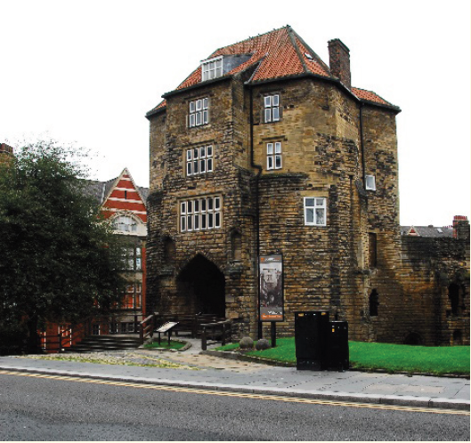
Early Residents
African Lives in Northern England
.
The Black Gate
Mary Ann Macham
Unknown servant
Notes:
Image:
The Black Gate, reproduced courtesy of Don O’Meara, Historic England
Mary Ann Macham, Reproduced courtesy of Breaking Chains Exhibition, The Old Low Light Heritage Centre, North Shields
Portrait of Captain Fenwick, his Wife Isabella Orde and her Sister Ann by Thomas Bardwell, TW426810, reproduced courtesy of Laing Art Gallery, Newcastle upon Tyne, TWAM

Slide 10
William Fifefield
African Lives in Northern England
William Fifefield, from St Kitts, in the Caribbean, settled in Newcastle in 1794. ‘Well-known and respected’, he worked as a ferryman on the Tyne river.
He and his wife, Margaret Wintrup, lived near a building in Newcastle, called the Black Gate.
He died in 1834. His son William Thomas had a hairdresser’s shop on Groat Market, Newcastle.
The Black Gate, reproduced courtesy of Don O’Meara, Historic England
Notes:
Image: The Black Gate, reproduced courtesy of Don O’Meara, Historic England

Slide 11
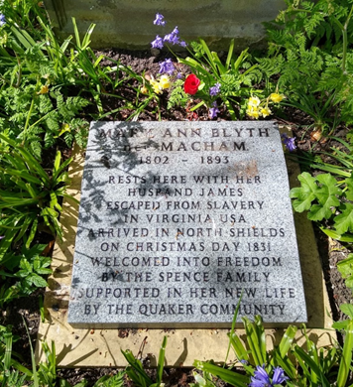
Mary Ann Macham
African Lives in Northern England
Mary Ann Macham (1802-1893) was sold at 12 years. She escaped enslavement in Virginia, North America and arrived in North Shields on Christmas Day in 1831. She was welcomed by the Miss Spences, a Quaker family. She worked in their household until her marriage to James Blyth, a local rope-maker. She lived in Nelson Street, North Shields and then in Benwell, Newcastle. She died, aged 91, and was buried in Tynemouth.
Photograph of Mary Ann Macham and Memorial Stone laid in 2019, reproduced courtesy of Breaking Chains Exhibition, The Old Low Light Heritage Centre, North Shields
Notes:
Images: Reproduced courtesy of Breaking Chains Exhibition, The Old Low Light Heritage Centre, North Shields

Slide 12
Unknown young black servant
African Lives in Northern England
In this picture from the 1740s, artist William Bardwell has painted the rich Captain Robert Fenwick of Northumberland, with his wife and her sister at Norham Castle, Northumberland, one of their homes. Also, at the edge of the painting is an unknown young black servant.
Portrait of Captain Fenwick, his Wife Isabella Orde and her Sister Ann by Thomas Bardwell, TW426810, reproduced courtesy of Laing Art Gallery, Newcastle upon Tyne, TWAM
Notes:
Image: TW426810, reproduced courtesy of Laing Art Gallery, Newcastle upon Tyne, TWAM

Slide 13
Research Tasks
African Lives in Northern England
Use these weblinks to find out more and to complete the tasks on the following slide:
https://www.oldnewcastle.org.uk/black-gate
http://www.newcastle-antiquaries.org.uk/index.php?pageId=793
https://www.youtube.com/watch?v=UGWRrytmRaU
https://www.english-heritage.org.uk/visit/places/portchester-castle/history-and-stories/black-people-in-late-18th-century-britain/
https://www.runaways.gla.ac.uk/
Notes:
https://www.oldnewcastle.org.uk/black-gate
http://www.newcastle-antiquaries.org.uk/index.php?pageId=793
https://www.youtube.com/watch?v=UGWRrytmRaU
https://www.english-heritage.org.uk/visit/places/portchester-castle/history-and-stories/black-people-in-late-18th-century-britain/
https://www.runaways.gla.ac.uk/

Slide 14
Research Tasks
African Lives in Northern England
There is still a ferry on the Tyne River. Which two towns do the ferries travel between?
What is the Black Gate in Newcastle? When was it built?
William came from St Kitts in the Caribbean and Mary Ann came from Virginia, USA. Can you find these places on a map? Which is closer to England?
Many people escaped enslavement by fleeing to parts of North America or countries where enslaving people was illegal. Who might have helped Mary Ann escape and travel to England?
Rich people often included richly dressed black servants in their pictures to show off their wealth. What would you choose to show off?
Enquiry Question?
Can you find any other people of African descent working as servants in Britain during the 18th century. Is there evidence of what their role included & how they were treated?
Notes:
https://www.oldnewcastle.org.uk/black-gate
http://www.newcastle-antiquaries.org.uk/index.php?pageId=793
https://www.youtube.com/watch?v=UGWRrytmRaU
https://www.english-heritage.org.uk/visit/places/portchester-castle/history-and-stories/black-people-in-late-18th-century-britain/
https://www.runaways.gla.ac.uk/

Slide 15
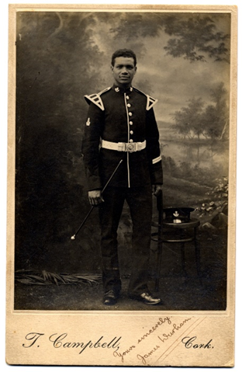
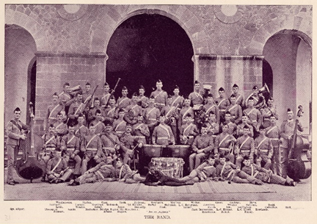
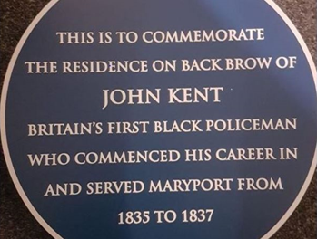
Africans in Uniform
African Lives in Northern England
Jimmy Durham
John Kent plaque
Notes:
Images: Jimmy Durham, both pictures reproduced courtesy of DLI Archives and Durham County Record Office, D/Lo/C 113
John Kent plaque, reproduced courtesy of Maryport Town Council

Slide 16
Jimmy Durham
African Lives in Northern England
In 1885, the Durham Light Infantry, having defeated a local army, found a baby in a boat on the Nile in the Sudan, Africa. The regiment adopted the baby and at the age of 14 he became the first African allowed to join the regular British army.
He played the clarinet and violin in the army band. He lived in Darlington, Tyneside, and Bishop Auckland. He was a strong temperance supporter and died in Ireland aged 27 years, three weeks before his daughter was born.
Jimmy Durham, reproduced courtesy of DLI Archives and Durham County Record Office
Notes:
Images: Both pictures reproduced courtesy of DLI Archives and Durham County Record Office, D/Lo/C 113

Slide 17
John Kent
African Lives in Northern England
John Kent (1805-1886) nicknamed ‘Black Kent’ is considered the first black police officer in Britain. He was a watchman and a parish constable in Maryport, near Carlisle and a constable in Carlisle, Cumbria.
He rescued a 17-year-old from drowning, kept the peace most of the time and fought fires. He worked at Carlisle Citadel railway station as a railway policeman.
He was described as ‘a Carlisle notable’ on his death in 1886.
John Kent plaque, reproduced courtesy of Maryport Town Council
Notes:
Image: John Kent plaque, reproduced courtesy of Maryport Town Council

Slide 18
Research Tasks
African Lives in Northern England
Use the web and these links to find out more and to complete the following tasks:
https://en.wikipedia.org/wiki/Temperance_movement
https://www.tulliehouse.co.uk/carlisle-citadel-railway-station
https://co-curate.ncl.ac.uk/carlisle-railway-station/
Can you name any other instruments played by regimental (army) bands?
The temperance movement encouraged people to avoid alcohol. Are people still encouraged to avoid alcohol and why?
Maryport in Cumbria and Newcastle shipped the same major product in the 1800’s. What was the name of the product?
When did Carlisle Citadel station open and why was it given this name?
Enquiry Question
Why do you think Africans were not usually allowed in the regular British army until Britain was losing in World War 2?
Notes:
https://en.wikipedia.org/wiki/Temperance_movement
https://www.tulliehouse.co.uk/carlisle-citadel-railway-station
https://co-curate.ncl.ac.uk/carlisle-railway-station/

Slide 19
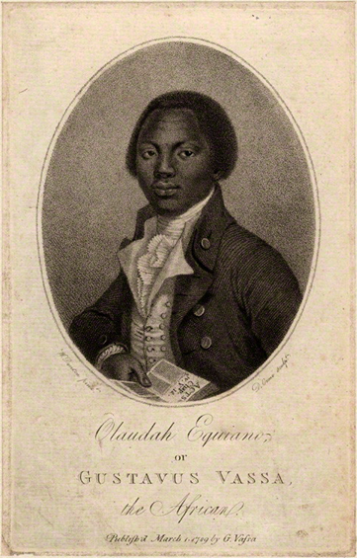
Writers
African Lives in Northern England
Olaudah Equiano
Celestine Edwards
Notes:
Olaudah Equiano, also called Gustavus Vassa by: Orme, D., after Denton, W. (1789), National Portrait Gallery. Public Domain, retrieved from https://commons.wikimedia.org/wiki/File:Daniel_Orme,_W._Denton_-_Olaudah_Equiano_(Gustavus_Vassa),_1789.png
Celestine Edwards portrait, reproduced courtesy of National Archives

Slide 20
Olaudah Equiano
African Lives in Northern England
Olaudah Equiano (1745-97) born in Nigeria, was kidnapped, and enslaved in the Caribbean and North America. He worked as a soldier, seaman, trader, and even an Arctic explorer.
He bought his own freedom and lived permanently in England from 1777. He worked with lawyers to help people see that murdering enslaved Africans on the Zong ship was wrong. He told people how terrible enslavement was and wrote about this in his book.
He travelled to Newcastle, staying in Bigg Market, and to Durham and Stockton in 1792. In 1807 Britain officially stopped enslaving and shipping people from Africa.
Olaudah Equiano
Notes:
Olaudah Equiano, also called Gustavus Vassa by: Orme, D., after Denton, W. (1789), National Portrait Gallery. Public Domain, retrieved from https://commons.wikimedia.org/wiki/File:Daniel_Orme,_W._Denton_-_Olaudah_Equiano_(Gustavus_Vassa),_1789.png

Slide 21
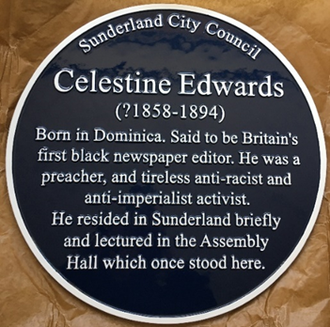
Celestine Edwards
African Lives in Northern England
Samuel Celestine Edwards, (1857-94), one of ten children of previously enslaved parents, left Dominica, aged 12, to become a seaman.
He lived in Sunderland in 1880-1882 working as a labourer and lecturer. His lectures there emphasizing equality between African and white men met with great applause.
He was a Christian preacher, a student doctor and an editor and writer.
He used his journals and books to challenge racism in Britain and British violent rule in Uganda and Rhodesia (now Zimbabwe).
Celestine Edwards, reproduced courtesy of National Archives
Plaque at site of New Assembly Hall, Fawcett Street, Sunderland
Notes:
Images: Celestine Edwards portrait, reproduced courtesy of National Archives
Assembly Hall, Sunderland 1900, reproduced courtesy of Newcastle Libraries Collection

Slide 22
Research Tasks
African Lives in Northern England
Use the web to find out more and to complete the following tasks:
What was the name of Olaudah Equiano’s book? Why do you think the different people who enslaved him changed his name?
Can you find Nigeria, Uganda, and Zimbabwe on a map of Africa?
Celestine Edwards’ parents got no money when they were freed though their owners did. Why do you think Celestine Edwards went to sea at 12 years old? If you could travel anywhere, where would you go?
Samuel Celestine Edwards preached at the New Assembly Hall, Fawcett Street, Sunderland. Fawcett Street would have looked quite different then. Can you find any pictures of streets in a town near you between 1800 and 1900? How have the streets changed?
Enquiry Question?
Millions of Africans were enslaved and shipped across the Atlantic Ocean by Britain. We don’t know the exact figure as the records give slightly different numbers. What numbers are given in the records you can find?

Slide 23
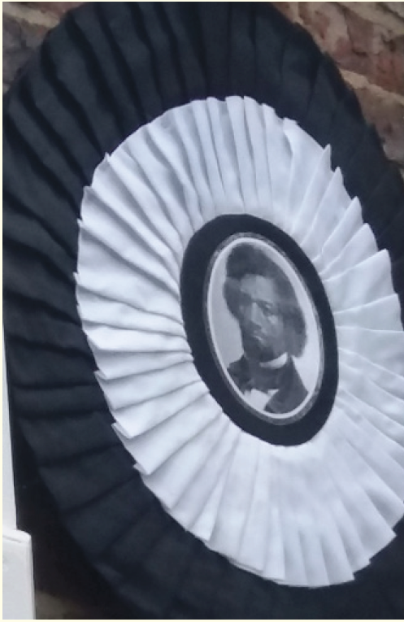
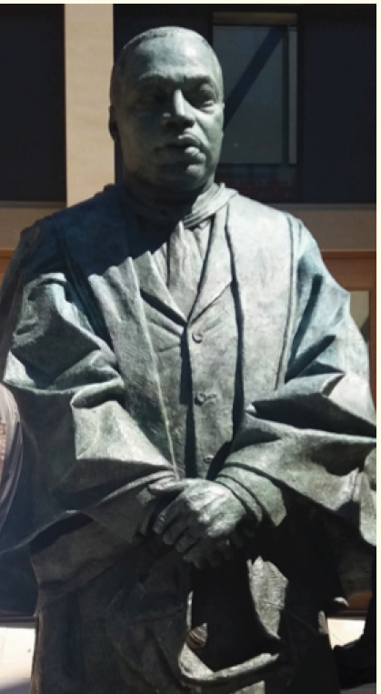
Orators
African Lives in Northern England
Ellen Craft
Frederick Douglass
Martin Luther King
Notes:
Images: Ellen Craft, image from The Underground Railroad from Slavery to Freedom by Wilbur Henry Siebert, Albert Bushnell Hart, Edition: 2. London: Macmillan, 1898. Public domain, retrieved from https://commons.wikimedia.org/wiki/File:Ellen_Craft_escaped_slave.jpg
Frederick Douglass’ temporary plaque at Richardson’s Home in Summerhill Grove, Newcastle. Reproduced courtesy of Beverley Prevatt Goldstein
Martin Luther King reproduced courtesy of Beverley Prevatt Goldstein

Slide 24
Ellen Craft
African Lives in Northern England
Ellen (1826-91) and William Craft escaped from enslavement in North America, with Ellen dressed in men’s clothes and William pretending to be her ‘slave’. They fled to England in 1850 to avoid being recaptured.
They wrote a book about their escape and spoke against enslavement in Carlisle, Darlington, and Newcastle in 1851. Ellen later brought her newly freed mother to England.
They returned to America with three of their five children after 19 years in England.
Ellen Craft, Public domain
Notes:
Image: Ellen Craft, image from The Underground Railroad from Slavery to Freedom by Wilbur Henry Siebert, Albert Bushnell Hart, Edition: 2. London: Macmillan, 1898. Public domain, retrieved from https://commons.wikimedia.org/wiki/File:Ellen_Craft_escaped_slave.jpg

Slide 25
Frederick Douglass
African Lives in Northern England
Frederick Douglass, (1818-95) spoke against enslavement throughout Tyne and Wear, Northumberland, Carlisle and Darlington in 1846 and 1860.
His lectures were so popular a special train was used so people from Sunderland, North and South Shields could attend his evening lecture in Gateshead.
He often stayed with the Richardson’s in Newcastle and Cullercoats and in 1847 they bought his freedom from enslavement. A plaque was erected to Frederick Douglass at their Newcastle home in 2018.
Frederick Douglass’ temporary plaque, reproduced courtesy of Beverley Prevatt Goldstein
Notes:
Image: Frederick Douglass’ temporary plaque at Richardson’s Home in Summerhill Grove, Newcastle. Reproduced courtesy of Beverley Prevatt Goldstein

Slide 26
Martin Luther King
African Lives in Northern England
Martin Luther King Junior, born 1929 in the USA, was a Christian minister, and a leader of the movement to give African people equal rights (the civil rights movement).
He led huge demonstrations for civil rights and supported non-violent action and the rights of workers and poor people. He was arrested 29 times and assassinated in 1968.
His statue in Newcastle University’s grounds commemorates his visit to Newcastle in 1967 to receive an honorary degree from Newcastle University.
Martin Luther King reproduced courtesy of Beverley Prevatt Goldstein
Notes:
Image: Martin Luther King reproduced courtesy of Beverley Prevatt Goldstein

Slide 27
Research Tasks
African Lives in Northern England
Use the web and these links to find out more and to complete the following tasks:
https://en.wikipedia.org/wiki/Stockton_and_Darlington_Railway
https://www.head-of-steam.co.uk/about-us/stockton-and-darlington-railway/
https://en.wikipedia.org/wiki/Underground_Railroad
In the nineteenth century, women did not dress in men's clothes as they do now. What do you think would have happened to Ellen and her husband if they had been caught during their escape?
Ellen had her arm in a bandage so she would not be asked to write or sign her name. Enslaved people were prevented from learning to read or write. Why do you think this was? How does being able to read or write help you?
Frederick Douglass used the newly built railway system to travel across Britain giving 280 talks, 29 of them in the North East and Cumbria. Can you find out the route of the first steam railway line and when it was built?
Frederick Douglass and his wife Anna were part of the Underground Railroad in America and helped 200 people escape from enslavement. How was this railroad different from the one in England?
Notes:
https://en.wikipedia.org/wiki/Stockton_and_Darlington_Railway
https://www.head-of-steam.co.uk/about-us/stockton-and-darlington-railway/
https://en.wikipedia.org/wiki/Underground_Railroad

Slide 28
Research Tasks
African Lives in Northern England
Why do you think Martin Luther King was arrested so many times? Why do you think he kept on working for human rights?
Enquiry Question?
At his speech at Newcastle University in 1967, Martin Luther King said war, poverty and racism were the three problems of our time. What do you think are the big problems now?
Notes:
A whole Teachers’ Pack of resources can be found here: https://research.ncl.ac.uk/martinlutherking/activities/mlkinuk/

Slide 29
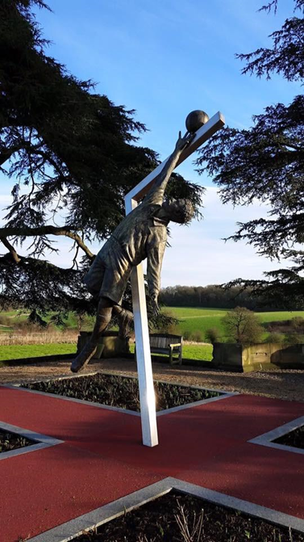
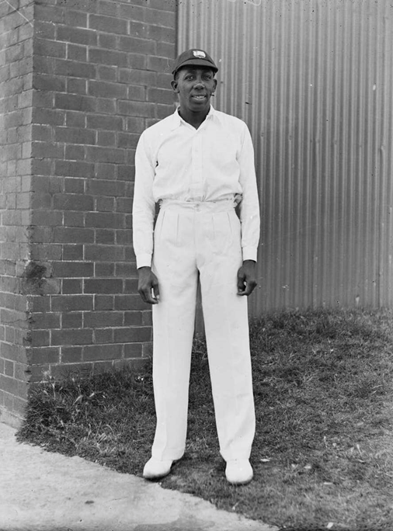
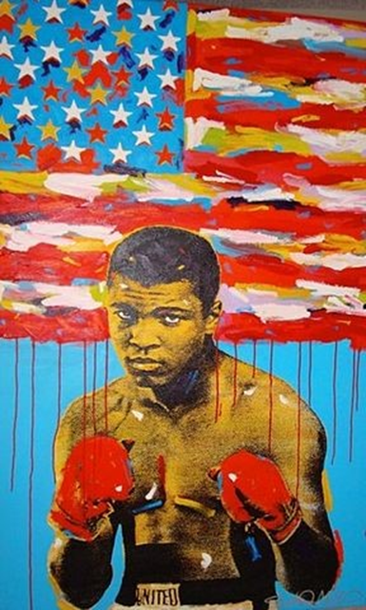
Sports People
African Lives in Northern England
Arthur Wharton
Learie Constantine
Muhammad Ali
Notes:
Images: Arthur Wharton statue at St George’s Park, from the Arthur Wharton Foundation, reproduced courtesy of Shaun Campbell
Learie Constantine retrieved from National Library of Australia, Public domain, via Wikimedia Commons, https://upload.wikimedia.org/wikipedia/commons/a/af/Learie_Constantine_1930_01.jpg
Muhammad Ali By John Stango, CC BY-SA 3.0, https://commons.wikimedia.org/w/index.php?curid=24121520

Slide 30
Arthur Wharton
African Lives in Northern England
Arthur “Kwame” Wharton was born in the Gold Coast (now Ghana) in 1865. In 1882 he came to England to train as a Methodist minister at Cleveland College, Darlington, but preferred playing sport!
As runner he became the first fastest man by running 100 yards in 10 seconds.
He played football for Darlington in 1885-6 and is remembered as the world’s first black professional football player, with this statue at the Football Association’s headquarters.
He also excelled in cycling, cricket and rugby!
He later worked as a miner and died in 1930.
Arthur Wharton statue at St George’s Park, from the Arthur Wharton Foundation, reproduced courtesy of Shaun Campbell

Slide 31
Learie Constantine
African Lives in Northern England
Learie Constantine, MBE (1901 –1971) played 18 Test Matches and took the West Indies' first wicket in Test cricket.
He came in England in 1928 as part of the West Indies Team tour and in 1929 signed a contract to play for Nelson Cricket Club in Lancashire.
He was Trinidad's High Commissioner to the United Kingdom and became the UK's first black peer in 1969.
He challenged racial discrimination, supported the Bristol Bus Boycott and the 1965 Race Relations Act in Britain.
Learie Constantine, Public Domain
Notes:
Learie Constantine retrieved from National Library of Australia, Public domain, via Wikimedia Commons, https://upload.wikimedia.org/wikipedia/commons/a/af/Learie_Constantine_1930_01.jpg

Slide 32
Muhammad Ali
African Lives in Northern England
Muhammad Ali (nee Cassius Marcellus Clay Jr) 1942-2016, nicknamed “The Greatest", won 56 of his 61 boxing matches.
He refused to fight in the Vietnam War because it was against his religion and principles.
In 1977 he visited youth clubs in Newcastle, toured the city in an open-air bus and he and his new wife, Veronica, had their marriage blessed at the Al Azhar Mosque in South Shields.
Muhammad Ali by John Stango,
CC BY-SA 3.0
Notes:
Muhammad Ali By John Stango, CC BY-SA 3.0, https://commons.wikimedia.org/w/index.php?curid=24121520

Slide 33
Research Tasks
African Lives in Northern England
Use the web and these links to find out more and to complete the following tasks:
https://www.ducksters.com/history/africa/empire_of_ancient_ghana.php
https://www.bristolmuseums.org.uk/stories/bristol-bus-boycott/
The kings of Ghana wore large, beautiful gold bangles. Can you draw some large beautifully decorated gold bangles?
Can you name any footballers of African descent who played for clubs in Northern England? Can you name any footballers of African descent who managed clubs in Northern England?
Can you name six countries in the Caribbean?
What religion was Muhammad Ali?
Enquiry Question
Who boycotted the buses in the Bristol Bus Boycott and why?
When did it happen?
Notes:
https://www.ducksters.com/history/africa/empire_of_ancient_ghana.php
https://www.bristolmuseums.org.uk/stories/bristol-bus-boycott/

Slide 34
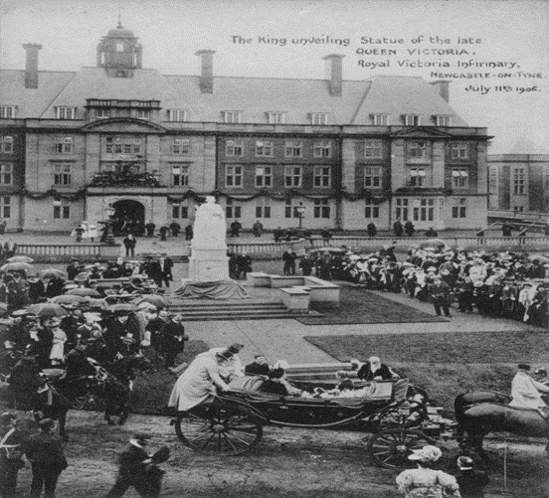
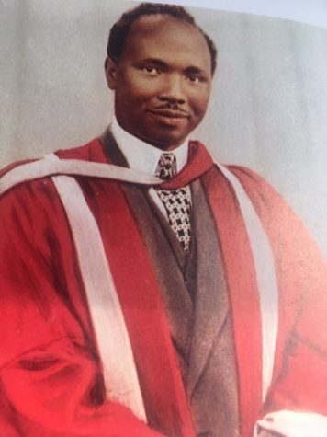
Medical People
African Lives in Northern England
Royal Victoria Infirmary, where Ishmael Cummings worked
Dr Robert Wellesley-Cole
Notes:
Images: Royal Victoria Infirmary, Newcastle, 1906, HO.RVI.163.2, reproduced courtesy of TWAM

Slide 35
Ishmael Cummings
African Lives in Northern England
Ishmael Cummings (1882-1977) born in Freetown, Sierra Leone, became a doctor at Newcastle Medical College (Durham University) in 1914. He was a Senior Doctor at the Royal Victoria Infirmary, Newcastle, and had his own practice at Burnopfield, County Durham.
In 1916 he joined the colonial service as an African Medical Officer in Eastern Nigeria, receiving inferior pay and accommodation to similarly qualified white practitioners.
He set up a successful general practice when he returned to Freetown in 1931 and died there in 1977.
Royal Victoria Infirmary, Newcastle, 1906, HO.RVI.163.2 reproduced courtesy of TWAM
Notes:
Image: Royal Victoria Infirmary, Newcastle, 1906, HO.RVI.163.2, reproduced courtesy of TWAM

Slide 36
Robert Wellesley-Cole
African Lives in Northern England
Robert Wellesley-Cole (1907-1995), from Freetown, Sierra Leone, graduated from Newcastle Medical College (Durham University) in 1934. He overcame racism to become the first African Fellow of the Royal College of Surgeons in 1944.
He was called ‘the black doctor’ with popular practices in Denton Burn and Whickham View, West Newcastle. He had five different clinics, including one for children, did minor operations himself and looked after his own patients in hospital.
He left Newcastle in 1949 and worked as a doctor in Nottingham, senior doctor and surgeon in Nigeria and Sierra Leone and an ophthalmologist (eye doctor) in London.
Dr Robert Wellesley-Cole, Creative Commons Licence
Notes:
Dr Robert Wellesley-Cole, Creative Commons Licence, retrieved from https://en.wikipedia.org/wiki/Robert_Benjamin_Ageh_Wellesley_Cole#/media/File:RWellesley-Cole.jpg

Slide 37
Research Tasks
African Lives in Northern England
Use the web to find out more and to complete the following tasks:
Can you find out why Freetown, Sierra Leone, was given this name? Its early residents came from many countries. Can you name some of these countries?
Many people from Sierra Leone, a British colony, came to Newcastle Medical College, which was then part of Durham University, to train as doctors. Why do you think becoming a doctor was so popular? Why did they need to come to England for their training?
The Royal Victoria Hospital in Newcastle now looks quite different to when Ishmael Cummings worked there in 1914. Can you find out when your nearest hospital was built? Can you find a picture of what it looked like then and looks like now?

Slide 38
Research Tasks
African Lives in Northern England
The founding of the National Health Service (NHS) in 1947 changed the way doctors like Dr Wellesley-Cole could work.
https://en.wikipedia.org/wiki/History_of_the_National_Health_Service
Enquiry Question?
The 2020 statistics show that a similar percentage of white and African descent NHS staff are doctors (around 6%). However, approximately 46% of white doctors are consultants (highest paid grade) compared to 30% of doctors of African descent.
Do you think Drs Ishmael Cummings and Wellesley-Cole would have been surprised by this?
Notes:
https://en.wikipedia.org/wiki/History_of_the_National_Health_Service

Slide 39
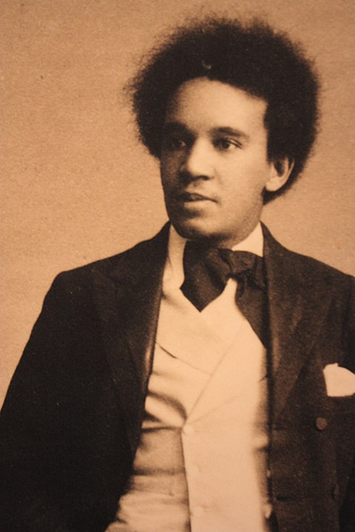
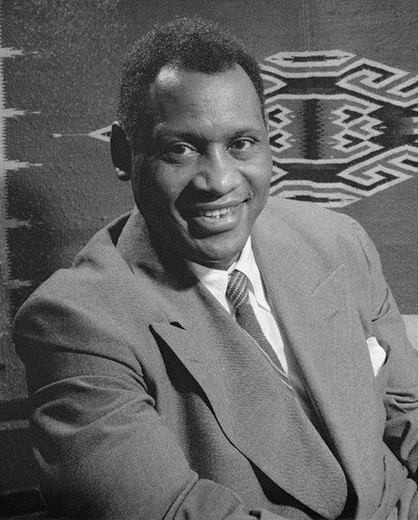
Entertainers
African Lives in Northern England
Ira Aldridge
Samuel Coleridge Taylor
Paul Robeson
Notes:
Images: Ira Aldridge, permission to reproduce purchased from Alamy Stock Photo, ID MP3PTM PA
Samuel Coleridge Taylor. Unknown author, Public domain, via Wikimedia Commons, retrieved from https://upload.wikimedia.org/wikipedia/commons/2/2d/Samuel_Coleridge-Taylor_c.1893.JPG
Paul Robeson, Gordon Parks, Office of War Information; cropped by Beyond My Ken (talk) 07:13, 3 February 2011 (UTC). Public domain, retrieved from https://upload.wikimedia.org/wikipedia/commons/3/3b/Paul_Robeson_1942_crop.jpg

Slide 40
Ira Aldridge
African Lives in Northern England
Ira Aldridge (1807-67), born in New York, North America, started acting at 14 years. Meeting racial discrimination, he moved to England, aged 17.
He performed in Sunderland and Newcastle in 1827. Until recently a room at the Theatre Royal, Newcastle, was named after him. He was the first black Shakespearean actor, famous for his performance of Othello. He also played comedies joking on stage about local people.
Popular in Europe, he received awards from the rulers of Prussia (a German state), Russia and Bern, Switzerland. He died in 1867 in Poland, before his planned return performance in the USA.
Ira Aldridge portrait, © Alamy Stock Photo and 1947 Playbill, Public Domain
Notes:
Images: Ira Aldridge, permission to reproduce purchased from Alamy Stock Photo, ID MP3PTM PA Images
Playbill, 1947: Public Domain, retrieved from https://nmaahc.si.edu/object/nmaahc_2011.57.44

Slide 41
Samuel Coleridge-Taylor
African Lives in Northern England
Samuel Coleridge-Taylor (1875-1912), with a father from Sierra Leone, proudly mixed African and classical music.
He attended the Royal College of Music at age 15. His music was celebrated in Europe and the USA.
He was received by the President of the USA in 1903, when most black people there were being treated very badly.
He conducted Hiawatha’s Wedding Feast, his most famous work, at the Sunderland Philharmonic Society in November 1898.
Samuel Coleridge Taylor, Public domain
Notes:
Samuel Coleridge Taylor. Unknown author, Public domain, via Wikimedia Commons, retrieved from https://upload.wikimedia.org/wikipedia/commons/2/2d/Samuel_Coleridge-Taylor_c.1893.JPG

Slide 42
Paul Robeson
African Lives in Northern England
Paul Robeson (1898-1976), the son of an enslaved African American, was a famous singer and actor.
His performances in England (1923-39) include the play Show Boat, the song, Old Man River, and the play Othello.
From 1933 onwards he supported the rights of black people and workers everywhere, despite the damage to his career.
In 1958, he sang in Newcastle City Hall to a full audience.
Paul Robeson, Public Domain
Notes:
Paul Robeson, Gordon Parks, Office of War Information; cropped by Beyond My Ken (talk) 07:13, 3 February 2011 (UTC). Public domain, retrieved from https://upload.wikimedia.org/wikipedia/commons/3/3b/Paul_Robeson_1942_crop.jpg

Slide 43
Research Tasks
African Lives in Northern England
Use the web to find out more and to complete the following tasks:
Why do you think Aldridge took so long to consider returning to the USA? What law was passed in 1865 in the USA that might have encouraged him to return?
Can you find Germany, Russia, Poland, and Switzerland on a map ? Which countries are in Europe and which in Asia?
Can you name any kinds of music which started in Africa or among African people in the Caribbean and the USA which is popular in Britain?

Slide 44
Research Tasks
African Lives in Northern England
In the song ‘Old Man River’, Paul Robeson sang about which river? It begins with M, has 11 letters and is in the Southern United States. Can you name it?
In the song ‘Old Man River’ Paul Robeson sings:
[The river] don’t plant taters (potatoes) and [it] don’t plant cotton.
And them what plants cotton is soon forgotten.
But ol’ Man River, jest keeps rollin’ along.
Enquiry Question?
Who planted the cotton in the Southern United States? What was life like for a cotton picker on a plantation in the southern states of the USA?
You can listen to the song here: https://www.youtube.com/watch?v=eh9WayN7R-s
Notes:
https://www.youtube.com/watch?v=eh9WayN7R-s

Slide 45
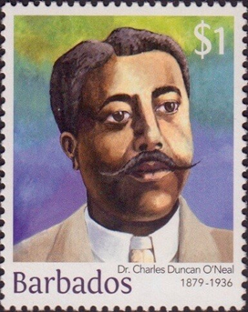
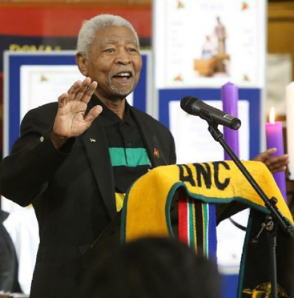
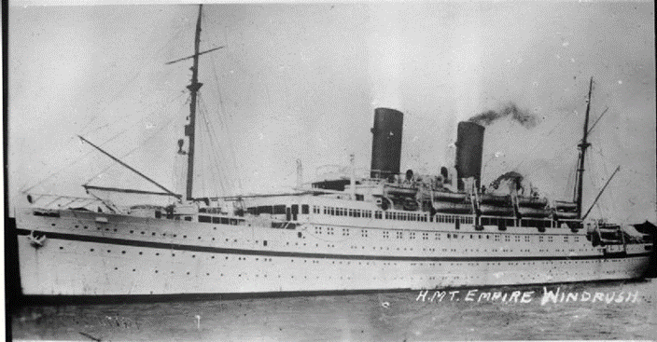
Nation Builders
African Lives in Northern England
Charles Duncan O’ Neal
HMT Empire Windrush
Archie Sibeko
Notes:
Charles Duncan O’ Neal Stamp retrieved from https://www.barbadosstamps.co.uk/
HMT Empire Windrush Royal Navy official photographer, Public domain, via Wikimedia Commons Public domain, retrieved from https://upload.wikimedia.org/wikipedia/commons/1/15/HMT_Empire_Windrush_FL9448.jpg
Archie Sibeko, reproduced courtesy of Steve Brock

Slide 46
Dr. Charles Duncan O’Neal
African Lives in Northern England
Dr. Charles Duncan O’Neal (1879-1936), from Barbados, studied medicine at Edinburgh University. While a doctor and a councillor in the Sunderland area (1905-1910) he worked to help the poorer people.
After spending 14 years in Trinidad and Dominica, he helped set up organisations in Barbados to work for better conditions for workers, for women and for compulsory free education for children.
He became a Member of Parliament in Barbados and his picture is on the Barbados $1 stamp and $10 note.
Charles Duncan O’ Neal Stamp
Notes:
Images: Charles Duncan O’ Neal Stamp retrieved from https://www.barbadosstamps.co.uk/new-definitive-stamp-issue-from-barbados-january-2016-the-builders-of-barbados/

Slide 47
Ivor Cummings
African Lives in Northern England
Ivor Cummings (1913-1992) was born in West Hartlepool. His father, from Sierra Leone, and his Yorkshire mother both worked at the Royal Victoria Infirmary, Newcastle.
Cummings supported the colonial hostels in Newcastle and North Shields and tried to make life in England better for students, residents and war volunteers from Africa and the Caribbean.
In 1948 he met the Caribbean passengers who came on the Windrush Ship to build up Britain after the war.
HMT Empire Windrush, Public Domain
Notes:
HMT Empire Windrush Royal Navy official photographer, Public domain, via Wikimedia Commons Public domain, retrieved from https://upload.wikimedia.org/wikipedia/commons/1/15/HMT_Empire_Windrush_FL9448.jpg

Slide 48
Archie Sibeko
African Lives in Northern England
Zola Ntambo, (1928–2018), born Archie Sibeko in South Africa, was a member of its African National Congress.
He trained in guerrilla warfare in Russia, he led guerrilla camps in Tanzania and Zambia. During his exile (1963-90) he encouraged unions to support the South African unions and their struggle for freedom.
He retired to Tynemouth in 2002, receiving an Honorary Doctorate from Newcastle University in 2017 for his contribution to overcoming racial discrimination.
Archie Sibeko, reproduced courtesy of Steve Brock

Slide 49
Research Tasks
African Lives in Northern England
Use the web to find out more and to complete the following tasks:
Can you look at the £5- and £10-pound notes in Britain or Scotland. Whose pictures are on them? Can you say what they have done to improve life for others?
Can you draw two triangles, one connecting Edinburgh, Newcastle, and Sunderland and one connecting Barbados, Trinidad, and Dominica, marking the distances between each place. Did Charles Duncan O’Neal travel further in the United Kingdom or in the Caribbean?
Look at this photo from the Colonial House, North Shields https://www.iwm.org.uk/collections/item/object/205199635
Why do you think colonial hostels were needed for people from Africa and the Caribbean who wanted to study or work in the North East or who came to help Britain in World War Two?
Notes:
https://windrushfoundation.com/wp-content/uploads/2019/06/WindrushFoundationEduPack2018_R10R4.pdf
https://www.iwm.org.uk/collections/item/object/205199635

Slide 50
Research Tasks
African Lives in Northern England
Use the web and this link to find out more and to complete the following tasks:
https://www.bbc.co.uk/teach/how-did-the-heroes-of-the-caribbean-help-win-ww2/zn96d6f
372,000 Africans and 12,000 West Indians fought with Britain in the Second World War. Many were volunteers and some paid their own passage or stowed away to come to Britain. Why were they so keen to help Britain win the war against the Nazis?
Why did some unions outside South Africa support the unions in South Africa and their struggle for freedom? Is there a union for schoolteachers? Is there a union for school children?
Enquiry Question?
How did the West Indians who came on the Windrush and their descendants help build up Britain?
Notes:
https://www.bbc.co.uk/teach/how-did-the-heroes-of-the-caribbean-help-win-ww2/zn96d6f

